Slide 1


GÉANT Identity Services + GDPR
TF-DPR, April 2018
Nicole Harris, Head of Trust and Identity Operations, GÉANT
www.geant.org

Slide 2
Data Inventory
Data Mapping
Privacy Notice
(Community Advice)

Slide 3



General Mapping and (draft) Privacy Notice:
https://wiki.geant.org/display/timops/GDPR
Advice and Guidance:
https://wiki.geant.org/display/eduGAIN/eduGAIN+GDPR+Impact+Assessment
Incident Response:
https://wiki.geant.org/display/gn42jra3/eduGAIN+Incident+Management+Coordination+Role
First test incident case run!
Next steps:

Slide 4

Same Process for:
Federation as a Service
eduPKI
eduTEAMs
InAcademia (need to look at contracts)
eduroam Managed IdP
(perfSONAR)
(eduVPN)

Slide 5

What did we learn?
Need to tighten up our OLAs / SLAs with NRENs delivering service components.
Need to work on retention periods.
People didn’t agree on all data inventory points!
  Controller– processor arguments.
  Identifier arguments.
Generally T&I services are privacy preserving.

Slide 6

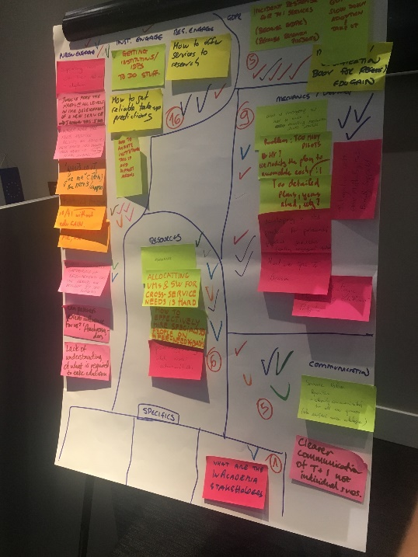
Research and Scholarship Entity Category
Getting IdPs to release THE BASICS
Specific advice and guidance for GDPR added:
  https://wiki.refeds.org/display/ENT/Guidance+on+justification+for+attribute+release+for+RandS
Code of Conduct (for T&I)
Version 2 in pipeline: https://wiki.refeds.org/display/CODE/Code+of+Conduct+ver+2.0+project.
This version GDPR compliant / WP29 sign off.
Getting to that stage is…. “interesting”.
Sirtfi
“Will GDPR slow down adoption / take-up?”

Slide 7

Advice and Guidance from AARC
General Advice
https://aarc-project.eu/wp-content/uploads/2016/12/AARC-DNA3.5_Recommendations-for-Processing-Personal-Data_2016_11_07_v4_DG.pdf
Targeted Advice
https://aarc-project.eu/wp-content/uploads/2018/03/AARC-G040-Preliminary-Policy-Recommendations-for-the-LSAAI-RandS-and-DPCoCo.pdf

Slide 8

Thank you
www.geant.org
© GEANT Limited on behalf of the GN4 Phase 2 project (GN4-2).
The research leading to these results has received funding from the European Union’s Horizon 2020 research and innovation programme under Grant Agreement No. 731122 (GN4-2).

