Slide 1
Op Sec & WISE
What do we need? (Do we need anything?)

Slide 2
What are our assets in WISE?
Security Policy Makers & Management
A few technical security people
A venue for face-to-face trust building
Support for the group from Infrastructure

Slide 3
WISE has to bring value to the operational security teams of its participating Infrastructure
A quote from an esteemed colleague of mine

Slide 4
Challenges
How can we share data confidentially between infrastructures? Incident Response, Threat Intelligence, Abuse Reports etc
  WLCG discovers hundreds of LIGO passwords. How can we tell them?

Slide 5
Challenges
How can we share data confidentially between infrastructures? Incident Response, Threat Intelligence, Abuse Reports etc
  WLCG discovers hundreds of LIGO passwords. How can we tell them?
Do we have a contact point for the Infrastructures and their participants? How can/should one infrastructure interact with sites of another?
  What if LIGO has a problem with an academic domain? Can they discover that this is part of WLCG and find a contact?

Slide 6
How can WISE use its assets
Spin off an operational security group (& mailing list) to align incident response practices??
Academic inventory of security contacts??
What makes sense??

Slide 7
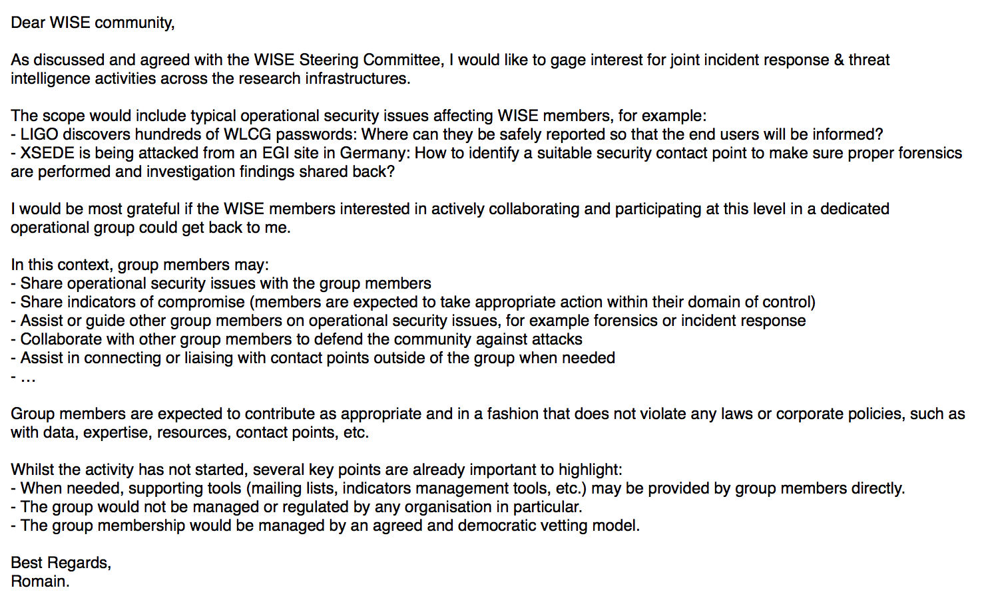
Call posted to WISE List
Interest expressed from:
2 European Infrastructures
2 US based Research Communities
1 US Infrastructure
This is probably not a critical mass to get started.

