Slide 1
BoF - WISE birds fly together
David Kelsey (STFC-RAL, UK Research and Innovation)
TNC18, Trondheim, 12 June 2018

Slide 2
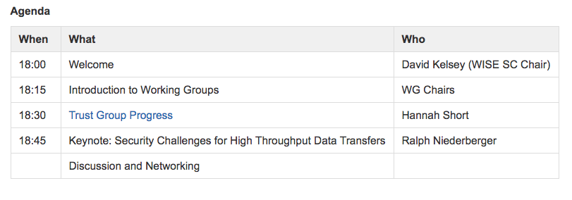
BoF – 12 June 2018 - Agenda

Slide 3
WISE Community – short history
Started in October 2015 – Workshop – Barcelona
  Jointly organized by SIG-ISM and SCI
Community members come from e-Infrastructures across the world
Governed by a steering committee
  Project managed by GEANT staff
Real work done by Working Groups
Meetings since TNC17
  NSF Cybersecurity Summit, USA – August 2017
  STFC Abingdon, UK – February 2018

Slide 4
Towards a Mission Statement (Feb 2018)
What? Joint development of policy frameworks, guidelines, templates and workshops
How? By fostering a collaborative community of security experts
Why? To promote best information security practices for research infrastructures

Slide 5
Old Working Groups
RAW-WG Risk Assessment (Urpo Kaila & Bart Bosma)
  Produced a Risk Assessment Template – and guidelines
  Bart will take-over as chair
  Work to continue – align with other similar work (Trusted CI?)
STAA-WG Security Training Awareness (Alf Moens & Jim Marsteller)
  An Inventory of Training and 3 other documents produced
  Now closed
SBOD-WG Security in Big and Open Data (Ralph Niederberger)
  Produced Case Statement and Definitions documents
  Now closed

Slide 6
Working Groups (continued)
SCI-WG Security for Collaborating Infrastructures
  Produced SCI document version 2 (see next slides) – Chair Dave Kelsey
Proposals for new groups
  Communication in Security Challenges (David Groep)
  Data Loss Prevention (Urpo Kaila)
  Security Challenges for High Throughput Data Transfers (Tim Chown, Ralph Niederberger and others) – see later – today’s “keynote”
  Security Trust, threat intelligence and communication (Romain Wartel)

Slide 7
SCI -WG

Slide 8
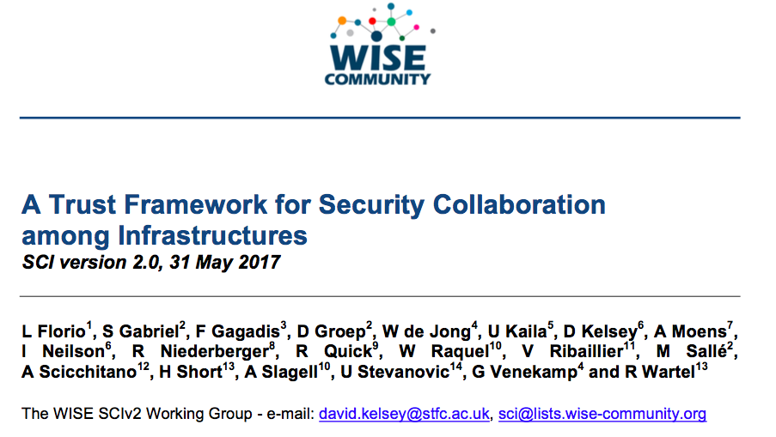
SCI Version 2 – at TNC17, Linz

Slide 9
SCI version 1 - children
Both separate derivatives of SCI version 1
REFEDS Sirtfi - The Security Incident Response Trust Framework for Federated Identity
  https://refeds.org/sirtfi
AARC/IGTF Snctfi – The Scalable Negotiator for a Community Trust Framework in Federated Infrastructures
  https://www.igtf.net/snctfi/

Slide 10
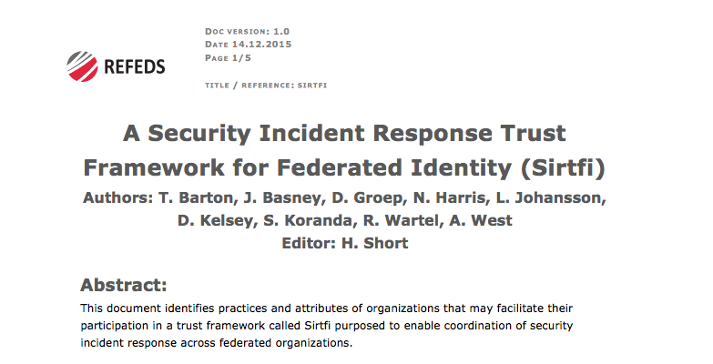
Sirtfi

Slide 11
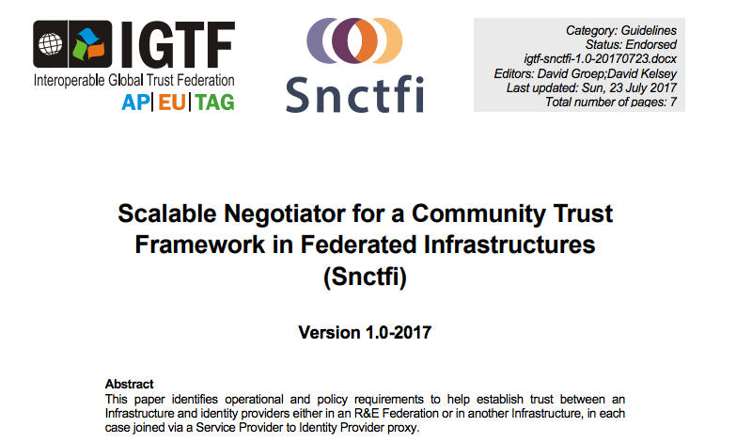
Snctfi

Slide 12
WISE SCI Version 2
Aims
  Involve wider range of stakeholders
    GEANT, NRENS, Identity federations, …
  Address conflicts in version 1 for new stakeholders
  Add new topics/areas if needed (or indeed remove topics)
  Revise all requirements
  Simplify!
SCI Version 2 was published on 31 May 2017
https://wise-community.org/sci/

Slide 13
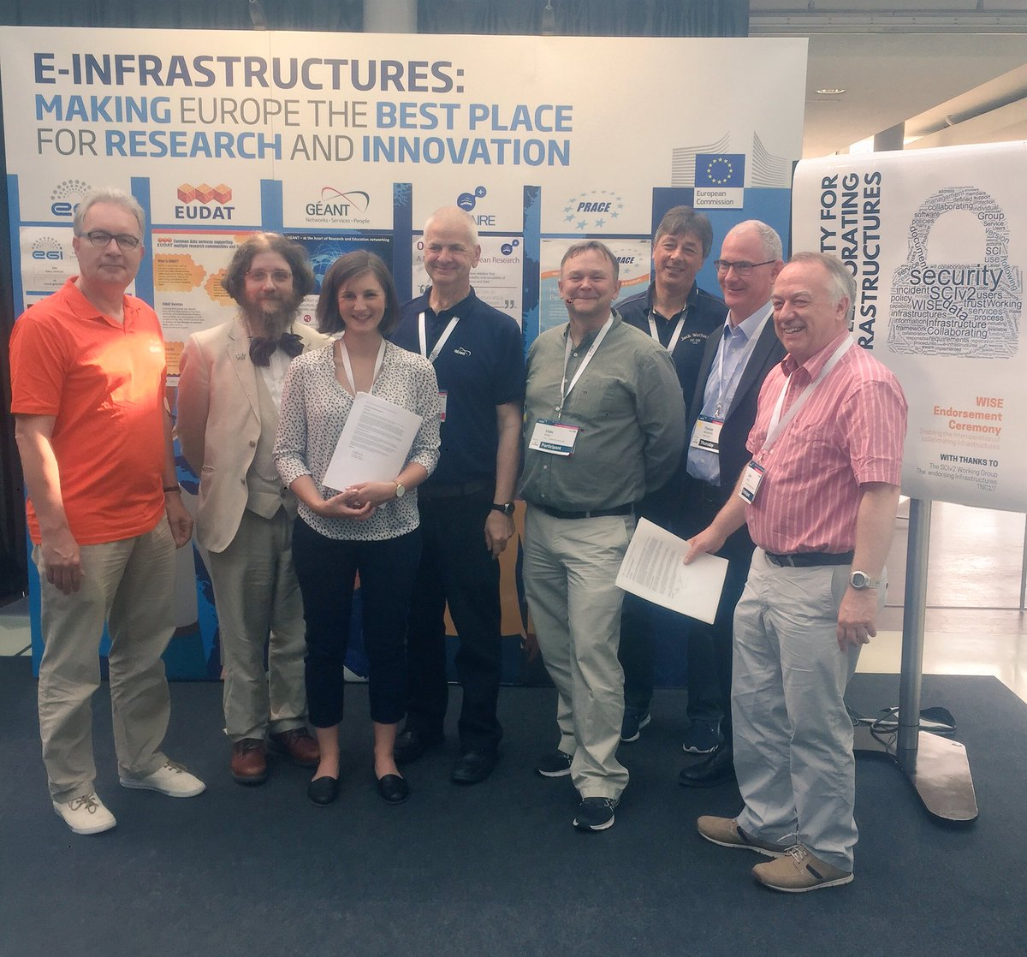
Endorsement of SCI Version 2 at TNC17 (Linz)
1st June 2017
Infrastructures endorse the governing principles and approach of SCI, as produced by WISE, as a medium of building trust between infrastructures, to facilitate the exchange of security information in the event of a cross-infrastructure incident, and the collaboration of e-Infrastructures to support the process. These Infrastructures welcome the development of an information security community for the Infrastructures, and underline that the present activities by the research and e-Infrastructures should be continued and reinforced
Endorsements have been received from the following infrastructures; EGI, EUDAT, GEANT, GridPP, MYREN, PRACE, SURF, WLCG, XSEDE.
https://www.geant.org/News_and_Events/Pages/supporting-security-for-collaborating-infrastructures.aspx

Slide 14
SCI–WG in 2018
Continue joint work AARC2/EOSC-hub on Policy Development Kit
  Based on SCI V2
  Compare with other similar activities elsewhere (Trusted CI)
Produce FAQ/Guidelines & Training – how to satisfy SCI V2?
Maturity Assessments from a number of Infrastructures

Slide 15
Questions?

