Slide 1
WISE @ NSF 2018
David Kelsey (STFC-RAL, UK Research and Innovation)
NSF Cybersecurity Summit, Alexandria VA, 21 August 2018

Slide 2
SCI -WG

Slide 3
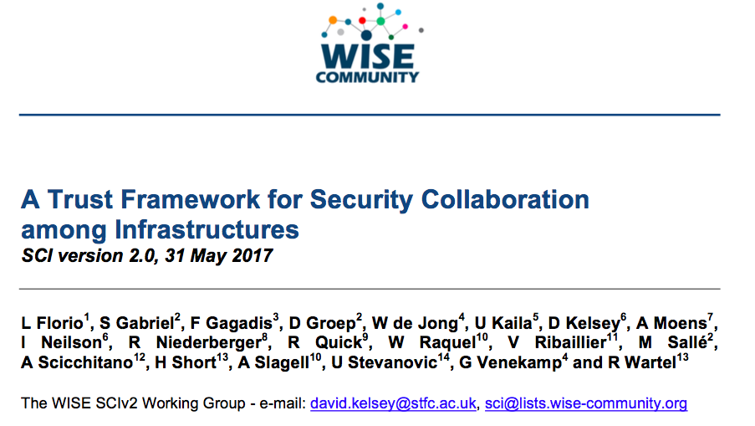
SCI Version 2 – at TNC17, Linz

Slide 4
SCI version 1 (2013) - children
Both separate derivatives of SCI version 1
REFEDS Sirtfi - The Security Incident Response Trust Framework for Federated Identity
  https://refeds.org/sirtfi
AARC/IGTF Snctfi – The Scalable Negotiator for a Community Trust Framework in Federated Infrastructures
  https://www.igtf.net/snctfi/

Slide 5
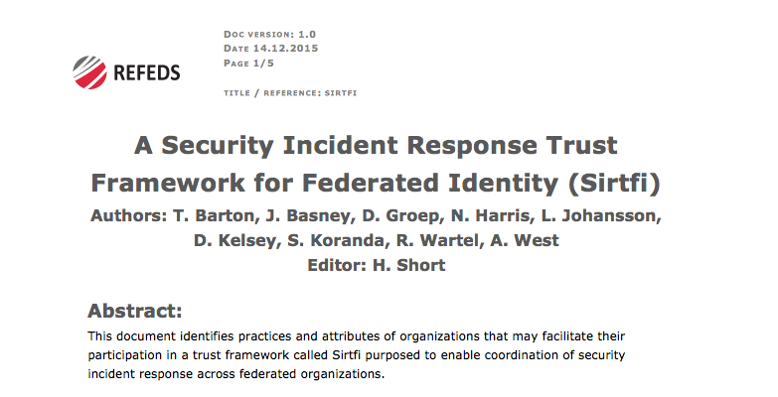
Sirtfi

Slide 6
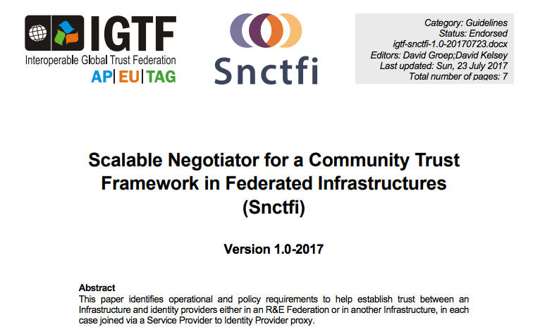
Snctfi

Slide 7
WISE SCI Version 2
Aims
  Involve wider range of stakeholders
    GEANT, NRENS, Identity federations, …
  Address conflicts in version 1 for new stakeholders
  Add new topics/areas if needed (or indeed remove topics)
  Revise all requirements
  Simplify!
SCI Version 2 was published on 31 May 2017
https://wise-community.org/sci/

Slide 8
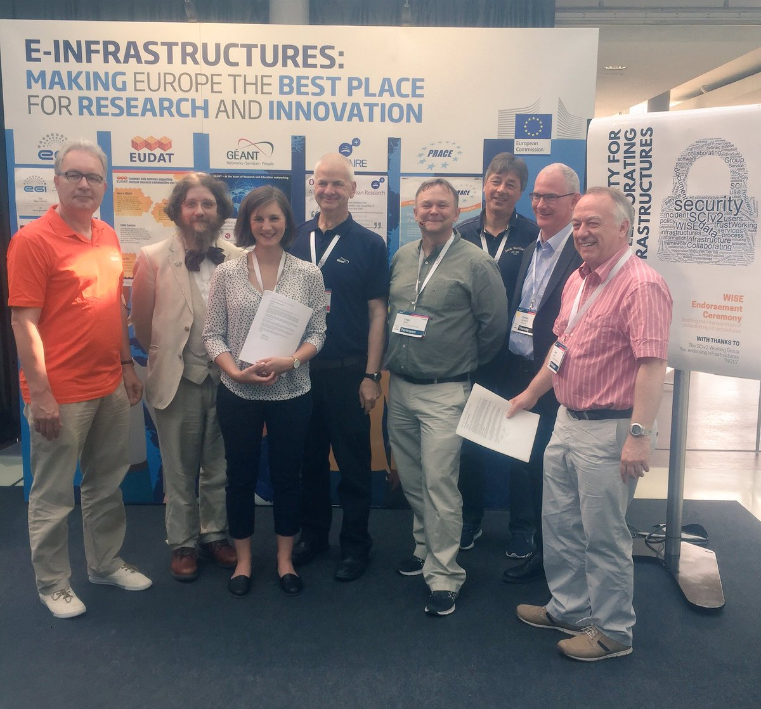
Endorsement of SCI Version 2 at TNC17 (Linz)
1st June 2017
Infrastructures endorse the governing principles and approach of SCI, as produced by WISE, as a medium of building trust between infrastructures, to facilitate the exchange of security information in the event of a cross-infrastructure incident, and the collaboration of e-Infrastructures to support the process. These Infrastructures welcome the development of an information security community for the Infrastructures, and underline that the present activities by the research and e-Infrastructures should be continued and reinforced
Endorsements have been received from the following infrastructures; EGI, EUDAT, GEANT, GridPP, MYREN, PRACE, SURF, WLCG, XSEDE, HBP
https://www.geant.org/News_and_Events/Pages/supporting-security-for-collaborating-infrastructures.aspx

Slide 9
SCI–WG in 2018
Continue joint work AARC2/EOSC-hub on Policy Development Kit
  Based on SCI V2
  Compare with other similar activities elsewhere (Trusted CI)
Produce WISE Baseline AUP v1.0
Produce FAQ/Guidelines & Training – how to satisfy SCI V2?
Maturity Assessments from a number of Infrastructures

Slide 10
Questions?
Acknowledgement: Some of the activities and people of SCI-WG have been co-funded by EU H2020 projects: EOSC-hub and AARC2

