Slide 1
WISE @ NSF 2018
David Kelsey (STFC-RAL, UK Research and Innovation)
NSF Cybersecurity Summit, Alexandria VA, 21 August 2018

Slide 2
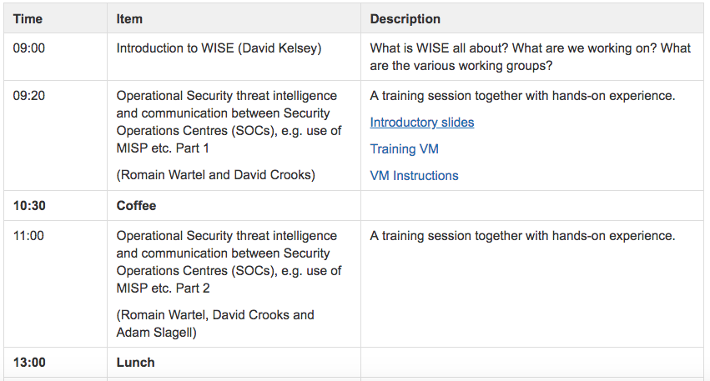
Welcome to all – Agenda this morning https://wise-community.org/
https://wiki.geant.org/display/WISE/WISE+@+NSF+CyberSecurity+Summit+2018

Slide 3
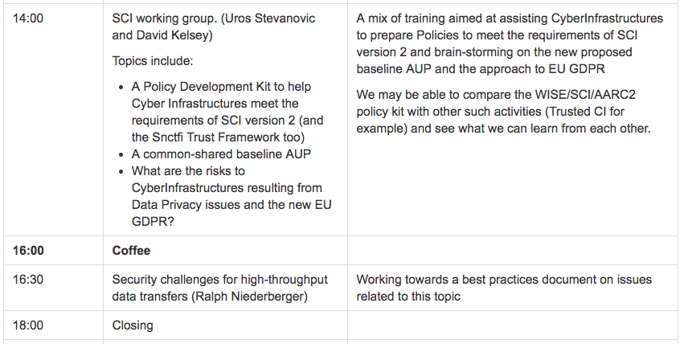
Agenda – this afternoon

Slide 4
WISE Community – short history
Started in October 2015 – Workshop – Barcelona
  Jointly organized by SIG-ISM and SCI
Community members come from e-Infrastructures across the world
Governed by a steering committee
  Project managed by GEANT staff
Real work done by Working Groups
Meetings since mid 2017
  NSF Cybersecurity Summit, USA – August 2017
  STFC Abingdon, UK – February 2018
  BoF session at TNC17, Trondheim, NO – June 2018

Slide 5
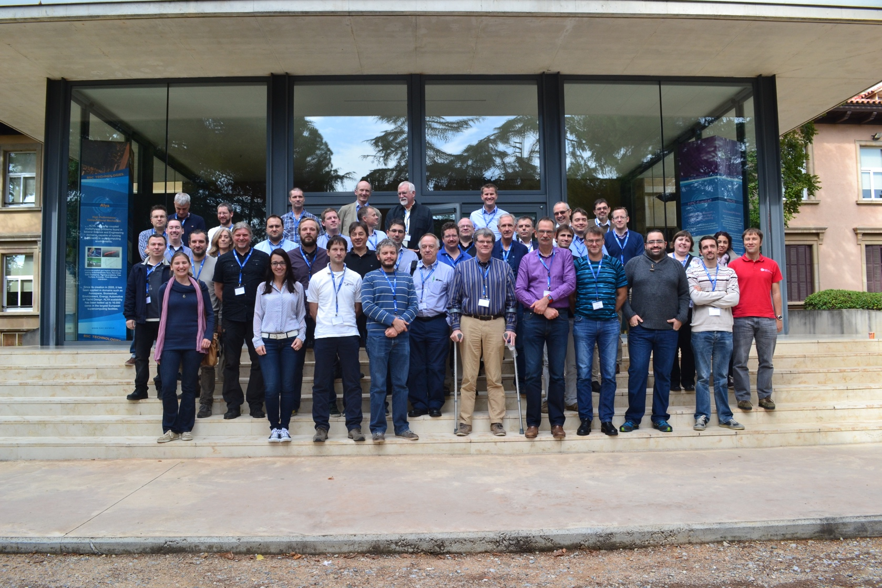
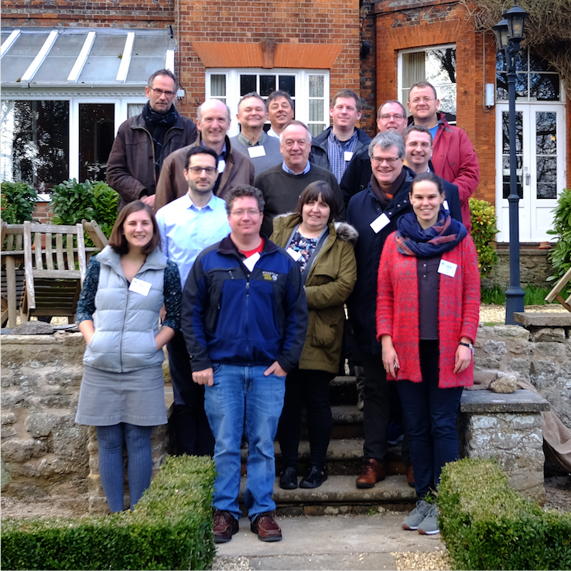
WISE meetings (Oct 2015 and Feb 2018)

Slide 6
Mission Statement (Feb 2018)
What? Joint development of policy frameworks, guidelines, templates and workshops
How? By fostering a collaborative community of security experts
Why? To promote best information security practices for research infrastructures

Slide 7
First Working Groups
RAW-WG Risk Assessment (Urpo Kaila & Bart Bosma)
  Produced a Risk Assessment Template – and guidelines
  Bart will take-over as chair
  Work to continue – align with other similar work (Trusted CI?)
STAA-WG Security Training Awareness (Alf Moens & Jim Marsteller)
  An Inventory of Training and 3 other documents produced
  Now closed
SBOD-WG Security in Big and Open Data (Ralph Niederberger)
  Produced Case Statement and Definitions documents
  Now closed

Slide 8
Working Groups (continued)
SCI-WG Security for Collaborating Infrastructures
  Produced SCI document version 2 (see today) – Dave Kelsey, Adam Slagell
New groups being formed
  Communication in Security Challenges (David Groep)
  Data Loss Prevention (Urpo Kaila)
  Security Challenges for High Throughput Data Transfers (Tim Chown, Ralph Niederberger, David Crooks) – see today
  Security Trust, threat intelligence and communication (Romain Wartel, David Crooks) – see today

Slide 9
Questions?
Let’s do a round-the-room introduction, first
Acknowledgement: Activities of WISE and some participants are co-funded by EU H2020 projects: EOSC-hub and AARC2

