Slide 1

WISE Workshop
GEANT Code of Conduct v2
WISE Information Security for Collaborating E-Infrastructures
NSF Summit 2018
Uros Stevanovic - KIT
https://aarc-project.eu

Slide 2
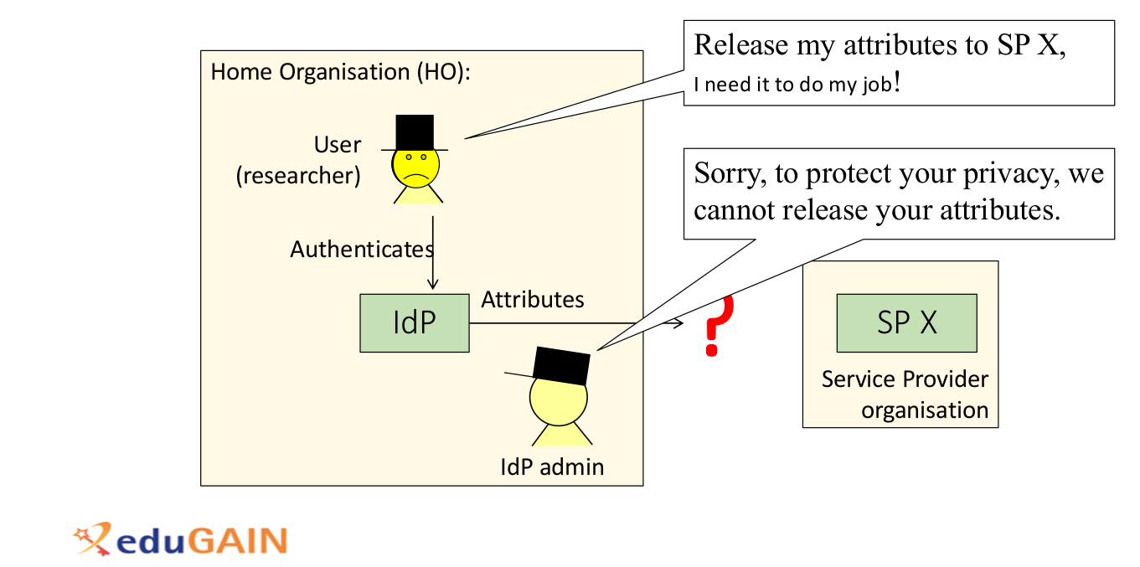
Accessing service – current problem
Image courtesy of M. Linden

Slide 3
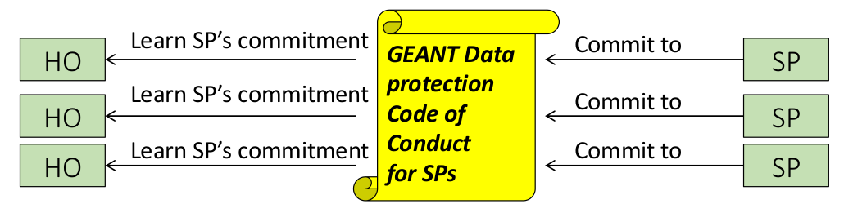
Data Protection Code of Conduct (DPCoCo)
Image courtesy of M. Linden
Service Providers (SPs) commit to CoCo
Identity Providers (IdPs, Home Organisation – HO) is aware of that
  SAML2 metadata (Entity Category), OIDC work in progress
IdP may release data (if confident enough)

Slide 4
History
DPCoCo v1
Published 2013
Submitted to WP29 (now EDPB)
Rejected 2015 → Doesn’t add value
  What is the benefit, what law means in the context of R&F (Directive and national laws…)
GDPR (adopted 2016, went into effect 05.2018)
  Code of conducts are more versatile
CoCo 2.0 aims at GDPR
  Several public consultations so far..

Slide 5
Current legal effects for Codes of Conduct
No need to have CoCo approved by DPAs
But, approved CoCos provide several advantages
Accountability (Art 24(3), 28)
  “… shall be used to demonstrate compliance with the obligations …”
Data Protection Impact Assessment (Art 35)
  “… shall be taken into due account in assessing the impact …”
Data transfer to 3rd countries (Art 46)
  “Adherence to an approved Code of Conduct together with binding and enforceable commitments…”

Slide 6
Territorial scope
SPs in EEA (EU + Iceland, Norway, Lichtenstein)
SPs in “whitelisted” countries (with “adequate” protection)
All other countries, with “binding and enforceable commitments”
  Art 46.2(e)

Slide 7
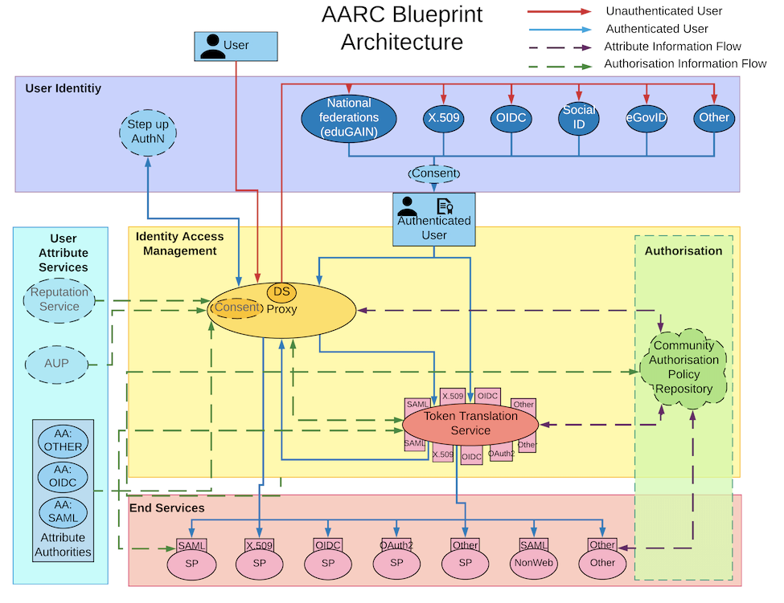
Scenario application
CoCo focus on the release of Attributes necessary to provide access to a Service

Slide 8
Scenario application
CoCo focus on the release of Attributes necessary to provide access to a Service
SPs (Communities, Infrastructures) may choose to apply CoCo to more complex scenarios of Attribute release (AA, SP-IdP Proxy)

Slide 9
Scenario application
CoCo focus on the release of Attributes necessary to provide access to a Service
SPs (Communities, Infrastructures) may choose to apply CoCo to more complex scenarios of Attribute release (AA, SP-IdP Proxy)
Out of scope
  Service content
  Data obtained directly from the users
  Research using personal data (medical records, etc.)

Slide 10
CoCo structure
Principles of the Processing of attributes
Legal compliance
Purpose limitation
Deviating purposes
Data minimization
Information duty towards End User Appendices
Information duty towards Home Organisation
Data retention
Security measures
Security breaches
Transfer of personal data to third parties
Transfer of personal data to third countries
End user consent
Liability
Governing law and jurisdiction
Termination of the Code of Conduct
Survival of the Code of Conduct
Precedence
Appendices
Appendix 1: Information duty towards End Users
  How to develop a Privacy Notice
  How the Home Organisation should inform the End User
Appendix 2: Information Security, technical and organizational guidelines for Service Providers
Appendix 3: Handling non-compliance of service providers
Appendix 4: Glossary of Terms

Slide 11
CoCo next steps
Consultation ongoing
  Third draft published
Submission to supervisory authority
Document URI
Entity Category
Establishing monitoring body
  Independent
  With powers (e.g. mandating removal of CoCo tags from HO)
  Establishing process not defined at the moment

Slide 12
Thank you
Questions?
wise@lists.wise-community.org

Slide 13
References
Mikael Linden presentation: https://wiki.geant.org/display/TFDPR/3rd+TF-DPR+Meeting
https://wiki.refeds.org/display/CODE/Code+of+Conduct+ver+2.0+project
https://eur-lex.europa.eu/legal-content/EN/TXT/PDF/?uri=CELEX:32016R0679

