Slide 1
WISE Workshop
Data Protection Impact Assessment
Uros Stevanovic
KIT
NSF Summit 2018

Slide 2
Risk and risk assessment
Risk – “scenario describing an event and its consequences, estimated in terms of severity and likelihood”
Risk management – “coordinated activities to direct and control an organization with regard to risk”
“Risks have to be identified, analyzed, estimated, evaluated, treated (e.g. mitigated...), and reviewed regularly.”
Continuous assessment of risks
Continuous mitigation of risks

Slide 3
Risk assessment and Data Protection Impact Assessment (DPIA)
GDPR Article 35(1) – “Where a type of processing in particular using new technologies, and taking into account the nature, scope, context and purposes of the processing, is likely to result in a high risk to the rights and freedoms of natural persons, the controller shall, prior to the processing, carry out an assessment of the impact of the envisaged processing operations on the protection of personal data. A single assessment may address a set of similar processing.”

Slide 4
DPIA
From WP29 – “Process to for building and demonstrating compliance” with the GDPR
Non-compliance may result in fines (2% or 10M€):
  Failure
  Wrong DPIA
European Data Protection Board (EDPB) and national DPA – guidelines, examples
  Consistent GDPR application
Not mandatory
  But as mentioned, continuous risk management is mandatory

Slide 5
DPIA decision schematic
High risk?
Art 35(1,3,4)
Article 35:
1 – “Likely to result in high risks”
3 – “systematic and extensive evaluation, automatic processing,
profiling, legal effects; large scale, special categories from Art 9(1);
systematic monitoring of public area”
4 – DPA issued examples

Slide 6
DPIA decision schematic
High risk?
Art 35(1,3,4)
No
Yes
Exceptions?
Art 35(5,10)
Article 35:
5 – DPA issued exception examples
10 – DPIA already conducted as a part of a legal basis
No DPIA necessary

Slide 7
DPIA decision schematic
High risk?
Art 35(1,3,4)
No
Yes
Exceptions?
Art 35(5,10)
No
Yes
Article 35:
7 – Assessment description:
Processing description
Necessity and proportionality of the processing
Risk assessment of the user’s rights
Measures to mitigate risks, security measures for the protection of data, demonstrating GDPR compliance
DPIA
Art 35(7)
No DPIA necessary

Slide 8
DPIA decision schematic
DPO, Compliance
Art 35(2), 39(1c)
Article 35(2) – DPO input (if DPO exists)
Article 39(1c) – DPO should Monitor DPIA performance
High risk?
Art 35(1,3,4)
No
Yes
Exceptions?
Art 35(5,10)
No
Yes
DPIA
Art 35(7)
No DPIA necessary

Slide 9
DPIA decision schematic
DPO, Compliance
Art 35(2), 39(1c)
CoCo
Art 35(8)
Article 35(8) – Compliance with approved CoCo by the controllers
High risk?
Art 35(1,3,4)
No
Yes
Exceptions?
Art 35(5,10)
No
Yes
DPIA
Art 35(7)
No DPIA necessary

Slide 10
DPIA decision schematic
DPO, Compliance
Art 35(2), 39(1c)
CoCo
Art 35(8)
Data subject’s view
Art 35(9)
High risk?
Art 35(1,3,4)
No
Yes
Exceptions?
Art 35(5,10)
Article 35(9) – Seeking the view of data subjects, where appropriate
No
Yes
DPIA
Art 35(7)
No DPIA necessary

Slide 11
DPIA decision schematic
DPO, Compliance
Art 35(2), 39(1c)
CoCo
Art 35(8)
Data subject’s view
Art 35(9)
High risk?
Art 35(1,3,4)
No
Yes
Exceptions?
Art 35(5,10)
No
Yes
DPIA
Art 35(7)
No DPIA necessary
Controller’s review
Art 35(11)
Article 35(11) – Controller conducts the review of processing to fit DPIA, especially when there is a change of risk

Slide 12
DPIA decision schematic
DPO, Compliance
Art 35(2), 39(1c)
CoCo
Art 35(8)
Data subject’s view
Art 35(9)
High risk?
Art 35(1,3,4)
No
Yes
Exceptions?
Art 35(5,10)
No
Yes
Article 36(1) – Consulting DPA prior to processing
DPIA
Art 35(7)
No DPIA necessary
Residual high risk?
Art 36(1)
No
Yes
Controller’s review
Art 35(11)
Prior consultation
No prior consultation necessary

Slide 13
When is DPIA necessary?
One operation, or group of similar operations
“Likely to result in high risks”, ten criteria
  Evaluation or scoring
  Automated decision making with legal or similar effects
  Systematic monitoring
  Sensitive data (or data of highly personal nature)
  Data processing on a large scale
  Matching or combining datasets
  Data concerning vulnerable subjects
  Innovative use or applying new technological or organizational solutions
  Data transfer outside EU
  Processing resulting in preventing data subjects from exercising a right or using a service or a contract
Two or more → DPIA likely (but not necessarily mandatory)
Sometimes even one is enough

Slide 14
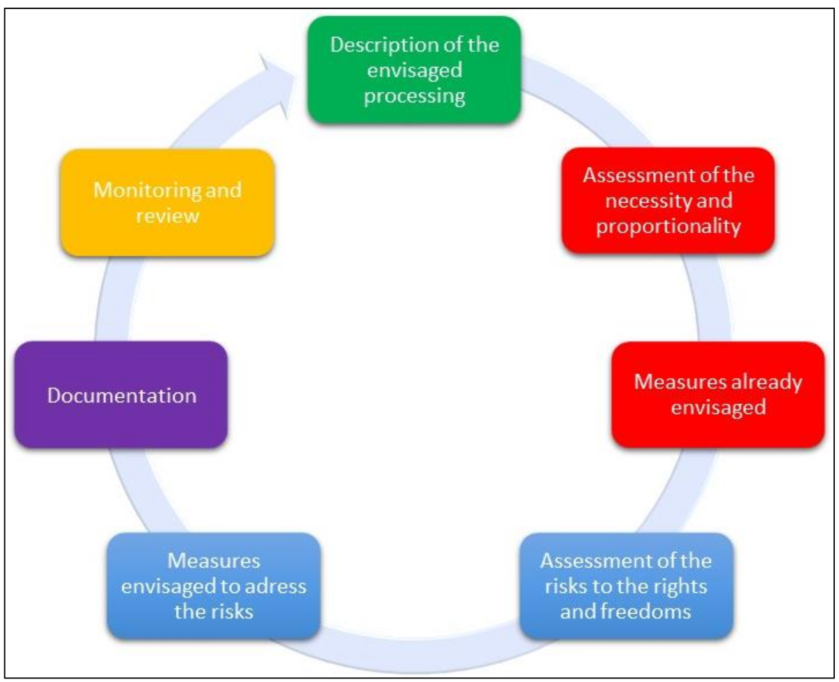
How to conduct DPIA?

Slide 15
Risk assessment in Federated AAI
Federated Identity Management (FIM) has privacy enhancing features built-in
  Anonymization, data minimisation, pseudonymization
Types of data involved in providing access:
  Attributes, identifiers
  Personal data: Name, Email, IP logs
Common Personal Data (CNIL)
  Name
  Email
Connection Data
  IP logs, event logs
→ Not sensitive data, i.e. their processing doesn’t require special considerations

Slide 16
EDPB criteria
Proportionality and necessity of processing
Controls protecting data subjects' rights
Types of outcomes arising from risks scenarios occurring

Slide 17
Proportionality and necessity of processing
Purpose: specified, explicit, and legitimate
  Access to resources
Basis: lawfulness of processing, prohibition of misuse
  Legitimate interest (or others, when applicable)
Data minimisation: adequate, relevant and limited
  R&S
  Additional data are still Common Personal Data
Quality of data: accurate and kept up-to-date
  Updated upon access
  Users may update/rectify their data
Storage periods: limited
  Regulated by policies (typically 6-18 months, longer/shorter possible)

Slide 18
Controls protecting data subjects' rights
Information for data subjects
  Privacy policies
Rights to rectification and erasure
  Privacy policies
  Contact
Transfers
  Policies
  DP CoCo
  Legitimate interest
  Other available methods

Slide 19
Types of outcomes arising from risks scenarios occurring
Illegitimate access to personal data
  E.g. spamming
Unwanted modification of personal data
  E.g. data not used properly
Disappearance of personal data
  E.g. service not accessible anymore

Slide 20
Severity
Negligible:
  Loss of time in repeating
  Spam emails
  Targeted advertising
  Mere annoyance caused by information received or requested
  Feeling of losing control of one’s data
  Feeling of invasion of privacy without real or objective harm (e.g. commercial
  intrusion)
  Loss of time in configuring one’s data
Limited:
  Unanticipated payments, additional costs (e.g. bank charges)
  Denial of access to administrative or commercial services
  Lost opportunities of comfort (termination of an online account)
  Minor but objective psychological ailments (defamation)
  Feeling of invasion of privacy without irreversible damage
  Intimidation on social networks
The level of severity may be raised or lowered by including the following factors:
  Level of identification of personal data
  Nature of risk sources
  Number of interconnections (especially with foreign sites)
  Number of recipients (which facilitates the correlation between originally separated

Slide 21
Likelihood
Negligible to maximum chance of occurrence
Factors raising or lowering the level:
  open to the Internet or it being a closed system
  data exchanges with foreign countries (or not)
  interconnections with other systems or no interconnection
  heterogeneity or homogeneity of the system
  variability or stability of the system
  the organization’s image

Slide 22
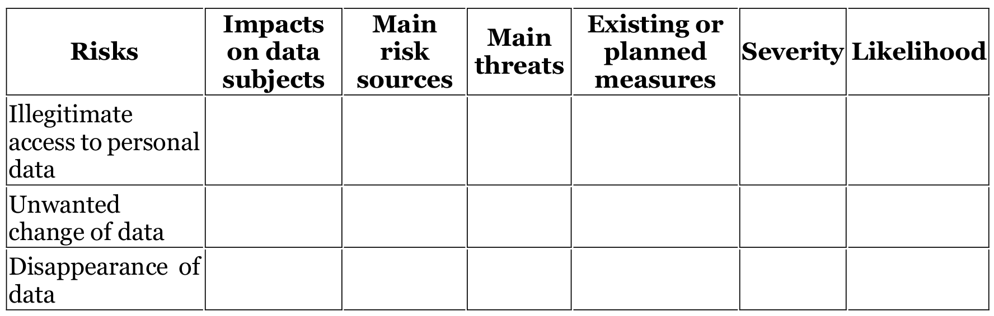
DPIA – risk table (CNIL)
Privacy risks, security risks → can be considered together
Input from WISE risk management

Slide 23
Risk mitigation
In Federated AAI already employs good practices
  Policies
Frameworks (past and ongoing)
  Sirtfi
  Snctfi
  R&S
  SCI
DP CoCo efforts
Physical security
  E.g. WISE guidances

Slide 24
Risk Assessment process
Risk assessment process has to be conducted
Continuous process
Documentation!
Process:
  Description of data processing
  Necessity and proportionality
  Identifying and assessing risks
  Measures to mitigate risks
  Record outcomes
  Integrate outcomes into actionable plan
  Review (reiterate)

Slide 25
Risk assessment in research communities summary
IdP-SP (or AA) scenario
Three “sources” of personal information:
  Information provided by the users (release of information from the IdP)
  Information provided about the user by external party (information contained in the IdP-proxy, e.g. group management, unique identifiers, etc.)
  Information containing users’ personal info created by other processing activities (logging, accounting, monitoring)
Information:
  Email and user’s actual name (usernames)
  Usage of resources (e.g.)
  Medical data, special personal data (sensitive, not extensively considered at the moment)
Ongoing efforts, best practices, recommendations employed
→ DPIA likely not needed

Slide 26
Thank you
Questions?
wise@lists.wise-community.org

Slide 27
References
https://aarc-project.eu/guidelines/aarc-g042/
https://www.cnil.fr/en/cnil-publishes-update-its-pia-guides
https://ec.europa.eu/newsroom/document.cfm?doc_id=47711
https://ico.org.uk/about-the-ico/ico-and-stakeholder-consultations/data-protection-impact-assessments-dpias-guidance/
Andrew Cormack’s presentations (and talks, posts..)
https://wise-community.org/risk-assessment-template/

Slide 28
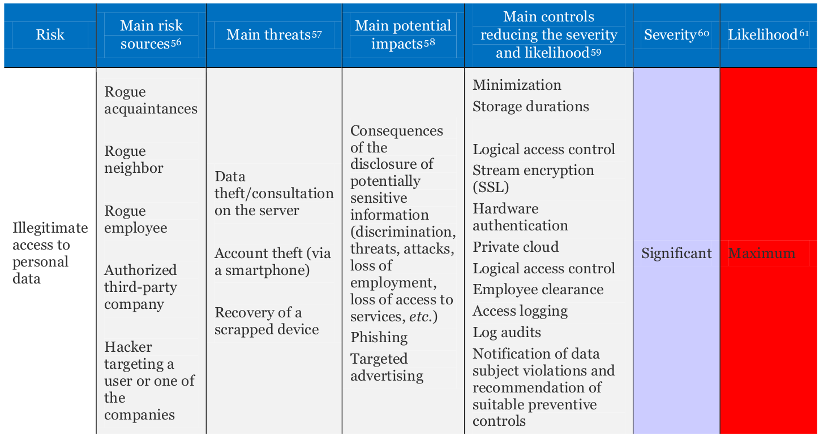
DPIA – risk of illegitimate access to data

Slide 29
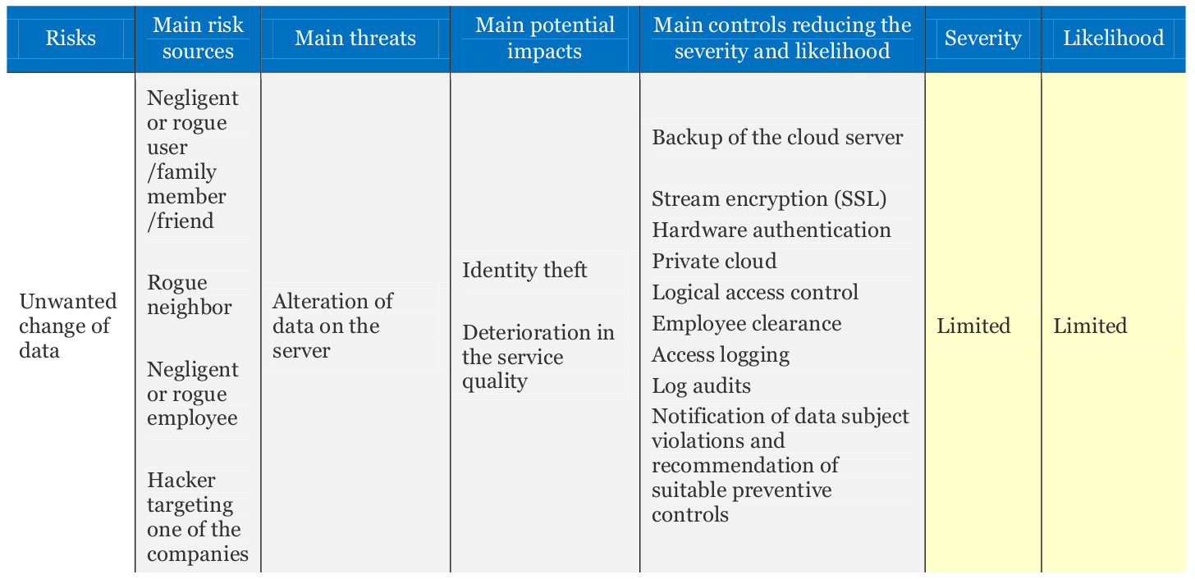
DPIA – risk of unwanted change of data

Slide 30
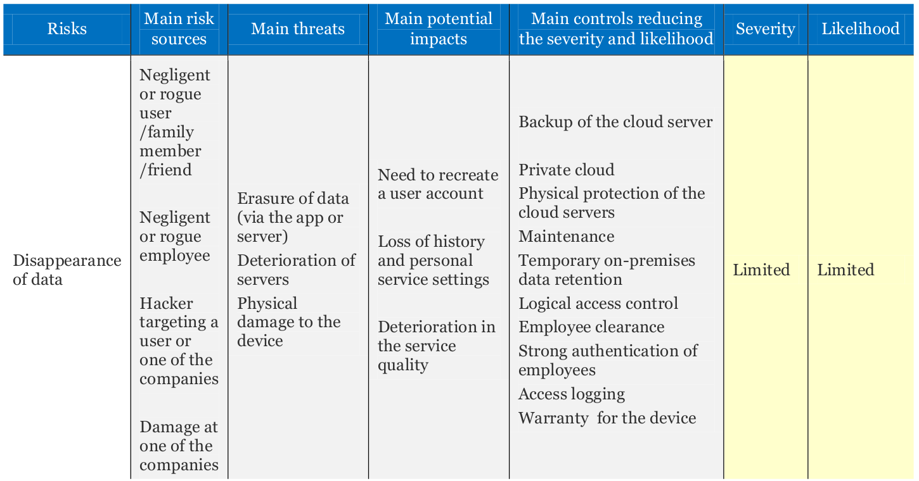
DPIA – risk of data disappearance

Slide 31
GIODO (The Inspector General for the Protection of Personal Data) opinion
(Polish DPA)
Types / criteria for processing operations for which assessment is required | Examples of operations / data scope / circumstances in which a high risk of a breach may occur for a given type of processing operation | Potential areas of occurrence / existing areas of application
Cross-border data Processing data of students, trainees and transmission outside academic staff by universities, as part of the European Union | Processing data of students, trainees and transmission outside academic staff by universities, as part of the European Union exchange and research programs, which is not covered by agreements between the Republic of Poland and third countries (e.g. data on students participating in exchanges between universities) | Universities participating in international scientific programs
 | Processing of HR data in international corporations established outside the EU | Keeping central HR documentation
 | Data processing using public cloud computing resources located in third countries | Use of cloud services provided by international corporations

