Slide 1
GNA-G Update: GREN Mapping
Ryan Davies | CANARIE
Tom Fryer | GÉANT
February 15, 2023

Slide 2
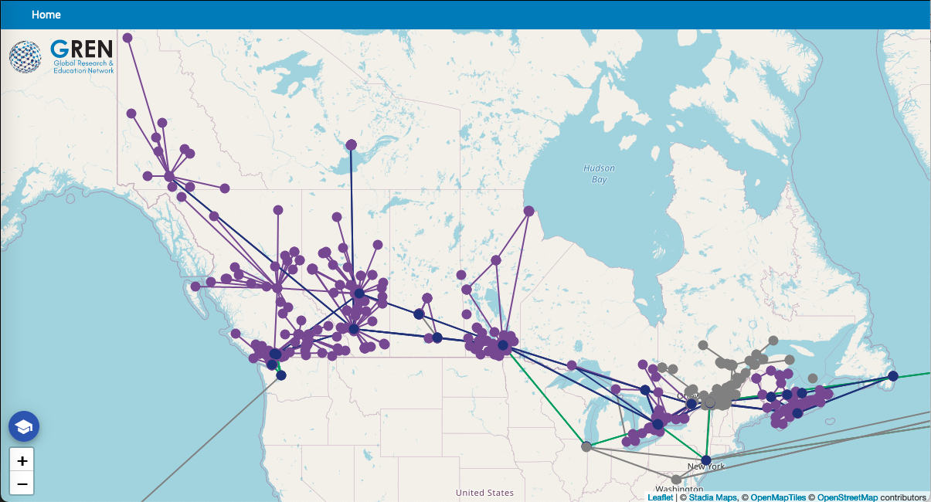
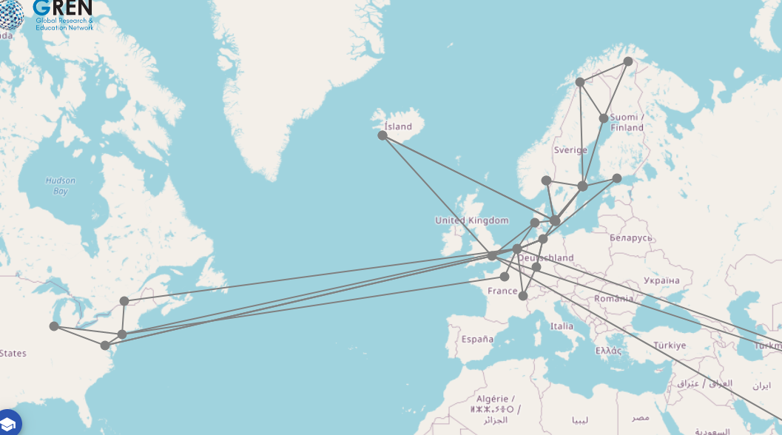
The GREN Map

Slide 3
Working Group update
No recent meetings
We will re-engage once:
  Development is complete on 1.0.0-rc1
  We have a Canadian release
Plan for the next stage of onboarding other Working Group users to version 1
Plan for outreach to other users

Slide 4
Development
Release Candidate 1: 1.0.0-rc1
Major refactoring of import
Main new features for release:
  Handling ID collision / Expanded use of Rules
  SSO integration
  Delete propagation
  Improved Documentation
Bug fixing

Slide 5
Deployment
Using Canadian NREN as a prototype
Top level CANARIE + 12 partner instances feeding data
Targeting mid-March to onboard Canadian NREN partners
Key features of the deployment:
  Kubernetes / Helm chart
  Production SSO
  Secrets management
Make available as a reference example

Slide 6
Looking forward
Finishing Canadian reference deployment
Soft launch to the Working Group community
  Examples of:
    Docker compose
    Kubernetes
Deployable public release of version 1.0.0 for TNC 2023
Community outreach activates to support launch

