Slide 1


GREN (Global Interactive) Map
Science and Technology Forum
Tom Fryer, GÉANT (remote participation)
Utrecht, NL
3 March 2023

Slide 2
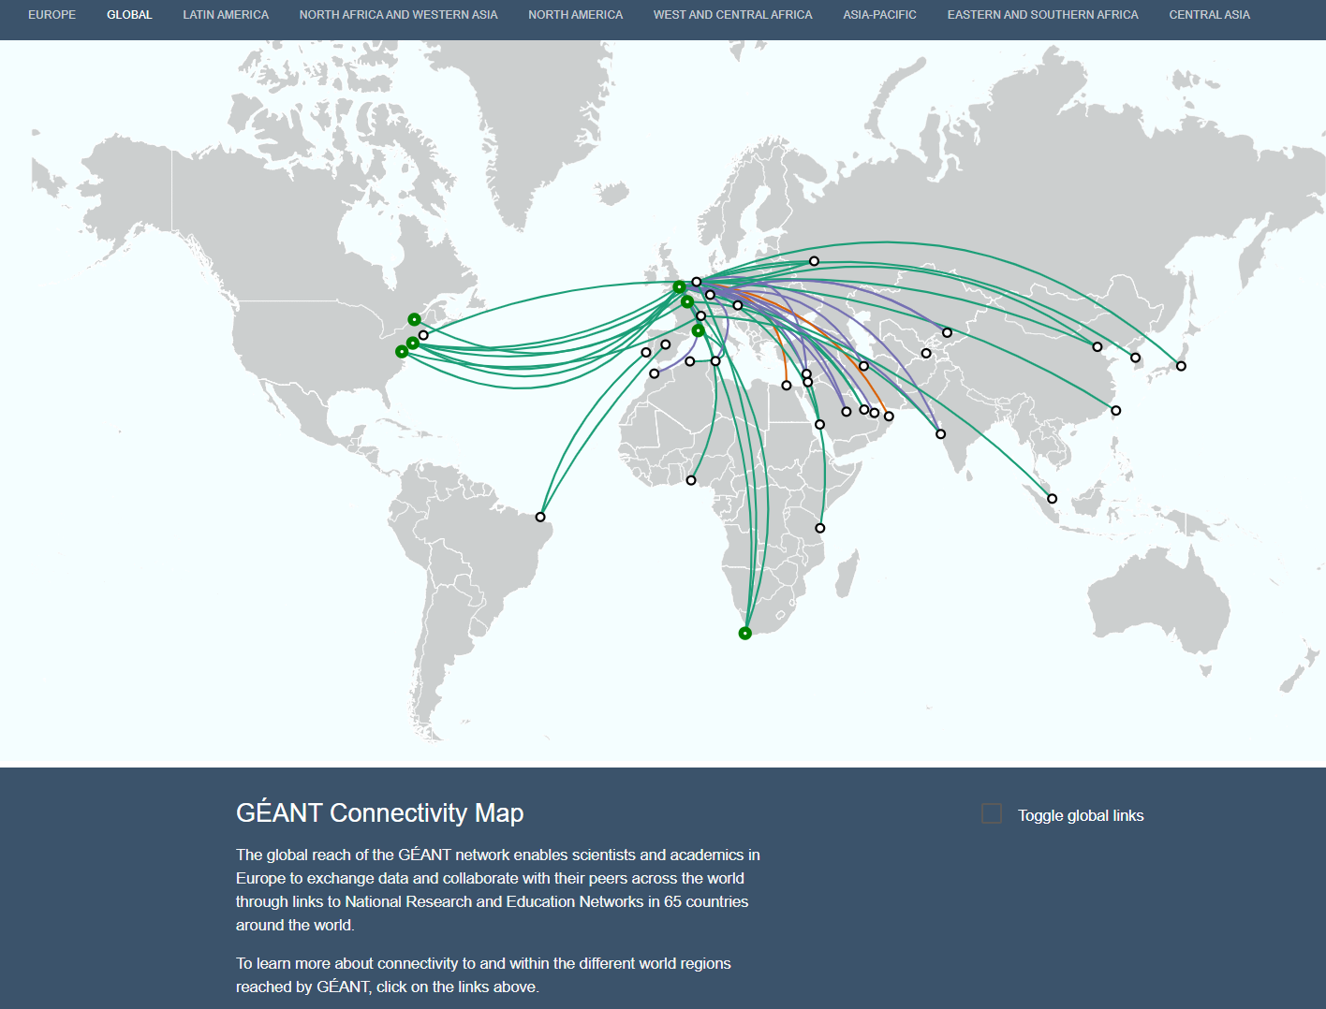
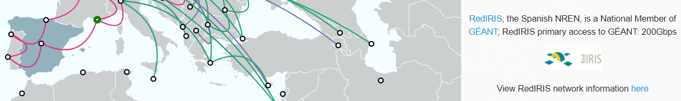
GREN (Global Interactive) Map – Background (i)
GÉANT Interactive Map launched at TNC16 in Linz, Austria
  Provides PoP & link information at global and regional level
  NREN website and map links provided
  Focus is on how data reaches GÉANT backbone from countries around the world.
    Does not include data for links between other world regions.
https://map.geant.org

Slide 3
GREN Map – Background (ii)
At TNC16 CANARIE proposed a collaboration to develop a fully global map.
Consequence was a group to define needs, pool resources for development work, etc., subsequently incorporated into the GNA-G
Main participants to date:
  CANARIE, GÉANT, NORDUnet, SURF, RNP, Internet2, RedCLARA
GNA-G WG Co-chairs: Ryan Davies (CANARIE) & Tom Fryer (GÉANT)
Wiki space: https://wiki.geant.org/display/GlobalMap/Global+Interactive+Map
Success is dependent on participation around the globe

Slide 4
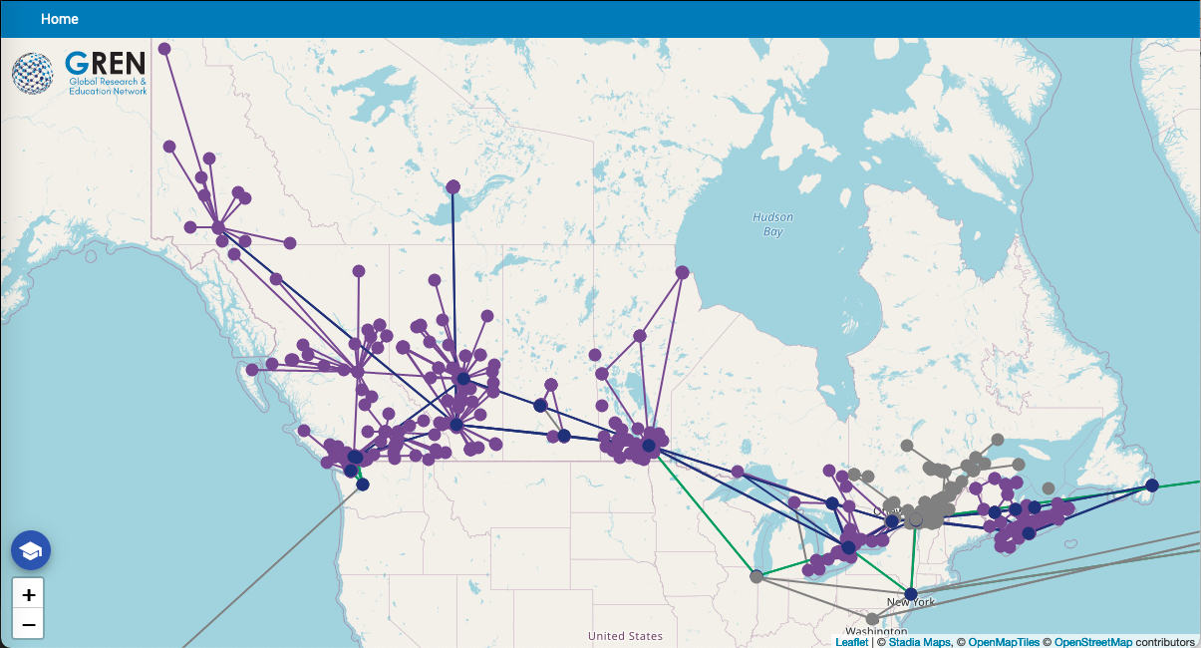
GREN Map - Status
Significant progress made
  Demos/presentations on progress at TNC
Focus now is on completing a Canada-focused map as a Release 1 Map:

Slide 5
Key Elements of CANARIE Deployment
Top level CANARIE + 12 partner instances feeding data
Targeting mid-March to onboard Canadian NREN partners
Key features of the deployment:
  Kubernetes / Helm chart
  Production SSO
  Secrets management
Make available as a reference example

Slide 6
Preparation for CANARIE Release 1
Major refactoring of data import
Main new features for release:
  Handling ID collision / Expanded use of Rules
  SSO integration
  Delete propagation
  Improved Documentation
Bug fixing
CANARIE are targeting April release

Slide 7
Beyond the CANARIE Map Release
Re-engage the working group
Onboarding of other Working Group members
  Implementation of local instance with their network data)
Deployable public release of version 1.0.0 for TNC 2023
Outreach to RENs globally; options under consideration:
  Deployment of demo map on GNA-G website
  International InfoShares
  Presentation at SIG-Marcomms in June 2023 (@TNC23)

Slide 8
Summary
GREN Map aims to make it possible to have a view of global R&E connectivity
Each REN:
  Provides its network data
  Can access data of other networks to create its own:
Improves reliability of shared network data
Significant progress expected in 2023
All RENs welcome to join WG. Queries to:
  Tom.Fryer@geant.org
  Ryan.Davies@canarie.ca

Slide 9

Thank you!
www.geant.org
© GÉANT Association
As part of the GÉANT 2020 Framework Partnership Agreement (FPA), the project receives funding from the European Union's Horizon 2020 research and innovation programme under Grant Agreement No. 856726 (GN4-3).

