Slide 1
Your Sixty Seconds Starts Now!
Brian Nisbet
Network Operations Manager HEAnet
@natural20
SIG-NOC 5 April 2017
Notes:
Not a 60 second talk NetOps Manager in a company with 60 clients. I spend a lot of time thinking about SLAs and processes, and I know you do too!
Most importantly I spend a lot of time thinking about what makes my clients and their users happy!
Hope that very few people here actually need this talk. SIG-NOC all about spreading information and hopefully this will either be useful information or useful reminder!
Equally applicable to NRENs or commercial telcos
Talking about academic users of general ISPs, flexibility of services, expectations of ubiquitous access to services regardless of how the user is connected.

Slide 2
Golden Age - Lucas Cranach the Elder
Notes:
Let’s cast our minds back to a golden era. Telnet was safe, DDoS almost unheard of, nobody ever mentioned the Cloud or Internet of Things… and NRENs could break the network and get away with it.
So could commerical telcos!
“Away with it?” Well, not really, but our SLAs (we should probably say SLO, but that’s a whole other talk) were gentle things, our maintenance windows long and reasonably placed during the day.
Indeed, chances are we would call our clients when they had an outage because we’d notice first.
TNC Talk, I’d promised a magic trick, I’m going to make our reaction times, all gentle SLAs & all the nicely scheduled maintenance windows we had disappear and replace it with sixty seconds.

Slide 3

lemaitreltd.com
Notes:
Time between a service going down and students realising they can’t access Moodle or that Facebook isn’t refreshing any more.
We live in a 24/7 world and learning is no different. No European university wants maintenance window while their students in China are learning!
Nobody wants a maintenance window when researchers are running big jobs/customers are buying lots of things!
Nobody wants an service outage ever!

Slide 4

Notes:
Similarities/Differences from NREN to Commerical Telco
Low number of NREN clients
Concerns over commoditisation of services
We’re reacting in ways that commercial SPs probably wouldn’t, is this a feature? Why is this?
AWS status page reference.
Mythic Beasts responding on a Sunday evening...
Are things really that different on certain levels?
Clients want their Netflix, or FB or… something else.

Slide 5
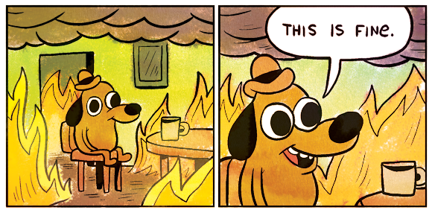
KC Green - http://gunshowcomic.com/
Notes:
Can we even have downtime anymore?
How can we live in that world? Of course not, so we have to put processes in place to minimise the impact.
How do we persuade senior stakeholders that eternal uptime is a myth?
What is their appetite for risk vs budget? How much do you pay for more resilience? How happy are they to live with the notion of possible outage at some random point versus definite at a fixed point?
Understating risk
HEAnet optical network example.

Slide 6
Marketing?
Notes:
Lots of different types of clients represented in this room, can we afford to lose them?
Individual DSL/hosting clients? Sure, for a while.
Enterprise clients?
Just how precious are those sixty seconds?
Depends so much on size of company, but only to a certain extent
What do we do about this?

Slide 7
Reality?
Notes:
Lots of different types of clients represented in this room, can we afford to lose them?
Individual DSL/hosting clients? Sure, for a while.
Enterprise clients?
Just how precious are those sixty seconds?
Depends so much on size of company, but only to a certain extent
What do we do about this?

Slide 8

Notes:
Resilience, in everything, everywhere.
Links, services, front-ends, back-ends...
Tested resilience

Slide 9
Notes:
Who do you trust more, computers or engineers?
Automatic service resolution?
Automation in general

Slide 10
Communicate
Define Process
Apply Process
Communicate
Refine Everything
Notes:
Control/Management... what level of maturity do you need to be at? Balance control/management against service flexibility. Make the software help.
Your methodology is up to you. Put things in place as early as possible in any new company, process or service.
Change control, in everything, everywhere. Very few, if any, services stand alone. Yes, you need it.
Engineers often resist this, it requires buy in from all levels of management and very strict controls. If no CR, no work.
Experience suggests intial push-back, but eventual acceptance & agreement. But there's a balance to strike.
Incident management.
Detailed information to avoid replicating issues. Blame free review of incidents.

Slide 11
User Pre-Fix Hierarchy of Needs
Comms
Communication
Communication
Notes:
Communication, all the communication.
Social media with more than just platitudes. Inform all of your communications staff as soon as possible, avoid them repeating an out of date story.
If you have a status page, make it informative and truthful. Remember, client view of impact is likely different from what you may think the impact is.
Communication breeds understanding from users, try to dispel the notion that far away fields are greener.
Provide comfort. If something breaks, tell people you’ve noticed, tell them what you’re doing (have done) and, while you’re doing that, fix it.
Improve processes & resilience afterwards…
First strike rarely fatal. Fifth strike on the other hand…

Slide 12
Notes:
- Users expect their service to work. In many cases they need that service to work. They will tolerate far more with communication and if they believe the same problem won't keep occurring.
- How do you cope with this for home broadband users? Possibly impossible demands balanced against very low, if any, profit. However if you can make them believe the service is improving...
- Enterprise users should be assumed to have zero tolerance during their working/service hours.
- More magic; properly managed (with process, with resilience, with communication), sixty seconds can last a very long time indeed…

Slide 13
brian.nisbet@heanet.ie
@natural20

