Slide 1

RADIUS infrastructure monitoring
Marko Eremija
User Services Engineer
5th SIG NOC meeting, Geneva
26 - 27 April 2017

Slide 2
eduroam in Serbia
eduroam project in Serbia started at the end of 2009
Process of connecting AMRES institutions to eduroam service and installation of equipment started in 2010
AMRES applied for donation from NATO SPS NIG programme (Networking Infrastructure Grant) with project “AMRES Access Infrastructure Establishment” and got the donation in 2010
new project is currently under way

Slide 3
What is being monitored?
eduroam monitoring system is incorporated into our in-house network monitoring system – NetIIS
AMRES institutions network administrators are already using NetIIS in their every day technical activities
Monitoring and reporting
  RADIUS servers (institutional RADIUS servers and Federation Top Level RADIUS – FTLR servers)

Slide 4
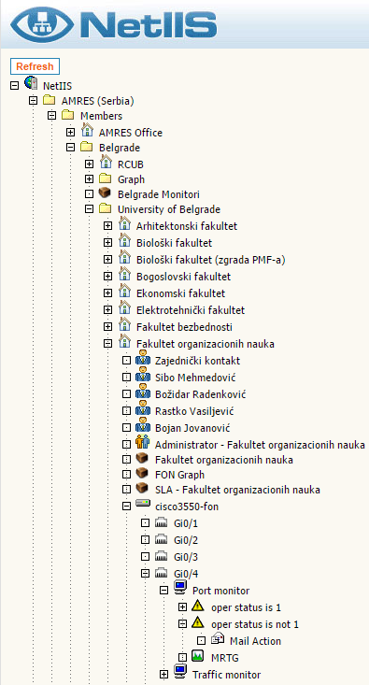
NetIIS – Networking Information and Monitoring System
directory
location
users and group of users
NetIIS is a web based networking information and monitoring system
All objects from external world are presented in a way that is easy to understand
The objects are hierarchically organized and presented by a tree
groups
device
monitor
alarm
action

Slide 5
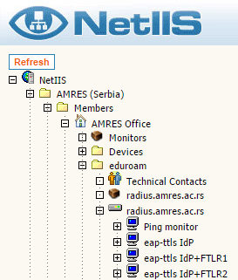
NetIIS – Networking Information and Monitoring System
Every institution has its own location in NetIIS infrastructure, under which eduroam directory is placed
eduroam data and infrastructure elements that are being monitored are stored in that directory

Slide 6
Monitoring and reporting - RADIUS servers
Testing availability of a RADIUS server over the network
  Ping RADIUS server IP address
Testing operability of RADIUS servers :
  eapol_test program from the WPA supplicant software is used http://w1.fi/wpa_supplicant/
  Shell script on the NetIIS runs the eapol_test
  EAP-TTLS and PEAP tunnels can be tested
In case of a test failure, the alarm is triggered and mail notifications are sent to the technical contacts of the corresponding institution
Notes:
Možda dodati i priču za eapol_test skriptu, tj. screenshot sa Netisa

Slide 7
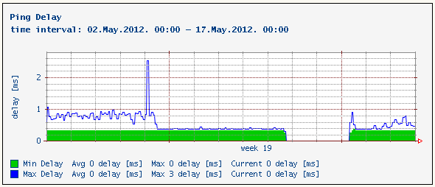
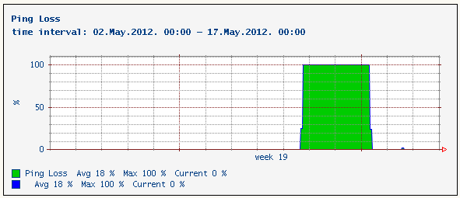
Monitoring and reporting - RADIUS Ping

Slide 8

Monitoring and reporting - RADIUS operability testing
NetIIS
FTLR
EAP TTLS Proxy
EAP TTLS IdP + FTLR
EAP TTLS IdP
EAP TTLS RP
RP RADIUS
IdP RADIUS

Slide 9
Monitoring and reporting - RADIUS IdP
Operability of EAP tunnel established directly with the IdP RADIUS server is tested
EAP TTLS
test@inst.ac.rs
eapol_test
NetIIS
inst.ac.rs
IdP RADIUS

Slide 10
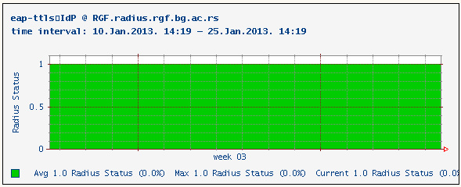
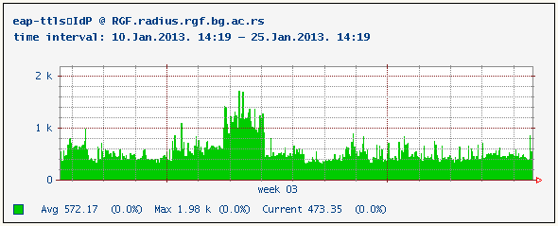
Monitoring and reporting - RADIUS IdP
RADIUS Status and Delay charts (period of 15 days)

Slide 11
Monitoring and reporting - RADIUS IdP + FTLR
Operability of EAP tunnel established over the FTLR server to the IdP RADIUS server is tested
eap-ttls
test@inst.ac.rs
eapol_test
eapol_test
NetIIS
FTLR
inst.ac.rs
IdP RADIUS

Slide 12
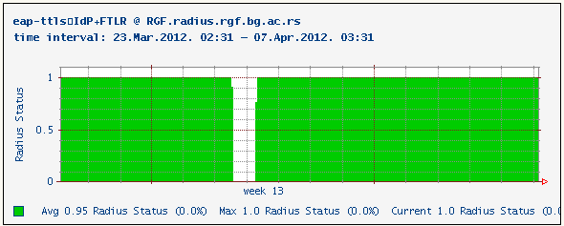
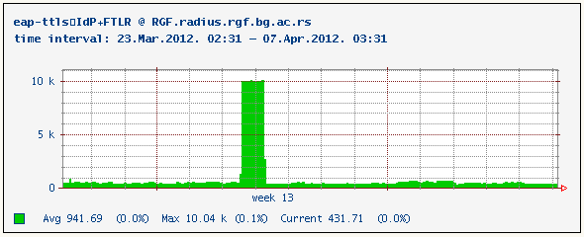
Monitoring and reporting - RADIUS IdP + FTLR
Radius Status and Delay charts (period of 15 days)

Slide 13
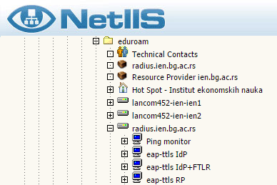
Monitoring and reporting - RADIUS RP
Operability of EAP tunnel established over the institutional RADIUS sever and FTLR server to the monitor RADIUS server is tested
NetIIS
monitor.eduroam.ac.rs
RADIUS
FTLR
monitor
RADIUS
eapol_test
eap-ttls
test@monitor.eduroam.ac.rs
RP RADIUS

Slide 14
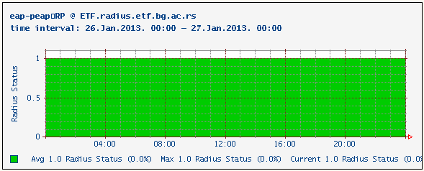
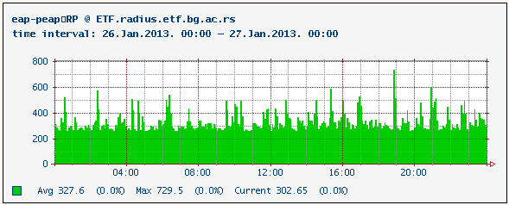
Monitoring and reporting - RADIUS RP
RADIUS Status and Delay charts (period of 24 hours)

Slide 15
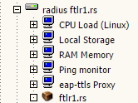
Monitoring and reporting - FTLR
The availability and operability of FTLR server are tested
FTLR
NetIIS
monitor.eduroam.ac.rs
IdP RADIUS
monitor
RADIUS
eapol_test
eap-ttls
test@monitor.eduroam.ac.rs

Slide 16

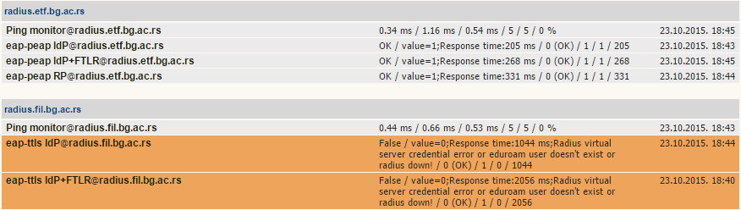
Groups of monitors – Institutional RADIUS servers

Slide 17
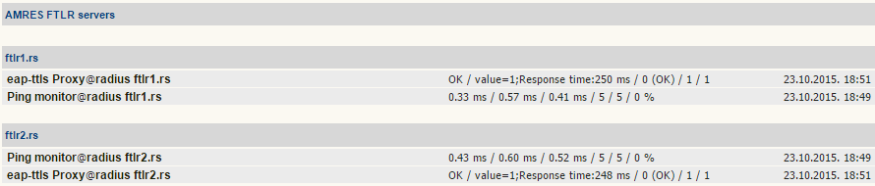
Groups of monitors – FTLR

Slide 18
Any Questions ?
marko.eremija@amres.ac.rs

