Slide 1
Joint cyber exercise
A post-it battle
Charlie van Genuchten
SIG-NOC meeting, CERN
April 26, 2017

Slide 2
Overview
Introduction
Crisis management event
What are your needs and objectives?
Notes:
2 minutes

Slide 3
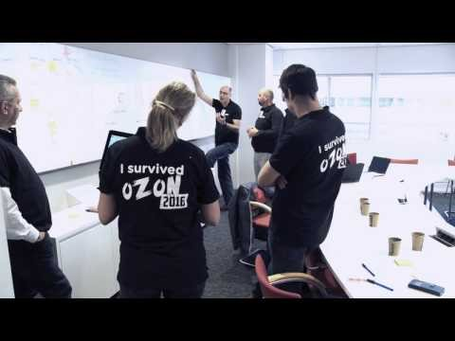
Example
Notes:
5 minutes

Slide 4
Crisis management event: CLAW
Idea of SIG-Marcomms
Two day event with an crisis exercise and workshops
20 and 21 November 2017 in Malaga
Exercise form: ‘sandbox’ exercise
With people from SIG-Marcomms, SIG-ISM, SIG-MSP, SIG-NOC
Working Group with people from those SIGs
  From SIG-NOC: Joze Hanc (ARNES) and Giovanni Sorenti (Jisc)
Notes:
Max 8 minutes

Slide 5
What are the needs of your NREN in terms of crisis management?
Notes:
Everyone writes down their needs on post its: 10 minutes

Slide 6
What are the things you would like to learn at a crisis management event?
Notes:
Everyone writes down their needs on post-its: 10 minutes

Slide 7
What kind of scenario/crisis would you like to play out in an exercise?
Notes:
A real battle: dividing the group up into teams with different colour post-its, the team with the most ideas wins. 10 minutes

Slide 8
Wrap up
Notes:
Grouping the needs and ideas and ending the session: 10 minutes

