Slide 1

Splunk log management
Andrijana Todosijevic
User services engineer
5th SIG-NOC Meeting, Geneva
26-27 April 2017

Slide 2
Splunk log management - BPD
Campus Best Practices SIG SCOPE
Best Practice Document (BPD) “Splunk log management”- collecting and analysing the log data in terms of eduroam service
Spunk in AMRES –
    eduroam
    Asterisk PBX
    iAMRES Identity Federation
    Web-site (App)
    Filesender (App)

Slide 3
Generation of logs messages
eduroam RADIUS statistics:
  Access-Accept/Access-Reject – authentication result;
  IdP – domain of the institution;
  MAC – MAC address of the user device;
  AP – string based on which the location of AP is determined;
  RP – RADIUS attribute Operator-Name.
Asterisk:
  callerid, src, dst - caller name and extensions
  from, to – SIP IDs
  startcall, end, callduration - time
  disposition – answering info
iAMRES:
  SP – Service Provider
  IdP – Identity Provider
  User - Person's principal name at home organization
syslog
Notes:
2017-04-12T03:07:24-04:00 147.91.255.126 cdr: "callerid:"AMRESHELPDESK" <199>","src:199","dst:121","from:SIP/amreshelpdesk-00000139","to:SIP/andrijana.todosijevic-0000013a","startring:2017-04-12 10:06:26","startcall:2017-04-12 10:06:30","end:2017-04-12 10:07:39","callduration:69","disposition:ANSWERED“
2017-04-18T18:26:02-04:00 147.91.1.11 simplesamlphp[18100]: 5 STAT [ac329f5d52] saml20-idp-SSO https://www.amres.ac.rs/simplesaml/module.php/saml/sp/metadata.php/default-sp https://login.iamres.amres.ac.rs/simplesaml/saml2/idp/metadata.php andrijana@amres.ac.rs

Slide 4

Generation of logs messages
linelog splunk {
  filename = syslog
  format = ""
  reference = "%{%{reply:Packet-Type}:-format}"
  Access-Accept ="Access-Accept: IdP=%{tolower:%{Realm}}
  MAC=%{Calling-Station-Id} AP=%{Called-Station-Id} RP=%{Operator-Name}"
  Access-Reject ="Access-Reject: IdP=%{tolower:%{Realm}}
  MAC=%{Calling-Station-Id} AP=%{Called-Station-Id} RP=%{Operator-Name}“
}
rewrite r_ap_use {
##################################
## UNIVERSITY OF BELGRADE ##
##################################
subst("18-ef-63-aa-aa-aa:eduroam", "cisco1142-rcub-sf1");
…
}
eduroam syslog-ng
iAMRES rsyslog
Asterisk syslog
Jan 28 15:37:21 ftlr1 radiusd[31369]: Access-Accept: IdP=etf.bg.ac.rs MAC=48-50-73-f2-80-5c AP=cisco1142-rcub-studenjak5 RP=1rcub.bg.ac.rs

Slide 5
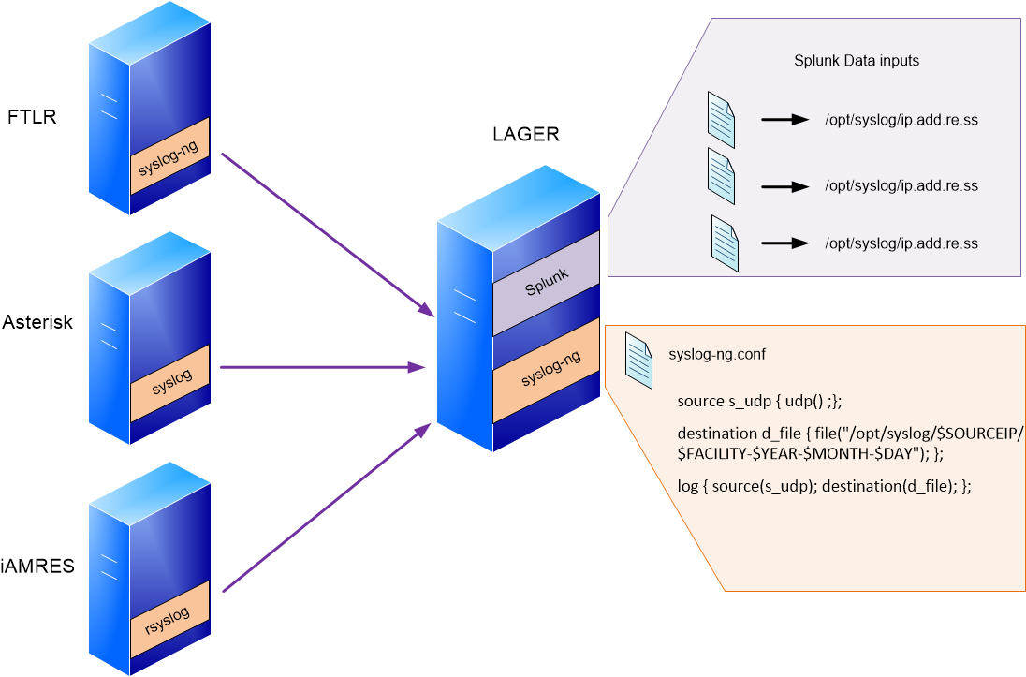
Collection of logs messages

Slide 6
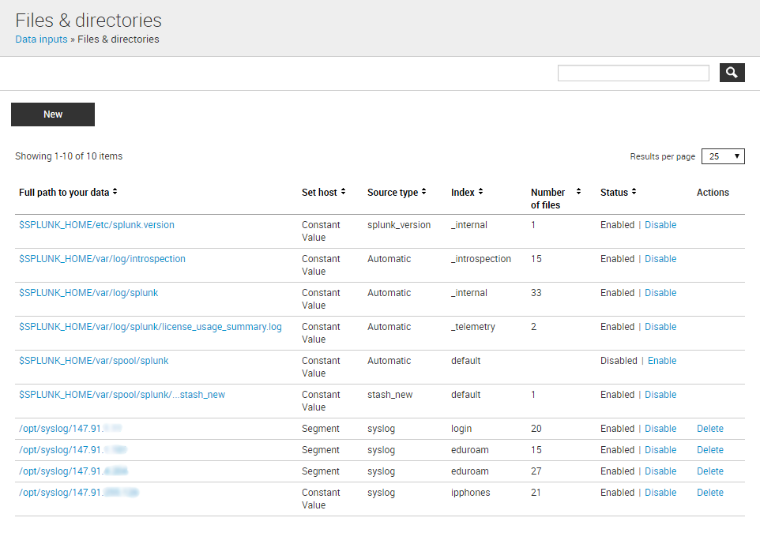
Collection of logs messages

Slide 7
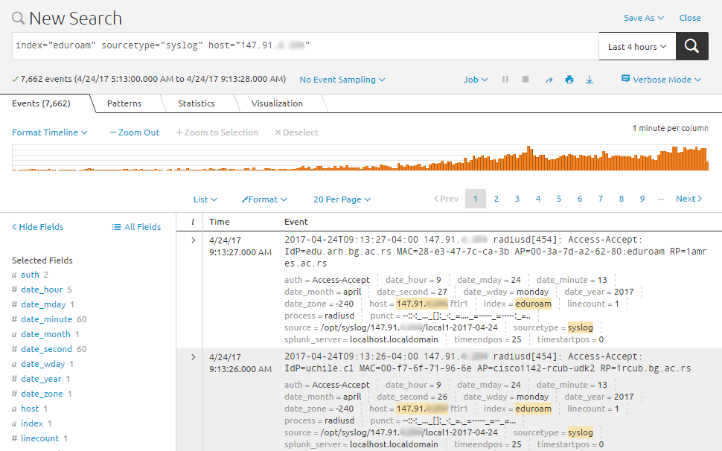
Collection of logs messages
index = “eduroam”
“login”
“ipphones”
sourcetype = “syslog”
host = “ip address/DNS”

Slide 8
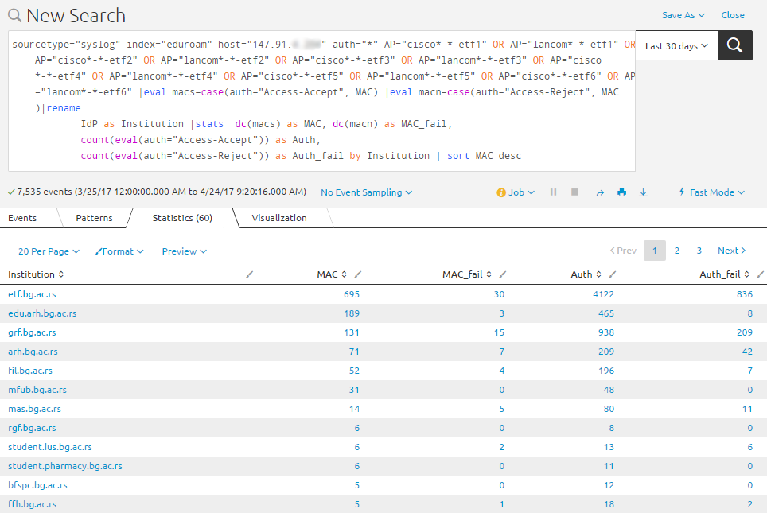
Splunk Search Processing Language (SPL)
Number of requests by IdP, per chosen location in AMRES network

Slide 9
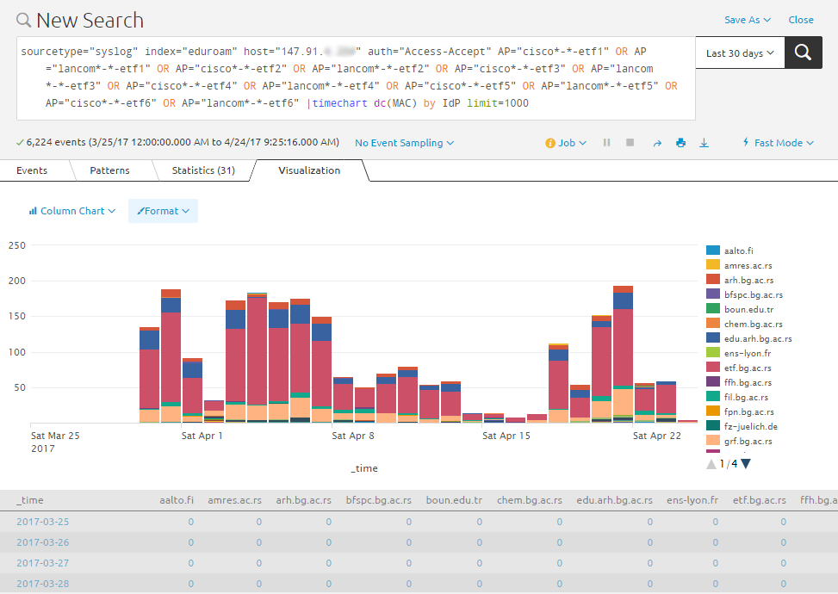
Splunk Visualisation
Number of distinct successfully authenticated MAC addresses per chosen location

Slide 10
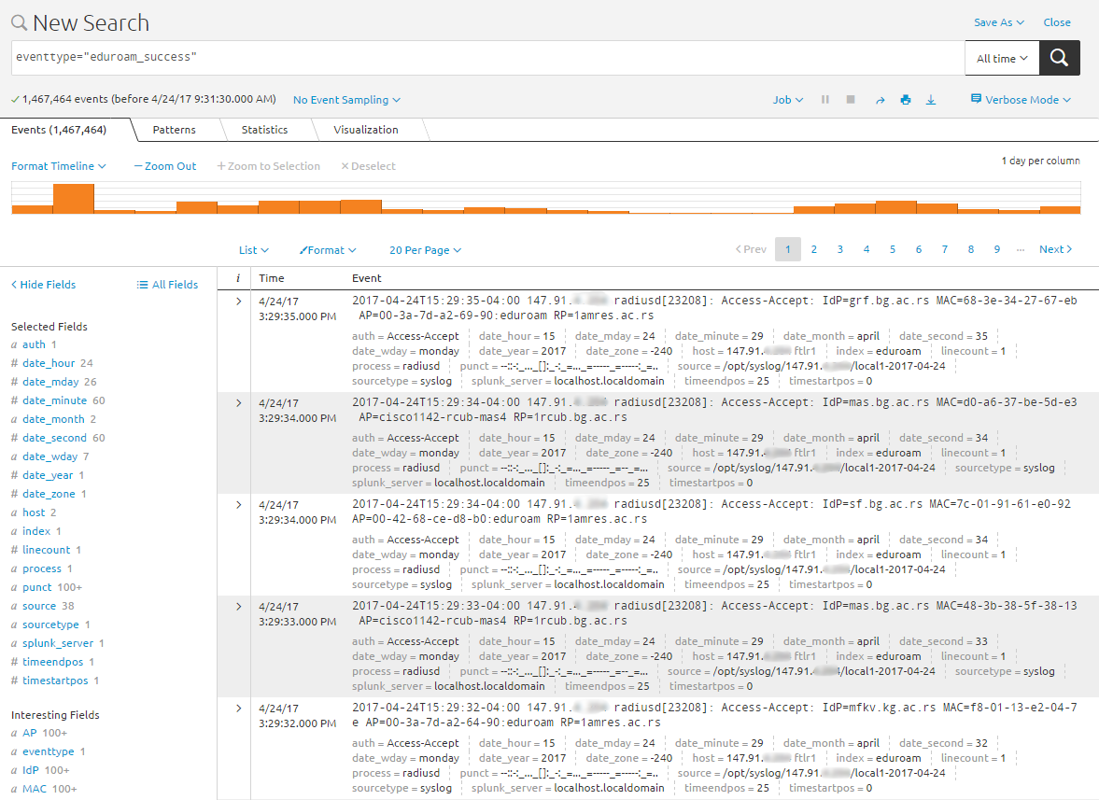
Splunk fields
Extract new fields
New tags
New event types
index="eduroam" IdP MAC RP Access-Accept
sourcetype=syslog > eduroam_success

Slide 11
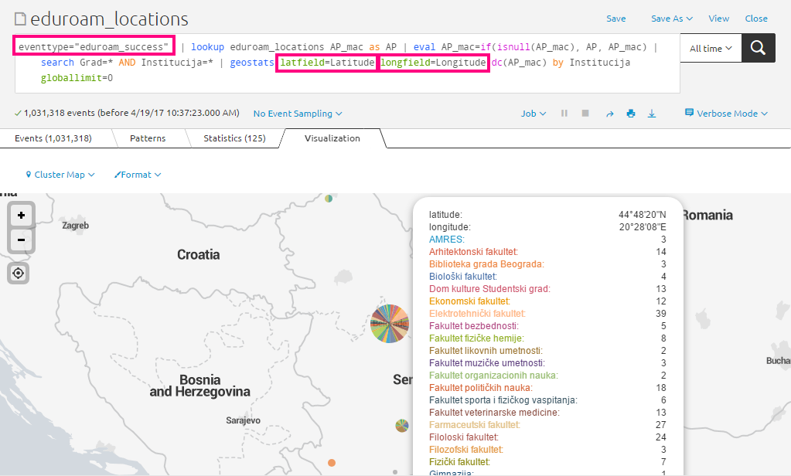
Splunk lookups
Institution | City | AP_MAC | AP_Name | Latitude | Longitude
School of Architecture | Belgrade | 00-3a-7d-75-66-90:eduroam | cisco2702-amres-bg.arh1 | 44.80596 | 20.4755
School of Economics | Belgrade | 00-3a-7d-a2-87-40:eduroam | cisco2702-amres-bg.ekfak1 | 44.81238 | 20.45493
School of Electrical Engineering | Belgrade | 00-3a-7d-a2-69-90:eduroam | cisco2702-amres-bg.etf1 | 44.80556 | 20.47623

Slide 12
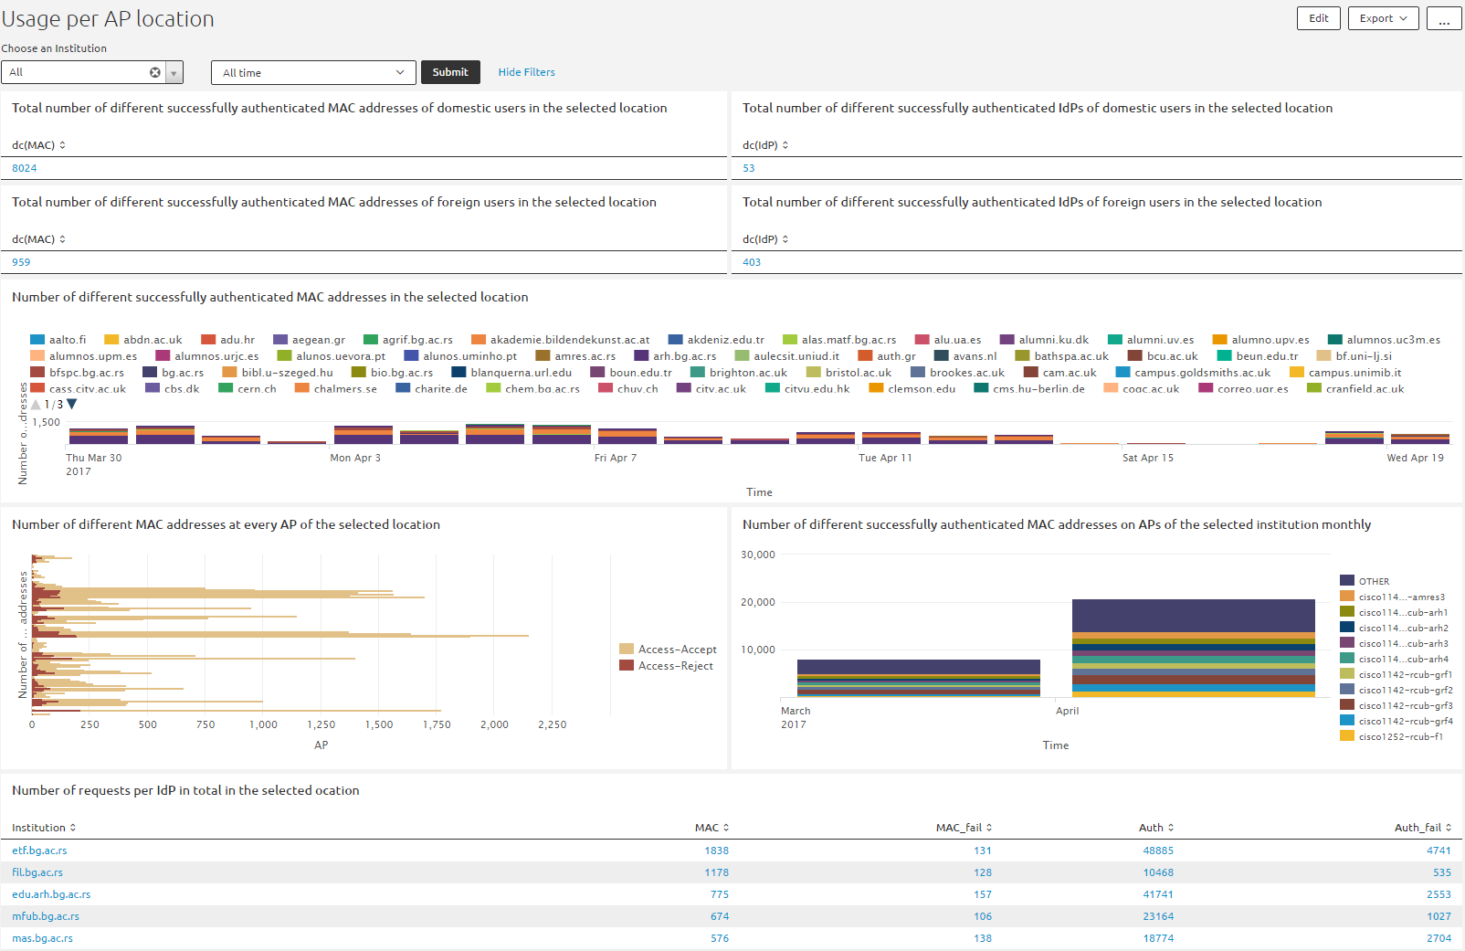
eduroam monitoring

Slide 13
eduroam monitoring
AMRES users (.ac.rs domain)
Foreign users (other)
All users:
Use by institution;
Use by location;
Combinations:
different MAC addresses
successful authentications
number of requests
use by IdP
use by AP
use by RP

Slide 14
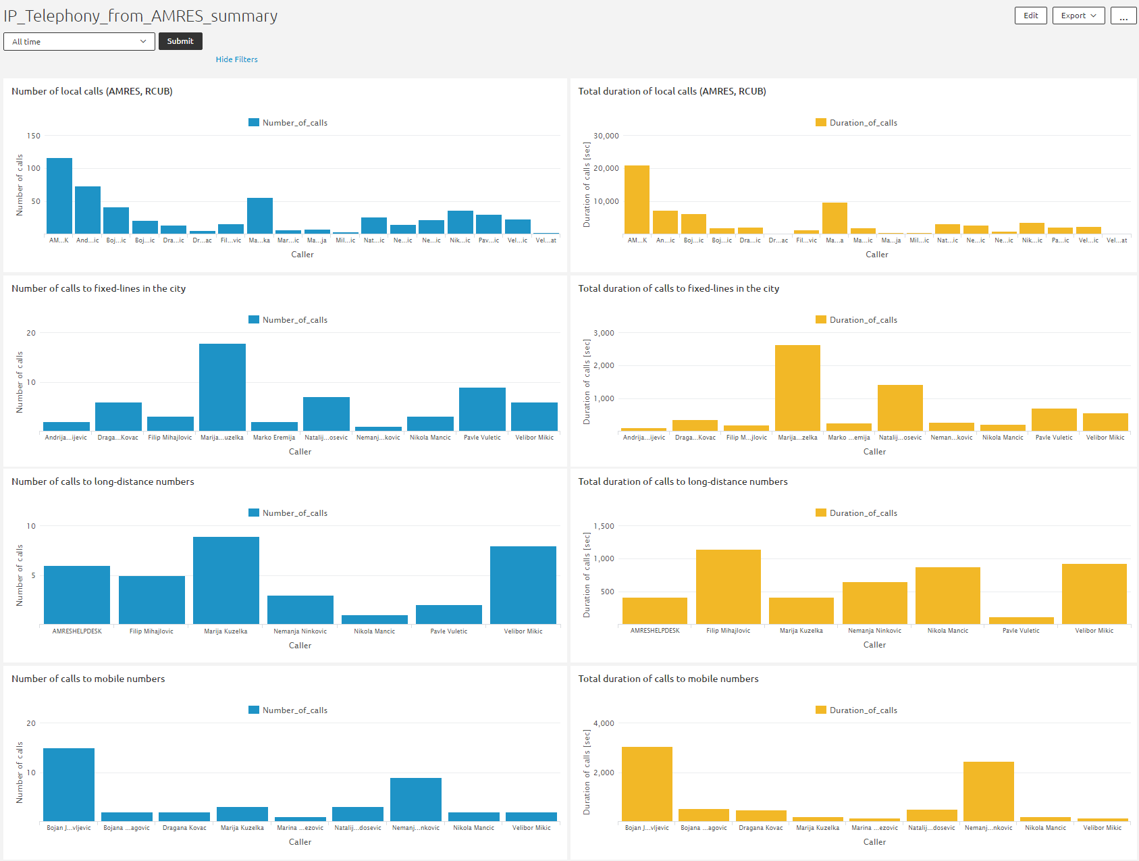
Asterisk monitoring

Slide 15
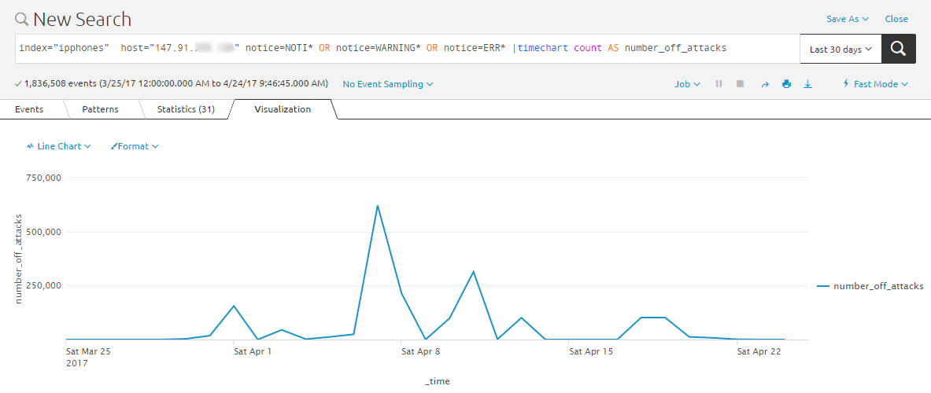
Asterisk monitoring
Number of attack attempts on Asterisk, on public ip address

Slide 16
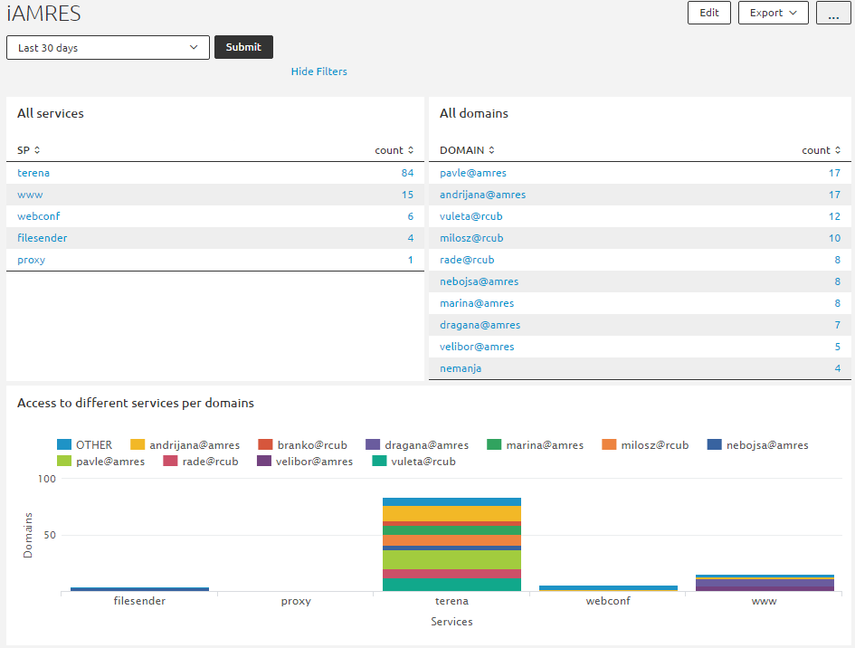
iAMRES monitoring
Access per services and per user domains

Slide 17
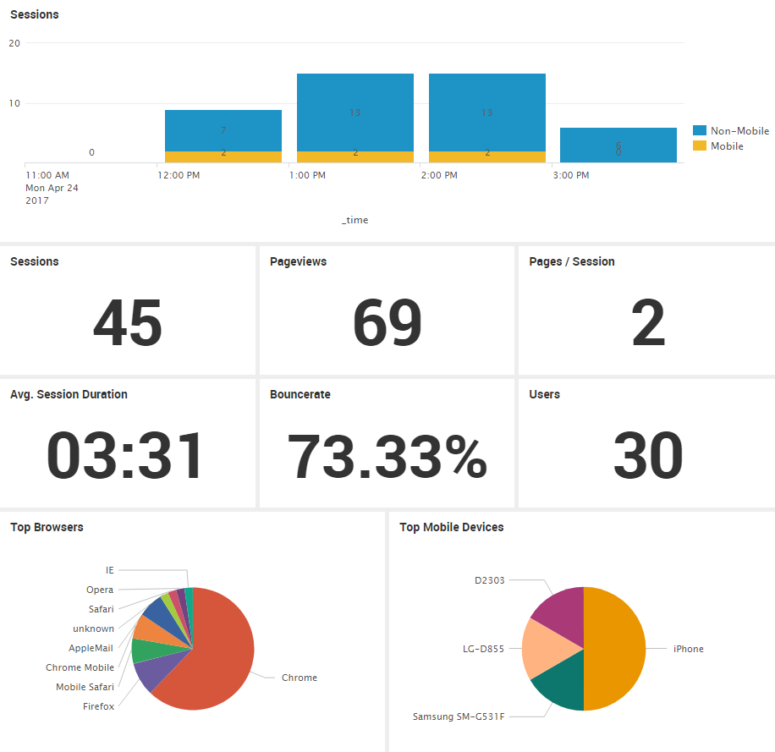
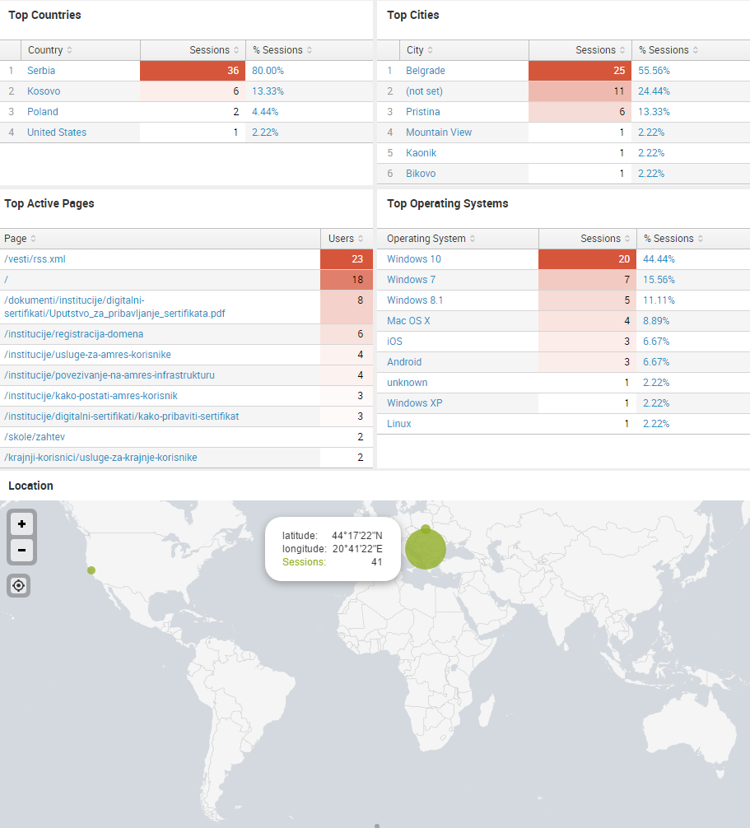
AMRES Web Analytics

Slide 18
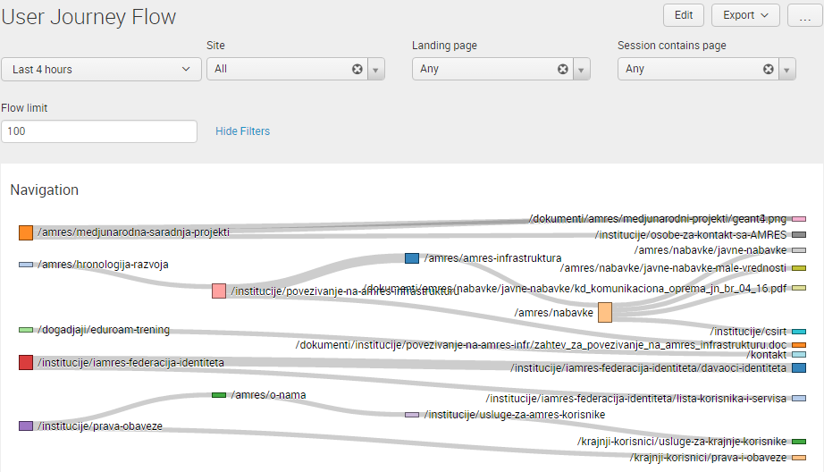
AMRES Web Analytics
User journey flow through AMRES web-site

Slide 19
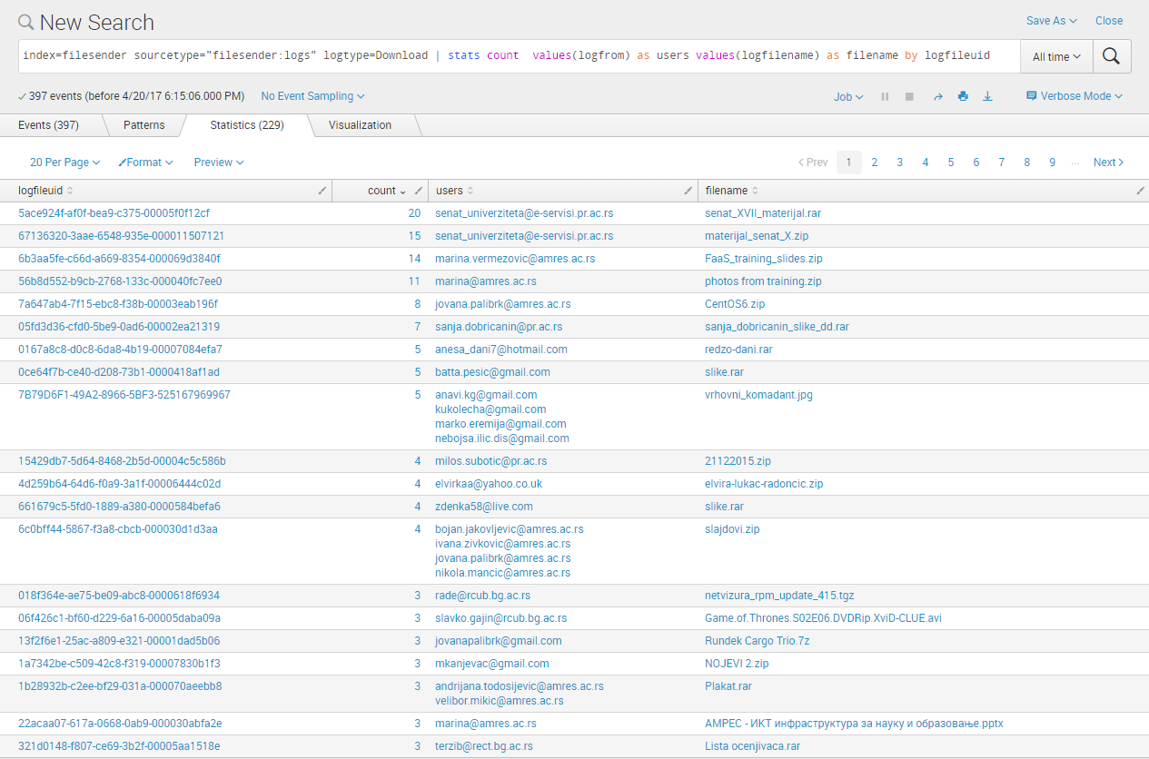
Filesender monitoring
Number of downloads per file

Slide 20
andrijana.todosijevic@amres.ac.rs

