Slide 1
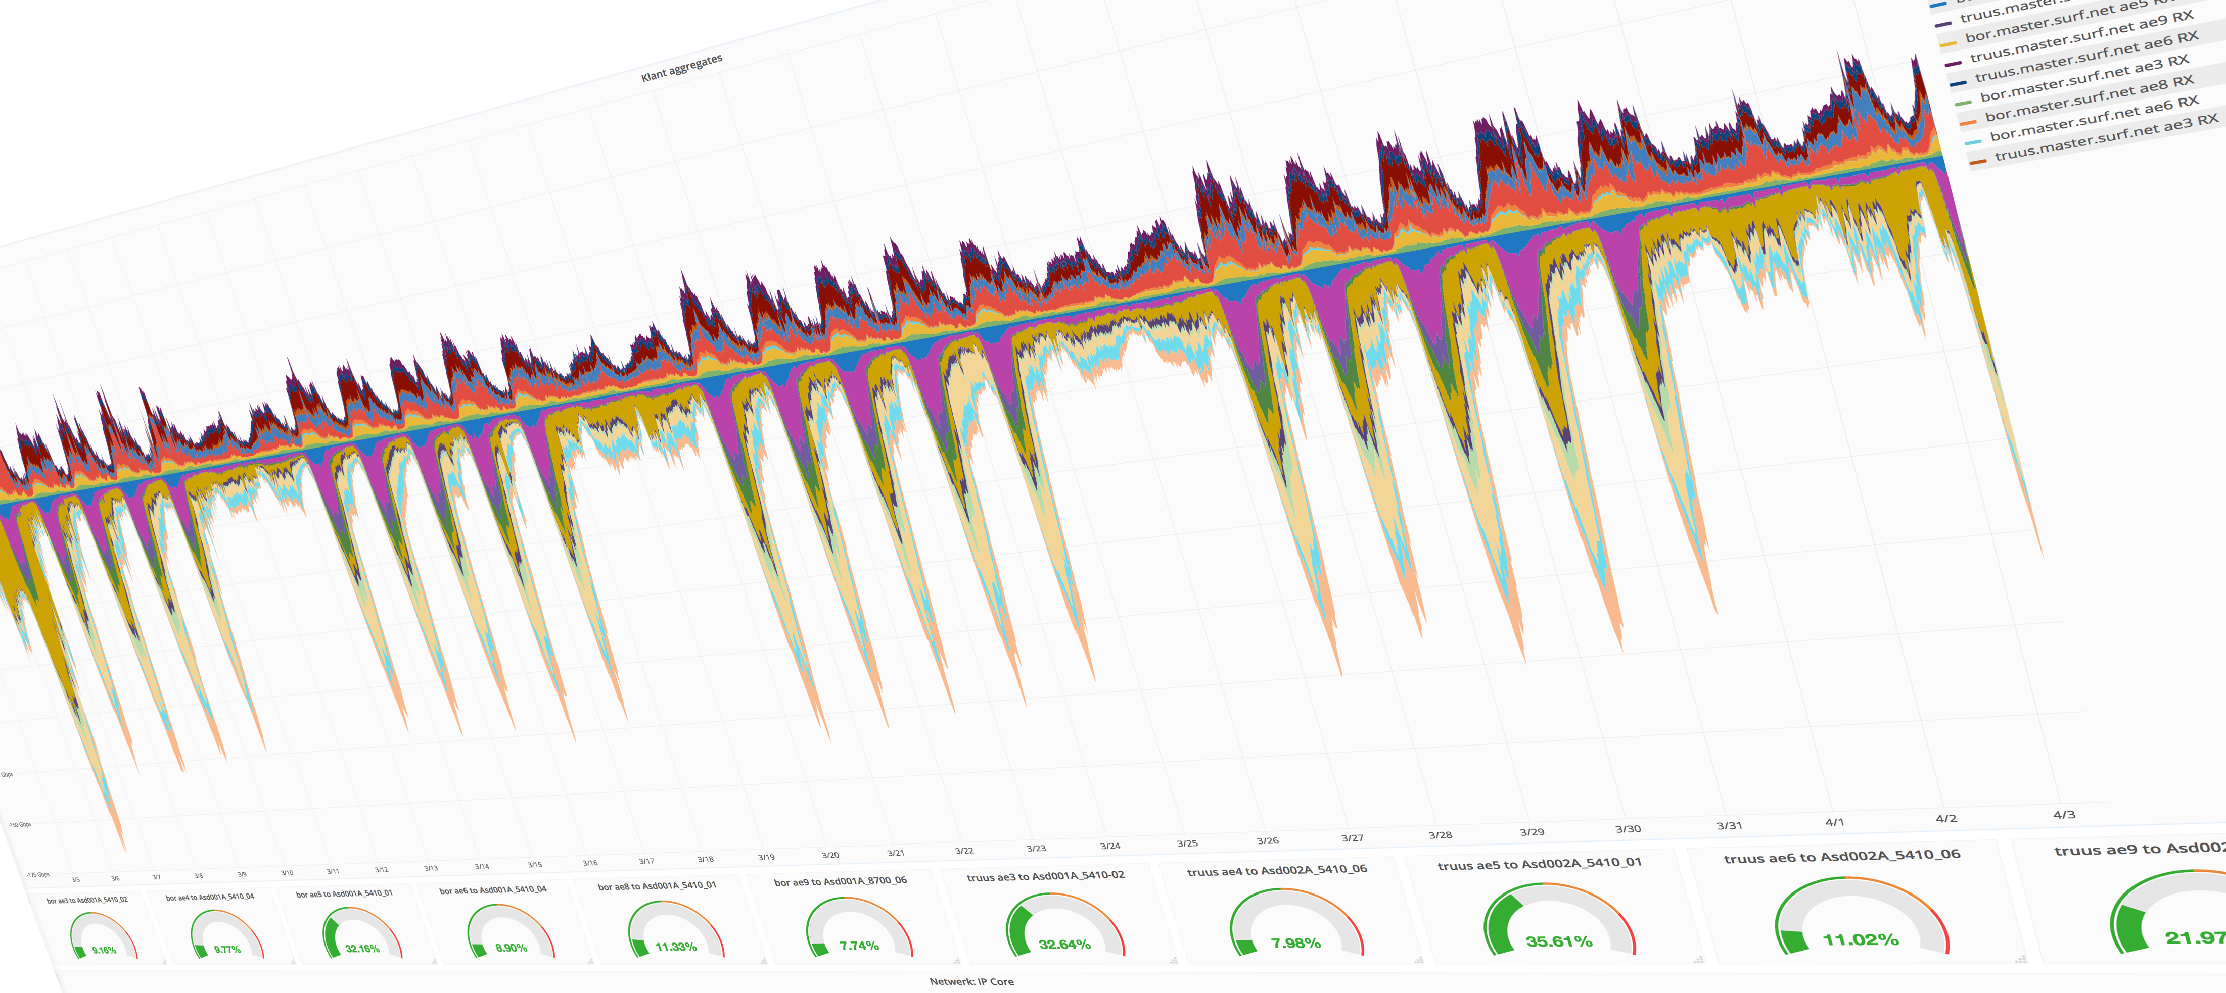
Network measurements with InfluxDB
Big data for measurements ;-)
Max Mudde (max.mudde@surfnet.nl)
Network Engineer

Slide 2
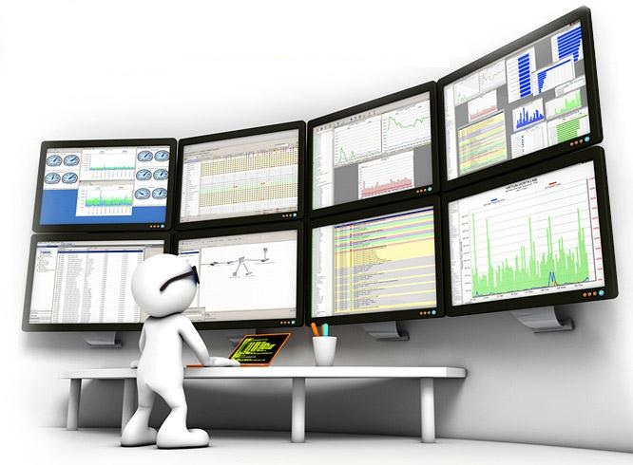
Agenda
What is a time series
Why do we need time series data
What we had
What we wanted
Database selection
Collection agent
Visualising data
Future of monitoring
Demo

Slide 3
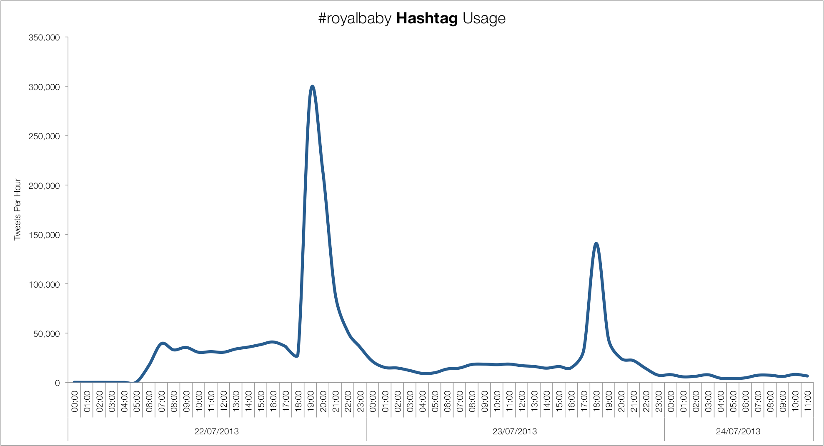
What is time series data
Is a series of data points indexed in time order.
The series is most commonly graphed or listed in order of time
We use it everywhere:
  Meterological data
  Tide graphs
  Financial trends

Slide 4
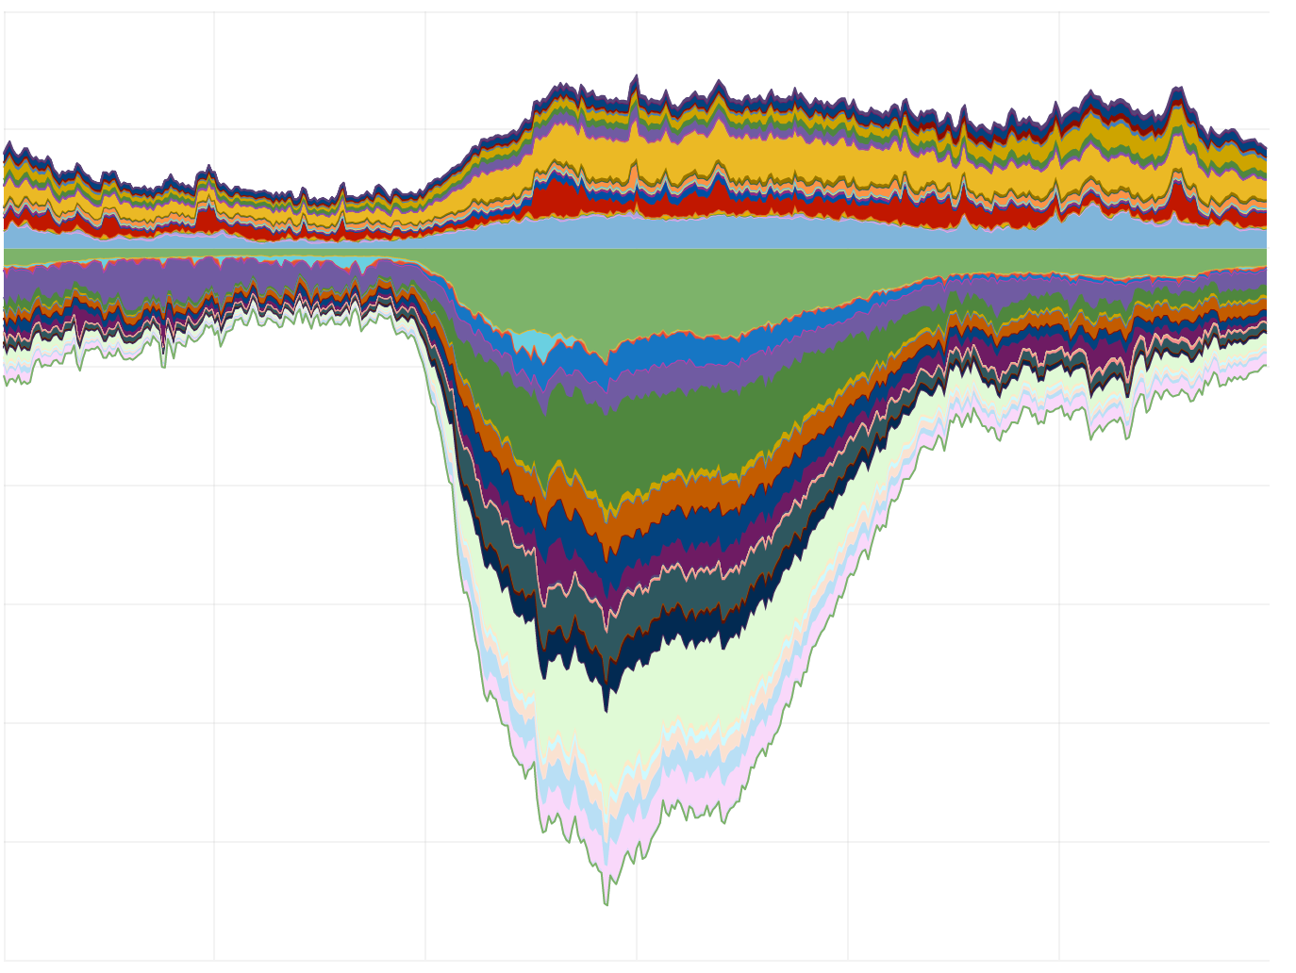
What is time series data
In a time series database a datapoint is ALWAYS accompanied with a timestamp
Datapoints are often accompanied with metadata (tags)
Numeric (integer) value
Binary (true/false)
String (events)
Equal time periods
State changes
Events

Slide 5
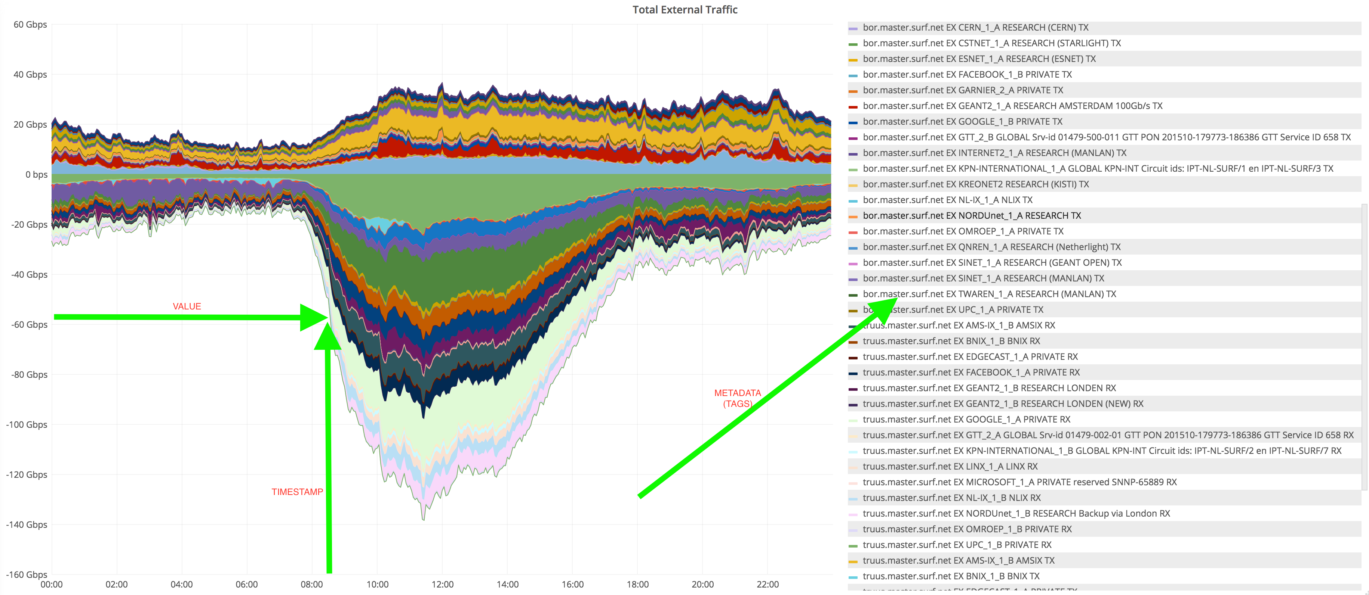
What is time series data

Slide 6
Why do we need time series data
Monitoring! We basically want to know whats going on
Sudden changes in traffic
Error detection
Capacitymanagement; Do we need to upgrade/downgrade
Trendanalysis; We want to track changes in behaviour
Billing
Reporting

Slide 7
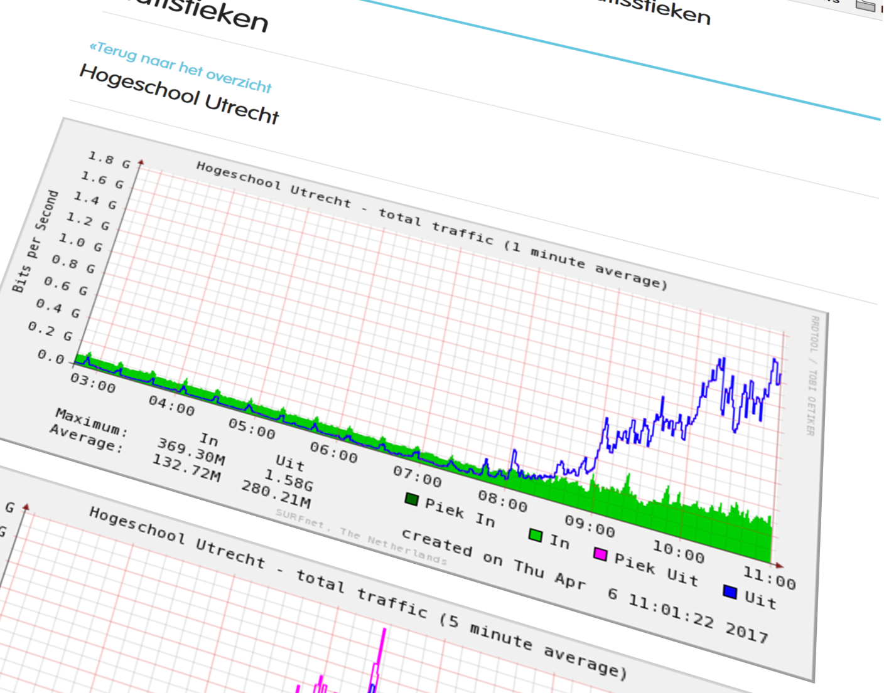
What we had
RRDtool based
Perl/Python snmp scripts
Cons:
File based time series
Horrible retention (default)
Static images
(almost) no correlation posibities
Static intervals
Static images
Plans to change this setup for almost a decade

Slide 8
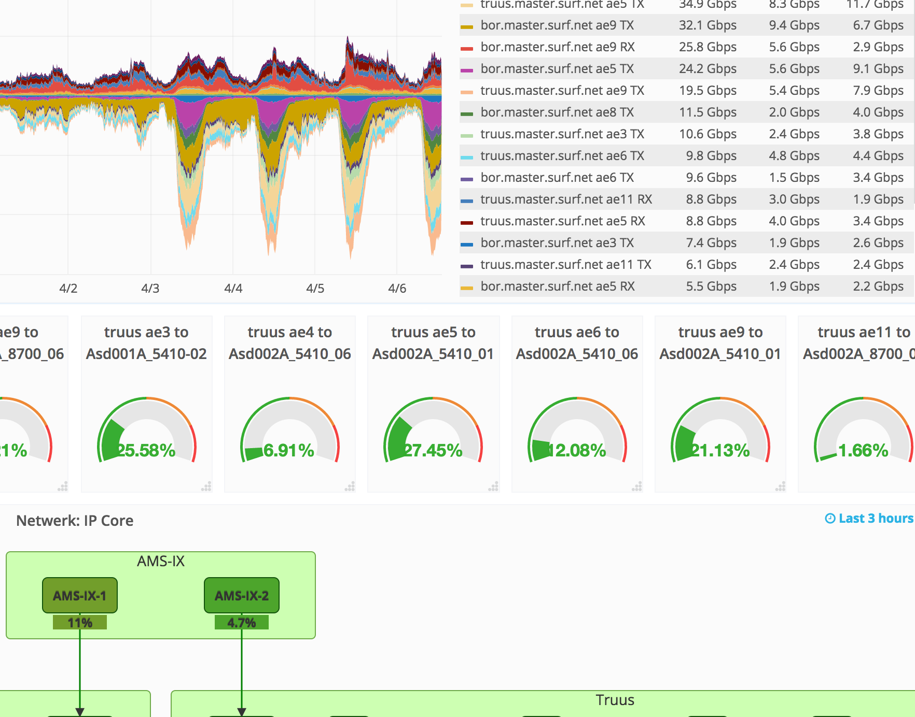
Wat we wanted
Correlation
Database
Query language
Better retention (and flexible)
Dynamic intervals
High resolution (per/(mili)second)
Basic statistical analysis
Big data for analytics!

Slide 9
Selection of TSDB’s

Slide 10
Selection of TSDB’s
OpenTSDB
Build on top of hadoop & hbase or Cassandra
Extremely scalable
High resolution (ms)
Tags
Very active community
Graphite
Build on Whisper
Not possible to store indefinitly
1 second resolution
No tags
Very active community
Does not scale well
Cyanite
Build on top of Cassandra
1 second resolution
No tags
Active community
InfluxDB
Own databaseformat
Scalable (commercial)
High resolution (ms)
Tags
Commercial support
KairosDB
Build on Cassandra
Promethius
Build on whisper
Lowest resolution (1min)
Tags

Slide 11

Selection of TSDB’s
What we found important
Time vs Money
Active community
Easy to understand query language
Enrich data with tags (Metadata)
Ease of management (we are not Dbadmin’s)
Documentation

Slide 12
Selection of TSDB’s
InfluxDB
Tags
HA Cluster (Commercial)
Support (commercial)
Easy install
  Binary packages (windows, RH, Deb, tar)
  Docker containers
Less moving parts and dependensies

Slide 13
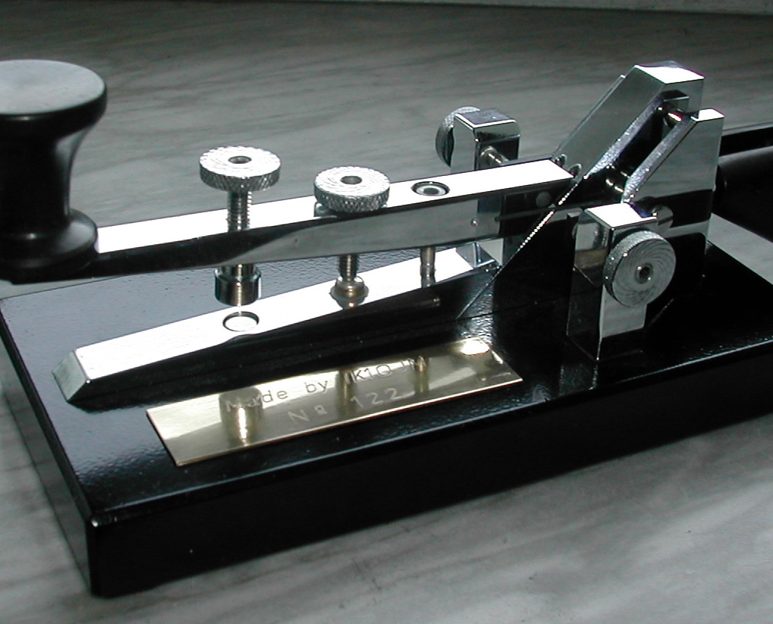
Monitoring Agent
Monitoring Through SNMP
Selective in what we monitor
Agents
Collectd (no tag support)
Telegraf (tags bases on snmp tables) (plugins)
Adapt current scripts

Slide 14
Monitoring Agent
Alternatively more and more tools supprt InfluxDB
Librenms
Icinga2

Slide 15
Monitoring Agent
Telegraf
Pluggable
Highly configurable
Seems to be gaining momentum
Strong development
Ease of maintance
Supports multiple backends
Parallel polling
Caching

Slide 16
InfluxDB setup

Slide 17
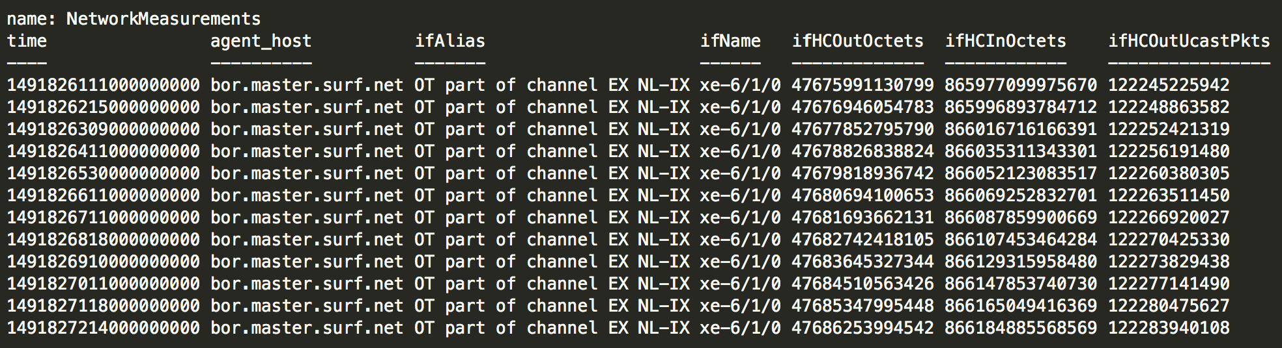
Querying influxDB
Looks somewhat like SQL
SELECT * from "NetworkMeasurements" where time > now() - 1h and agent_host = 'bor.master.surf.net' AND ifName = 'xe-6/1/0';

Slide 18
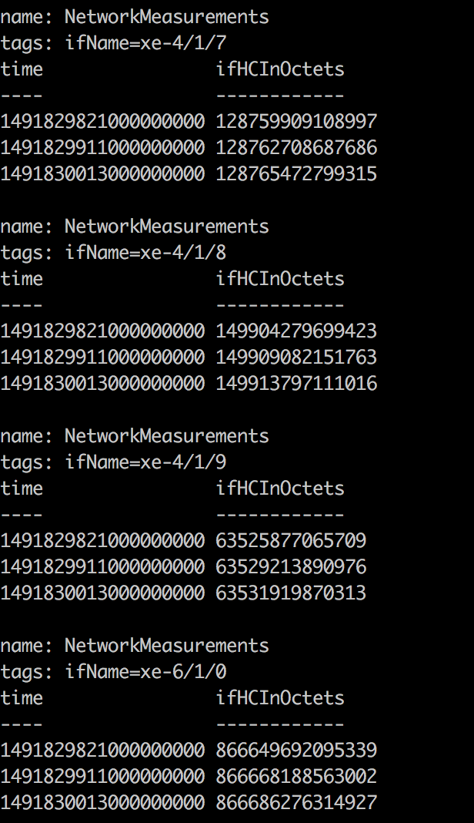
Querying InfluxDB
GROUP BY (tag)
SELECT ifHCInOctets from "NetworkMeasurements" where "agent_host" = 'bor.master.surf.net'and time > now() - 5m GROUP By ifName;
Get all input counters from router ‘bor’ of the last 5 mins and group them by interface name

Slide 19
Querying InfluxDB
Mathematical & statistical functions
SELECT non_negative_derivative(ifHCInOctets,1s)*8 from "NetworkMeasurements" where "agent_host" = 'bor.master.surf.net'and time > now() - 1h GROUP By ifName;
Derivative = Convert counters to bytes/sec
Math = Convert bytes to bits
Other functions:
Mean
Median
Sum
Distinct
Percentile
Top
Etc…

Slide 20
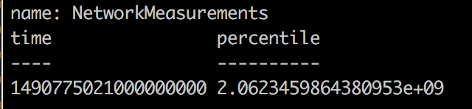
Querying InfluxDB
Subqueryies
select percentile("derivative",95) from (SELECT derivative(ifHCInOctets,1s)*8 from "NetworkMeasurements" where time > now() - 30d and agent_host = 'bor.master.surf.net' AND ifName = 'xe-6/1/0')
First get derivative and convert to bits/sec of last 30 days
Then
Get 95th percentile

Slide 21
Visualizing data

Slide 22
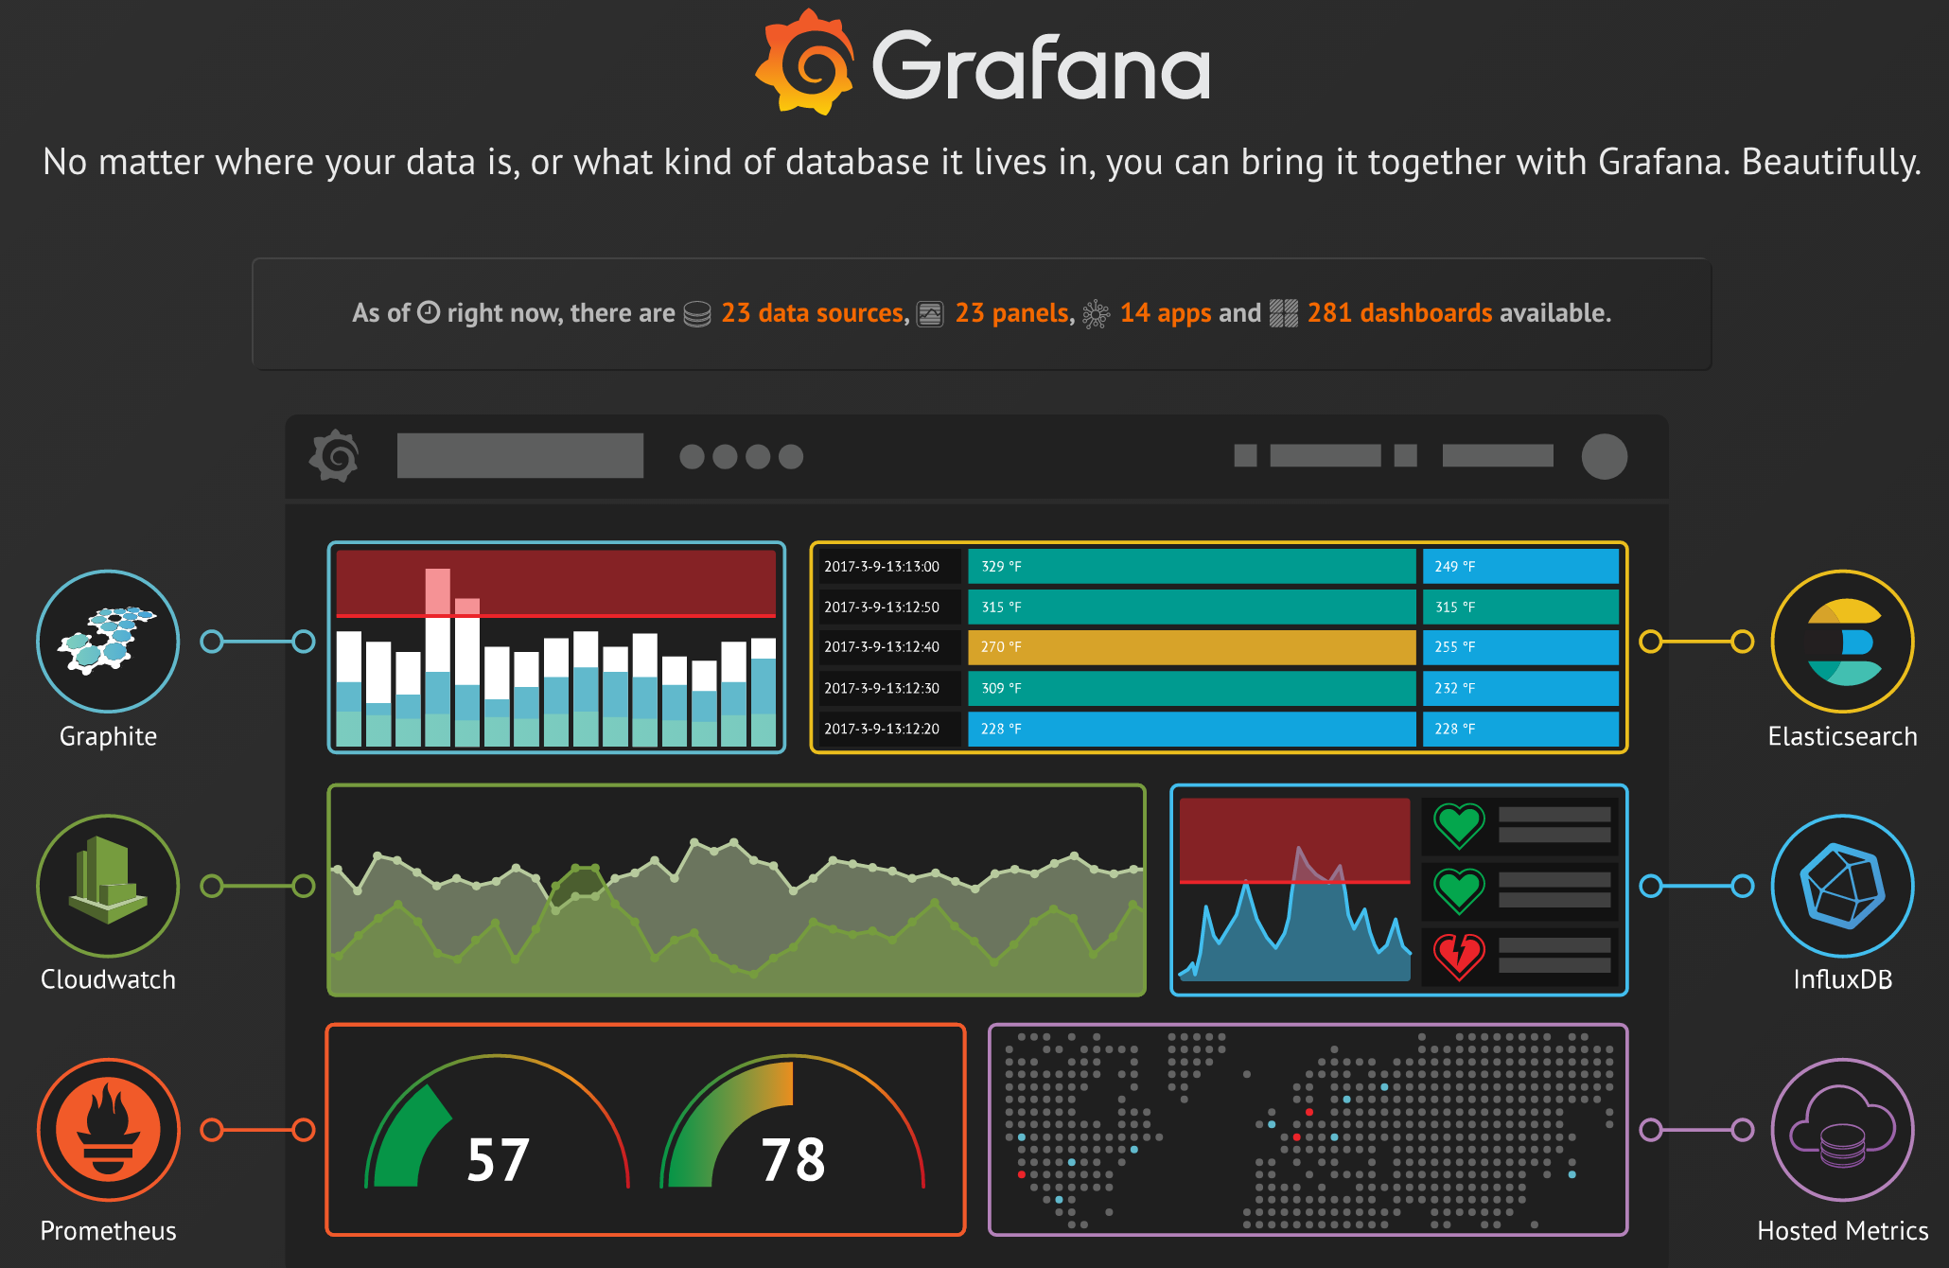
Grafana
Supports every major backend
Easy to use query builder
Plug-ins
Easily create (dynamic) dashboards
Correlate graphs from different backends
i.e. Create graphs and anotate them with log events from elasticsearch

Slide 23
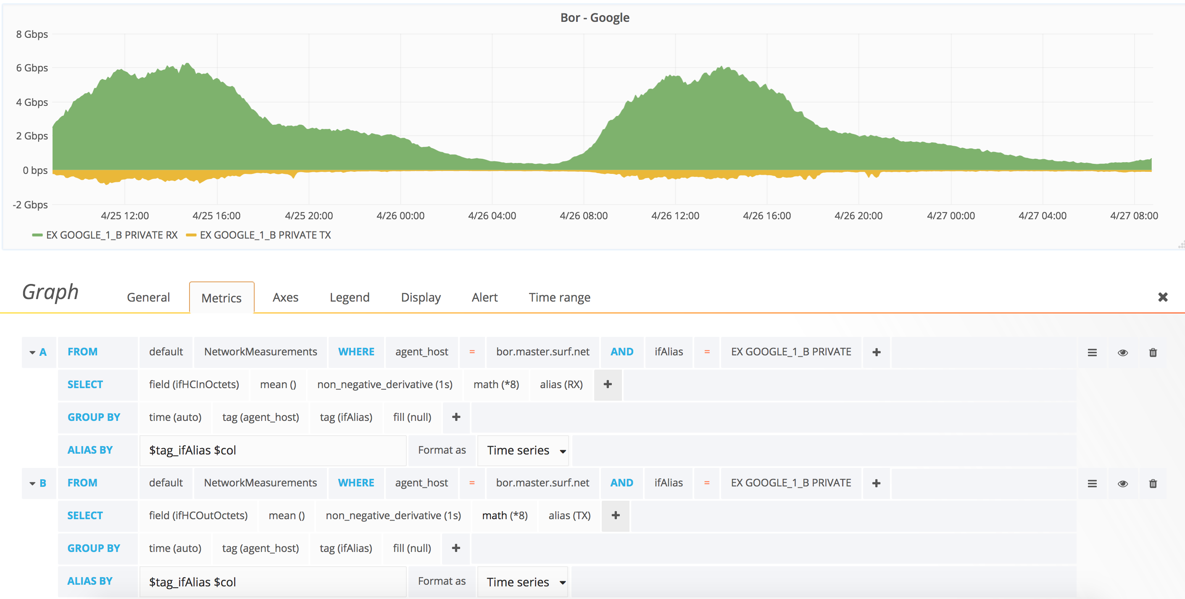
Grafana

Slide 24
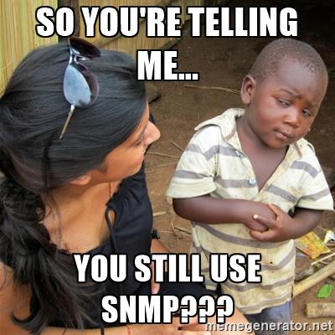
But…….SNMP???

Slide 25
But…….SNMP???
Inefficiënt design
  Polling based
  Creates high load in NE’s
  Slow
  Scaling issues
CLI
  Unstructured
  Subject to chanes
Syslog
  Unstructured

Slide 26

Behold….Streaming Telemetry
Focus on statistics
Monitoring system just listens (push model)
Structured
Efficient
Resolution
Periodic delivery
Not just traffics statistics (unlike sFlow)
  Interface up/down
  BGP
  LSP
  Topology
  QoS
  ACL stats
  System health (CPU/memory)

Slide 27
Streaming telemetry setup
Router config
  Define what needs to be sent (ie traffic and routing stats)
  Define to witch collector
Fluentd
  Accepts data
  Translates it
  Sends it to InfluxDB
InfluxDB
  Stores meterics

Slide 28
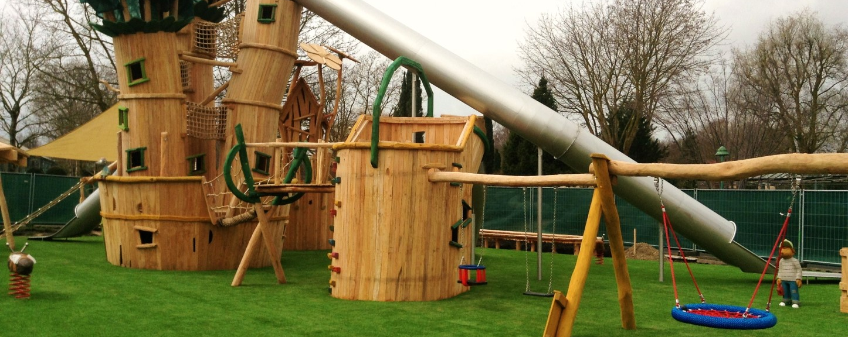
Demo time

Slide 29
Max Mudde
max.mudde@surfnet.nl

