Slide 1
6th SIG-ISM Workshop
February 2018, Madrid

Slide 2
Agenda February 12th
12.30 – 13.30 | Arrival, light lunch
13.30 – 14.00 | Welcome, introductions and update in other related activities (Alf)
14.00 – 14.30 | Updates on regional collaborations (Cynthia, Rolf, James, Roderick)
14.30 – 15.30 | GEANT GN4-3 Security white paper (Alf & Sigita)
15.00 – 15.30 | Break
15.30 – 17.00 | Community presentations: Cybersave yourself – Albert hankel SANFREN Sybersecurity challenge – Roderick SURFaudit Benchmark 2017 (Bart) CLAW exercise 2017 & 2018 (Charlie)
17.00 – 17.15 | Closing remarks (Alf)
20./30 | Group Dinner at El Anciano Rey de los Vinos

Slide 3
International Security Activities
WISE
Workshop in Abingdon, Feb. 26 – 28
Global NREN security group
Crisis exercise
Security baseline
DDOS mitigation
TF-CSIRT
CSIRT/FIRST meeting
FIRST Academic Security SIG

Slide 4
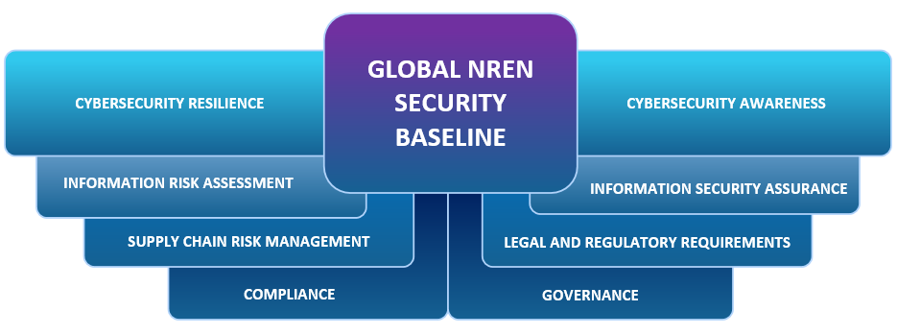

Slide 5
2nd Crisis exercise Global NREN security group
Participants:
RNP, Esnet, Internet2, Canary, Jisc, GÉANT, Nordunet, DFN, SURFnet, SANREN, AARNet, REANNZ
Purpose:
get a good representation in a VC within 1 hour to discuss and coordinate a global crisis
Method:
pre-announce for exercise ‘window’, announce by e-mail, telephone follow-up, VC
Treath: Strong suspicion on coming large scale, multi-vector DDOS attacks on scientific e-infrastructures by religious, right wing activists that think science is a treath for mankind
Timing:
VC at 12.00 (noon) CET, announce e-mail 1 hour before
Results:
Telephone contact with all,
within 15 minutes,
100% participation in VC
Conclusion:
++ VC is good for a ‘war’-room
-- Strong dependency on internet

Slide 6
Regional Collaborations
Benelux
Nordic
Uk-Ireland
Indian Ocean Rim Association

Slide 7
Géant Security whitepaper
Scope:
  GÉANT and NRENs
  Internal organisation of security, products and services, security for the constituents
Reach: 2018 - 2022, input for GN4-3 program 2019 – 2022
Status:
  Whitepaper input collected from communities and individuals
  Draft whitepaper reviewed by participants of communities and external NREN experts
  Draft whitepaper reviewed by GÉANT GPPC
  Whitepaper distributed to NRENs for ‘scoring’

Slide 8
GÉANT Whitepaper: 6 subjects areas
Security Baselining For Products, Services And Organisations
Managed SecurityProducts and Services
Legal and Privacy Compliance
Management of Risks
Training and Awareness
Incident Response, Business Continuity and Crisis Management

Slide 9
GÉANT Whitepaper: 12 Subject Proposals
Annex 1: Baselining for Products and Services and Organisations
Annex 2: Firewall on Demand
Annex 3: Centralised DDoS mitigation
Annex 4: SOC operations and tools
Annex 5: Vulnerability Assessment "as-a-service"
Annex 6: EduVPN
Annex 7: Other security products and services
Annex 8: Legal and Privacy Compliance
Annex 9: Management of Risks
Annex 10: Training
Annex 11: Awareness
Annex 12: Incident Response, Business Continuity and Crisis Management

Slide 10
Agenda February 12th
12.30 – 13.30 | Arrival, light lunch
13.30 – 14.00 | Welcome, introductions and update in other related activities (Alf)
14.00 – 14.30 | Updates on regional collaborations (Cynthia, Rolf, James, Roderick)
14.30 – 15.30 | GEANT GN4-3 Security white paper (Alf & Sigita)
15.00 – 15.30 | Break
15.30 – 17.00 | Community presentations: Cybersave yourself – Albert hankel SANFREN Sybersecurity challenge – Roderick SURFaudit Benchmark 2017 (Bart) CLAW exercise 2017 & 2018 (Charlie)
17.00 – 17.15 | Closing remarks (Alf)
20./30 | Group Dinner at El Anciano Rey de los Vinos

Slide 11
Agenda February 13th
8.45 –9.00 | Arrival, Coffee and tea
9.0 – 10.30 | Workshop activity WG 1: Inventory for Security Officers WG 2: Guidance on setting up and running ISMS for NRENs
10.30 – 10.45 | Wrap up - short presentations on the work done
10.45 – 11.00 | Coffee Break
11.00 – 13.00 | SIG-ISM Value proposition(preparation for TNC18 sessions)
13.00 – 14.00 | Next meeting Wrap up, lunch, departures

