Slide 1

SURFaudit Benchmark 2017
RESULTS
Bart Bosma, product manager SURFaudit

Slide 2
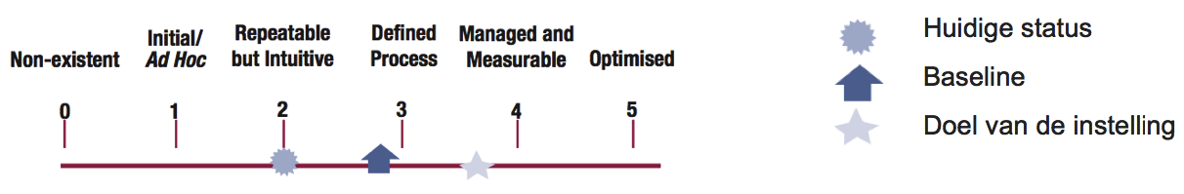
What is it?
Mapping information security state of SURFnet membership every two years.
Based on the results of a self-assessment against the SURF Information Security Standard (2015) for Higher Education.
  The SURF Information Security Standard is based on ISO 27002:2013 and the current Dutch Personal Data Protection Act (Guidelines published by NL DPA on 19/02/2013).
  Scoring uses CMM levels:
  For each level the required evidence is described in the accompanying SURF Information Security Assessment framework.
  Controls have been grouped in 6 clusters to reflect processes in educational and research organizations.
  Peer-review board to coordinate voluntary peer-reviews of the self-assessments.
Current status
Baseline
Goal

Slide 3
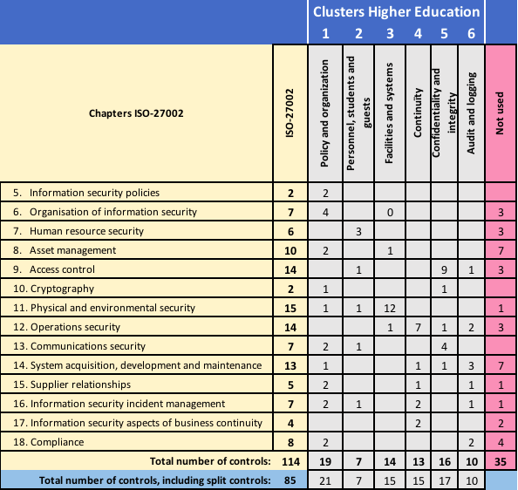
Clusters

Slide 4
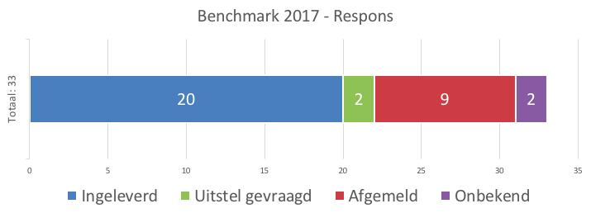
Registration and response
Period: 1 juni 2017 tot 1 december 2017.
Last registration came in on September 3rd.
Last response so far came in on Januari 26th 2018.
Registration total was 33 (64% WO + HBO, 30% of the entire membership),
Number of results submitted: 20 (60% of the number of registrants).
Benchmark 2017 - response
Submitted
Postponed
Canceled
Unknown

Slide 5
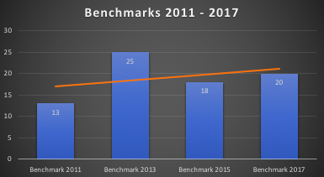
Participation since 2011
Since the first benchmark took place there a slight increase in the number of participants/submitters:
Participation:
2011: 13
2013: 25
2015: 18
2017: 20

Slide 6
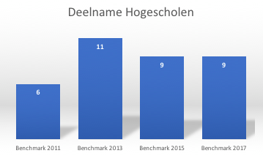
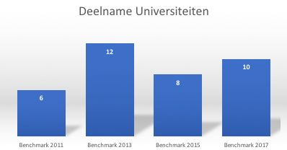
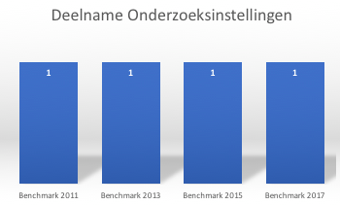
Participation since 2011
Per sector:
Universities of applied science
Universities
Research institutions
Only in 2013 one participant was not part of these three sectors.

Slide 7
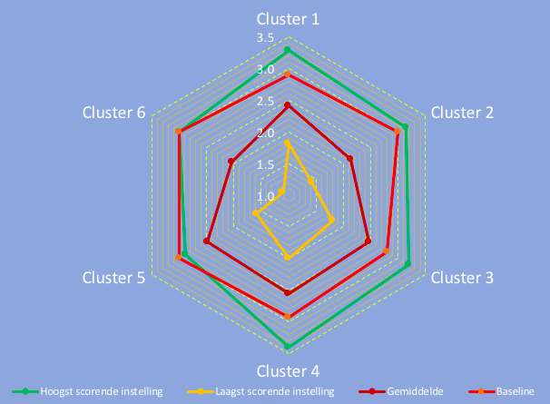
Results per cluster
Highest and lowest scoring organizations:

Slide 8
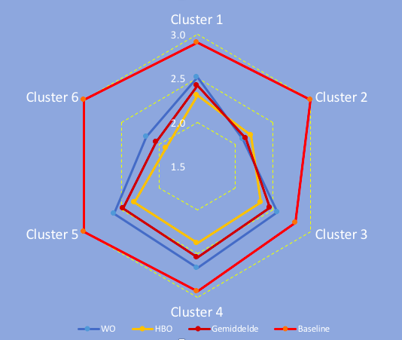
Results per cluster
One organization scores at or above the baseline,
As groups both universities and universities of applied science are well below the baseline,
Cluster 2 and 6 score most weakly.
Cluster 1 = Policy & organisation
Cluster 2 = Personnel, students & guests
Cluster 3 = Facilities & systems
Cluster 4 = Continuity
Cluster 5 = Confidentiality & integrity
Cluster 6 = Audit & logging

Slide 9

Cluster 2
Distribution of CMM levels:
Cluster 2 lowest scoring controls:
  2.2: Information security awareness, education and training (CMM 1,85)
  2.7: Screening (CMM 1,73)
Cluster 2 highest scoring controls:
  2.3: Removal or adjustment of access rights (CMM 2,35)
  2.6: Reporting information security weaknesses (CMM 2,37)
  More than 57% of this cluster’s controls score lower than in 2015.

Slide 10

Cluster 6
Distribution of CMM levels:
Cluster 6 lowest scoring controls:
  6.5: System security testing (CMM 1,73)
  6.8: Collection of evidence (CMM 1,75)
Cluster 6 highest scoring controls:
  6.4: Outsourced development (CMM 2,23)
  6.6: System acceptance testing (CMM 2,50)
  But 80% of this cluster’s controls score lower than in 2015

Slide 11




Clusters 1 & 3 – 5
Distribution of CMM levels:
Cluster 1:
Cluster 3:
Cluster 4:
Cluster 5:
Most institutions score at CMM level 2 & 3 for these clusters.
For clusters 2 & 6 most institutions score at CMM level 2 and many more at CMM level 1.

Slide 12
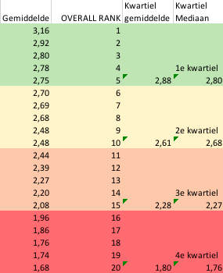
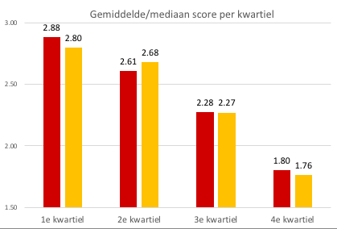
Results grouped by quartile
Average Overall Rank Average Median
(quartile) (quartile)
Average/median score per quartile

Slide 13
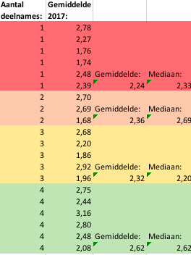
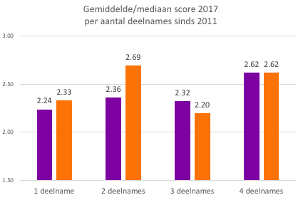
Results grouped by number of participations
Number of Average
participations 2017
Average Median
(per number of participations)
Average/median score 2017
per number of participations since 2011
once
twice
3 times
4 times

Slide 14
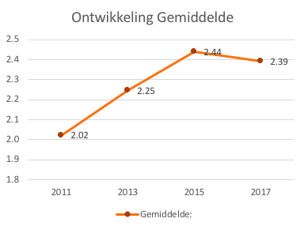
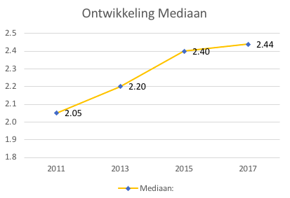
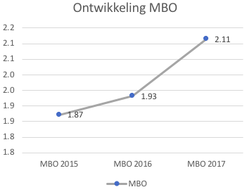
Trend 2011 – 2017
Since the first benchmark there has been progress (but it’s decreasing...):
Average – trend
Median – trend
Vocational – trend

Slide 15
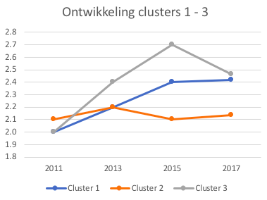
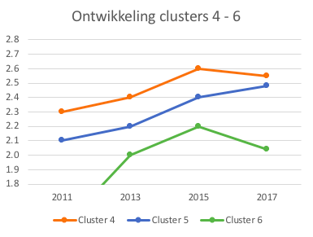
Trend 2011 – 2017
Trend per cluster; note that cluster 3 and 6 are getting worse:
Trend cluster 1 – 3
Trend cluster 4 – 6

Slide 16


Benchmark 2017 Vocational schools!!
3rd benchmark ibp!
Participation went from 19 (2015) via 30 (2016) to 47 (2017) out of 61 vocational schools, i.e. 77% in 2017.
Since 2015 self-assessment includes 24 privacy related controls.
Source: Ludo Cuijpers, Kennisnet

Slide 17
Vocational – trend
Source: Ludo Cuijpers, Kennisnet

Slide 18
Conclusion
Participation is slightly better than in 2015, but remains low (certainly compared to the benchmark of the vocational schools).
Scores have improved since 2015.
Cluster 1 & 3 – 5 scores have improved since 2015.
However, cluster 2 & 6 scores are lower than in 2015.
Participation of vocational schools is much better (77%).
In general results are similar, i.e. cluster 2 & 6 are the weakest
Overall scores are lower.
Both Higher Education & Reasearch and Vocational schools need to improve on awareness and audit/logging!

