Slide 1


Slide 2
IdP-a-a-S: goals and context
Develop a web platform to manage spawning of SAML Identity Provider for the benefit of Federations and FedOps ( Identity Federation operators)
  Define the corresponding business model
  Service provisioning model
  Value creation
  Costs and pricing
  Model for sustainability
Two platforms currently being endorsed
  Campus IdP platform GN4-2 JRA3 T1 https://campusidp.ct1.garrservices.it/
  SAMLIdP.io https://samlidp.io/

Slide 3
Overall role of sprint 2
Move from deployment of platforms to initial additional required developments according to the plan
Consolidate the Business Model development
  To be finalized in sprint 3 + input from f2f meeting with NRENs and Federations

Slide 4
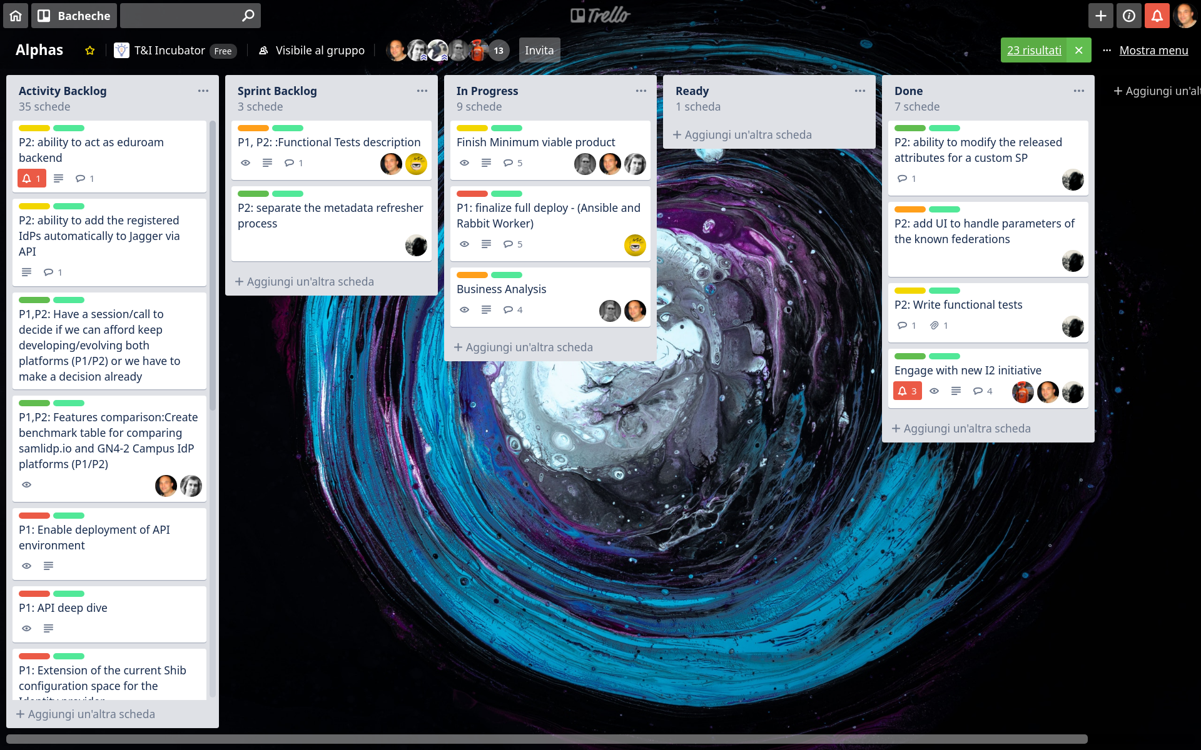

Slide 5
Sprint backlog for sprint 2:
Ongoing tasks:
  P1: finalize full deploy
  P2: Add ability to modify the released attribute set for a custom SP
  Finalize definition of MVP
  Business Analysis : discuss all aspects in the canvas
Not yet started in sprint 2:
  Functional test description for P1 platform
  P2: separate MD refresher process
Completed tasks:
  Write functional tests for P2

Slide 6
Definition of Done for Sprint 2
Finalized full automated deployment for both platforms
Functional tests description for both platforms available and implementation started
Complete the navigation of the business model Canvas
Finalized Minimal Viable Product description
P2: Separate the MD refresher process

Slide 7


Sprint 2 backlog
P1, P2: Functional test description
P1: finalize full deploy - Ansible and Rabbit Worker
Further structure Business Analysis taking into account all canvas features
Finalize the Minimal Viable Product (MVP) definition
Pending f2f discussion with NRENs at TNC2019
P2: prepare the MD refresher process

Slide 8
Business model development
Completed the analysis of all the features reported by the Business Model canvas
  Costs
  Offering
Decided to organize a f2f @ TNC 2019 with Federations to update general ideas around IdP-a-a-S business model gathered 3 years ago (2016)
  Started organization of f2f session
Just started writing document gathering outcome of canvas discussions

Slide 9
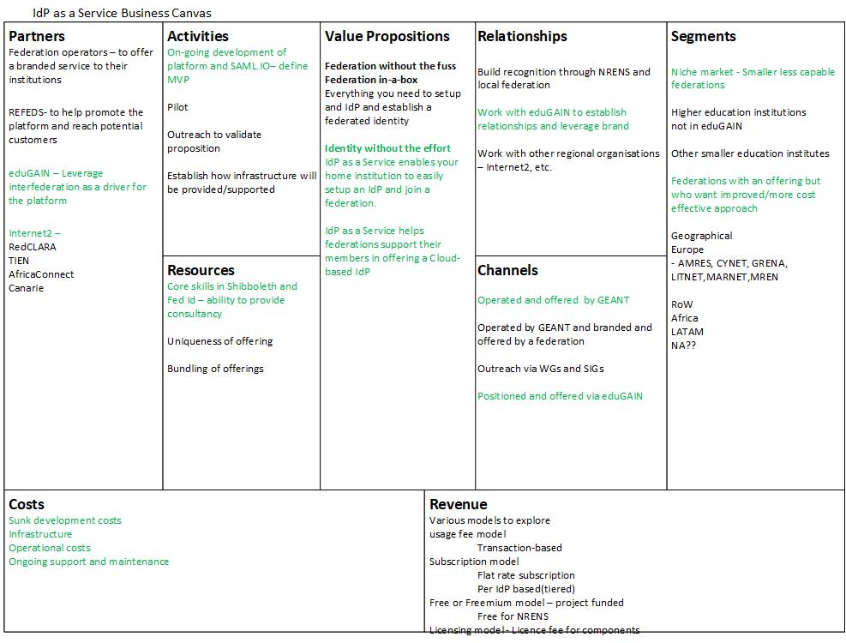

Slide 10
P1: Finalize full deploy
Focus on Worker component of Web Platform:
  Drop all hard coded references and GARR-related customizations
Missing final worker component deploy

Slide 11
P1: Adding additional functionality to the platform
Currently some IdP configuration bits are not accessible and some settings are pre-set (hard-coded) for GARR
  Need to correct for all hard-coded references to GARR
  Need to add additional configuration hooks in the config space for the Identity Provider
    Passwords to connect to LDAP and base DN to be able to connect to a pre-existing external LDAP server
See video on demo ( 3 min ) - Docker deploy
  https://www.dropbox.com/s/sd7xk4neah0fjbo/Demo-sprint-may-2019.mp4?dl=0

Slide 12
P2: Functional tests developed and described
Functional tests have been defined and developed for platform 2, according to plans.
See demo video.

Slide 13
DEMO IdP-a-a-S sprint 2 - Demo videos on current status of platforms
Current status of platform developments:
P1:
https://www.dropbox.com/s/sd7xk4neah0fjbo/Demo-sprint-may-2019.mp4?dl=0
P2:
samlidp.io : docker-compose.yaml current status:
https://trello-attachments.s3.amazonaws.com/5c9241d537127e5b7771bbd3/5cb0431285c59e5a15f10250/115d8360a18a99ef67912c44f1934486/incubator-samli-functional-tests-screencast.mp4

