Slide 1

Efforts by the Danish universities to mitigate targeted phishing campaigns
DKCERT – part of DeiC www.cert.dk / www.deic.dk
Henrik Larsen, Head of Security and Identity Services, DeiC
Email: henrik.larsen@cert.dk / henrik.larsen@deic.dk

Slide 2
DKCERT - Services
Incident Response
Information Service
Vulnerability Assessments
Netflow Data Analysis
Awareness Programmes (e.g. Phishing-as-a-Service)
GDPR Services
Overall Threat Assessment for the R&E Sector
Decentral Cyber and Information Security Unit for the Telcom Sector

Slide 3
Danish Universities hit by Massive Phishing Campaigns
CEO Fraud / BEC
Phishing for credentials
Mail accounts for spam, phishing
Cyber espionage, phishing for intellectual property

Slide 4
January/February 2015 to March 2018
Iranians targeting a large number of universities worldwide 2014-2016
Spear-phishing
Web sites advertising “interesting conferences” in the name of DK universities
FBI charged a number of named Iranian persons in 2018
“In Denmark, the cyber attack has targeted employees at specific Danish universities with specialties in particular economics, health, chemistry, physics, geology, environment and transport”
Center for Cyber Security, March 2018

Slide 5
May/June 2019 UCPH
7,500 employees targeted by malicious mail over several campaigns
Link leading to a false “UCPH” login site
Credentials for 500 users disclosed on website
Launched crisis management, more than 40 countermeasures, e.g.:
Blocked SMTP
Awareness/information campaign to all employees
Forced change of password for more than 17,000 faculty and staff
Multifactor Authentication on webmail
  – existing project rushed through

Slide 6
2019 Silent Librarian
Iranians once again active
One university especially targeted
Did analysis and shared IOCs
Suggested all Danish universities joining SIE Europe Project
Launched awareness campaigns and used phishing tests from DKCERT to measure

Slide 7
Countermeasures

Slide 8
Protecting Mail Domains
SPF, DKIM, DMARC
DTU example – 500 to 1,000 a day for a week or more
MFA on mail accounts

Slide 9
Raising awareness
Universities are doing their own awareness programmes
Awareness film funded by DKCERT (2014)
“Phishing-as-a-service” (2018)

Slide 10
“Phishing-as-a-Service”
Testing the level of awareness with a simulated phishing attack
DKCERT service using an isolated environment and open source tools
Campaigns developed in close cooperation with the receiving institution
So far a couple of campaigns, targeting faculty and staff
Ongoing campaign: c. 35,000 faculty, staff and students at one mid-size Danish university

Slide 11
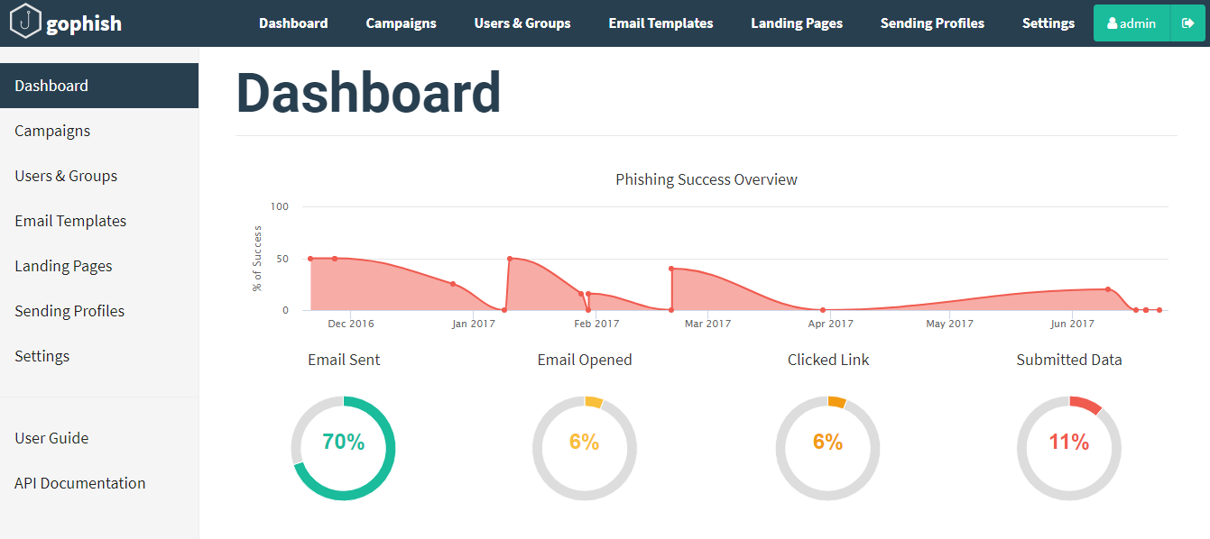

Slide 12
Threat Intelligence
Sharing IOCs among the universities
DKCERT collecting intelligence from the Danish Center for Cyber Security and from other CERT/CSIRTs
DKCERT Threat assessment for the R&E sector August 2019
SIE Europe Project

Slide 13
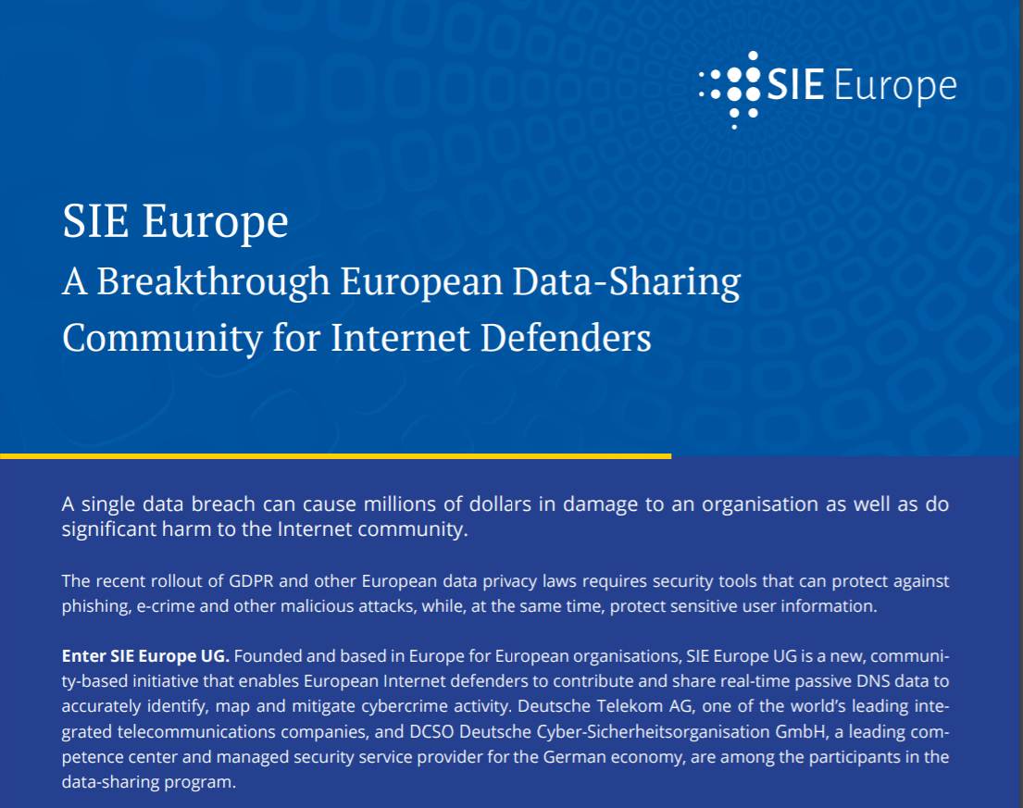

Slide 14
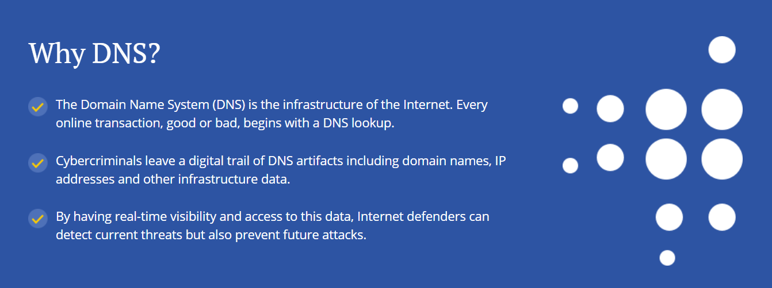

Slide 15
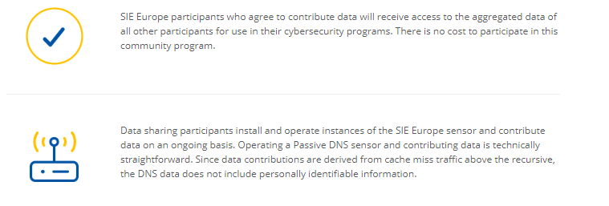
How it works

Slide 16
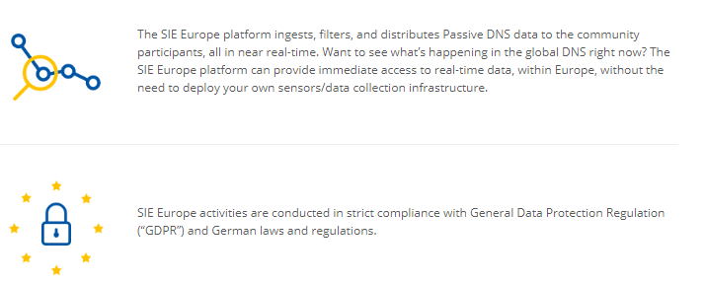
How it works

Slide 17
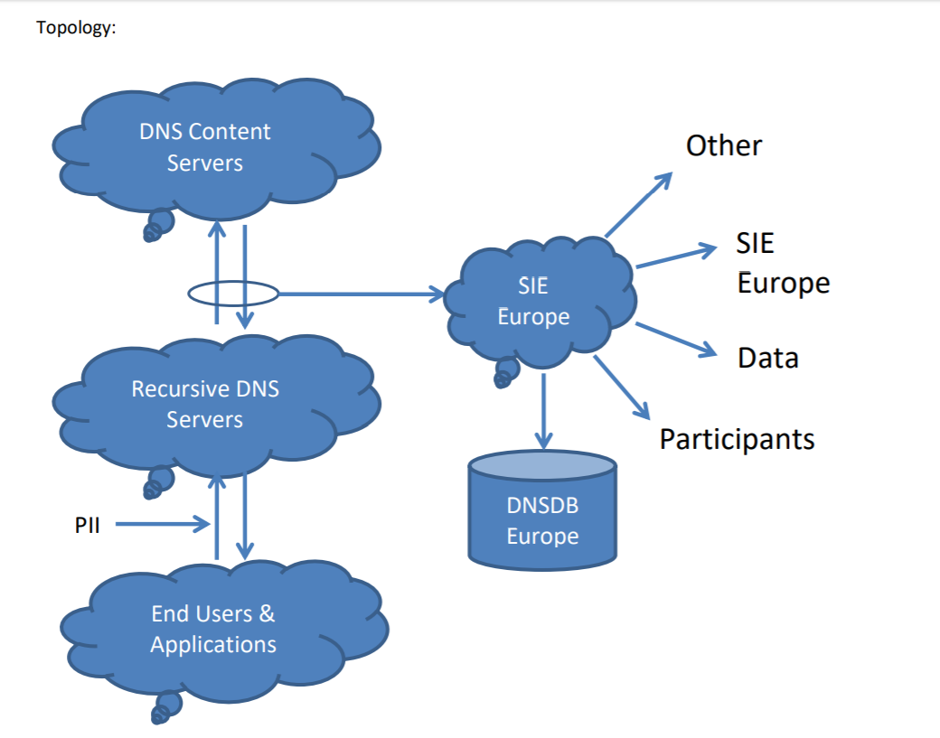

Slide 18
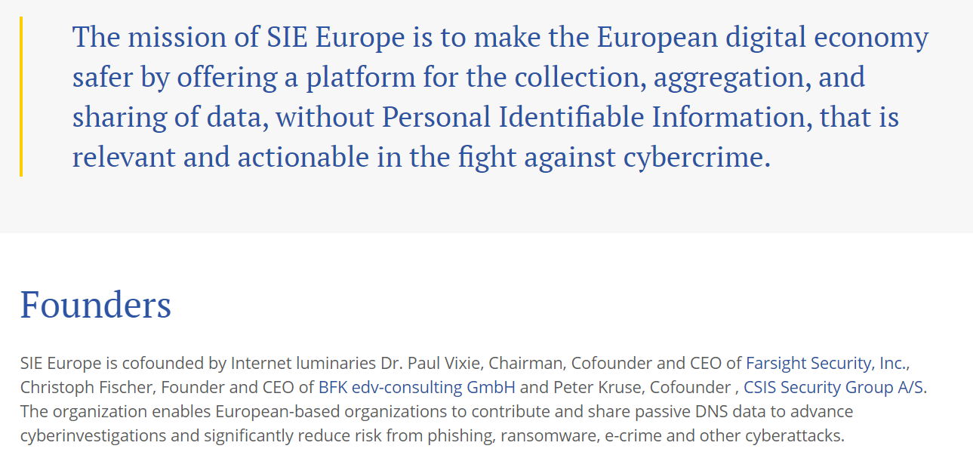
Threath Intelligence
https://www.sie-europe.net/

Slide 19
Links
Awareness film (in Danish with English subtitles)
https://www.cert.dk/en/video/en
SIE Europe
https://www.sie-europe.net/
https://www.helpnetsecurity.com/2018/10/02/sie-europe/
https://www.newscybersecurity.com/2018/10/internet-luminaries-launch-sie-europe.html

Slide 20
?
Henrik Larsen
+45 9351 1100
henrik.larsen@cert.dk / henrik.larsen@deic.dk
www.cert.dk / www.deic.dk

