Slide 1
Governance of information security in the HE-sector in Norway
Rolf Sture Normann
UNIT – The Norwegian Directorate for ICT and Joint Services for Higher Education and Research

Slide 2



UNIT – The Norwegian Directorate for ICT and Joint Services for Higher Education and Research
Key figures
200 staff
2 locations
45 services
220 institutions
€50 mill budget

Slide 3

Notes:
New strategy for digitalization of higher education.
Unit is responsible to fulfill this strategy at the sectorlevel
Joint ICT projects and initiatives
Education, research, administration, infrastructure, architecture and information security and privacy

Slide 4
Digitalisation strategy and information security
«Extensive use of data and technology poses challenges related to information security»
«Sharing data presents researchers with new challenges related to data security and proper handling of data»
«The student must be made aware of ethical, legal and security issues»
«Management must safeguard the institution's values and interests, and follow national guidelines through systematic efforts to strengthen information security.»
«Comprehensive governance and management of information security is a foundation for digitalisation and strategic initiatives, and supports on the sector objectives.»
«The ministry will continue to make clear demands on the institutions with regard to information security»
«The ministry will strengthen the governance of information security»
Notes:
Digitaliseringsstrategien tar inn over seg at en vellykket digitalisering er avhengig av god informasjonssikkerhet og et godt personvern
KD vil stille tydelige krav til institusjonene på dette området
Styrke styringen av informasjonssikkerhet og personvern – dette er linken til å begynne å snakke om den nye styringsmodellen

Slide 5
The ministry will strengthen the governance of information security
The ministry decided in the summer of 2018 to base the sector governance of information security on the international standard ISO27014: 2013
  Every institutions shall implement ISMS built on ISO27001
The purpose is for The Ministry to have an overview of the state of the sector in the area of information security and privacy
Want to know if the condition involves a risk of failure to achieve goal, or unacceptable security incidents
Make priorities and decisions based on a state overview and risk assessments
The Ministry gave Unit the responsibility to implement the new framework
Notes:
KD har lenge erkjent at man burde hatt et tydelig rammeverk for sektorstyringen av IS og POV
Det har pågått et arbeide i regi av KD som har gjennomgått ISO27014, som i utgangspunktet er laget for en organisasjon om denne kunne benyttes også i styringen av informasjonssikkerhet sett i fra et eierdepartement mot en sektor.
Standarden har vært drøftet med Unit, og ble formelt vedtatt sommeren 2018
KD ønsker med denne å ha oversikt over tilstanden til sektoren på området. Basert på en tilstandsvurdering og evaluering av denne sett opp imot sektormålene. Vite hvilken risiko sektoren løper for at sektormålene ikke nåes.
Dersom KD vurderer denne risikoen som høy nok, vil de kunne gjøre beslutninger og prioriteringer

Slide 6
New national governance model – gains for the HEIs
More clear direction for HEIs work with information security in their systems and services through a sub-strategy for information security and privacy.
Planned implementation of the sub-strategy through an action-plan.
Closer dialogue and follow-up between the HEIs and the Ministry (Unit).
Better and more accurate priorities made by the Ministry.
Notes:
The governance model is being implemented in the HE-sector during 2019. The immediate gains for the institutions are:
- More clear direction for HEIs work with information security in their systems and services. The Ministry and UNIT work on new sub-strategy for information security and privacy with clear objectives for the sector and the HEIs
- Planned implementation of the sub-strategy. The Ministry and UNIT will publish an action plan that implements the sub-strategy and a general policy that provides guidelines and communicates requirements.
- Closer dialogue and follow-up between the HEIs and the Ministry. UNIT is currently mapping the status for information security at the institutional level in order to provide a national report as well as risk assessment on the sector level. The dialogue and follow-up takes place during the first part of the 2019 by means of series of face-to-face meetings between UNIT and leadership of each HEI in Norway.
- Better and more accurate priorities made by the Ministry. Based on the risk assessment conducted on the national level by UNIT, the Ministry will be able to adjust necessary actions and earmark funding for the relevant areas.
- Customized advice and guidance for the HE-sector. The national governance model will make it easier to perceive the challenges in the Norwegian HE-sector in the overall perspective and make it possible to write sector-specific guidelines and tools.

Slide 7
Governance framework
Based on ISO/IEC 27014:2013
Notes:
I am going to talk a litle about the 27014 standard. Purpose for the ministry and gains for the institutions. I will a short explanation on the different processes in the standard. Then i will say som words about our implementation. At the end i will show som of the result of the surveys

Slide 8

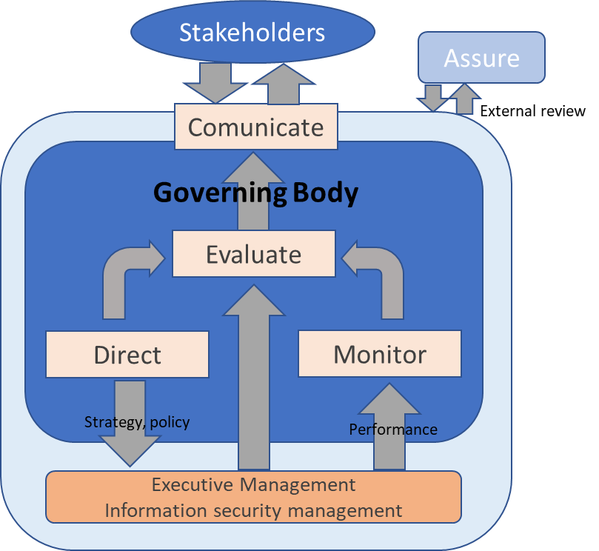

Ministry want to know the state overview and risk
The ministry:
Direction and demands
State overview/risk
Evaluate the state and make corrective actions
Comunicate
Responsible for governance activities
in the HE-sector
Eget lokalt arbeid på
informasjonssikkerhet og personvern
Virksomhet n…
Local management of information security
ISO 27001
Institusjon n…
Other organisation under the Ministry
Universities and university collages
Notes:
This is how we can see the sectorlevel of the governance. The ministry as a owner want to govern the sector, and has given Unit the responsibility for the governance activities. The ministry want to know the state of the work with information security and privacy, and know the risk for not meet the business goals. Unit will perform reviews of every institution and make a report to the ministry. The ministry will use this information to make prioritized descisions.

Slide 9
The framework
Based on ISO/IEC 27014:2013 – Govenance of information security
  Consepts with goals and targets for governing information security and privacy
  6 principles
  5 processes
  Compatibel with other governance frameworks (IT management, risk management, financial management etc.)
  Designed for the business level, but now adjusted and used by the ministry and Unit at the sector level
  Represents the level over the ISO/IEC 27001, management of information security
Notes:
Have been adjusted to the HE-sector level
6 principles
Implement the whole organisation
Risk based approach
Directions of investment decisions
Conformance with internal and external requirements
Foster a security-positive environment
Review performance in relation to business outcomes

Slide 10
Governance framework (ISO27014:2013)
Stakeholders
Assure
Comunicate
External review
Governing Body
Evaluate
Direct
Monitor
Strategy, policy
Performance
Executive Management
Information security management
Notes:
Styre → Tydelig retning og krav → Monitorere tilstanden → Evaluere grad av måloppnåelse og risiko → Kommunisere til intressenter

Slide 11
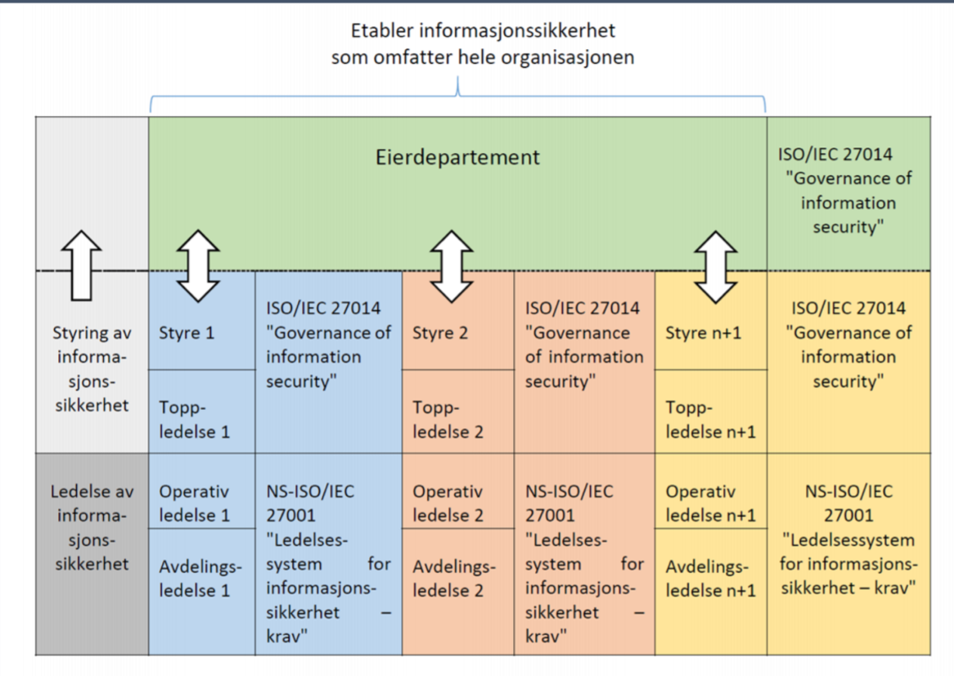
ISO27014 vs ISO27001

Slide 12
Evaluate
This is the process that consider the current and forecast achievement of security objectives based on current processes and planned changes, and determines where any adjustments are required.
Ensure that the sector initiatives take into account information security issues
Respond to information security performance results, prioritize and initiate required actions
Ensure that information security supports and sustain the sector objectives
Submit new projects with impact to governing body.
Notes:
Evaluate is the process that evaluates the result in the process monitor against the business goals and risk for not acheive them

Slide 13
Direct
This is the process by which the governing body gives direction about information security objectives and strategy that need to be implemented.
The level of resources
Prioritation of needed activities
Strategies
Policies and action plans
Define risk acceptance
Risk management plans
Notes:
Direct is the process that gives directions to the institutions

Slide 14
Monitor
This is the process that gives answere on how the state are and enables the governing body to assess the achievement of strategic objectives.
Assess the effectiveness of information security management activities
Assess conformance with internal and external requirements
Understand the risk
Notes:
Monitor is the prosess that is needed to adopt an understanding of the state of the institutions when it comes to the work with information security and privacy

Slide 15
Communicate
This is the process by wich the governing body and stakeholders exchange information about information security
Report to external stakeholders about the level of information security
(Notify the executive management of the results of external reviews)
Recognize regulatory obligations, stakeholders expectations and business needs
..
Notes:
Communicate is the process wich communicate to the stakeholders and the people.

Slide 16
Assure
This is the process by wich the governing body make assurance that the framework/standard is working as intended
External rewievs
Notes:
Communicate is the process wich communicate to the stakeholders and the people.

Slide 17
Implementation in 2019
Unit and the ministry adjust the standard to fit the HE-sector
A letter to the institutions from our Minister of Education
Developed a procedure for the process «monitor» and «evaluate»
Survey interview with 21 universities and university collages under the ministry
  24 questions regarding information security and privacy (GDPR)
Survey interview with the other organisations under the ministry
  13 questions regarding information security and privacy (GDPR)
Risk and evaluation report of the state of information security and privacy delivered to the Ministry
Open Risk and evaluation report
Develop a strategy and action plan based on the findings
Develop a sectorwide information security policy
Notes:
The framework was adjusted to meet our sector and to make it work as a governmentmodell for a sector
Formally a letter stated that the ministry was impementing this framework, and gives Unit the responsibility for running the governance activities.

Slide 18
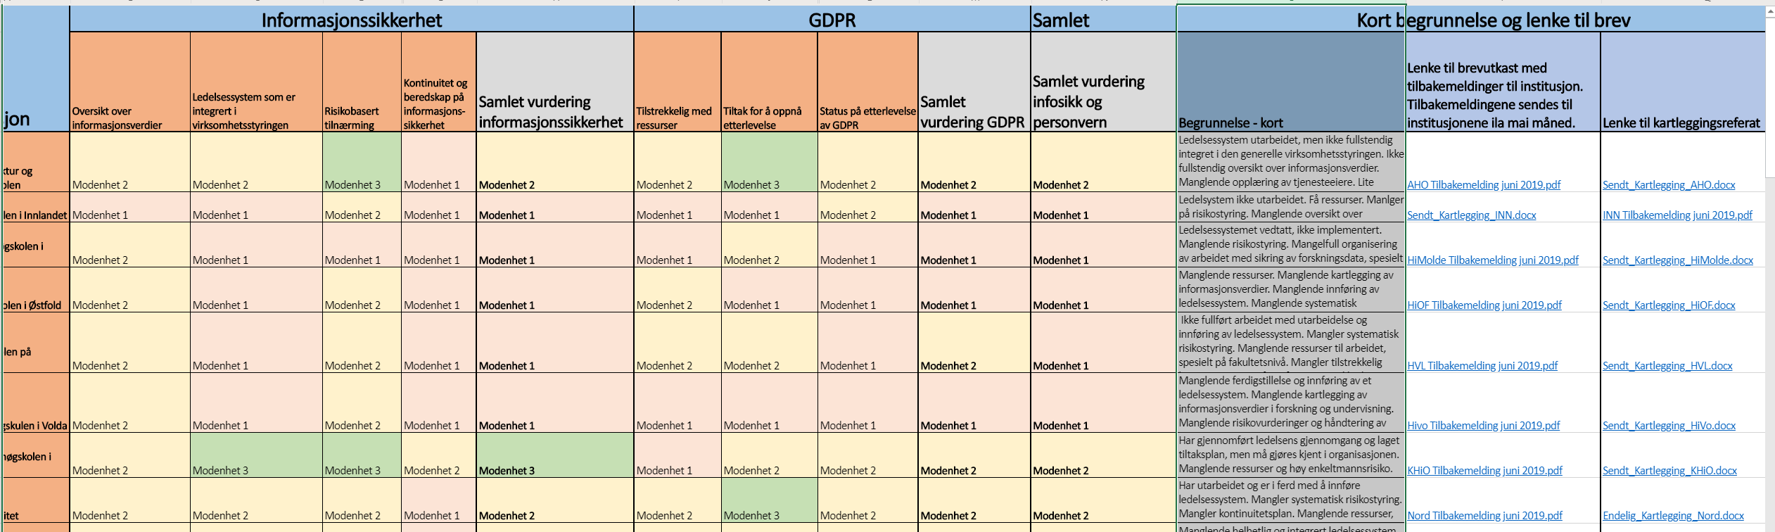
Assessment of each institution

Slide 19
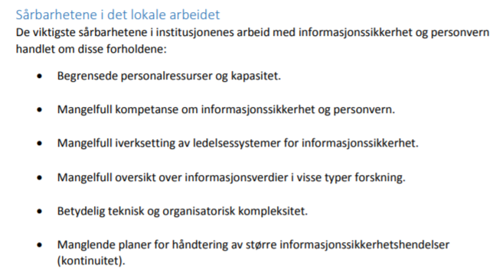
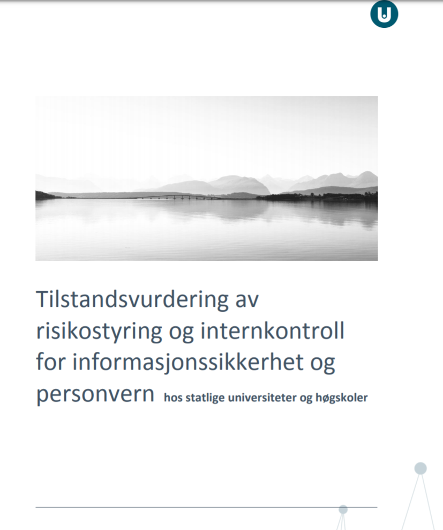
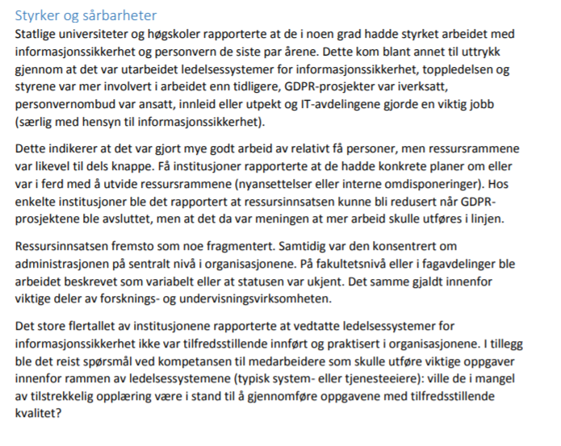
Risk assessment sector-level

Slide 20
Some findings…

Slide 21
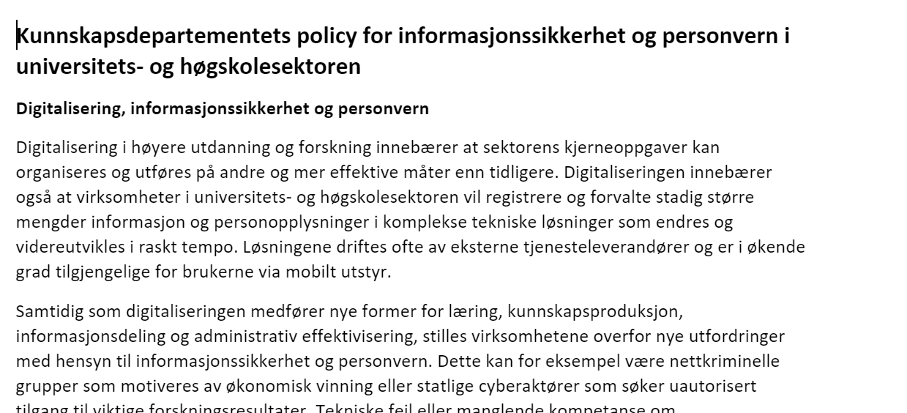
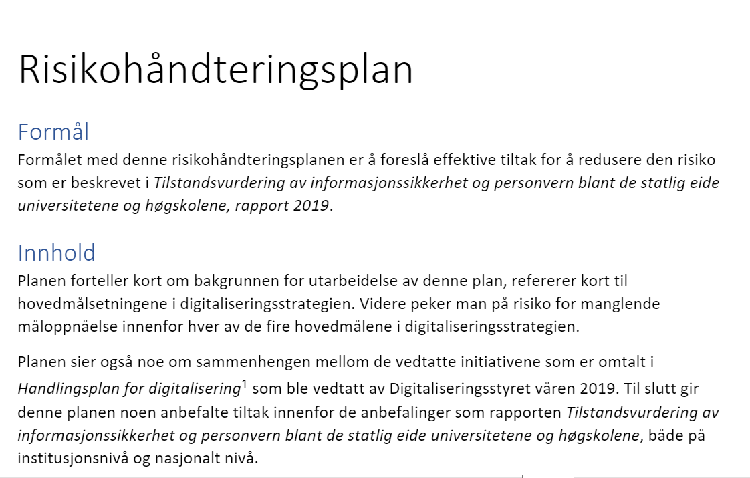
Under «construction»
Policy for IS
Risk treatment plan

