Slide 1
WLCG SLATE Security WG
WISE Meeting
October 15, 2019
Romain Wartel, Rob Gardner

Slide 2



WLCG Security model
WLCG security model is a key success of WLCG
Foundation of the trust between MoU signatories
The security model directly impacts the ability of WLCG participants to collaborate
Crucial that all participants support and are satisfied with the trust model
Established model:
  WLCG sites are in full control over their computing resources
  WLCG sites are responsible for their own operational security (incident response, etc.)
    EGI or OSG security team always available to help
They are however grey areas
  Pilot jobs, VMS, containers
  Operational security roles and responsibilities gradually shift towards the VO
  VOs have/need to develop operational security capabilities and fulfil adequate roles

Slide 3
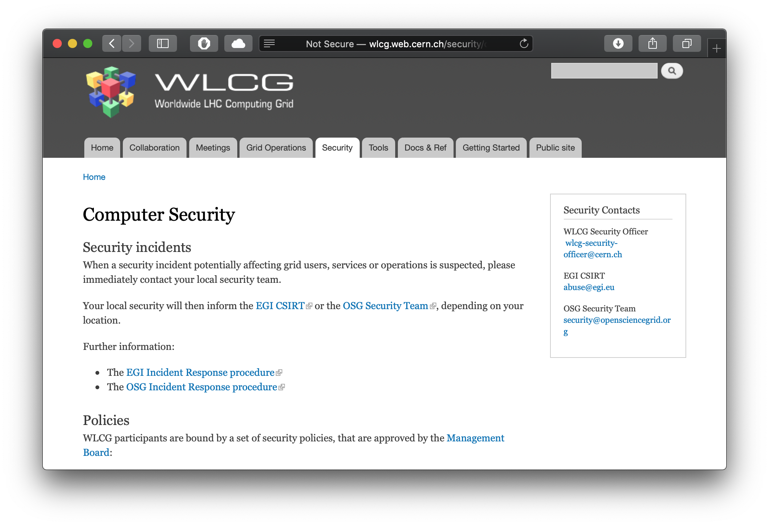
WLCG Security policies

Slide 4
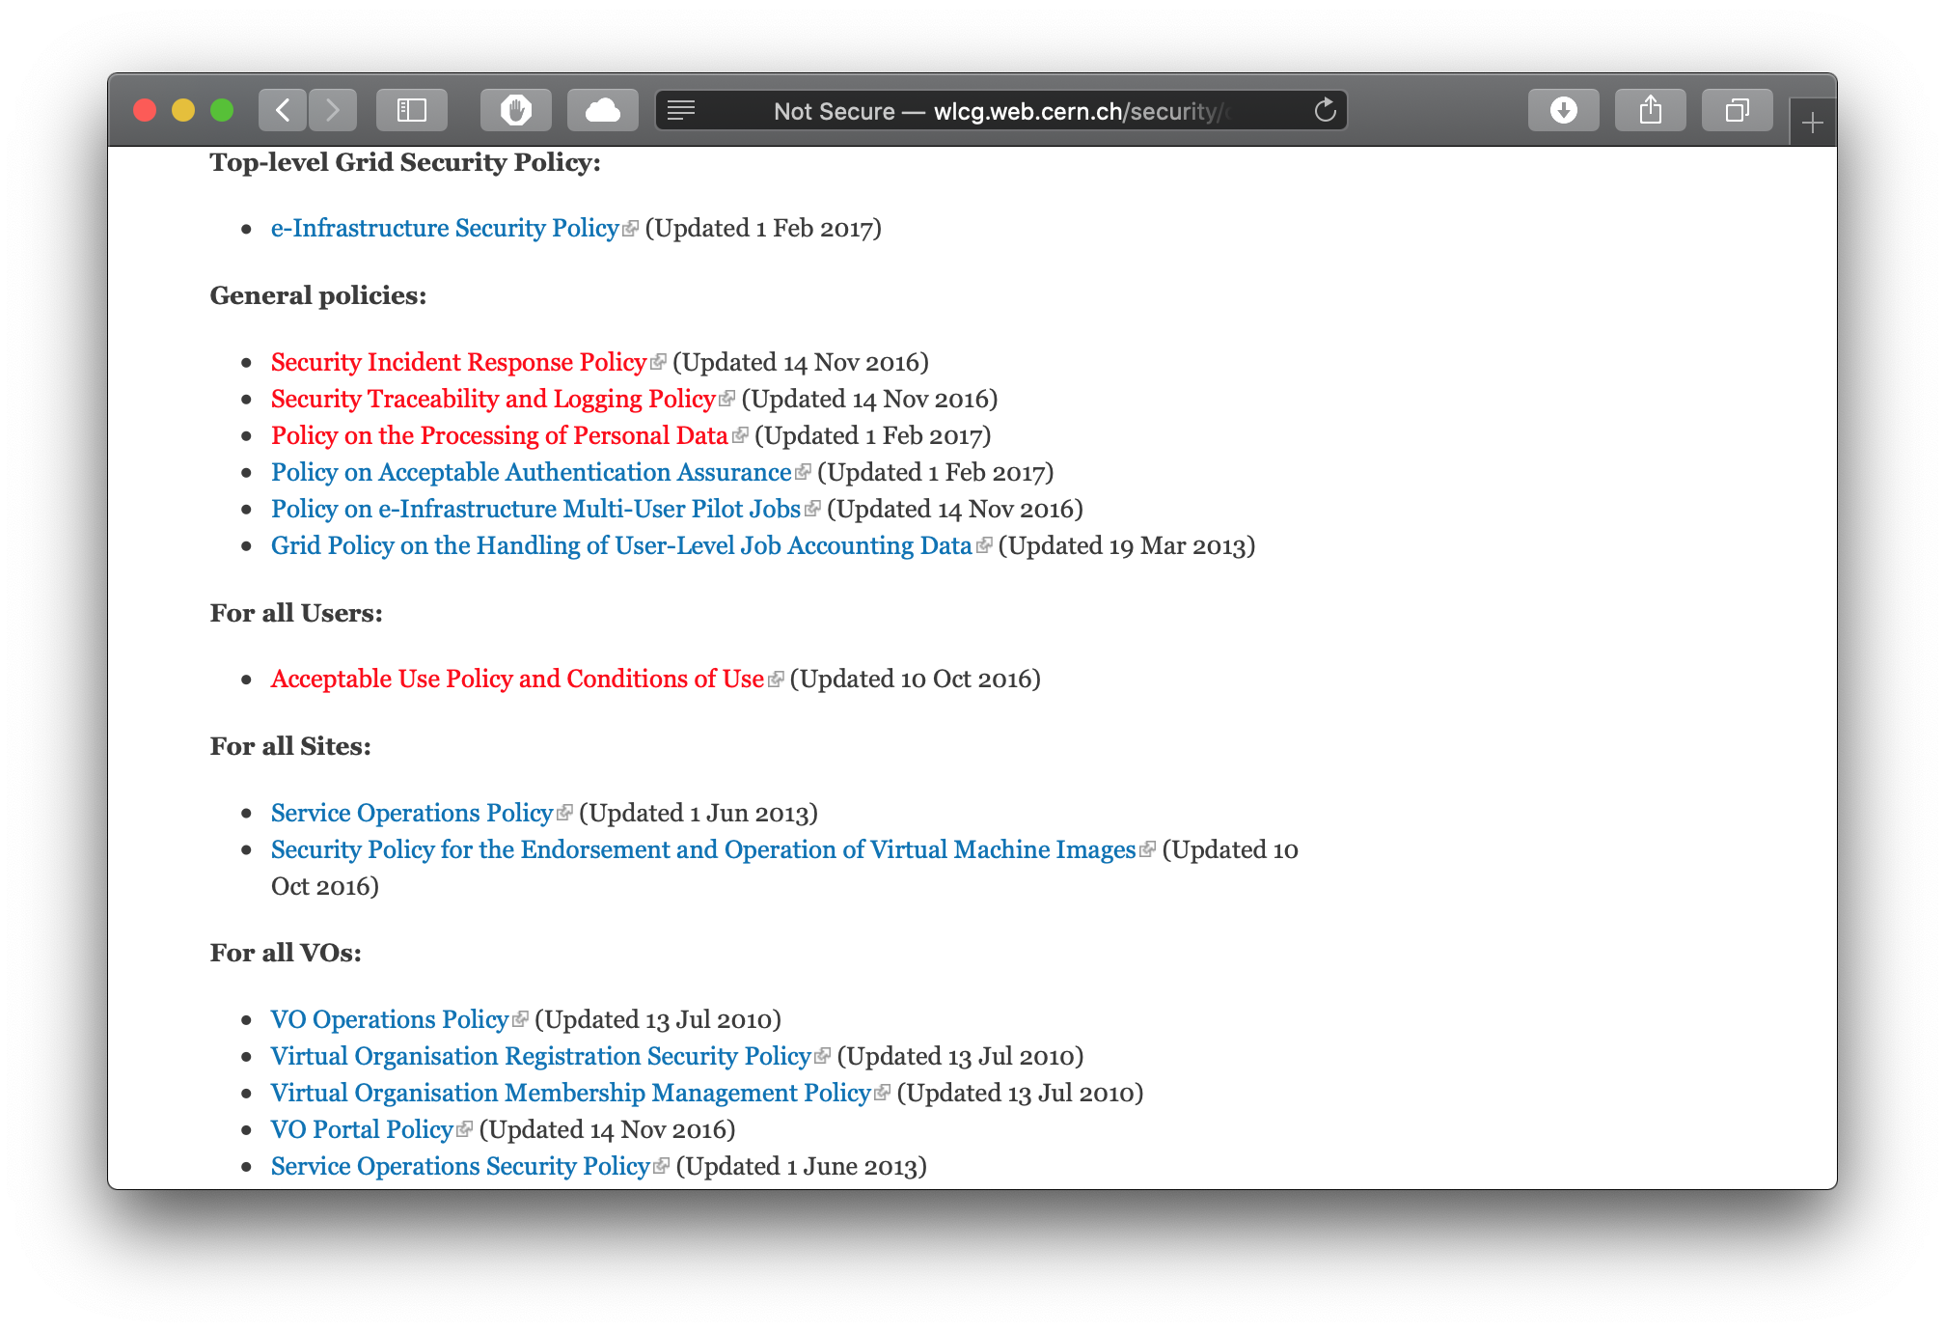
WLCG Security policies

Slide 5
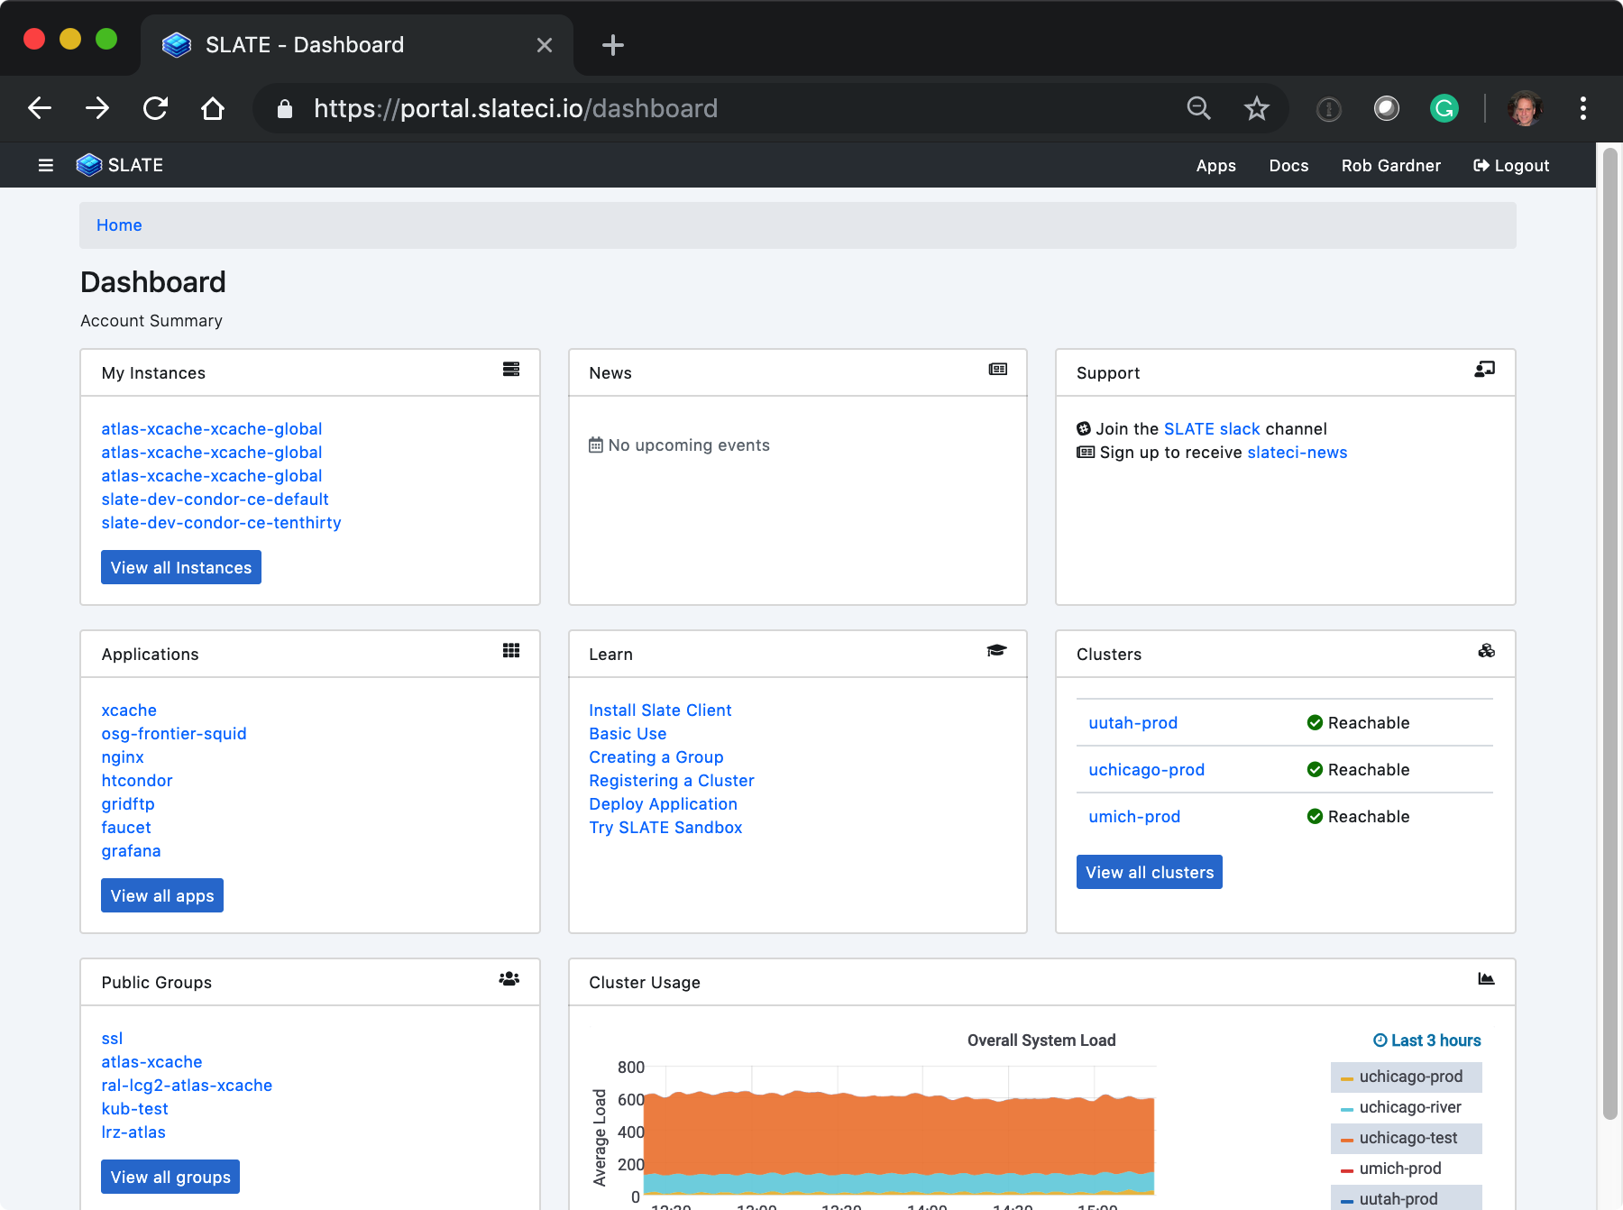
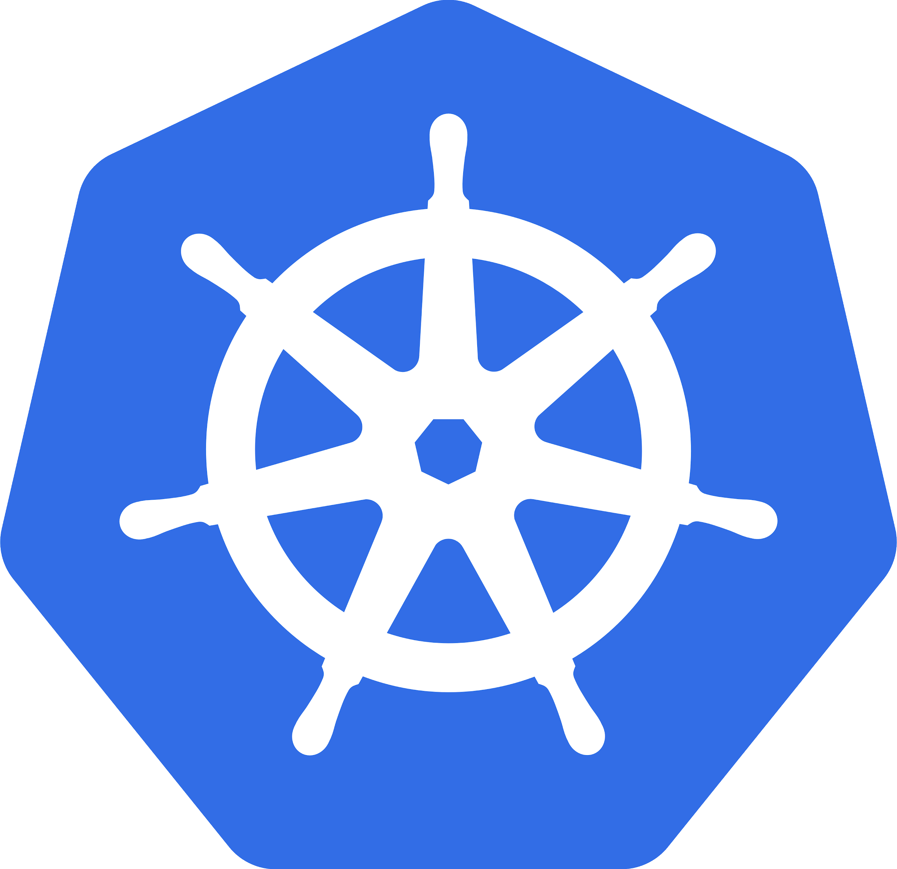
Federated Ops with SLATE
Remotely manage edge services at sites by expert teams from trusted organizations will full visibility/traceability/audit
Deploy updates more quickly & introduce new services more easily
Save time and effort for local site admins
Allow option for local ops if required
Sites always retain full control on what & who & when
Edge federation via lightweight server/client overlay using
Kubernetes, the industry leading container orchestration platform
Software catalog, with push button or CLI deploy using vetted Helm charts
$ slate instance list
$ slate instance delete <instance name>
$ slate app install --group atlas-xcache --cluster uchicago-prod --conf MWT2.yaml xcache

Slide 6
Eg. Operating a network of caching servers for ATLAS
US ATLAS Computing Facility has a pilot to centrally operated Frontier Squid (easy, low impact edge service)
OSG announced a vulnerability in Frontier Squid on July 26
SLATE instances were all updated within the hour:
for i in $(slate instance list | grep squid | awk '{print $4}'); do
slate instance restart $i
done

Slide 7
SLATE — WLCG Security
WLCG Security policies describes:
  Minimal security requirements
  Related roles and responsibilities
SLATE and NoOps models involve additional shifts in roles and responsibilities
  Can we continue to fulfil the requirements from the WLCG Security policies?
  By whom and how will the different roles and responsibilities be implemented?

