Slide 1
SCCC-JWG
Sigita Jurkynaitė (GÉANT)
NSF Cybersecurity Summit, San Diego, 15 October 2019

Slide 2
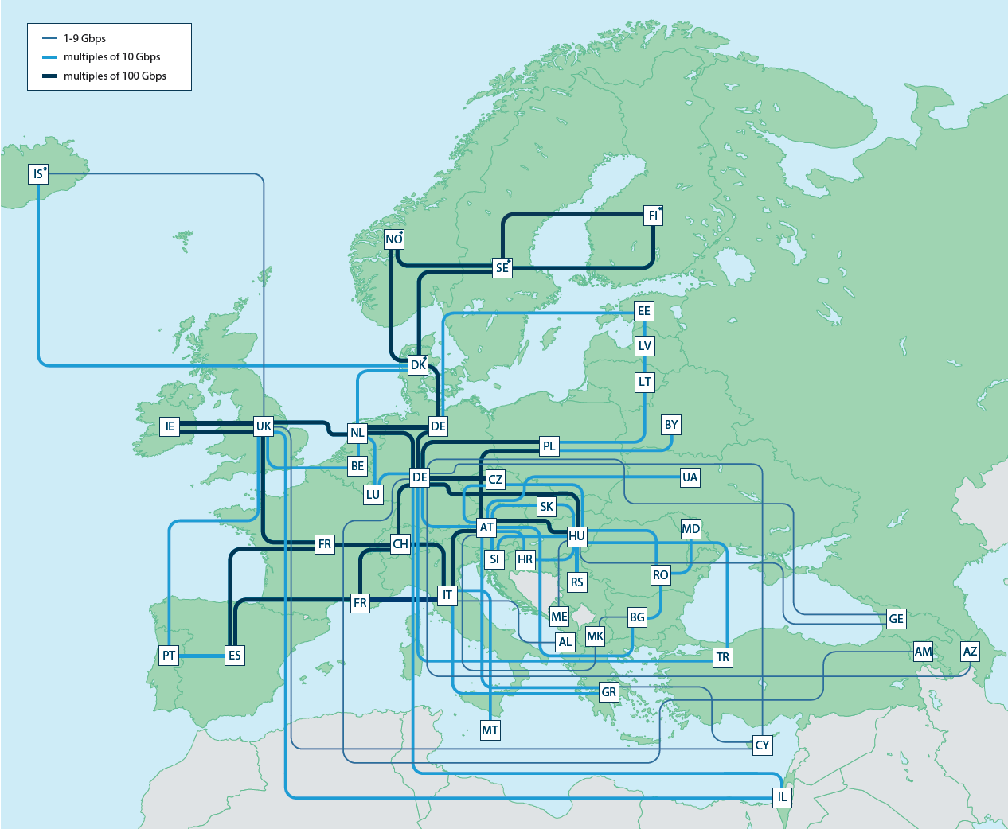

GÉANT
Operates a pan-European e-infrastructure
GÉANT network
GÉANT Association supports and represents over 40 NRENs across Europe
10,000 institutions and 50 million academic users

Slide 3
Security Communication Challenges Coordination – Joint Working Group
WHY?
WHO?
WHAT?
HOW?

Slide 4
Security Communication Challenges Coordination
WHY?
Sirtfi Incident Response Simulations (x 2 in 2018) – part of AARC
“Participants found the simulations to be useful for testing internal procedures, as well as for preparing for federated incidents. There was a strong request for future simulations to be coordinated. WISE, the Wise Information Security for collaborating E-Infrastructure Community [WISE], has a newly formed Working Group for this purpose. It aims to coordinate simulations and navigate the balance between desensitisation due to too many tests, and insufficient preparation.”
Notes:
Future Coordination
Participants found the simulations to be useful for testing internal procedures, as well as for
preparing for federated incidents. There was a strong request for future simulations to be
coordinated. WISE, the Wise Information Security for collaborating E-Infrastructure
Community [WISE], has a newly formed Working Group for this purpose. It aims to
coordinate simulations and navigate the balance between desensitisation due to too many
tests, and insufficient preparation.

Slide 5
Security Communication Challenges Coordination
WHY?
SIG-ISM: Inventory for Security Officers (what’s next?)
(Global NREN Security Group – x2)
Notes:
Presented in Kaunas
SIG-ISM had similar ideas…

Slide 6
Security Communication Challenges Coordination
WHO?
eduGAIN
GÉANT
but also any EOSC-HUB (research communities) and e-Infrastructure CSIRT teams
the IGTF (as it leverages federated id)
each of the e-Infrastructures XSEDE, EGI, EUDAT, PRACE, OSG, HPCI, …
every research infra with an interest: WLCG, LSAAI, BBMRI, ELIXIR, …
And any institution (or person) with access to https://mds.edugain.org/
Notes:
Logical candidates that could all run the test
… and have an interest in knowing the result to establish trust
eduGAIN enables identity federations to interconnect, so that participating institutions and services can collaborate without the need to establish individual bilateral connections.
eduGAIN and GÉANT
eduGAIN was pioneered by the GÉANT research and education networking community in Europe.
This group is provided with some secretariat support by the GÉANT staff.

Slide 7
Security Communication Challenges Coordination
WHAT?
WISE & SIG-ISM joint working group
https://wiki.geant.org/display/WISE/SCCC-JWG
Notes:
“balance between desensitization due to too many tests &
insufficient preparation because there aren’t enough of them

Slide 8
Security Communication Challenges Coordination
WHAT?
Coordination of ‘CCs recipient groups’ among participating infrastructures
Transitivity of trust in CC results between infrastructures
Definition of CC models and classification
Frequency of CCs
Notes:
Coordination of ‘CCs recipient groups’ among participating infrastructures
ensure targets are not overloaded by coinciding or overlapping challenges, for example by designating lead agency
Transitivity of trust in CC results between infrastructures
- for example by specifying the level of disclosure detail for CCs between trusted infrastructures, by using an SCI evaluation framework approach to it, or by coordination of testing and success criteria.
- how can requests for CCs between infrastructures be handled, e.g. in response to changing needs or a changed risk assessments; or as remediation after an incident in which communications did not meet expectation.
Definition of CC models and classification
‘depth’ of the CC testing is a balance between the level of trust gained (assuming that more profound testing and good results gives more trust) and expediency - convenience (asking the recipient to respond to a mail or click a link consumes less resources than requesting forensic investigation of a simulated incident of deliberately unknown nature).
Frequency of CCs
- simple communications challenges are often performed one or several times per year (e.g. for TF-CSIRT, by SURFcert for the SURFconext federation, EGI Operations on their sites).
- complex challenges are less frequent (e.g. ‘black-box traceability’ trials in EGI take place once every 1-2 years).
- following a CC model classification, propose an appropriate frequency for each class.

Slide 9
Security Communication Challenges Coordination
HOW?
•timeliness
•investigative capability
•confidentiality
•ability to take action
•….
but a single test can answer the questions of many
•if the challenge measures responsiveness and the data are available, each infrastructure can set its own level of expectancy
•responsiveness vs. ability to take action or forensics/traceability capacity
Notes:
What should we take into consideration?

Slide 10
Security Communication Challenges Coordination
HOW?
Examples:
Trusted Introducer and TF-CSIRT
•2-3 Reaction Tests per year
•supported by web click infrastructure, but requires (team) authentication
IGTF RAT Communications Challenges
•every 1-2 years
•in parallel with continuous operational monitoring
Notes:
WIKI!
https://wiki.geant.org/display/WISE/Communications+Challange+planning

Slide 11
Security Communication Challenges Coordination
HOW?
Examples:
https://wiki.geant.org/display/WISE/Communications+Challange+planning
Notes:
WIKI!
https://wiki.geant.org/display/WISE/Communications+Challange+planning
First examples in – we need more

Slide 12
Security Communication Challenges Coordination
HOW?
Security Communication Challenges at your institutions/constituencies?
WHAT, WHO, HOW
What works, what does not?
Is there any regional, global coordination?
Notes:
Tell us about your experiences
• Standing coordination function through WISE? – for (global) Members –interested parties, infrastructures, and their peers?

Slide 13
Security Communication Challenges Coordination
HOW?
Designate a lead ‘management’ organization for each element?
so that each ‘target’ does not get hit by many competing and concurrent challenges?
coordination must be global?
Communications challenges also build confidence and trust – an important social aspect
•unless you run the test yourself, or get full insight in the results of a challenge, you may not be growing more trust in the entities tested?
•so to get that ‘warm and fuzzy feeling of trust’, results (responsiveness measurement data) should be shared (but that sharing needs to be confidential as well –limit to WISE SCI checked infrastructures?)
Notes:
Can it be done?
(Some points from previous discussions)

