Slide 1
WISE Information Security for collaborating e-Infrastructures
David Kelsey (STFC-RAL, UK Research and Innovation)
WISE @ NSF Cybersecurity Summit, San Diego, USA, 15 Oct 2019
In collaboration with and
co-supported by EU H2020 EOSC-HUB

Slide 2
WISE Community – short history
Started in October 2015 – Workshop – Barcelona
  Jointly organized by GEANT SIG-ISM and IGTF SCI
Community members come from e-Infrastructures across the world
Governed by a steering committee
  Project managed by GEANT staff
Real work done by Working Groups
Meetings since mid 2017
  NSF Cybersecurity Summit, USA – August 2017
  STFC Abingdon, UK – February 2018
  NSF Cybersecurity Summit, USA – August 2018
  LITNET – Kaunas, Lithuania – April 2019 (joint with SIG-ISM)
  NSF Cybersecurity Summit, USA – October 2019

Slide 3
WISE Mission
The WISE community enhances best practice in information security for IT infrastructures for research.
How do we operate to fulfil the WISE mission?
WISE fosters a collaborative community of security experts and builds trust between IT infrastructures, i.e. all the various types of distributed computing, data, and network infrastructures in use today for the benefit of research, including cyberinfrastructures, e-infrastructures and research infrastructures.
Through membership of working groups and attendance at workshops these experts participate in the joint development of policy frameworks, guidelines, and templates.

Slide 4
WISE and Trusted CI have agreed a joint statement of collaboration
“Trusted CI and WISE share a common goal to support the research mission through the development of appropriate cybersecurity practices. Through close collaboration, the groups will ensure that cybersecurity frameworks, templates, and policies for our international infrastructures for research will grow increasingly aligned and interoperable.”

Slide 5
WISE Working Groups
Active Working Groups:
Trust and policy issues related to the Security for Collaborating Infrastructures trust framework (SCI-WG)
Risk Assessment WISE (RAW-WG) – joint with SIG-ISM
Incident Response & Threat Intelligence Working Group (IRTI-WG)
Security Communications Challenge Coordination Working Group (SCCC-WG)
Working Group being created – or now dead?:
Security for High Speed Transmissions Working Group (S4HST-WG)

Slide 6
WISE recommendations & papers
Security for Collaborating Infrastructures Trust Framework v2
https://wise-community.org/sci/
Risk Management Template
https://wise-community.org/risk-assessment-template/
WISE Baseline AUP version 1 (from AARC2 Policy Development Kit)
Link to AUP
Also, in the past:
Catalogue of security training material (STAA-WG)
white papers on state of security in big data management (SBOD-WG)

Slide 7
Working groups in action this morning …

Slide 8
Incident Response & Threat Intelligence Working Group (IRTI-WG) – Romain Wartel & David Crooks
Not competing with other operational security trust groups
Sharing security information is a challenge
  Proactive threat intelligence
  Reactive incident response handling
Useful to share threat intelligence to help protect organisations
Handling security incidents important to protect services and data and to prevent re-occurrence
IRTI-WG will address
  Security Operations Centres and Threat Intelligence sharing
  Collating security contact information
  Incident response procedures

Slide 9
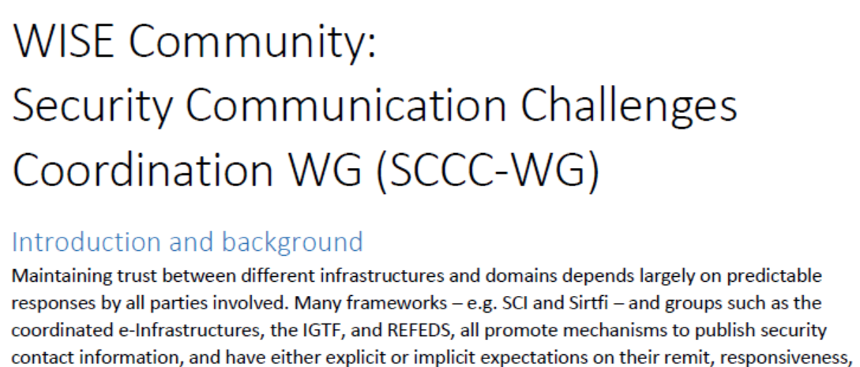
Security Communications Challenge Coordination Working Group (SCCC-WG)
(Joint with SIG-ISM) (Sigita Jurkynaite)

Slide 10
Security for Collaborating Infrastructures (SCI) …

Slide 11
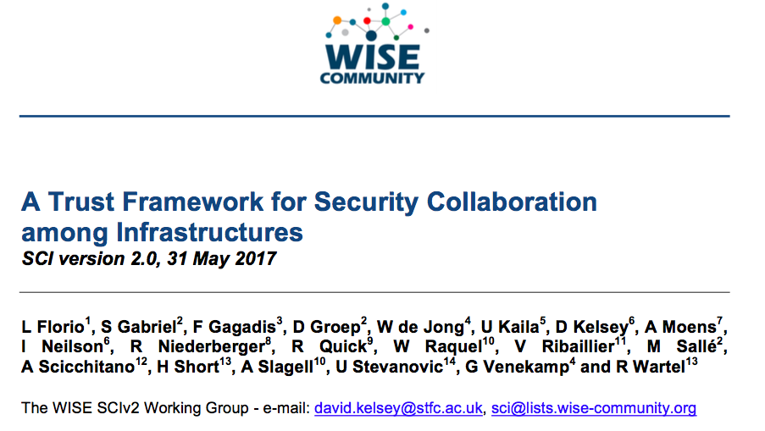
SCI Version 2 – published 31 May 2017

Slide 12
SCI-WG
A place to discuss and Trust and Policy issues related to the SCI Framework
More details later on future work for SCI-WG
BUT – for today, SCI-WG is a good place to discuss security, trust and policy issues related to Edge Services, and in particular SLATE
Jim Basney and colleagues

Slide 13
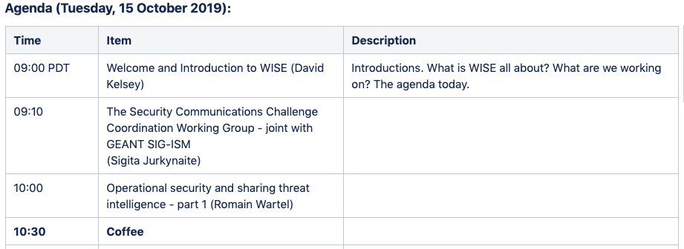
Agenda today (09:00 to 11:00)

Slide 14
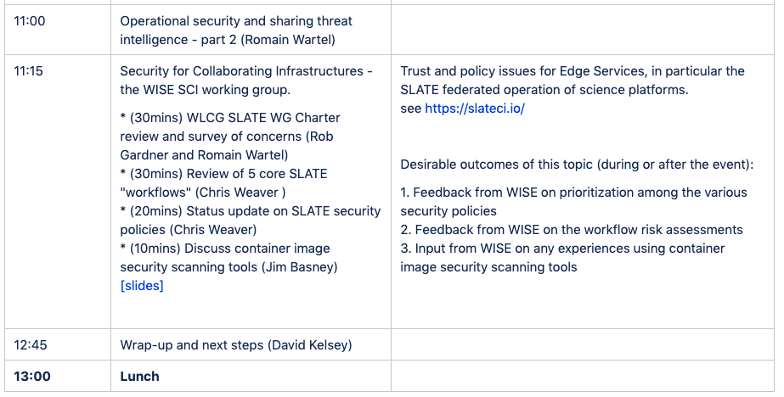
Agenda today (11:00 to 13:00)

Slide 15
Next steps (SCI-WG)
SLATE? – assume handled by the WLCG working group and Trusted CI?
  But more discussions during this week, I am sure
  Jim and colleagues?
Started work on some more baseline security policies
  From the AARC2 Policy Development Kit
  Aim to simplify and reduce the number of separate documents
  Reduce the cross-linking between policies – difficult for boot-strapping
  Started work (under EOSC-hub and EU GEANT4-3)
    Service Operations Policy
    Acceptable Assurance Policy
    Research Community (VO) operations policy
Continue work on SCI maturity assessment
And collaborate with Trusted CI

Slide 16
Next steps – other working groups
Security Communications Challenge Coordination Working Group (SCCC-WG)
  Sigita?
Incident Response & Threat Intelligence Working Group (IRTI-WG)
  Romain?

Slide 17
Next F2F meeting of WISE?
Another joint SIG-ISM and WISE meeting next Spring in Europe
  21-23 April 2020 (still “To Be Confirmed”?)
  Hosted by Jisc in London, UK

