Slide 1
SIG MarComms Meeting
June 11 & 12, 2020
Kathryn Anthonisen, Vice President, External Relations

Slide 2
Items for Discussion
GREN Map
GREN Value Proposition
GREN Website

Slide 3
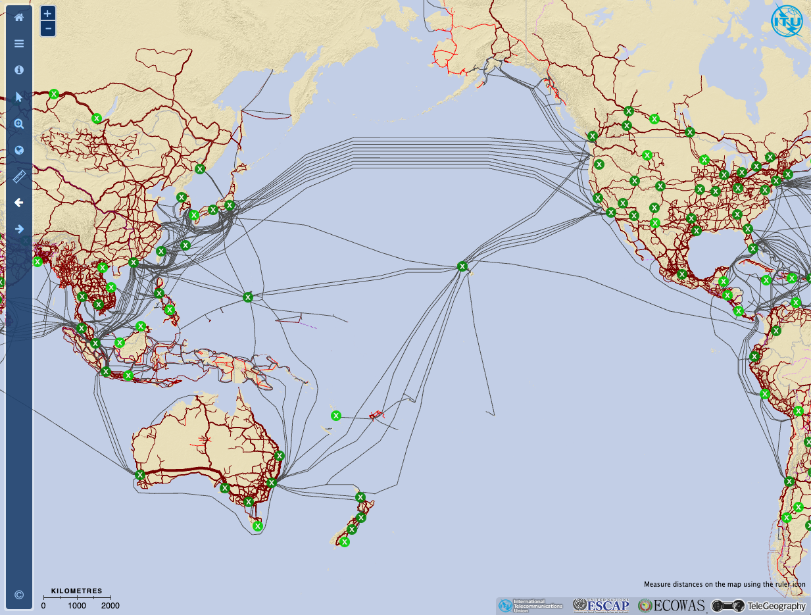
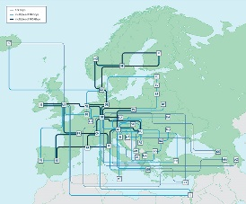
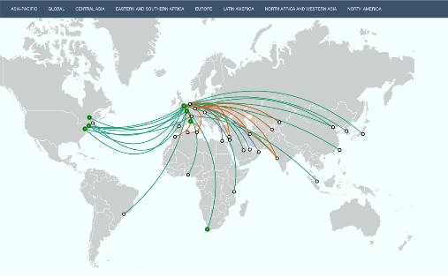
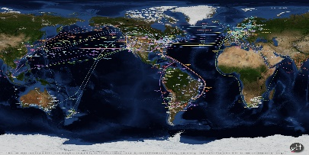
1. GREN Map
Objective:
A single unified map: a visual representation of Research & Education Network connectivity over the entire GREN.
Primary goal: demonstrate the REN value proposition to all stakeholders.
Current and previous efforts are limited in one way or another: onerous, incomplete, stale, static, isolated, technical, …
Demand is high!

Slide 4
GREN Mapping Working Group
Formed in the fall of 2018
Enjoys participation from a wide variety of regions
Meets roughly bi-weekly; English as primary language
Reports to the GNA-G
Chairs:
Tom Fryer, GÉANT
Ryan Davies, CANARIE
Members (24):
Alain Aina, WACREN
Kathryn Anthonisen, CANARIE
Ed Balas, Indiana University
Tiwonge Banda, UbuntuNet
Erik-Jan Bos, NORDUnet
Wallace Chase, REANNZ
Leandro Ciuffo, RNP
Dale Finkelson, Internet2
Lars Fischer, NORDUnet
Lisandro Zambenedetti Granville
Carlos Gonzalez, RedCLARA
Laurent Gyde, RENATER
Andrew Howard, APAN
Jo Kimaili, UbuntuNet
John Macauley, ESnet
Alex Moura, RNP
Marcos Schwarz, RNP
Dan Sellars, CANARIE
Jerry Sobieski, NORDUnet
Michael Stanton, RNP
Thomas Tam, CANARIE
Marco Teixeira, RedCLARA
J.P. Velders, SURFnet
Mark Wolff, CANARIE

Slide 5
Data Format: Working Draft
To support the streamlined sharing of network data for visualising the GREN
Requirements extrapolated from features identified by this working group
Basis: NML — Network Markup Language (XML)
  Maintained by the Open Grid Forum
  Meets many requirements
Extension: “GRENML”
  Added features
    focus on visual mapping
  Conveniences
    support easier translation to/from the format

Slide 6
Next Steps
Seek early adopters:
  Gather more initial source data & sources
  Deploy “sandboxed” database node for alpha testing
  Collect feedback
Recruit more software development support
Establish some conventions
  Web registry
Canadian NREN map
  Core functionality, except automatic data merging
  Fall 2020
Global map
  Core functionality
  Some initial diverse global data — work with us by providing yours!
  Summer 2021

Slide 7
2. GREN Value Proposition
Propose three elements:
  Emotional appeal (video)
  Logical appeal (PPT deck, GREN map, global investment)
  Societal appeal (Inthefieldstories.net)

Slide 8
A dedicated network of networks… connecting researchers, educators, students, scientific instruments, and datasets, across the globe.

Slide 9
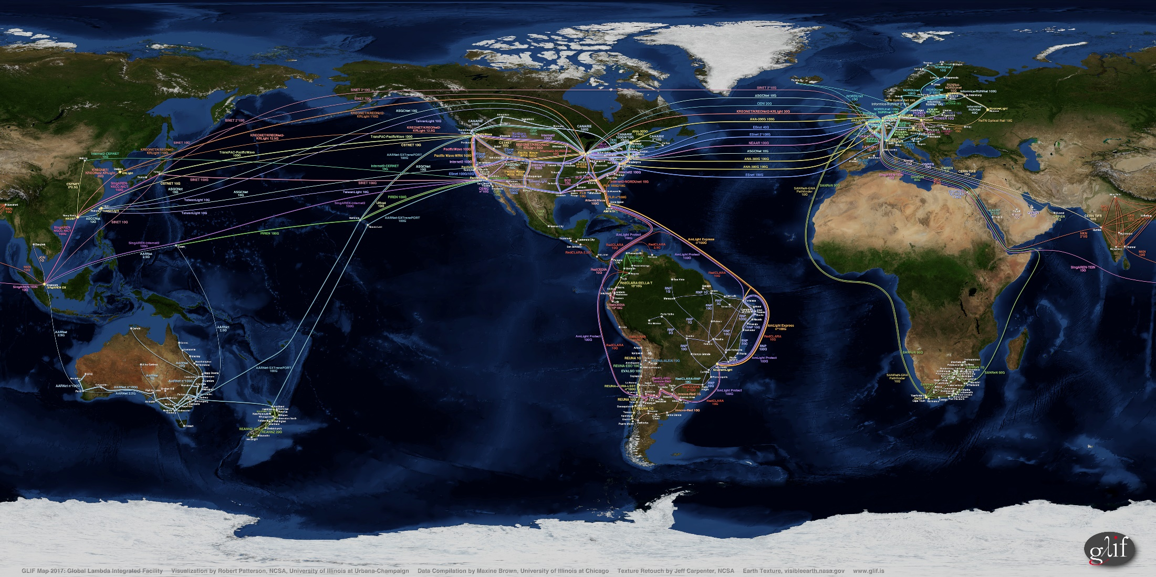
Thousands of institutions and millions of researchers, faculty, and students connected to the GREN

Slide 10

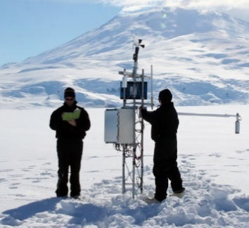

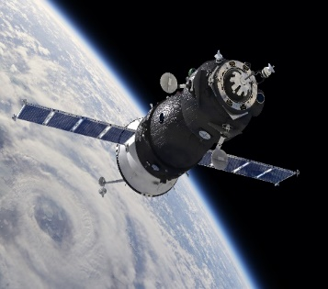

…making distance irrelevant
30 Metre Telescope
Large Hadron Collider
Square Kilometre Array
Sensor networks worldwide
Datasets in all research domains

Slide 11
How the GREN works
Most countries have dedicated National Research and Education Network(s) – NRENs - which allow researchers, educators and students access to data and each other regardless of where they are in the world
These NRENs connect to each other – either directly, or through supra-national R&E Networks (like GEANT or NORDUnet)
The global ecosystem of these NRENs and supra-national R&E Networks makes up the Global Research and Education Network – or GREN

Slide 12



Why is the GREN unique?
Built for purpose, to support the unique needs of the research and education community
Globally collaborative community of support that enables international research and education
Unique services developed to support the R&E community – eduroam; eduGAIN; eduVPN

Slide 13
The GREN for Researchers
Dedicated R&E networks are purpose-built to handle burst-y research workloads; commercial Internet providers cannot provide this cost-effectively
R&E focus ensures networks - and their supporting software and applications - are built to handle and improve the research workflow
Data from many of the world’s leading science instruments and specialized data repositories are only accessible via the GREN

Slide 14
The GREN for Funders
The GREN's scope and reach erases country boundaries and supports groundbreaking collaborative research
Relatively small R&E Networking investments by individual governments and/or institutions leverage a much larger global investment - $1.2B USD annually, with 55 networks and 50 regionals reporting
The GREN's purpose-built infrastructure increases speed to discovery, helps answer the pressing concerns of our time – medical, environmental, energy, etc.

Slide 15
The GREN for Society
Powerful, purpose-built networks help researchers answer the pressing concerns of our time – medical; environmental; etc.
Dedicated R&E networks represent strong return on taxpayer investments
Supporting the digital infrastructure enabling research and innovation drives the digital economy of tomorrow for all

Slide 16


The GREN: Constantly evolving
GNA – To improve technical harmonization, and help maximize the impact of global investments
In The Field Stories – To increase understanding of the science and research enabled by the GREN
Knowledge Exchange activities – To help improve capacity in new and developing RENs

Slide 17
The GREN – Demonstrating Value
Global GREN Map
  An interactive map showing institutions connected to the GREN around the world
  Ability to move from local to global view of GREN-connected institutions
  Powerful visual representation of this essential infrastructure
Global GREN Investment
  Project to determine annual global investment in GREN
  To illustrate significant leverage that individual NRENs benefit from, and thus, leverage that institutions connected to NRENs benefit from

Slide 18
3. GREN Website
Central location for all GREN value proposition materials
GREN.org URL is available
High-level architecture?
  GREN.org
    Light touch site, central location for VP materials:
      Video
      PPT deck
      GREN map (when complete)
  Links to
    GNA-G website
    Inthefieldstories.net
  Centralized list of GREN members with links to NREN websites
  Value to community of centralized repository/simplified messaging?

