Slide 2

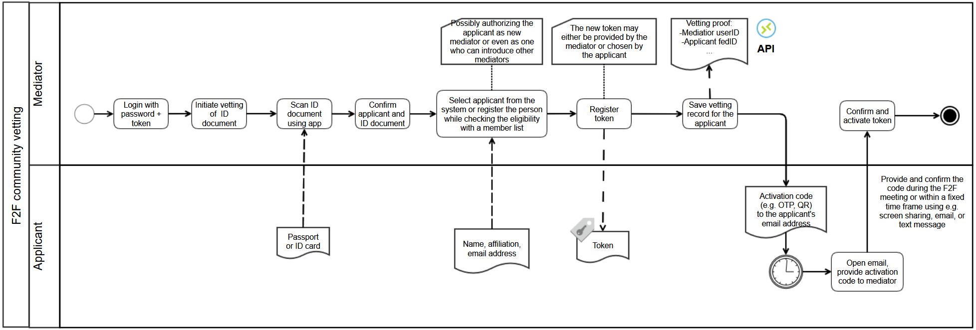
Overall Community Vetting Workflow

Slide 3
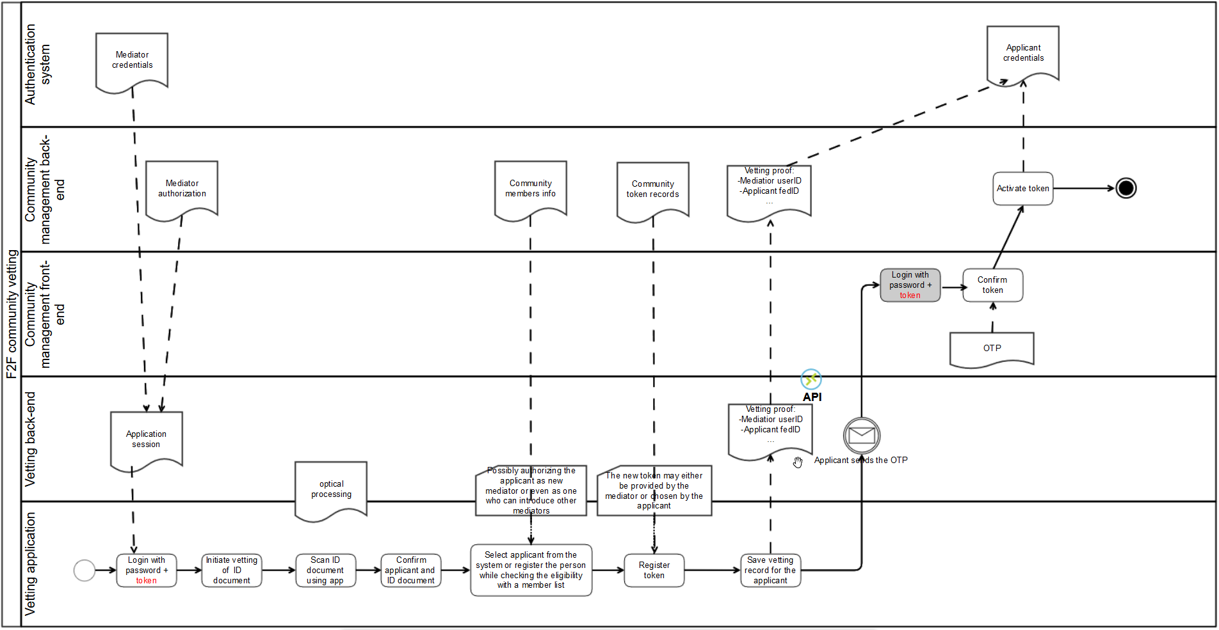
Technical Community Vetting Workflow Outline

Slide 4
Community Trust Vetting Demonstrator
Various potential sources
  Passport (or other IDs)
  Attributes/claims as provided through federated identity
  Affiliation (as validated via InAcademia)
  ORCID ID (optional)
  RA (mediator) attestations
Additional requirements
  Minimal storage of personal data
  Self-service for both end-users and RAs, making then aware of stored data
  Validation based on real-time information exchange

Slide 5
Community Trust Vetting Demonstrator
Various potential sources
  Passport (or other IDs)
  Attributes/claims as provided through federated identity
  Affiliation (as validated via InAcademia)
  ORCID ID (optional)
  RA (mediator) attestations
Additional requirements
  Minimal storage of personal data
  Self-service for both end-users and RAs, making then aware of stored data
  Validation based on real-time information exchange

Slide 6
Technical Requirements and Design
Web-based GUI
Start with token self-registration (?)
Collection of attestations by querying external sources
Federated authN: act as SAML SP (eduGAIN) or OIDC RP (InAcademia)
Data from ReadID app (via the vendor’s API?)
Querying ORCID records
Potential implementation elements
  Data recording API for RAs and end-users to attest the use of tools and actions
  RAs statements to be stored in the same way as technical attestations
  Express agglomerations and states (hardcoded, via rule expressions?)
  Asynchronous notification of the applicant and RA needed (email, OTP …?)
  Status, based on defined agglomerations or state sequences.
  SimpleSAMLphp?
  Hierarchical data storage (LDAP, MongoDB, CouchDB…) or perhaps RDBMS?
  Updates from several sources (via template-based plug-ins?)
  Listeners for changes/events in the DB (a few related plug-ins?)

