Slide 1


Community-based Trust Establishment
Sprint demo #2– 3rd February 2020
Branko Marovic/Alan Lewis/Sergio Gomez
Q1 2020
Public
www.geant.org

Slide 2

Background
Follow-up on SFA Distributed Vetting
  Aim: Focus on a specific flow identified in cycle #1
    Community-based (Web of Trust Approach)
    Assumes a pre-existing trust fabric exists for R&E ☺
Identify and/or develop tools to support this approach
  Aim: Detail the workflow and develop a PoC demo
    Identify use cases
    Elaborate typical flows
    Design data model
    Investigate tools (platforms, pre-existing components)
    Develop PoC that integrates some of the fabric
    Demonstrate PoC and gather feedback on applicability to services

Slide 3

Overall workflow
Initiation
Identity
Proofing
Identity
Verification
Issuance
Record keeping
Activation

Slide 4

Technical workflow

Slide 5


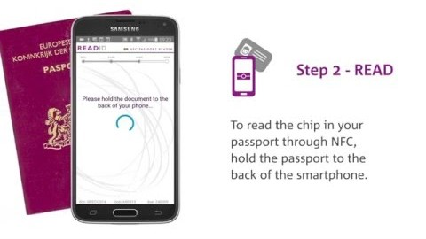
Identity Proofing
ReadID identity proofing solution
Reads ICAO 9303 compliant documents
Mobile app/SDK and SaaS backend
Facial matching – ‘liveness’ check
Here’s how it works

Slide 6

Activities status
Status
Overall flow defined
Functional architecture for PoC defined
Collaboration with SURFnet agreed
Use case identification underway
Detailed discussions with ReadID progressing
Initial PoC Management portal created







Slide 7

The core PoC authentication demo
Applicant and Operator/RA
Identify federation login
Token usage and check

Slide 8

Looking ahead
There are a number of tasks underway and many still to complete until the topic is fully explored. In particular:-
  Fully identifying all the applicable use cases within the community
  Defining the subset to be support by the PoC demonstrator
  Identifying the various possible sub-flows for different use cases
  Building a working PoC demonstrator
  Create an package for the community from the existing documention
  Feedback of results to community

Slide 9

Current work documents
Distributed Vetting - Multi-Factor Authentication Report https://docs.google.com/document/d/1J2SfA1dcsrVHDMVtCtH4SToW_niRztc4UioWPbI60ro/edit#
Community trust vetting demonstrator https://docs.google.com/document/d/1Sk0u5BXdEpvXFzS-wrXD-dPil8UxeE3V5tbzez80oRg/edit#
Community Trust Use Cases https://docs.google.com/document/d/1cNk94jp5OnOr6lGutAfdJ9ZYR64CL7qKEBL8boG7xOA/edit#
CommTrust Overall Flow https://wiki.geant.org/display/gn43wp5/CommTrust+Overall+Flow
CommTrust Components Flow https://wiki.geant.org/display/gn43wp5/CommTrust+Components+Flow

Slide 10

Thank you
www.geant.org
© GÉANT Association on behalf of the GN4 Phase 2 project (GN4-2).
The research leading to these results has received funding from
the European Union’s Horizon 2020 research and innovation programme under Grant Agreement No. 731122 (GN4-2).

