Slide 2

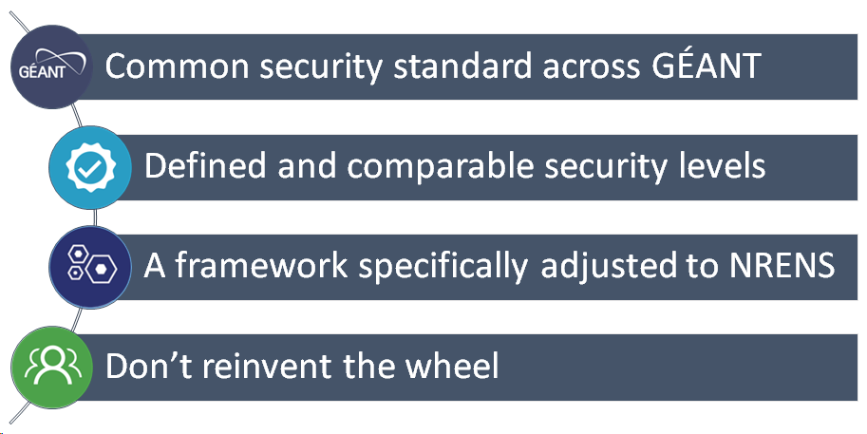
How to define a baseline
Notes:
Explain the baseline goals

Slide 3

Security from every angle
01
Policy
Management Commitment and Mandate
Internal Security Policy
Acceptable Use Policy
Regulatory and Privacy
02
People
Training and Awareness
Personnel Management
Supplier Management
03
Threats
Risk Management
Incident Management
Business Continuity Management
04
Tools
Cryptography
Access Management
Patch Management
Vulnerability Management
Operations
Notes:
Briefly describe the four security areas

Slide 4

Towards the next maturity level
Expert
10% of NRENS
Sophisticated security program. Only a few NRENS are already compliant. This is the long term goal to achieve.
3
Advanced
30% of NRENS
Solid security practices. A minor part of NRENS is already compliant, most implement just individual requirements.
2
Baseline
80% of NRENS
Entry level security. The majority of NRENS is already compliant.
1
Notes:
Explain the security maturity model

Slide 5







Achievements
First security baseline version published
Outreach
  SIG-ISM 2019
  GÉANT Symposium 2020
Potential Pilot Partners
Assessment sheet prepared

Slide 6

Assessment Sheet
Support organizations to conduct a (self) assessment
Helps to better understand the requirements of the security baseline
Makes the maturity level and requirements fulfillment of an organisation visible
Enables us to create statistics to identify the security level of our community

Slide 7
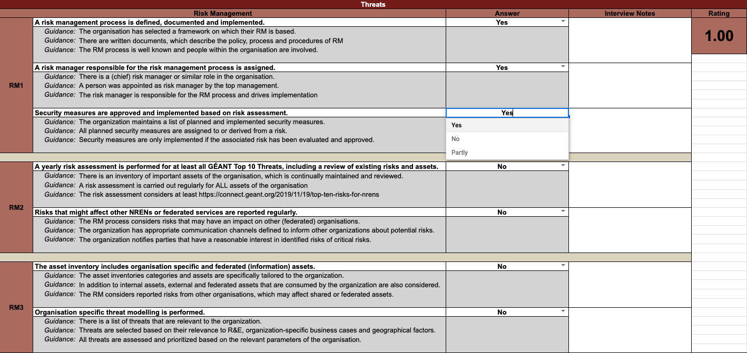

Slide 8
0-1
0-1
0-1

Slide 10
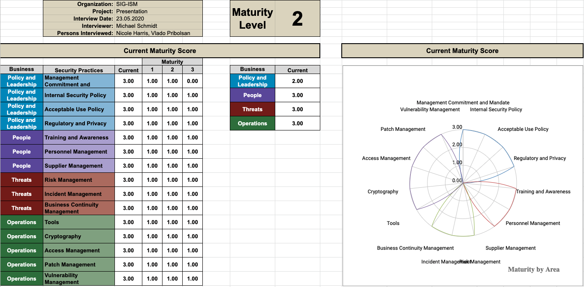

Slide 11

Next steps
Assessment Sheet
Baseline Updates
Community Maturity
Distribute the sheet
Collaborate with pilot partners
Support and advice the community
Improve the framework
Update the baseline
Version 1.x
Restructure the baseline
Version 2
Publish first results
Gather the assessment results from partners
Evaluate the community maturity level
Present the results at the next meeting

Slide 13
Resources & References
GÉANT Security Baseline
https://wiki.geant.org/x/iDH5Bw
Baseline Assessment Sheet
https://wiki.geant.org/x/bwGMC

