Slide 1


Security work package update
Sigita Jurkynaitė, GÉANT
SIG-ISM virtual meeting
23 April 2020

Slide 2

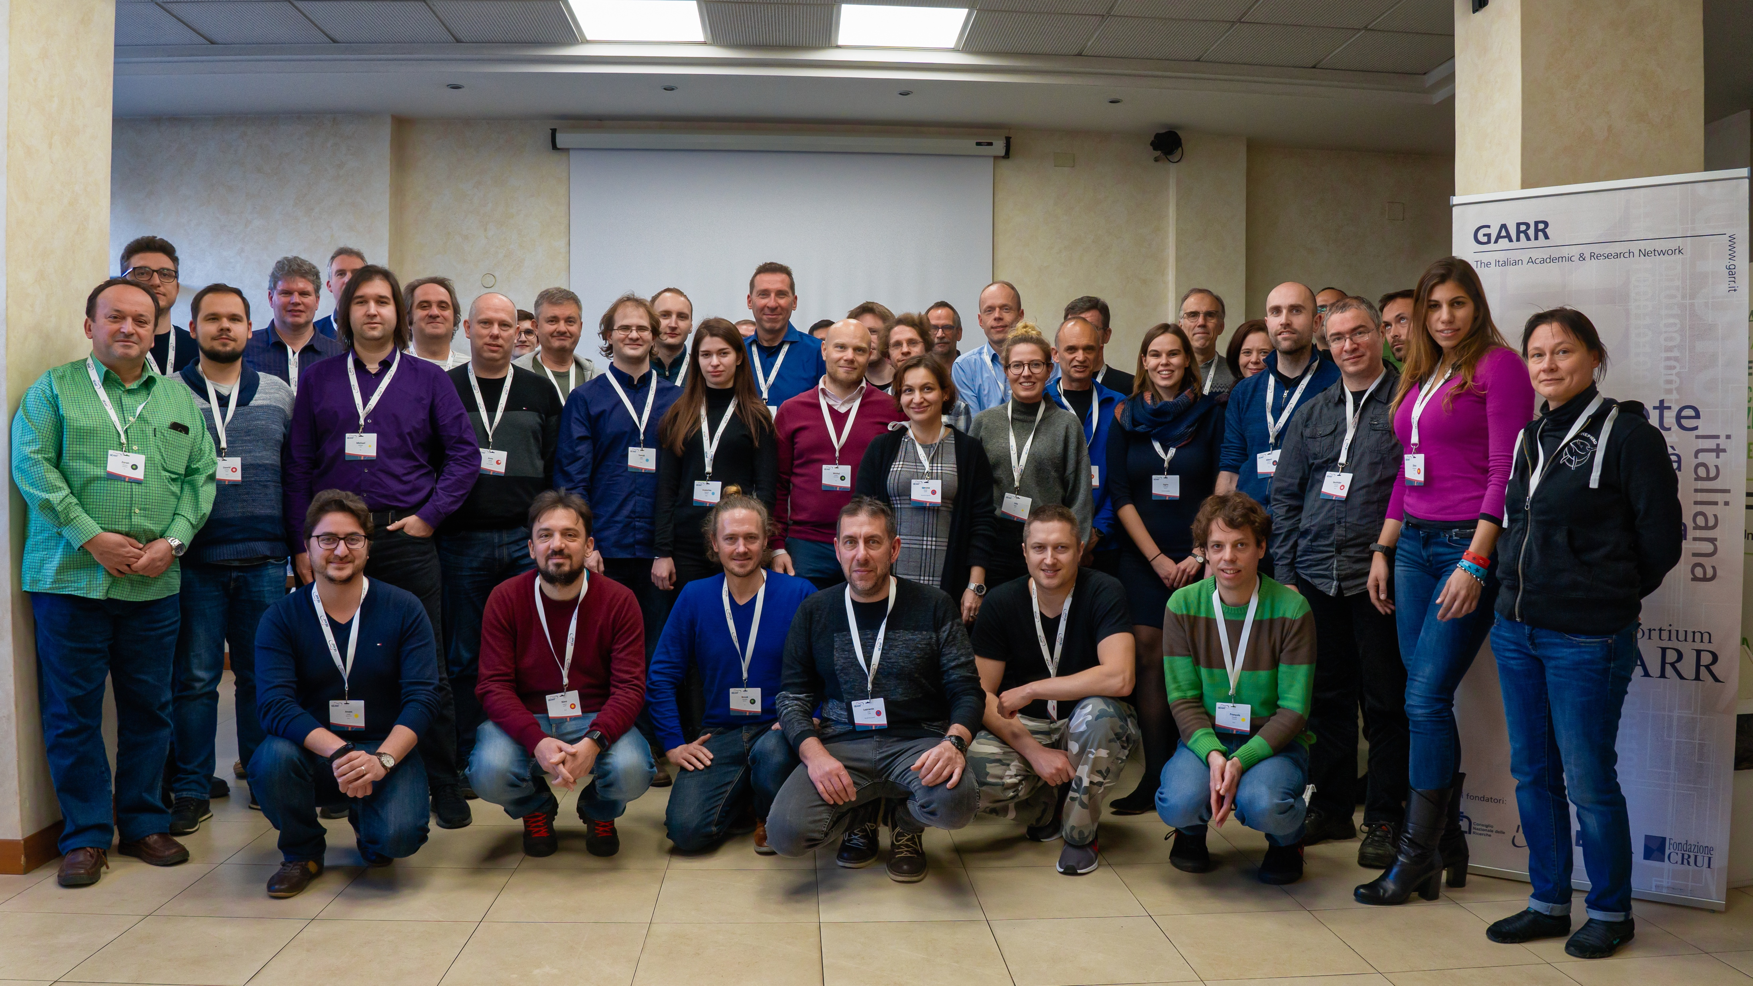
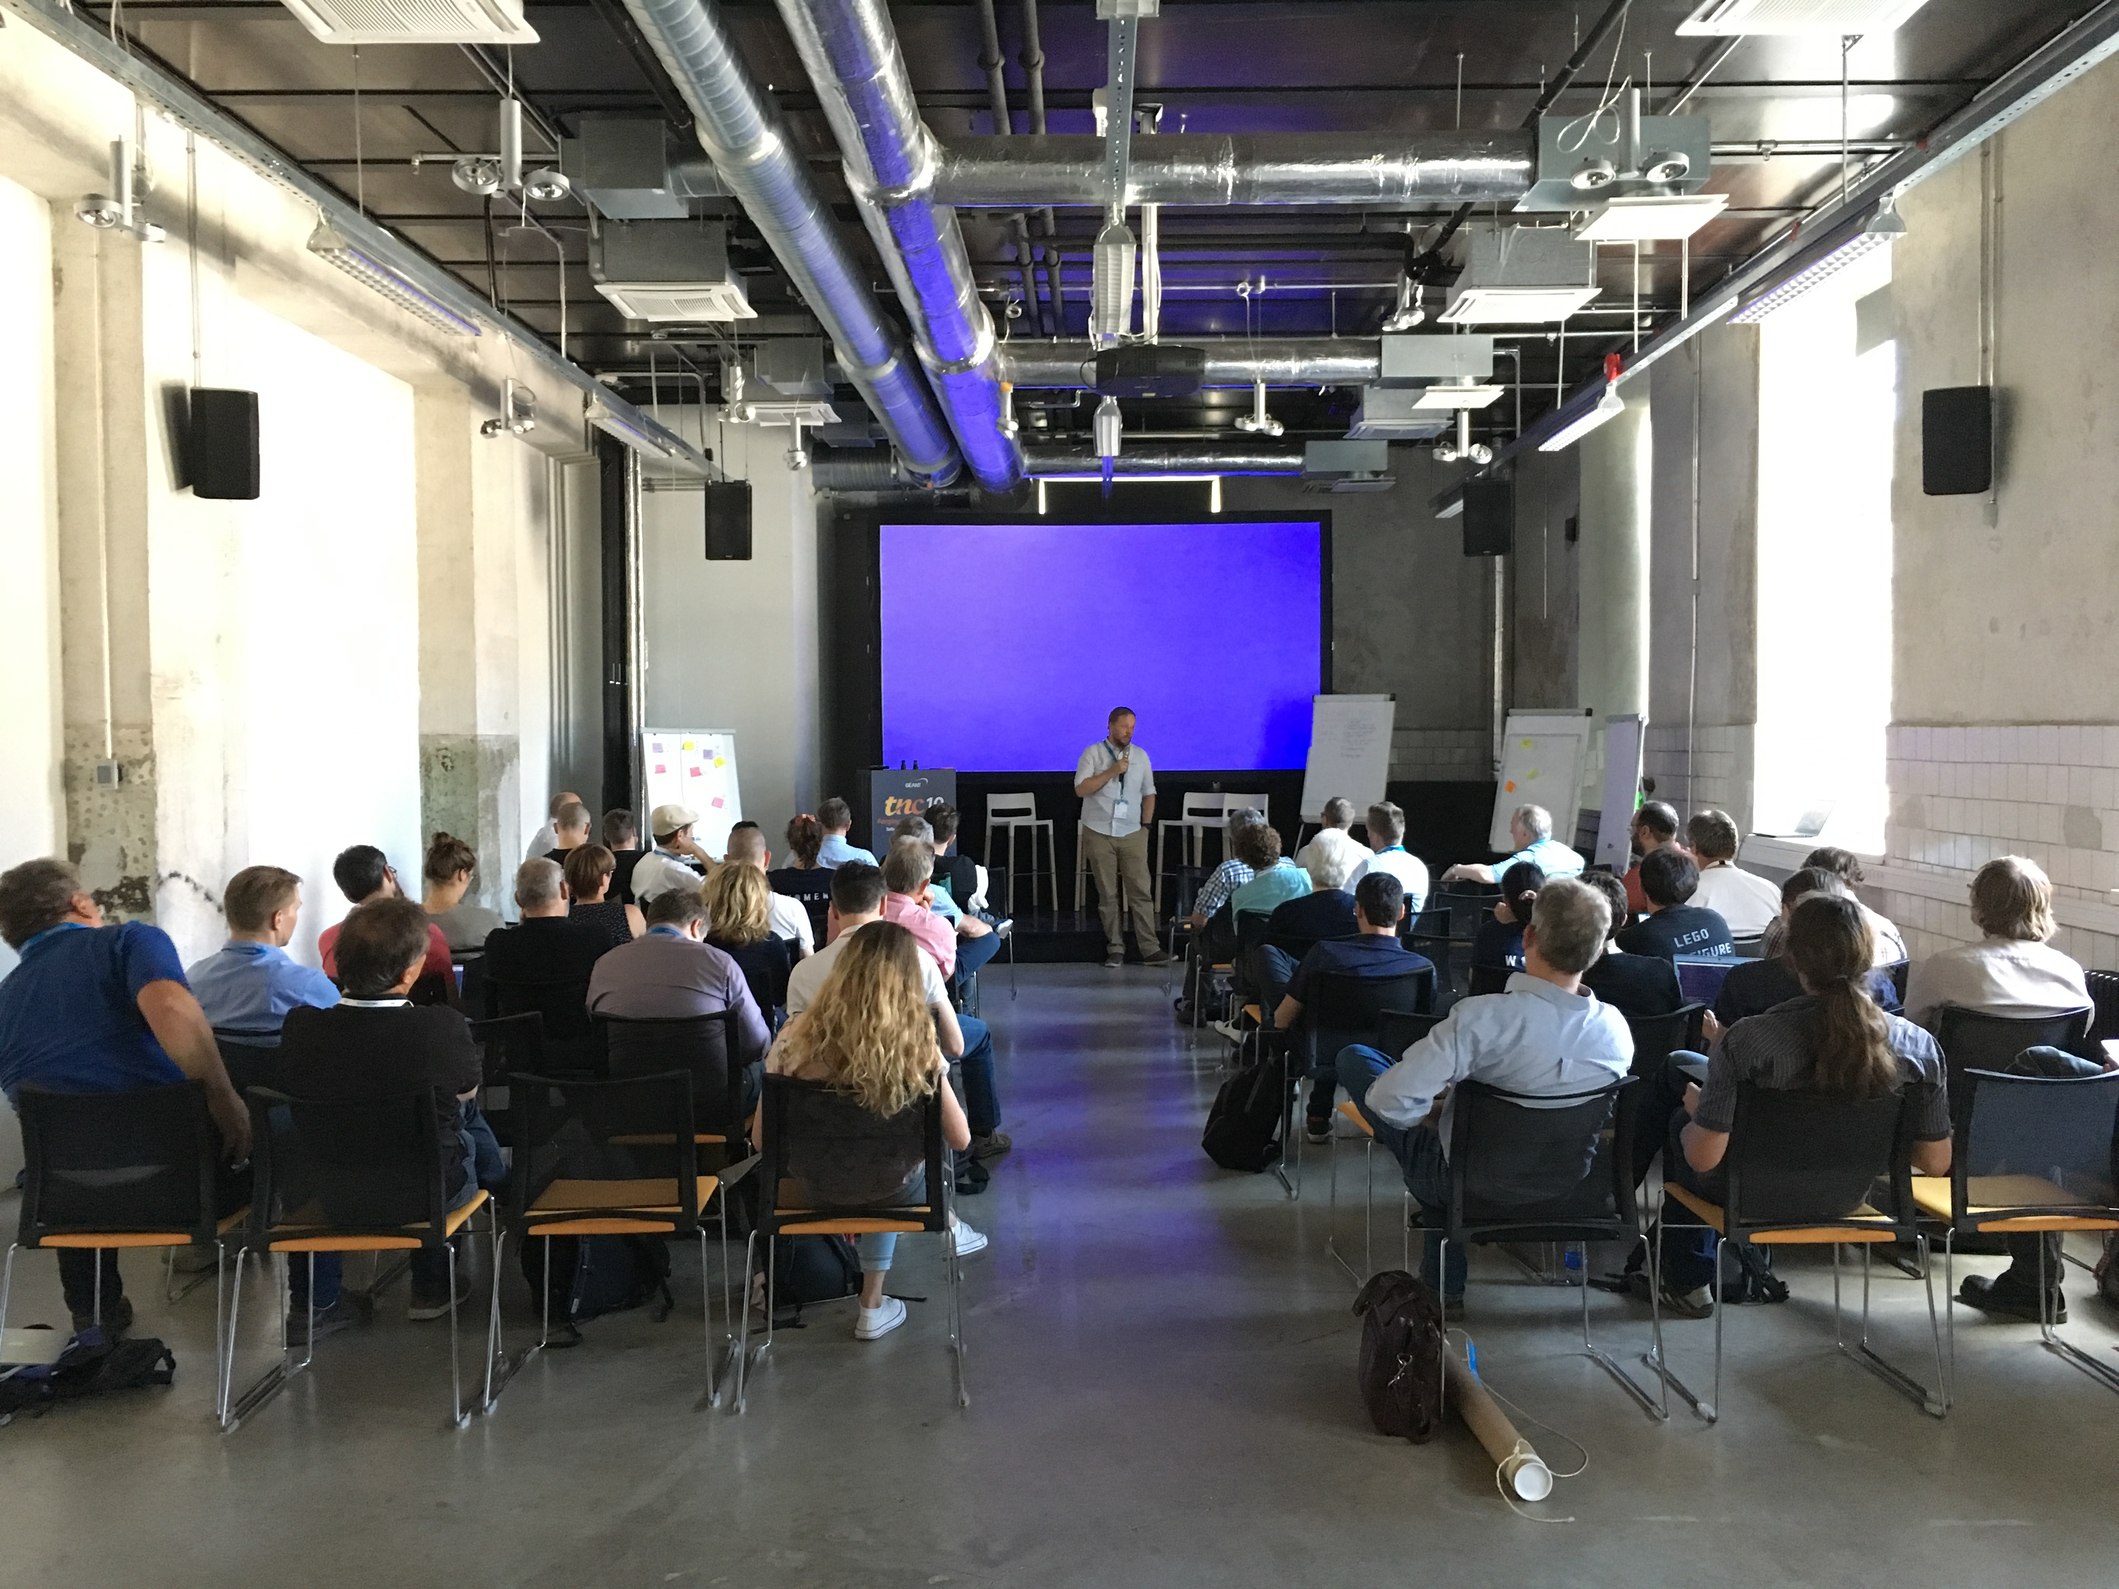
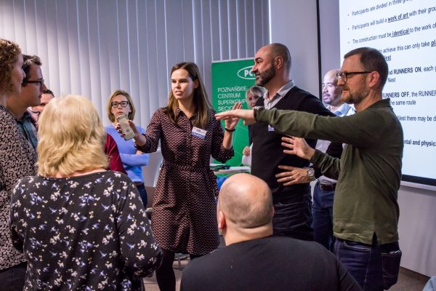
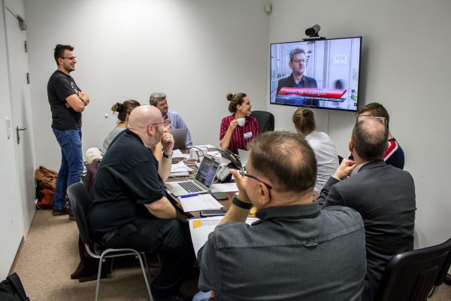


Year 1 in numbers
43 people (+3 soon)
16 countries (+1 soon)
Community engagement:
Security day at TNC19
Cybersecurity month 2019
2 workshops (DDoS and SOC)
CLAW2019
17 Events
23 presentations
26 GÉANT member NRENs attended events

Slide 3
Year 1 highlights – Task 1: Business Continuity & Task 2: Security Baseline
Train the Trainer: create your own crisis exercise (7 organisations)
A list of 70+ trainings and sources of training materials
Security baseline for NRENs completed and reviewed by the international R&E community

Slide 4
Year 1 highlights – Task 3: Products and Services
All SOC tools installed in the lab and demonstrated at the SOC tools workshop
Comparing requirements both technical and legal for vulnerability scanning and finding that participating countries are not so different
Firewall on Demand: Docker container for test installation, approaching web UI testing, transition to Python3 in progress
API between Firewall on Demand and NeMo software defined
eduVPN adopted by major universities and NRENs; 13 secure Internet instances on 4 continents before March 2020

Slide 5


Year 2 (or what is left of it)
Security baseline:
As a self-assessment
As part of an NREN visit
Growing interest of NRENs
Crisis Management – Train the Trainer
Security day at TNC20
#CyberSecMonth2020
Workshops: DDoS, Baseline, SOC tools – October?, CLAW2020 – December? DDoS – December?
Notes:
The team are looking for NRENs who would be interested in piloting the security baseline within their own organisation. This can be done in one of two ways:
- As a self-assessment. We would ask the NREN to assess themselves using the tools provided and also give feedback on the effectiveness of the baseline as a tool in a short report.
- As part of an NREN visit. Members of the Security Baseline task can visit your NREN and work through the maturity model with them.

Slide 6
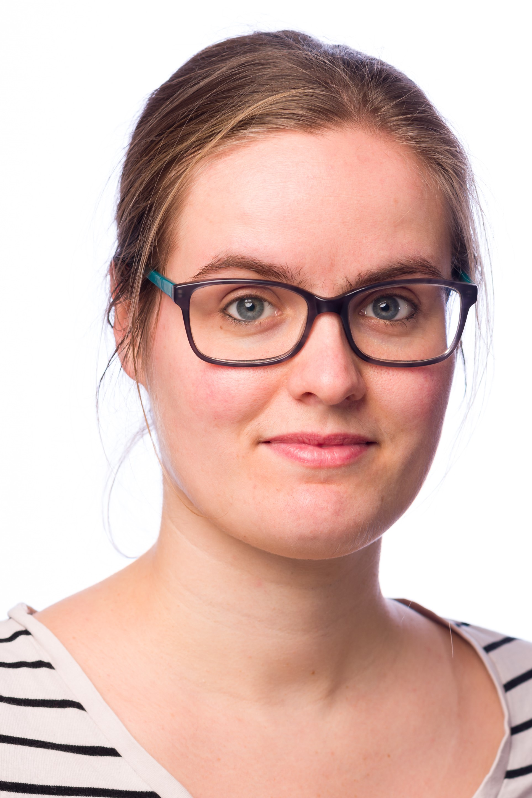
NEW TASK!
Task 4: Crisis Management
assisting NRENs in setting up and improving crisis management plans and procedures;
helping NREN staff to improve their skills related to crisis management, such as stress management, internal and external communication, leadership and decision making.
CLAW 2020 – 1-2 December, Poznan, Poland
Themes:
    Working with external stakeholders
    How to triage information and time management
    Creative problem solving
    How to deal with media
Registration in Open:
https://eventr.geant.org/events/3277
Task leader
Charlie van Genuchten

Slide 7

Thank you
Any questions?
As part of the GÉANT 2020 Framework Partnership Agreement (FPA), the project receives funding from the European Union's Horizon 2020 research and innovation programme under Grant Agreement No. 856726 (GN4-3).​​​

