Slide 1



Community-based Trust Establishment
Sprint demo #4– 21st April 2020
Branko Marovic/Alan Lewis/Sergio Gomez
Q2 2020
Public
www.geant.org

Slide 2

Background
Follow-up on SFA Distributed Vetting
  Aim: Focus on a specific flow identified in cycle #1
    Community-based (Web of Trust Approach)
    Assumes a pre-existing trust fabric exists for R&E ☺
Identify and/or develop tools to support this approach
  Aim: Detail the workflow and develop a PoC demo
    Identify use cases
    Elaborate typical flows
    Design data model
    Investigate tools (platforms, pre-existing components)
    Develop PoC that integrates some of the fabric
    Demonstrate PoC and gather feedback on areas of applicability

Slide 3

Overall workflow
Initiation
Identity
Proofing
Identity
Verification
Issuance
Record keeping
Activation

Slide 4
High-LOA guest enrolment use case
Initiation
Issuance/Activation
Identity verification

Slide 5

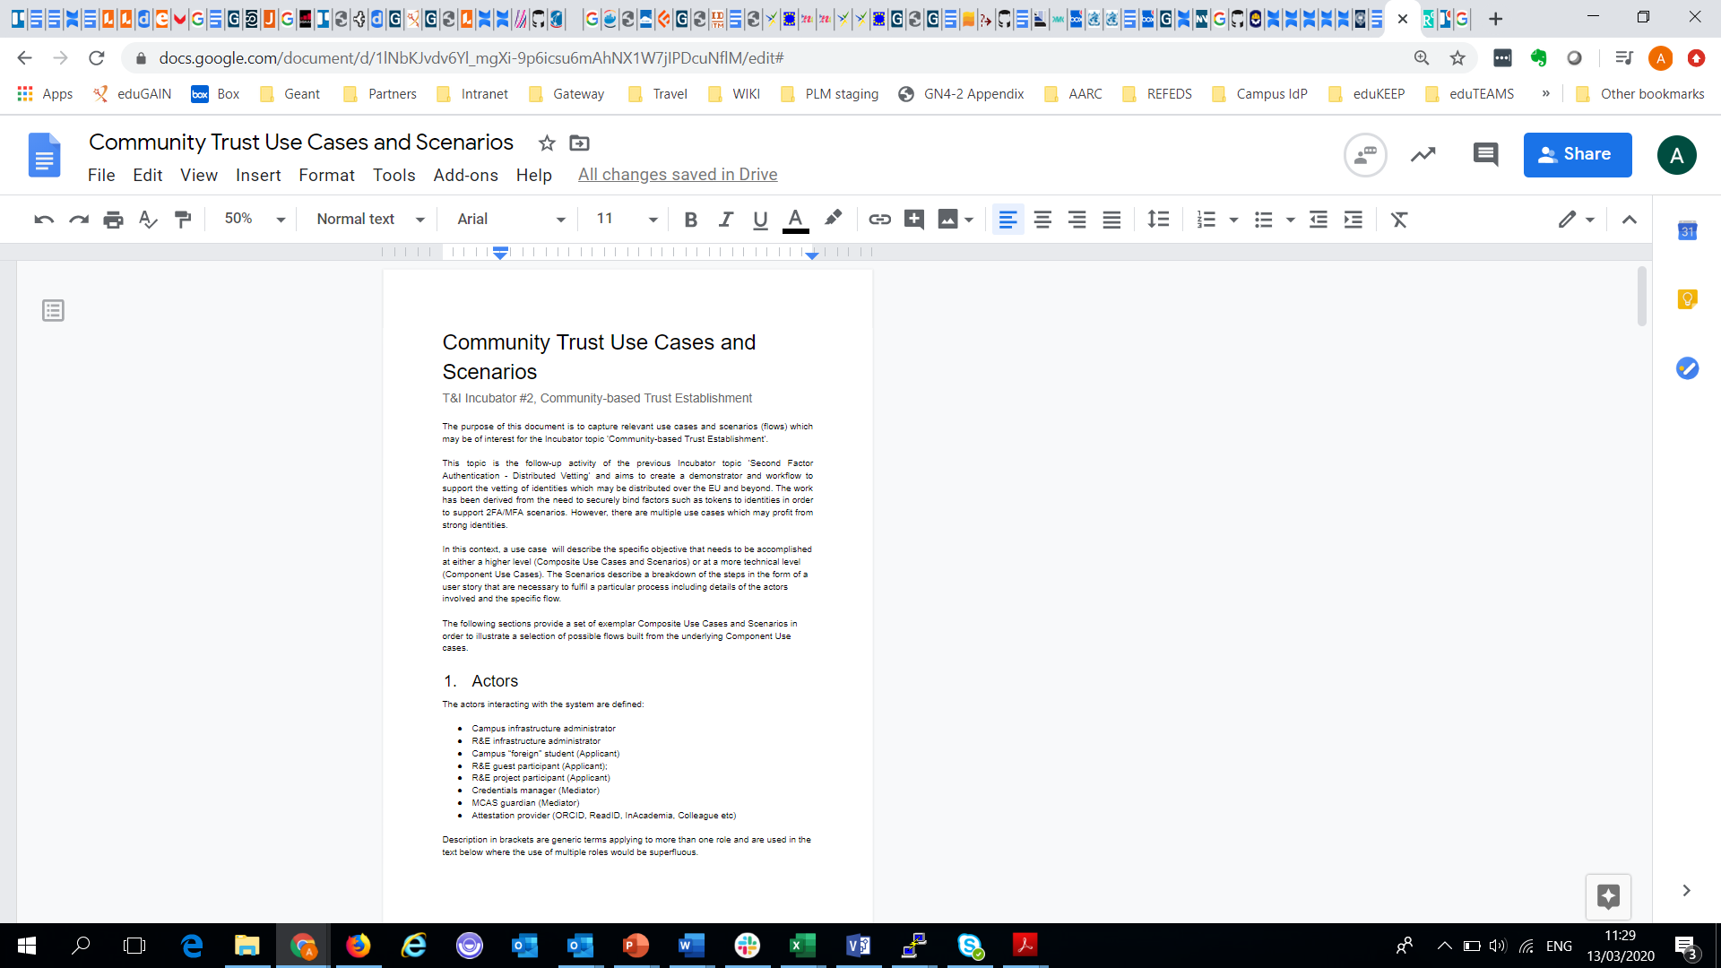
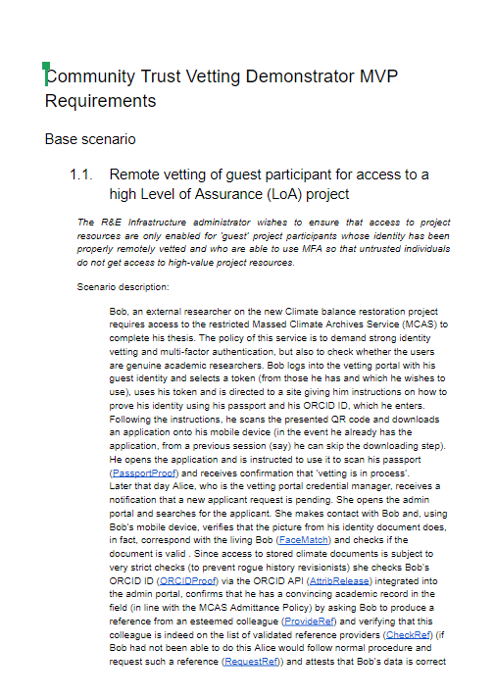
Activities status
Status
Overall flow defined
Functional architecture for PoC defined
Collaboration with SURFnet agreed
Use case identification underway
Initial PoC Management portal created
Mapping of use cases to PoC MVP
Integration with ReadID progressing
Discussions with interested communities









Slide 6

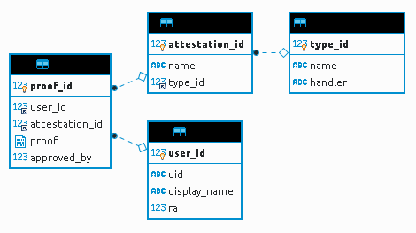
Use case scenarios feedback
What did we learn so far?
  Some large collaborations already have their own solution
  Not all research data is highly sensitive – no need for 2FA
  No specific need for user to confirm activation of token
  Should define an integration API for services (eduTEAMS)
  Possibility of a generalised identity vetting solution
  There are a number of identity proofing solutions available
  Key use case is the creation, storage and
  management of attestations

Slide 7
Demonstrator PoC MVP
What use cases should we support?
Prioritise by use case importance – stakeholder input
Prioritise by available effort/complexity
We need your input
Maximal scenario (MVP EPIC)
User story category (Admin GUI)
User story category (User GUI)
Attestations
Notifications
(………..)
Implied requirements
Implied requirements
…………………………………………………………………

Slide 8

Looking ahead
There are a number of tasks underway and some still to complete until the topic is fully explored. In particular:-
  Identifying as many use cases as possible engaging with community/stakeholders
  Agreeing the subset to be supported by the PoC demonstrator
  Building a useful PoC demonstrator as an exemplar
  Creating a package for the community from the existing documentation
  Feedback of the study results to community

Slide 9

Current work documents
Distributed Vetting - Multi-Factor Authentication Report https://docs.google.com/document/d/1J2SfA1dcsrVHDMVtCtH4SToW_niRztc4UioWPbI60ro/edit#
Community trust vetting demonstrator MVP requirements
https://docs.google.com/document/d/1JHraLfQBL8pK6GLGVIST9XYZA3hNc5cZJ80s7aTBe7E/edit#
Community Trust Use Cases https://docs.google.com/document/d/1lNbKJvdv6Yl_mgXi-9p6icsu6mAhNX1W7jIPDcuNflM/edit#
CommTrust Overall Flow https://wiki.geant.org/display/gn43wp5/CommTrust+Overall+Flow
CommTrust Components Flow https://wiki.geant.org/display/gn43wp5/CommTrust+Components+Flow

Slide 10

Thank you
www.geant.org
© GÉANT Association on behalf of the GN4 Phase 2 project (GN4-2).
The research leading to these results has received funding from
the European Union’s Horizon 2020 research and innovation programme under Grant Agreement No. 731122 (GN4-2).

Slide 11

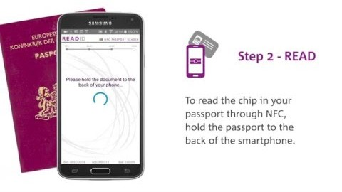
Identity Proofing
ReadID identity proofing solution
Reads ICAO 9303 compliant documents
Mobile app/SDK and SaaS backend
Facial matching – ‘liveness’ check
Here’s how it works

