Slide 1

Community Security Policy Revisited
WISE virtual meeting, April 2020
Ian Neilson – UKRI-STFC

Slide 2
Policy Relationships
Policy map derived from AARC PDK and others in first year of IRIS Trust Framework
Shows there are many policies, groups, procedures, ‘standards’, notices, agreements, regulations and fuzzy objects in this space.
Shows relationships between different policy items
Can be used to inform most useful next steps

Slide 3
PDK and Communities
PDK is a ‘bootstrap’ tool. Part of this is supporting Communities of users.
IRIS focus on the 2 Community policies -
  Membership Management (M-Man)
  Community Operations (C-Ops – used EGI draft)
Both well ‘connected’ documents -
  M-Man is ‘inside’ PDK
    8 references: C-Ops + 7 out
  C-Ops is ‘outside’ PDK
    6 references: 2 out + 4 in
A lot of ‘context’ to gather during ‘bootstrap’

Slide 4
Community policies compared -
There’s no reason for them to be similar but …..
 | Membership Management | Community Operations | Totals
In PDK? | Yes | No
Pages | 7 | 3 | 10
Words | 2184 | 892 | 3076
Clauses* | 34 | 12 | 46
“Requirements”* | ~77 | ~16 | ~93
*Author’s analysis
Community Management to understand and implement
Even with help from the infrastructure, feedback is –
  “understanding this is hard”

Slide 5
IRIS - Community Policies revisited
Communities (and Infrastructures) find this (too) complex
Can we find another way?
  First try at ‘simplifying’ M-Man but was still inaccessible
    7 pages, 34 statements, ~77 clauses
  C-Ops is accessible but lacks implementation details
There is overlap between the two: Management role, Registry provision ….
Can a single high-level policy provide the required policy objectives?
  ~10 statements seems to work well
  Implementation details (knowledge) moved to guidelines
IRIS approach (ongoing) -
  Perform a simple gap analysis between M-Man and C-Ops
  Start integration from C-Ops ….

Slide 6
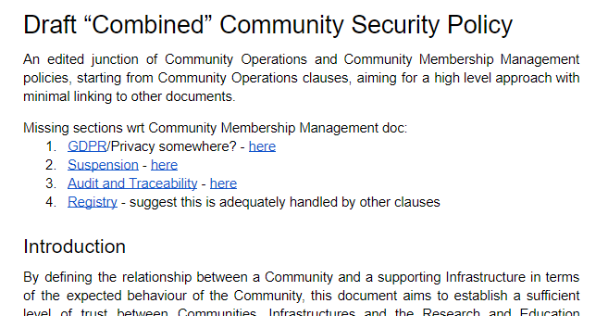
IRIS – “Combined” Community Policy
First (very) draft …
Based off C-Ops
Include ‘topics’ from M-Man not covered
Strip out the details
  But don’t lose them!
Share our experiences
Learn from the WISE …
https://bit.ly/3al8TMV
https://docs.google.com/document/d/1LxfkL9mIhtKNpkGRCuzxM7mQXJA14eysZmEIIcSABYs/edit?usp=sharing

Slide 7

Thank you
Facebook: Science and Technology Facilities Council
Twitter:@STFC_matters
YouTube: Science and Technology Facilities Council

