Slide 1



Community-based Trust Establishment
Sprint demo #5– 26th May 2020
Branko Marovic/Alan Lewis/Sergio Gomez
Q2 2020
Public
www.geant.org

Slide 2

Background
Follow-up on SFA Distributed Vetting
  Aim: Focus on a specific flow identified in cycle #1
    Community-based (Web of Trust Approach)
    Assumes a pre-existing trust fabric exists for R&E ☺
Identify and/or develop tools to support this approach
  Aim: Detail the workflow and develop a PoC demo
    Identify use cases
    Elaborate typical flows
    Design data model
    Investigate tools (platforms, pre-existing components)
    Develop PoC that integrates some of the fabric
    Demonstrate PoC and gather feedback on areas of applicability

Slide 3

Overall workflow
Initiation
Identity
Proofing
Identity
Verification
Issuance
Record keeping
Activation

Slide 4

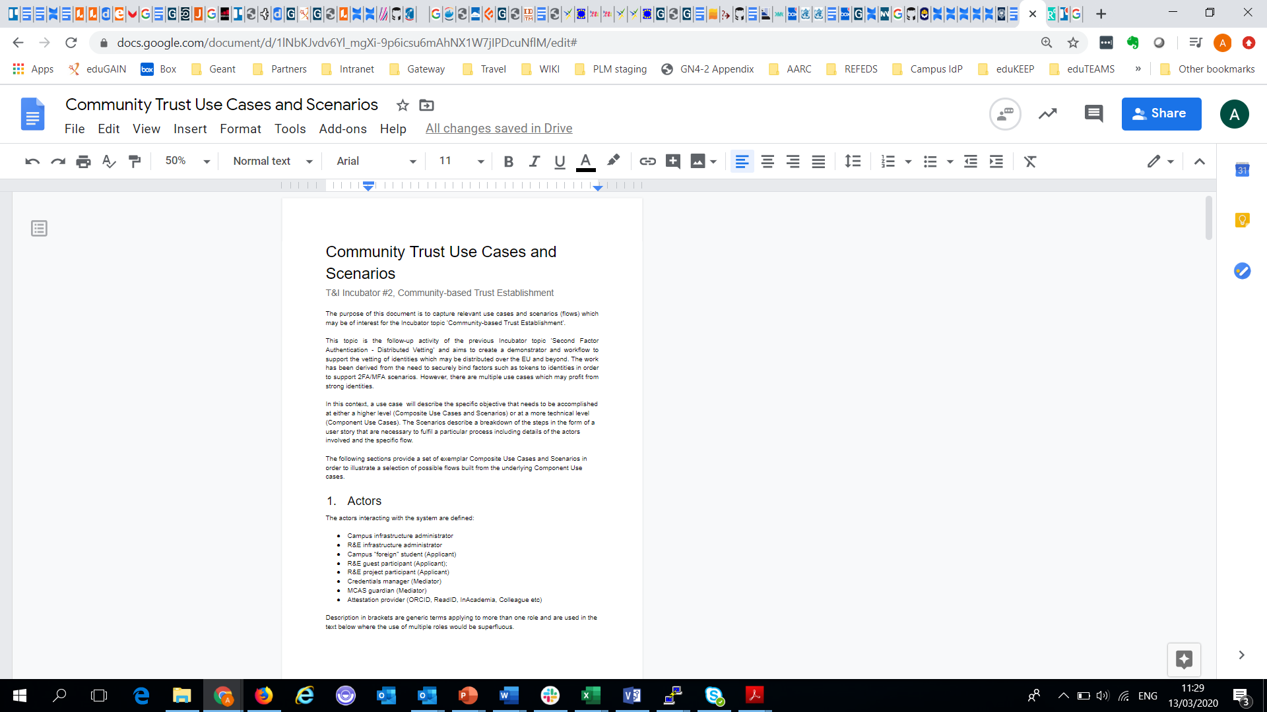
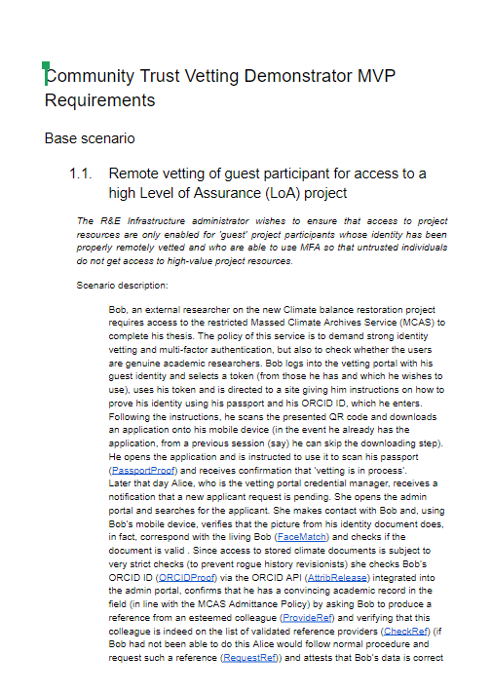
Activities status
Status
Overall flow defined
Functional architecture for PoC defined
Collaboration with SURFnet agreed
Use case identification underway
Initial PoC portal portal created
Mapping of use cases to PoC MVP
Integration with ReadID progressing
Discussions with interested communities









Slide 5

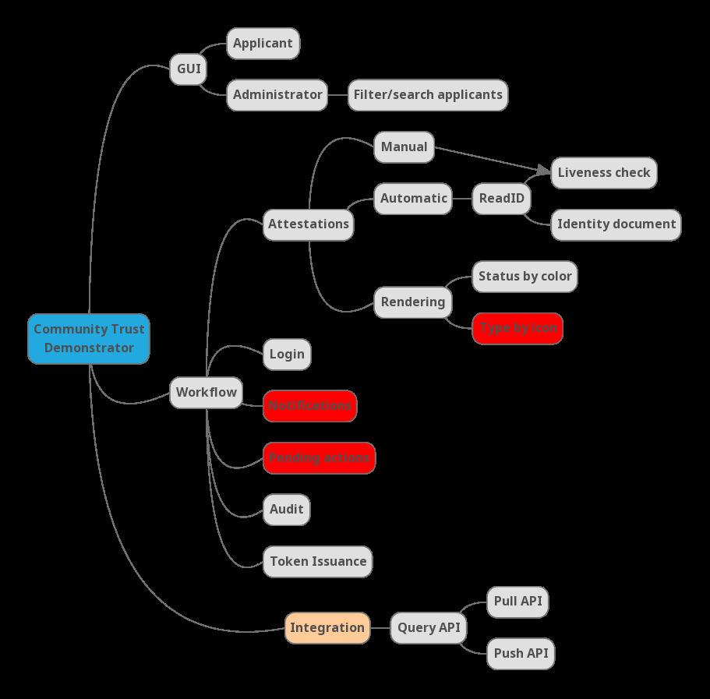
Demonstrator Use cases
USE CASE: As an applicant, I want to be guided through the workflow to register a token so it is easy to achieve.
GUI should contain descriptive text to explain the workflow process to the applicant
The GUI should be arranged in a hierarchical fashion revealing different levels of information at each level Top level……..
Starting with the demo EPIC..
Breaking down to categorised user stories…
Leading to implied requirements

Slide 6
Demonstrator PoC demo
There are two parts to our demo
  GUI showing collection of assertions, claims and attestations
  ReadID SAML API that could be separately used by services
Martin/Sergio demo

Slide 7

Coming up next….
Work is now focused in a number of areas:
  Completing work on the PoC demonstrator to illustrate the key use cases as an exemplar
  Creating a package for the community from the existing documentation
  Feedback of the study results to community
  Provide details of ReadID integration API for services (eduTEAMS)
  Consider a possible generalised identity vetting solution

Slide 8

Thank you
www.geant.org
© GÉANT Association on behalf of the GN4 Phase 2 project (GN4-2).
The research leading to these results has received funding from
the European Union’s Horizon 2020 research and innovation programme under Grant Agreement No. 731122 (GN4-2).

