Slide 1



Metadata PushMDQ
Sprint demo #5– 26th May 2020
Martin van Es /Alan Lewis
Q2 2020
Public
www.geant.org

Slide 2

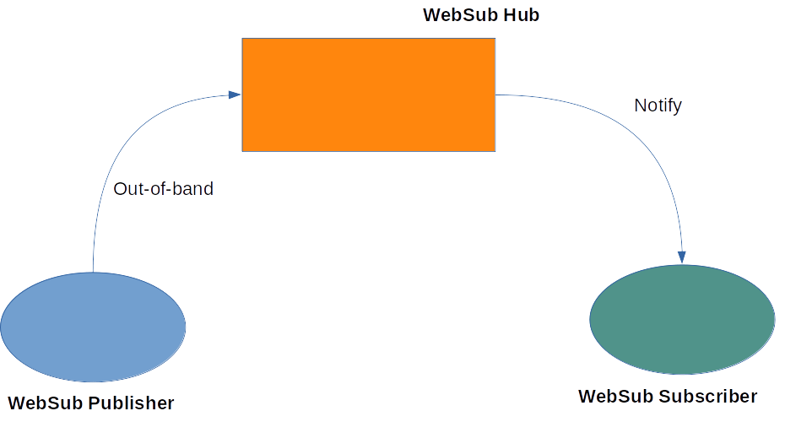
Background
Problem statement
  Efficient metadata distribution is vital for all federations
    As federations scale, exchanging a flat file becomes problematic
    Propagation delays can open the possibility of compromise
    MDQ goes some way to addressing this issue
    BUT is deterministic and a SPOF
Solution proposal
  A push-based publisher-subscriber approach based on websub
    Metadata publisher publishes to a hub
    Interested parties subscribe
    Hub send notifications when an update occurs
    Metadata propagation time is reduced

Slide 3

To PushMDQ…….
Adoption of PushMDQ has a number of potential benefits
  Changing from deterministic pull to a push mechanism reduces pulls by up to 95%
  Updates can be propagated to all entities instantly (for practical purposes)
  Use of MDQ within PushMDQ reduces the processing overhead
  Backwards compatibility with existing flat-file distribution is possible
  There is no longer a single point of failure
  Websub hubs do not need to be intelligent and may exist outside the federation

Slide 4
or not to PushMDQ, that is the question?
Adoption of PushMDQ needs careful consideration to maximise the benefits
  The protocol must be implemented (at least) at federation level
  A hub must be establish – but a public hub could be used
  Batch processing delays at the federation must be minimised
  Use of MDQ instead of flat file metadata needs investigation
  Notification thresholds for pulling of all changes must be set
  The end to end trust model needs to be worked out
  A hub reliance mechanism must be established
  Missed notification and back off strategy must be proven

Slide 5

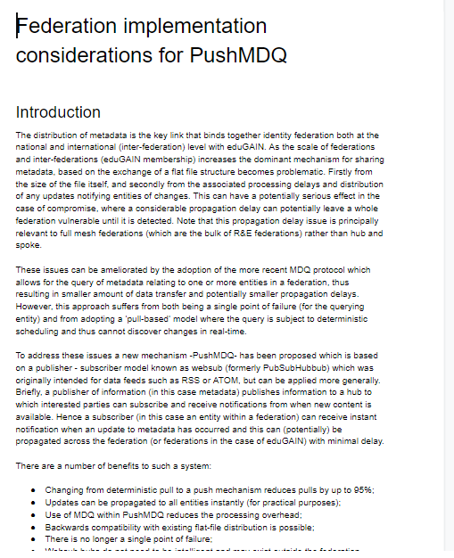
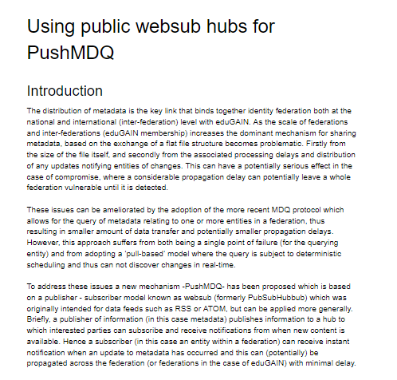
Activities status
Status
Outline proposal defined
Functional architecture for PoC defined
Test environment and PoC established
Public hubs investigated
Implementation considerations explored
Feedback from community onboarded
Proposal finalised
RFC drafted









Slide 6

Where next?
We need feedback in a number of areas
  Is the proposal of interest to federations?
  Do the issues make implementation viable?
  Are there other considerations not yet identified?
  Would some federations be interested in exploring further?
  Is a robust RFC a pre-requisite for further progress?

Slide 7

Thank you
www.geant.org
© GÉANT Association on behalf of the GN4 Phase 2 project (GN4-2).
The research leading to these results has received funding from
the European Union’s Horizon 2020 research and innovation programme under Grant Agreement No. 731122 (GN4-2).

