Slide 1
WiFiMon - a system for WiFi network performance monitoring

Slide 2





Why a system for WiFi monitoring?
WiFi is among the most popular network access methods
Measuring the performance of the WiFi networks is challenging:
Shared medium
Physical obstacles
Other networks
Antenna positioning
Measuring only signal strength or link quality from fixed points is not sufficient to get the impression about the Quality of user’s Experience (QoE)
Vendor solutions – closed and focused on the network equipment (APs)
Notes:
WiFi is among the most popular network access methods
Measuring the performance of the WiFi networks is challenging:
Air is a shared medium – other users and their usage patterns
Physical obstacles
Other networks
type of antenna, positioning, signal reflection, diffraction, refraction…
Measuring only signal strength or link quality from fixed points is not sufficient to get the impression about the Quality of user’s Experience (QoE)
Vendor solutions – closed and focused on the network equipment (APs)

Slide 3






What WiFiMon offers?
WiFiMon is vendor-independent, open-source monitoring tool transparent to the WiFi network users
Uses well known open-source components:
ELK
Akamai Boomerang
Libretest/Speedtest
NetTest
It is an active monitoring tool which creates a low network overhead (similar to one site visit)
It captures user’s perception of the network quality and provides metrics like: throughput, latency, signal strength, link quality,…
Notes:
It is a vendor-independent, open-source monitoring tool
It is transparent to the users
It creates a low network overhead (active monitoring tool)
It captures user’s perception of the network quality
It provides metrics like: throughput, latency, signal strength, link quality,…
It is built upon the well-known open-source tools like:

Slide 4

WiFiMon building blocks and operation
Two modes of operation:
crowdsourced and fixed hardware probes
Some site
WAS
Client – any user’s device
WHP – WiFiMon hardware probe (rPi)
WTS – WiFiMon Test Server - measurements
WAS – WiFiMon Analysis Server (ELK)
Site – popular web site (University, captive portal,…)
jS code
visit
results
WTS
tests
Client
WHP

Slide 5
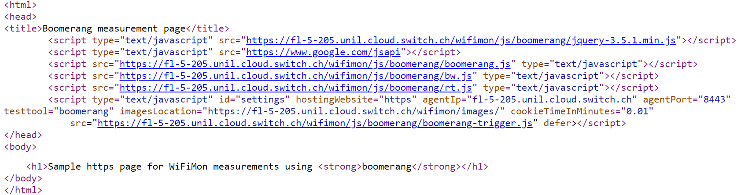
WiFiMon Software Probes (WSPs)
User devices, e.g. laptops, smartphones, etc.
Crowdsourced measurements triggered against the WTS when users visit a WiFiMon-enabled site (not triggered by end users themselves).
WiFiMon does not require additional software to be installed on user devices.
WiFiMon regulates repetitive measurements through a cookie parameter in order not to overload WAS and WTS.

Slide 6
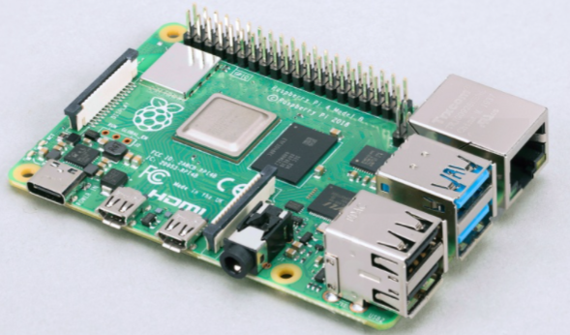
WiFiMon Hardware Probes (WHPs)
WHPs measure Wi-Fi performance from fixed points within the network
(distance between WHPs and Access Points remains relatively constant).
WHPs complement crowdsourced measurements by providing a baseline throughput.
Performance measurements similar to WSPs (based on predefined period)
WHPs collect data about monitored ESSID and nearby ESSIDs
(APs, signal strength, link quality, bit rate, TX power)
WiFiMon currently uses Raspberry Pi v3 and v4,
but any small form factor device may be used.

Slide 7
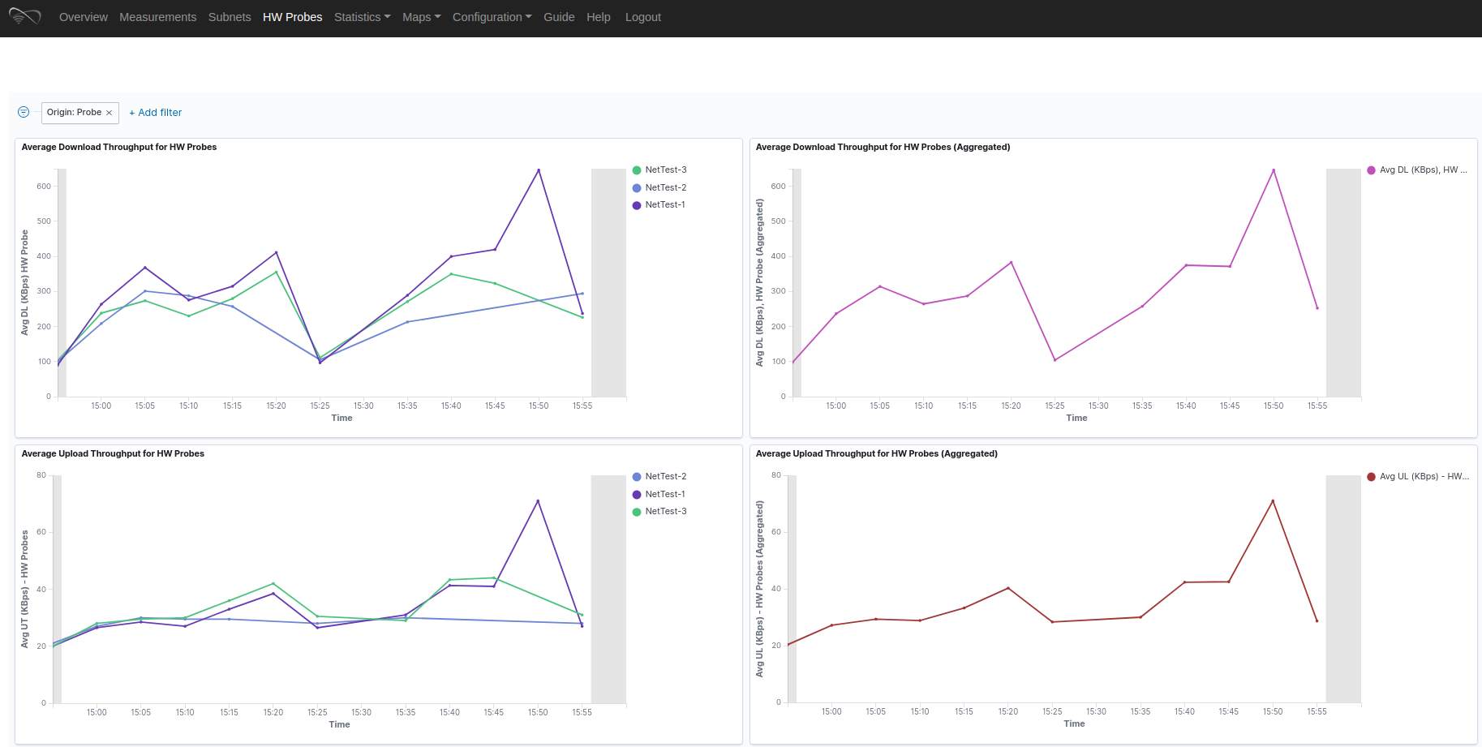
WiFiMon User Interface (UI)
Results per WHP
Aggregated Results
Results from three WHP during an hour

Slide 8
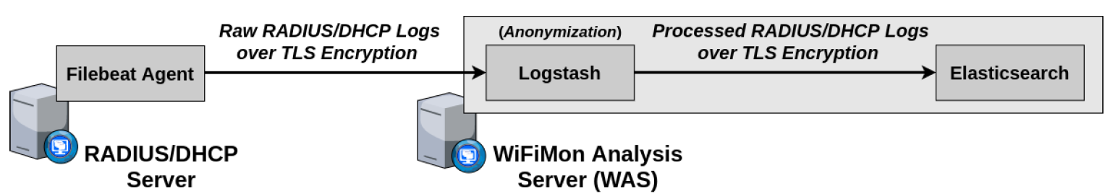
Correlation with RADIUS/DHCP Logs
Logs are:
Extracted from RADIUS/DHCP servers using Filebeat, processed and transformed by Logstash in WAS, stored in Elasticsearch of WAS
Correlation options:
With end user IP address (relying solely on RADIUS logs)
With end user MAC address (using both RADIUS and DHCP logs)
Personally Identifiable Information (PII): IP and MAC addresses are secured in transit using a TLS-encrypted channel and stored hashed in WAS (based on X-Pack)
Notes:
→ Correlation comparisons are performed on hashed strings.
Still a problem of rainbow tables…

Slide 9
WiFiMon measurement results

Slide 10
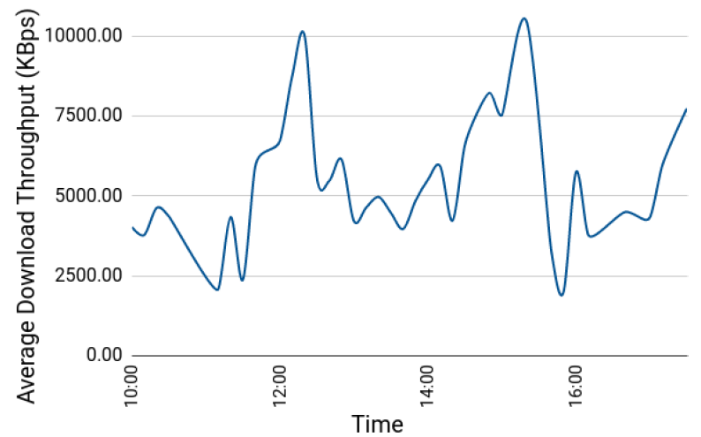
GÉANT Symposium 2020 (1)
Average download throughput reported by crowdsourced measurements
(1st Symposium Day between 10:00 and 17:00):
Major drops: 11:00 – 11:40 and 15:30 – 16:00
→ periods after coffee break (more people visiting symposium agenda)
Notable drop: 12:30 – 14:00
→ during and after lunch time when most participants gathered in less space
Higher levels: around 12:20 and 15:20 → participants distributed across many different sessions
3
3
1
2
2
1
1
3

Slide 11
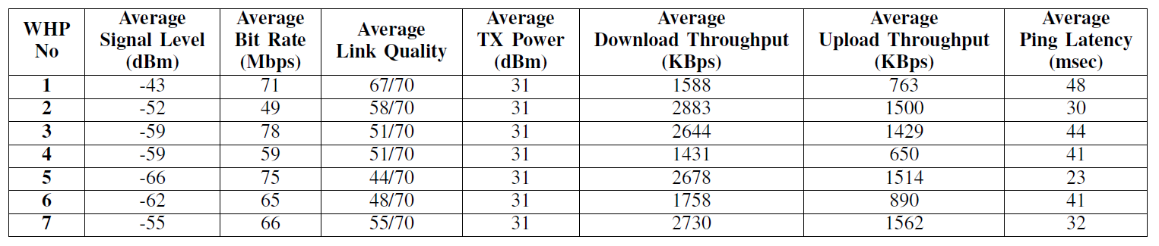
GÉANT Symposium 2020 (2)
Wireless network metrics and performance measurements
Observation: The trends of wireless network metrics do not necessarily follow those of the performance measurements
WHP #1: best average link quality, but among the worst throughput results
WHP #5: worst average link quality, but among the best throughput results

Slide 12
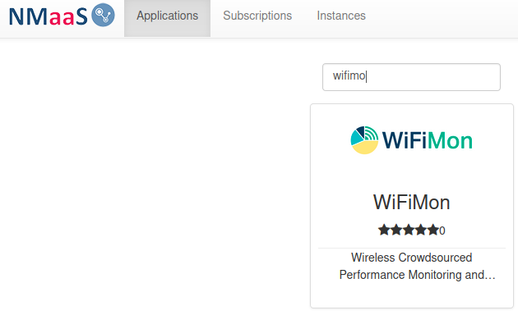
WiFiMon service model
Two service delivery options:
(prefered) Download and install. Support from WiFiMon team. Interested institutions install all the components at their premises
If needed (for testing/trying) WiFiMon team offers a central WiFiMon WAS instance per institution on NMaaS
With Option 1 there is no personal data and PII sharing with the third party. WiFiMon offers data protection and pseudonymisation methods as will be described.
If you are interested, register at (our mailing lists) you will get news, updates, new feature description:
https://www.geant.org/wifimon/Pages/Register.aspx

Slide 13
WiFiMon resources
WiFiMon video: https://www.youtube.com/watch?v=9LuGlF6JSnA
GEANT WiFiMon page: https://www.geant.org/wifimon/Pages/default.aspx
WiFiMon wiki page: https://wiki.geant.org/display/WIF
WiFiMon code: https://bitbucket.software.geant.org/projects/WFMON/repos/agent/browse
WiFiMon Infoshare: https://www.youtube.com/watch?v=VXQV2zWRKgo
Publications and Presentations: https://wiki.geant.org/display/WIF/WiFiMon+Publications

Slide 14
Pavle Vuletić
Associate professor @ UoB
pavle.vuletic@etf.bg.ac.rs

