Slide 1

Wi-Fi Performance Monitoring with WiFiMon: Simplifying Installation via Automation
Elisantila Gaci, RASH
Team Leader of Services Department/WiFiMon Team Member
TNC22 Lightning Talks
June 2022, Trieste, Italy

Slide 2



WiFiMon History
More than six years ago an idea about crowdsourced Wi-Fi monitoring was presented at the TNC15 in Porto.
The idea came from HEAnet representatives within the GN4-1 project- how to capture the user’s perception of the WiFi network performance
Mission Statement
WiFiMon - Problem statement
Caused later development of the WiFiMon service within the GÉANT projects
• Development in GN4-2 – crowdsourced WiFi monitoring
• New features in GN4-3 – fixed hardware probes
  • The same tools as for the crowdsourced monitoring
  • Information about the signal strength and quality
  • Correlation with RADIUS logs
• GEANT service since July 2020

Slide 3

Introduction WiFiMon
WiFiMon is now a GÉANT service:
An open-source toolset
Provides methods for evaluating the performance of Wi-Fi networks
Its purpose is to assist network administrators to identify underperforming areas within their networks.

Slide 4
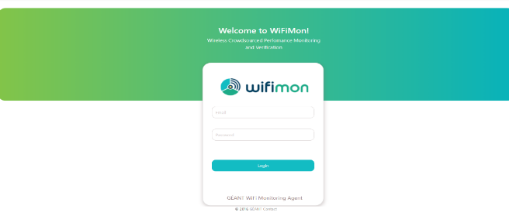
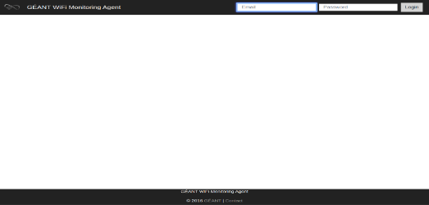
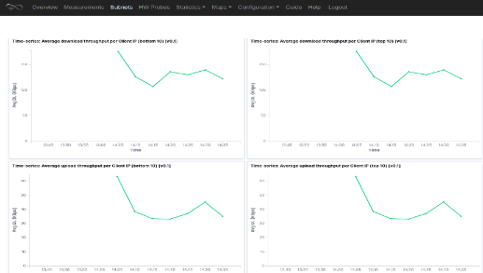
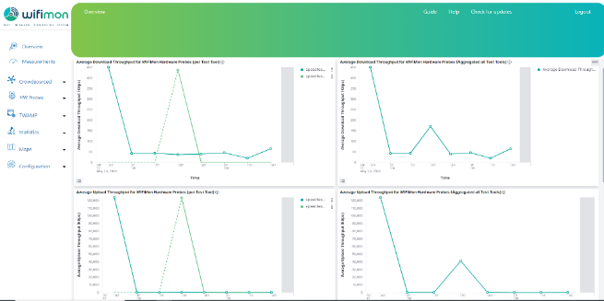
WiFiMon Web User Interface
Old version
In December 2021 was decided to change the User Interface of WiFiMon
This came as a work for changing the logo and the WiFiMon wiki pages

Slide 5
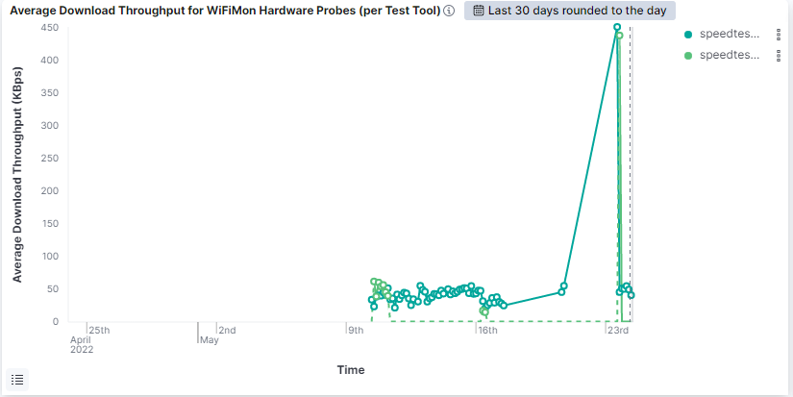
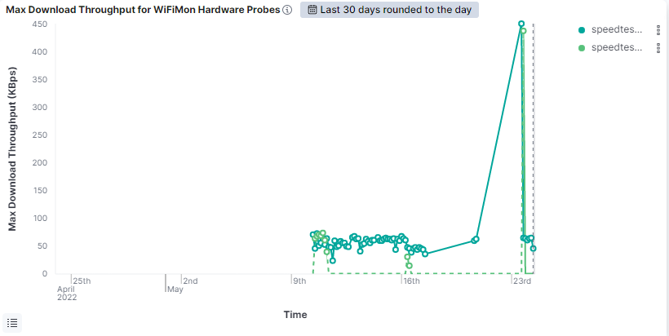
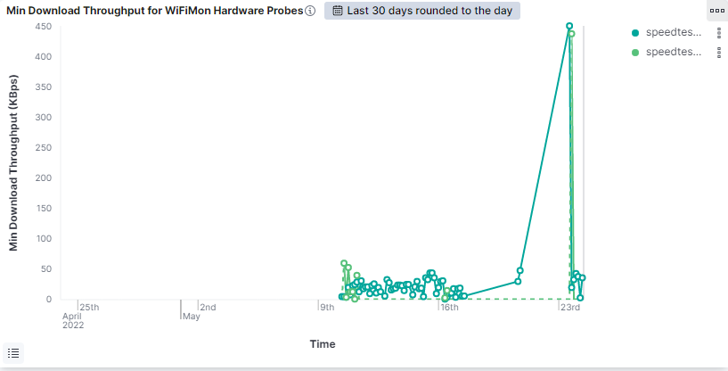
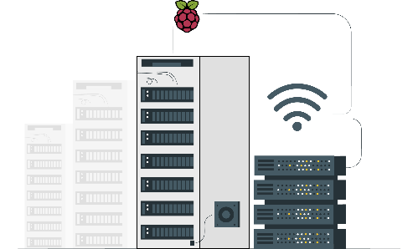
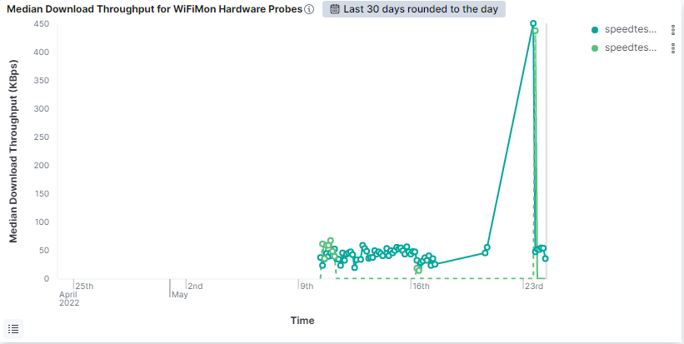
WiFiMon Web User Interface
Average download
Median download
Max download
Min download

Slide 6

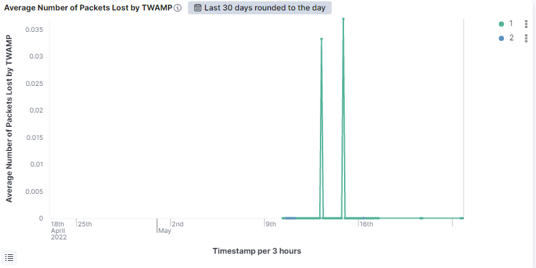
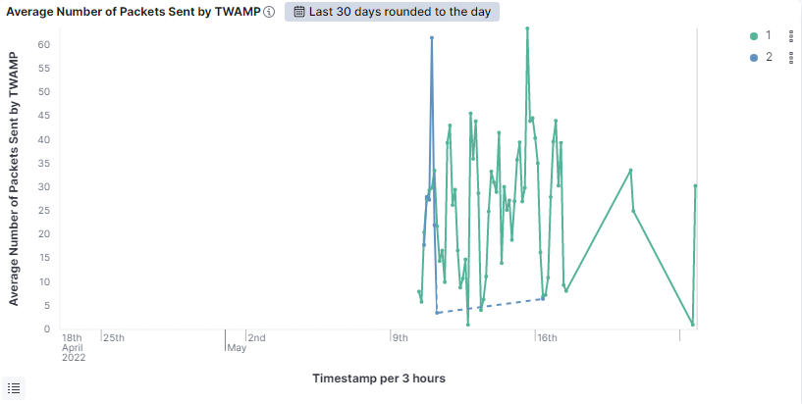
WiFiMon Web User Interface
Average Number of Packets Sent by TWAMP
Average Number of Packets Lost by TWAMP

Slide 7


Slide 8

WiFiMon Installation
WiFiMon Analysis Installation (WAS): Manual Installation
PostgreSQL Installation / Creation of database, users & tables in PostgreSQL
Installation of Java
Elasticsearch, Kibana, Logstash (ELK): Installation/Configuration
Installation of WiFiMon Agent & WiFiMon User Interface
Elasticsearch indices creation & Kibana Dashboards import
Configuration of WiFiMon Secure Agent certificates
Correlation with RADIUS/DHCP logs
Configuration of X-Pack for ELK Stack security

Slide 9

WiFiMon Installation
WAS Automated Installation
Two Options:
1. WAS (institution premises)
Ansible playbook for automated installation
All data stay within the institution
Installation in less than 15 min
2. WAS (cloud environment)
WAS instance per institution deployed on NMaaS
Appropriate for trying WiFiMon
Installation in less than 10 min

Slide 10

Advantages of the final version
Installation in less than 15 min
Support for TWAMP measurements (hardware probes)
Support for IPv6

Slide 11

I'm in a serious relationship with my WIFI
You could say we have a strong connection

Slide 12

WiFiMon – Dissemination
1. TNC2015 – Porto
2. IEEE: ICUMT- Lisbon October 2016
3. TNC2016 - Praha
4. IEEE: ICT-2017, Limassol May 2017
5. 2021 16th Annual Conference on Wireless On-demand Network Systems and Services (WONS)

Slide 13


WiFiMon Future Steps
Additional information from WHPs
- CPU/Memory/Disk info
- Wi-Fi frequency
- TWAMP protocol measurements
Additional monitoring tools
- Research for appropriate UNIX-based tools
Automatic prediction of Wi-Fi performance drops (Time series analysis)
Automatic correlation between crowdsourced and probe measurements
Support for IPv6

Slide 14

WiFiMon resources
WiFiMon video: https://www.youtube.com/watch?v=9LuGlF6JSnA
GEANT WiFiMon page: https://www.geant.org/wifimon/Pages/default.aspx
WiFiMon wiki page: https://wiki.geant.org/display/WIF
WiFiMoncode: https://bitbucket.software.geant.org/projects/WFMON/repos/agent/browse
WiFiMon Infoshare: https://www.youtube.com/watch?v=VXQV2zWRKgo
Publications and Presentations: https://wiki.geant.org/display/WIF/WiFiMon+Publications

