Slide 1

Wi-Fi Performance Monitoring with WiFiMon: Simplifying Installation via Automation
Elisantila Gaci, RASH
Team Leader of Services Department / WiFiMon Team Member
TNC22 Lightning Talks
June 2022, Trieste, Italy

Slide 2

WiFi and THE importance OF IT

Slide 3

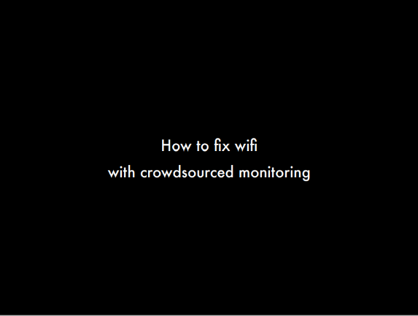
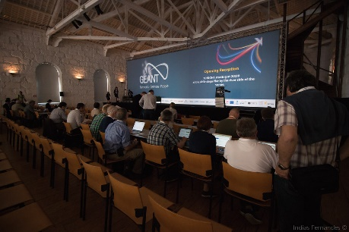

WiFiMon HISTORY

Slide 4



WiFiMon HISTORY

Slide 5
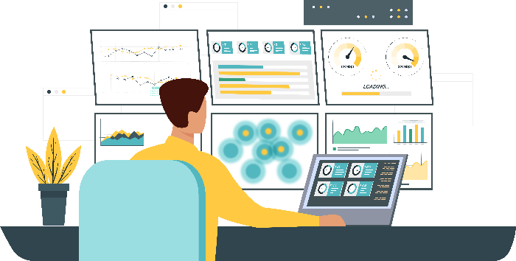
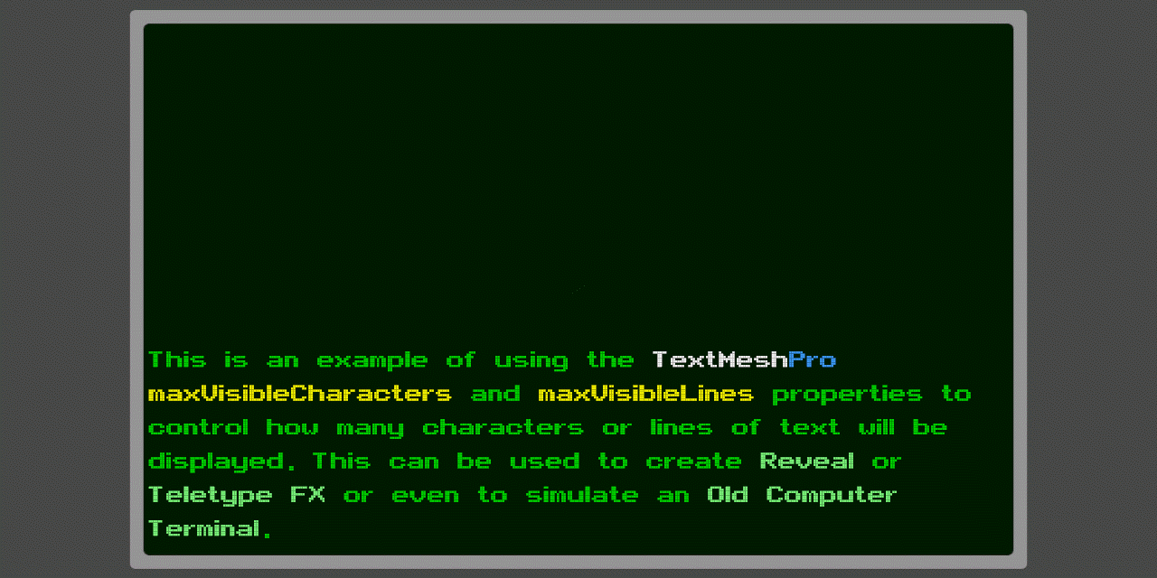
WiFiMon MANUAL INSTALLATION

Slide 6

WiFiMon MANUAL INSTALLATION
Time consuming

Slide 7


WiFiMon INSTALLATION
WAS Automated Installation
15MINUTES

Slide 8
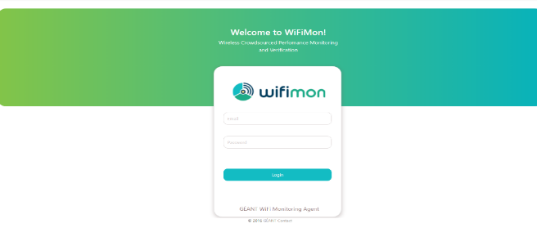
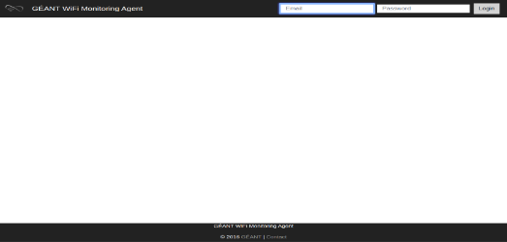
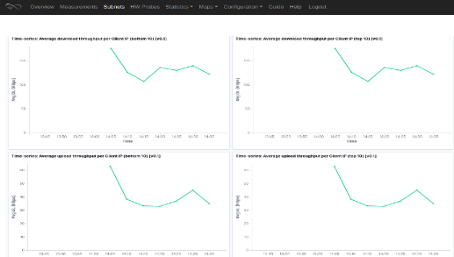
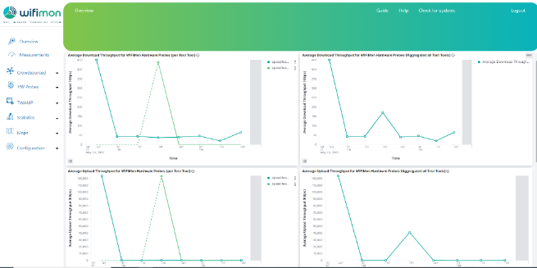
WiFiMon WEB USER INTERFACE
Old version

Slide 9
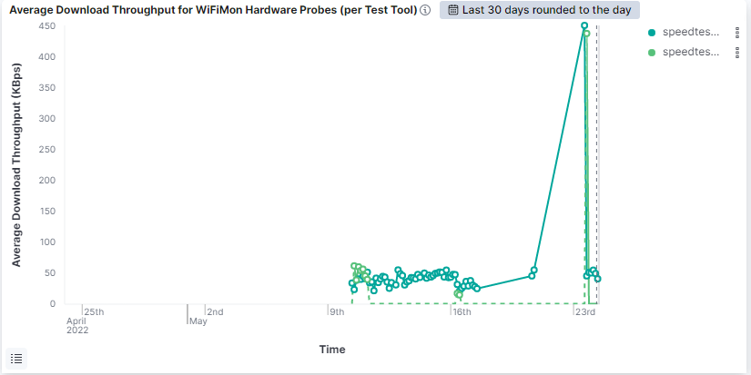
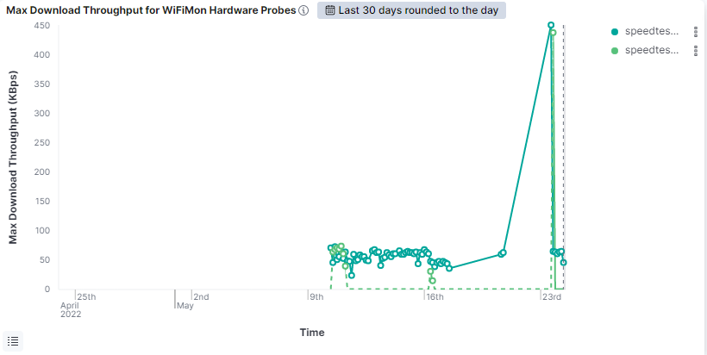
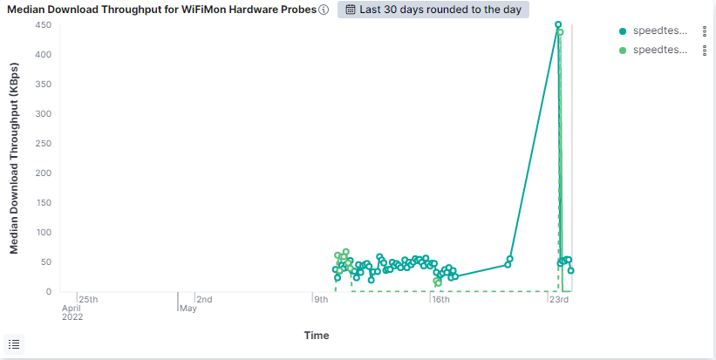
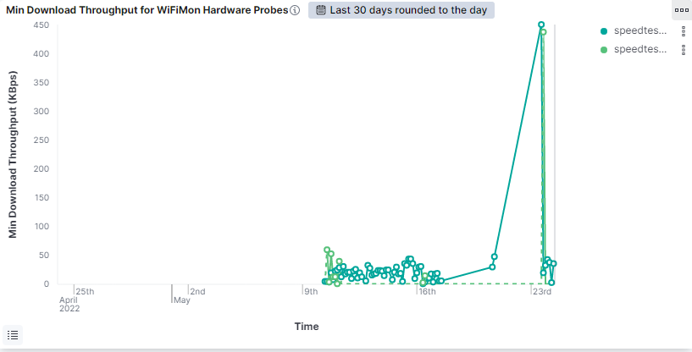
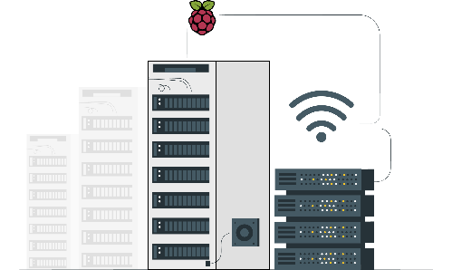
WiFiMon WEB USER INTERFACE
Average download
Median download
Max download
Min download

Slide 10
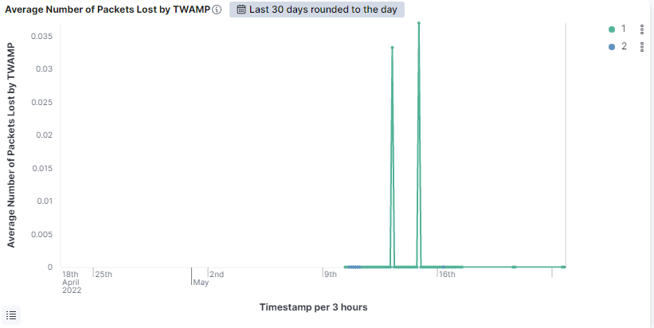

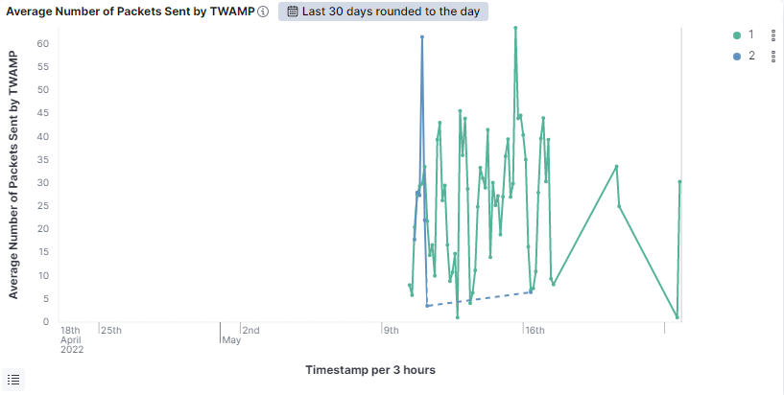
WiFiMon WEB USER INTERFACE
Average Number of Packets Sent by TWAMP
Average Number of Packets Lost by TWAMP

Slide 11
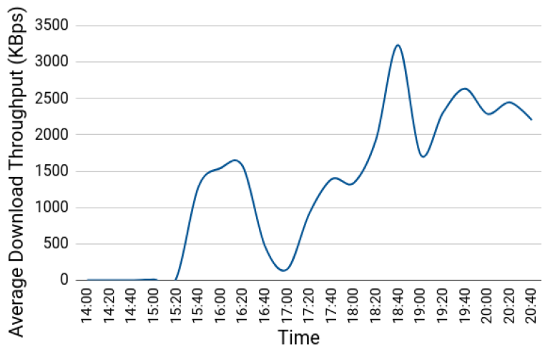
TNC19 PILOT
Average download throughput reported by a WHP placed in the main hall during the 1st conference day:
14:00 – 15:20: Low throughput and connectivity issues during lightning talks
15:20 – 16:30: Less people in the venue → Higher throughput
Around 17:00: Significant drop because of opening ceremony
After 18:00: Wi-Fi performance restored after people had left the venue

Slide 12
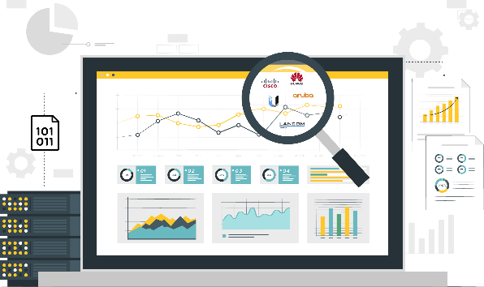
WiFiMon RESOURCES
WiFiMon video: https://www.youtube.com/watch?v=9LuGlF6JSnA
GEANT WiFiMon page: https://www.geant.org/wifimon/Pages/default.aspx
WiFiMon wiki page: https://wiki.geant.org/display/WIF
WiFiMoncode: https://bitbucket.software.geant.org/projects/WFMON/repos/agent/browse
WiFiMon Infoshare: https://www.youtube.com/watch?v=VXQV2zWRKgo
Publications and Presentations: https://wiki.geant.org/display/WIF/WiFiMon+Publications

Slide 13
egaci@rash.al

