Slide 2
WiFiMon: Introduction
Monitoring Wi-Fi network performance as experienced by end users
Purpose:
Detection of Wi-Fi throughput degradation
Determination of underperforming areas within a Wi-Fi network
→ Admins may enhance performance, e.g. by installing more APs
Main sources of data:
End users roaming the network → WiFiMon Software Probes (WSP’s)
Fixed-point devices → WiFiMon Hardware Probes (WHP’s)
WHP’s enable baseline comparisons for WSP measurements
WiFiMon Analysis Server (WAS): Centralised processing and control

Slide 3
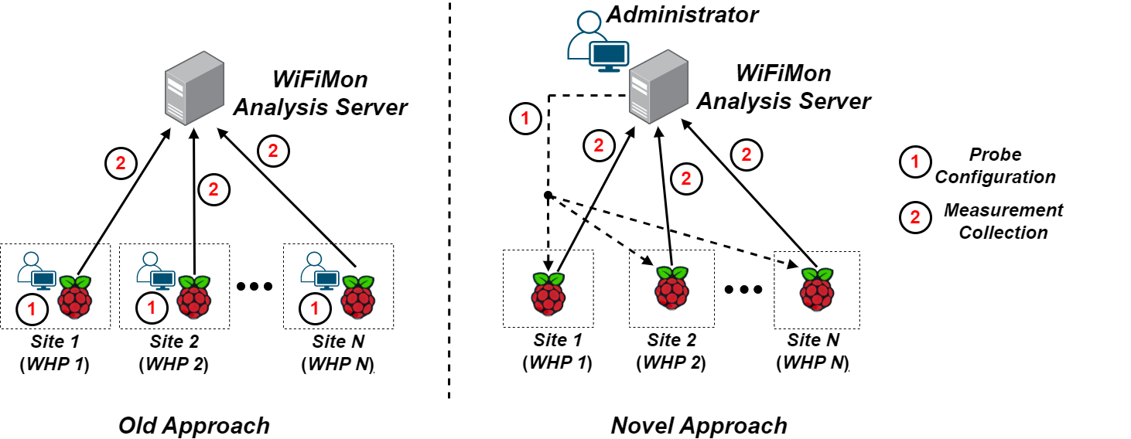
WHP Configuration & Control
WHP’s are installed by various NREN’s and Universities
Feedback from Administrators demonstrated limitations for setups with several WHP’s:
In NAT networks, reconfigurations require physically connecting to WHP’s
In public networks, remote SSH connectons require static IP’s → reduced flexibility
Administrators must edit configuration files themselves (hard, error-prone)
Novel approach required!!!
Remote & user-friendly configuration of WHP’s from a central point (WAS)
Ability to control WHP’s behind NAT networks

Slide 4
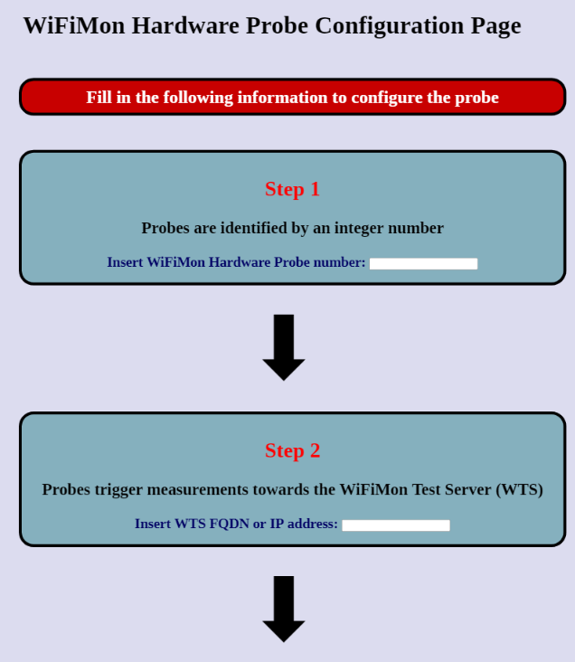
WHP Configuration Made easy
New feature integrated within the WIFiMon User Interface (UI)
WiFiMon Administrators (re)configure WHP’s from the WiFiMon UI instead of manually editing configuration files
Provided data:
Device identification number
FQDN’s/IP addresses of WiFiMon components
Location information
Configuration files are generated based on Jinja2 templates

Slide 5
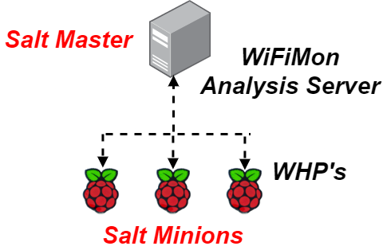
Remote WHP Configuration Made Possible
Solution based on the Salt
infrastructure management tool
WiFiMon Analysis Server → Salt Master
WiFiMon Hardware Probes → Salt Minions
Salt establishes application layer communication:
- WHP’s are remotely configured from the WAS
Remote reconfiguration possible even for WHP’s behind NAT
Static IP addresses are not required → Flexibility
1
Salt includes a ZeroMQ message broker:
Parallel configuration regardless of the WHP total number
2
3
Configuration files generated from templates are pushed from the WAS to the respective probes
Why not Ansible??? → Agentless, but requires SSH

