Slide 1
Wi-Fi Network Monitoring with GÉANT WiFiMon
Nikos Kostopoulos, NTUA, WiFiMon Team Member
Elisantila Gaci, RASH, WiFiMon Service Manager
RoEduNet Conference 2023, Craiova, Romania
September 21th, 2023

Slide 2

Introduction

Slide 3
WiFiMon GÉANT Service
Monitoring Wi-Fi performance as experienced by end users
Combination of crowdsourced & hardware probe measurements
IEEE 802.1X networks (eduroam): Data from RADIUS & DHCP logs
for richer analysis, e.g. per Access Point (AP)
Contribution:
Detection of Wi-Fi throughput degradation
Determination of underperforming areas within a Wi-Fi network
→ Admins may enhance performance, e.g. by installing more APs

Slide 4

WiFiMon vs Related Monitoring Tools
Monitoring from the end-user perspective (end-user experience)
No requirements for app installation or end-user intervention
Centralized view of Wi-Fi performance available to the administrator

Slide 5
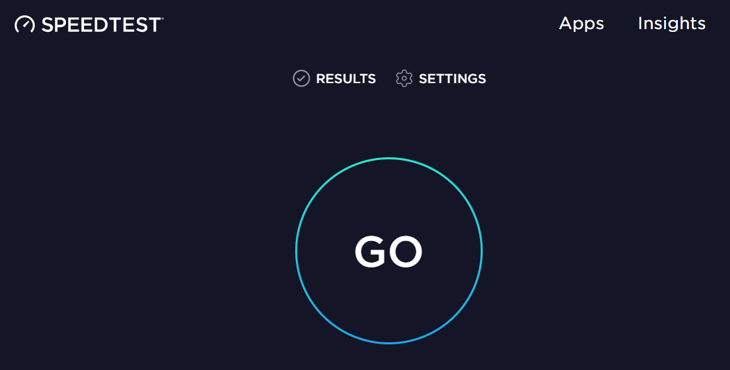
Example: WiFiMon vs Ookla Speedtest
WiFiMon | Ookla Speedtest
Automatically by visiting a site | By pressing “GO”
Wi-Fi administrator | End users
Measurements are triggered:
Results collected by:

Slide 6
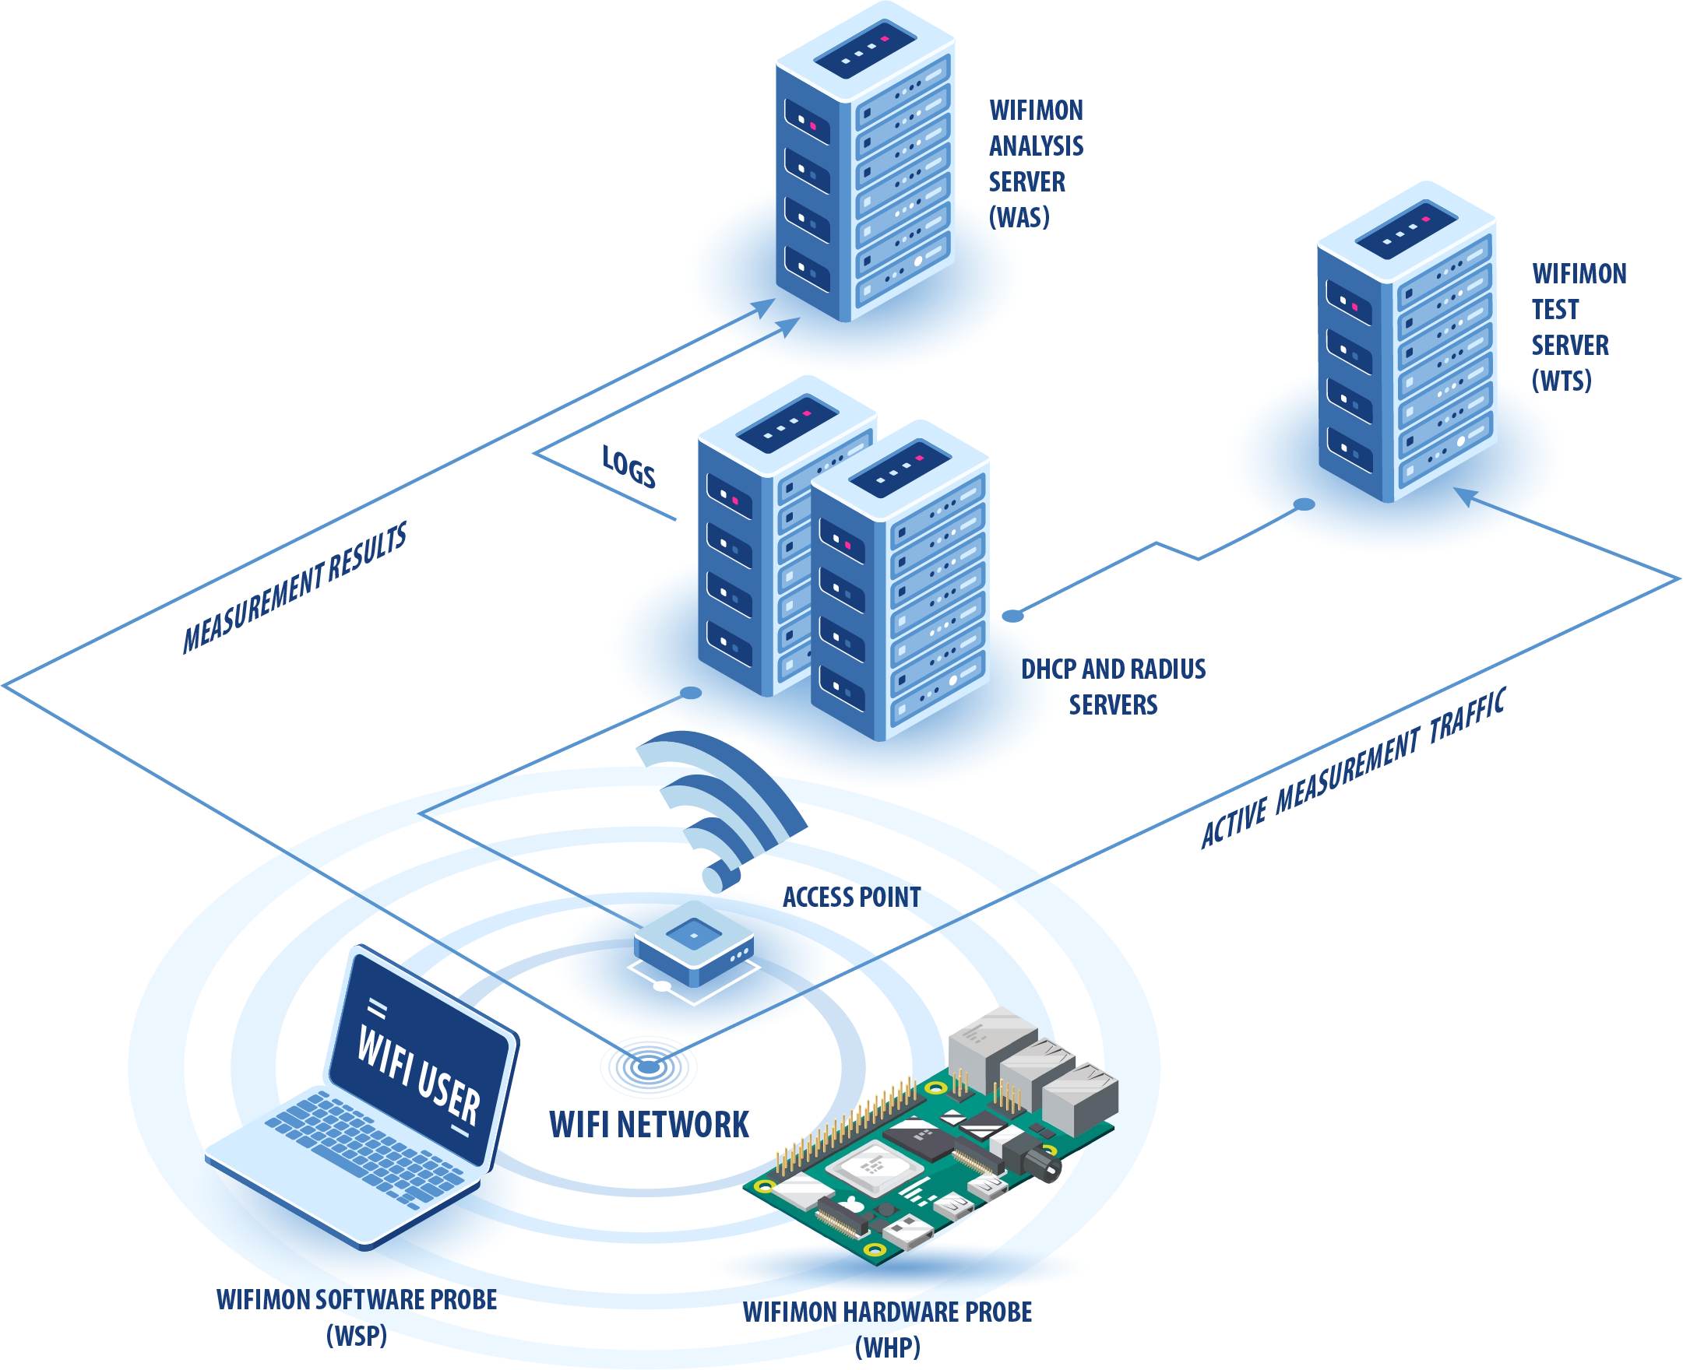
WiFiMon Operation
WiFiMon Components:
WiFiMon Software Probes (WSPs)
WiFiMon Hardware Probes (WHPs)
WiFiMon Analysis Server (WAS)
WiFiMon Test Server (WTS)

Slide 7
Components

Slide 8


WiFiMon Test Server (WTS)
Purpose: Holds code and test data for performance measurements
Based on JavaScript (JS) technology
HTML script tags pointing to test tools added to frequently visited sites
2 available test tools:
Akamai Boomerang
LibreSpeed Speedtest
WTS Placement: Close to the monitored networks
(RTT between end devices and WTS included in results)
→ If impossible: WiFiMon captures relative performance changes

Slide 9

WiFiMon Software Probes (WSPs)
End-user devices
Crowdsourced measurements triggered against the WTS when users visit a WiFiMon-enabled site
No requirement for additional software within user devices
Repetitive measurements regulated via a cookie value

Slide 10
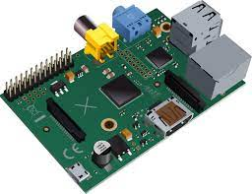
WiFiMon Hardware Probes (WHPs)
Wi-Fi performance measurements from fixed points within the network
Baseline throughput that complements crowdsourced measurements
Performance measurements similar to WSP ones
Additional data about monitored and nearby ESSIDs
TWAMP Measurements, System data (CPU, memory, etc)
Triggering measurements based on crontabs
Tested for Raspberry Pi v3 and v4

Slide 11
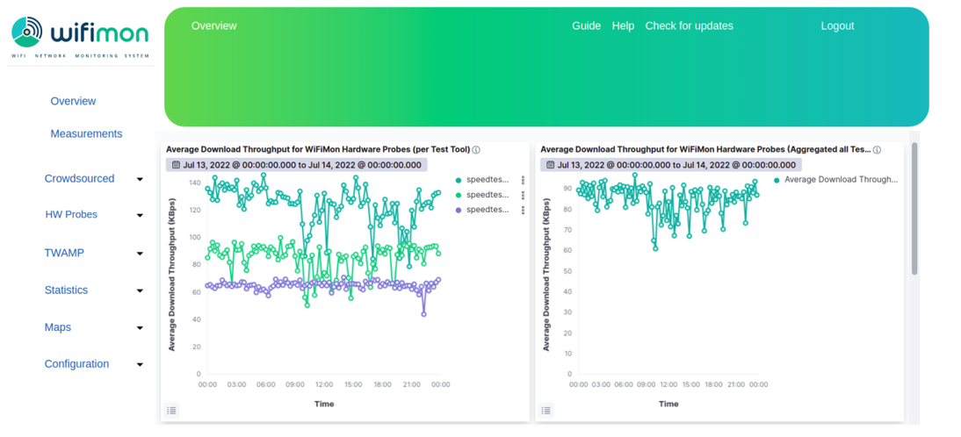
WiFiMon User Interface (1)
Results per WHP
Aggregated Results

Slide 12
WiFiMon User Interface (2)
Dashboards available for:
Average values
Median values
Maximum values
Minimum values
95th Percentile values
Depicting estimations of:
Download throughput
Upload throughput
HTTP ping Round Trip Time (RTT)
That may be:
Uncorrelated
Correlated with the available APs
Sources:
Crowdsourced measurements
Hardware Probe measurements

Slide 13
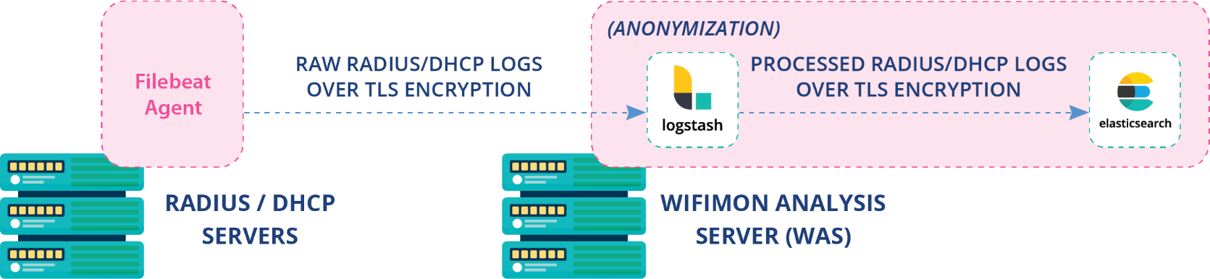
Correlation with RADIUS/DHCP Logs
Logs are:
Extracted from RADIUS/DHCP servers using Filebeat
Processed and transformed by Logstash in WAS
Stored in Elasticsearch of WAS
Correlation options:
With end-user IP address (only RADIUS logs)
With end-user MAC address (both RADIUS & DHCP logs)
Personally Identifiable Information: IP/MAC addresses secured in transit using TLS-encrypted channels and stored hashed in WAS (X-Pack)

Slide 14
Installation

Slide 15
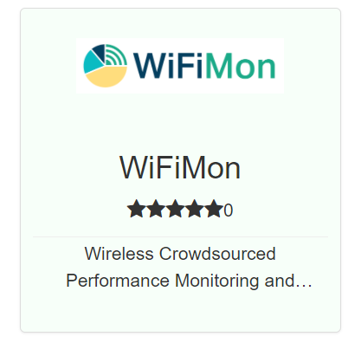
WiFiMon Installation Options
Institutions install all components on their premises
- Ansible playbook for WAS/WTS automated installation
- All data stay within the institution premises
NMaaS Portfolio
NMaaS (simpler option for testing/trying WiFiMon)
- Another GÉANT Service
- WiFiMon WAS instance deployed on NMaaS
- WTS installation still required by institutions
(should be close to the monitored network)
Manual WAS installation: Abandoned by WiFiMon

Slide 16
WiFiMon Evolution

Slide 17
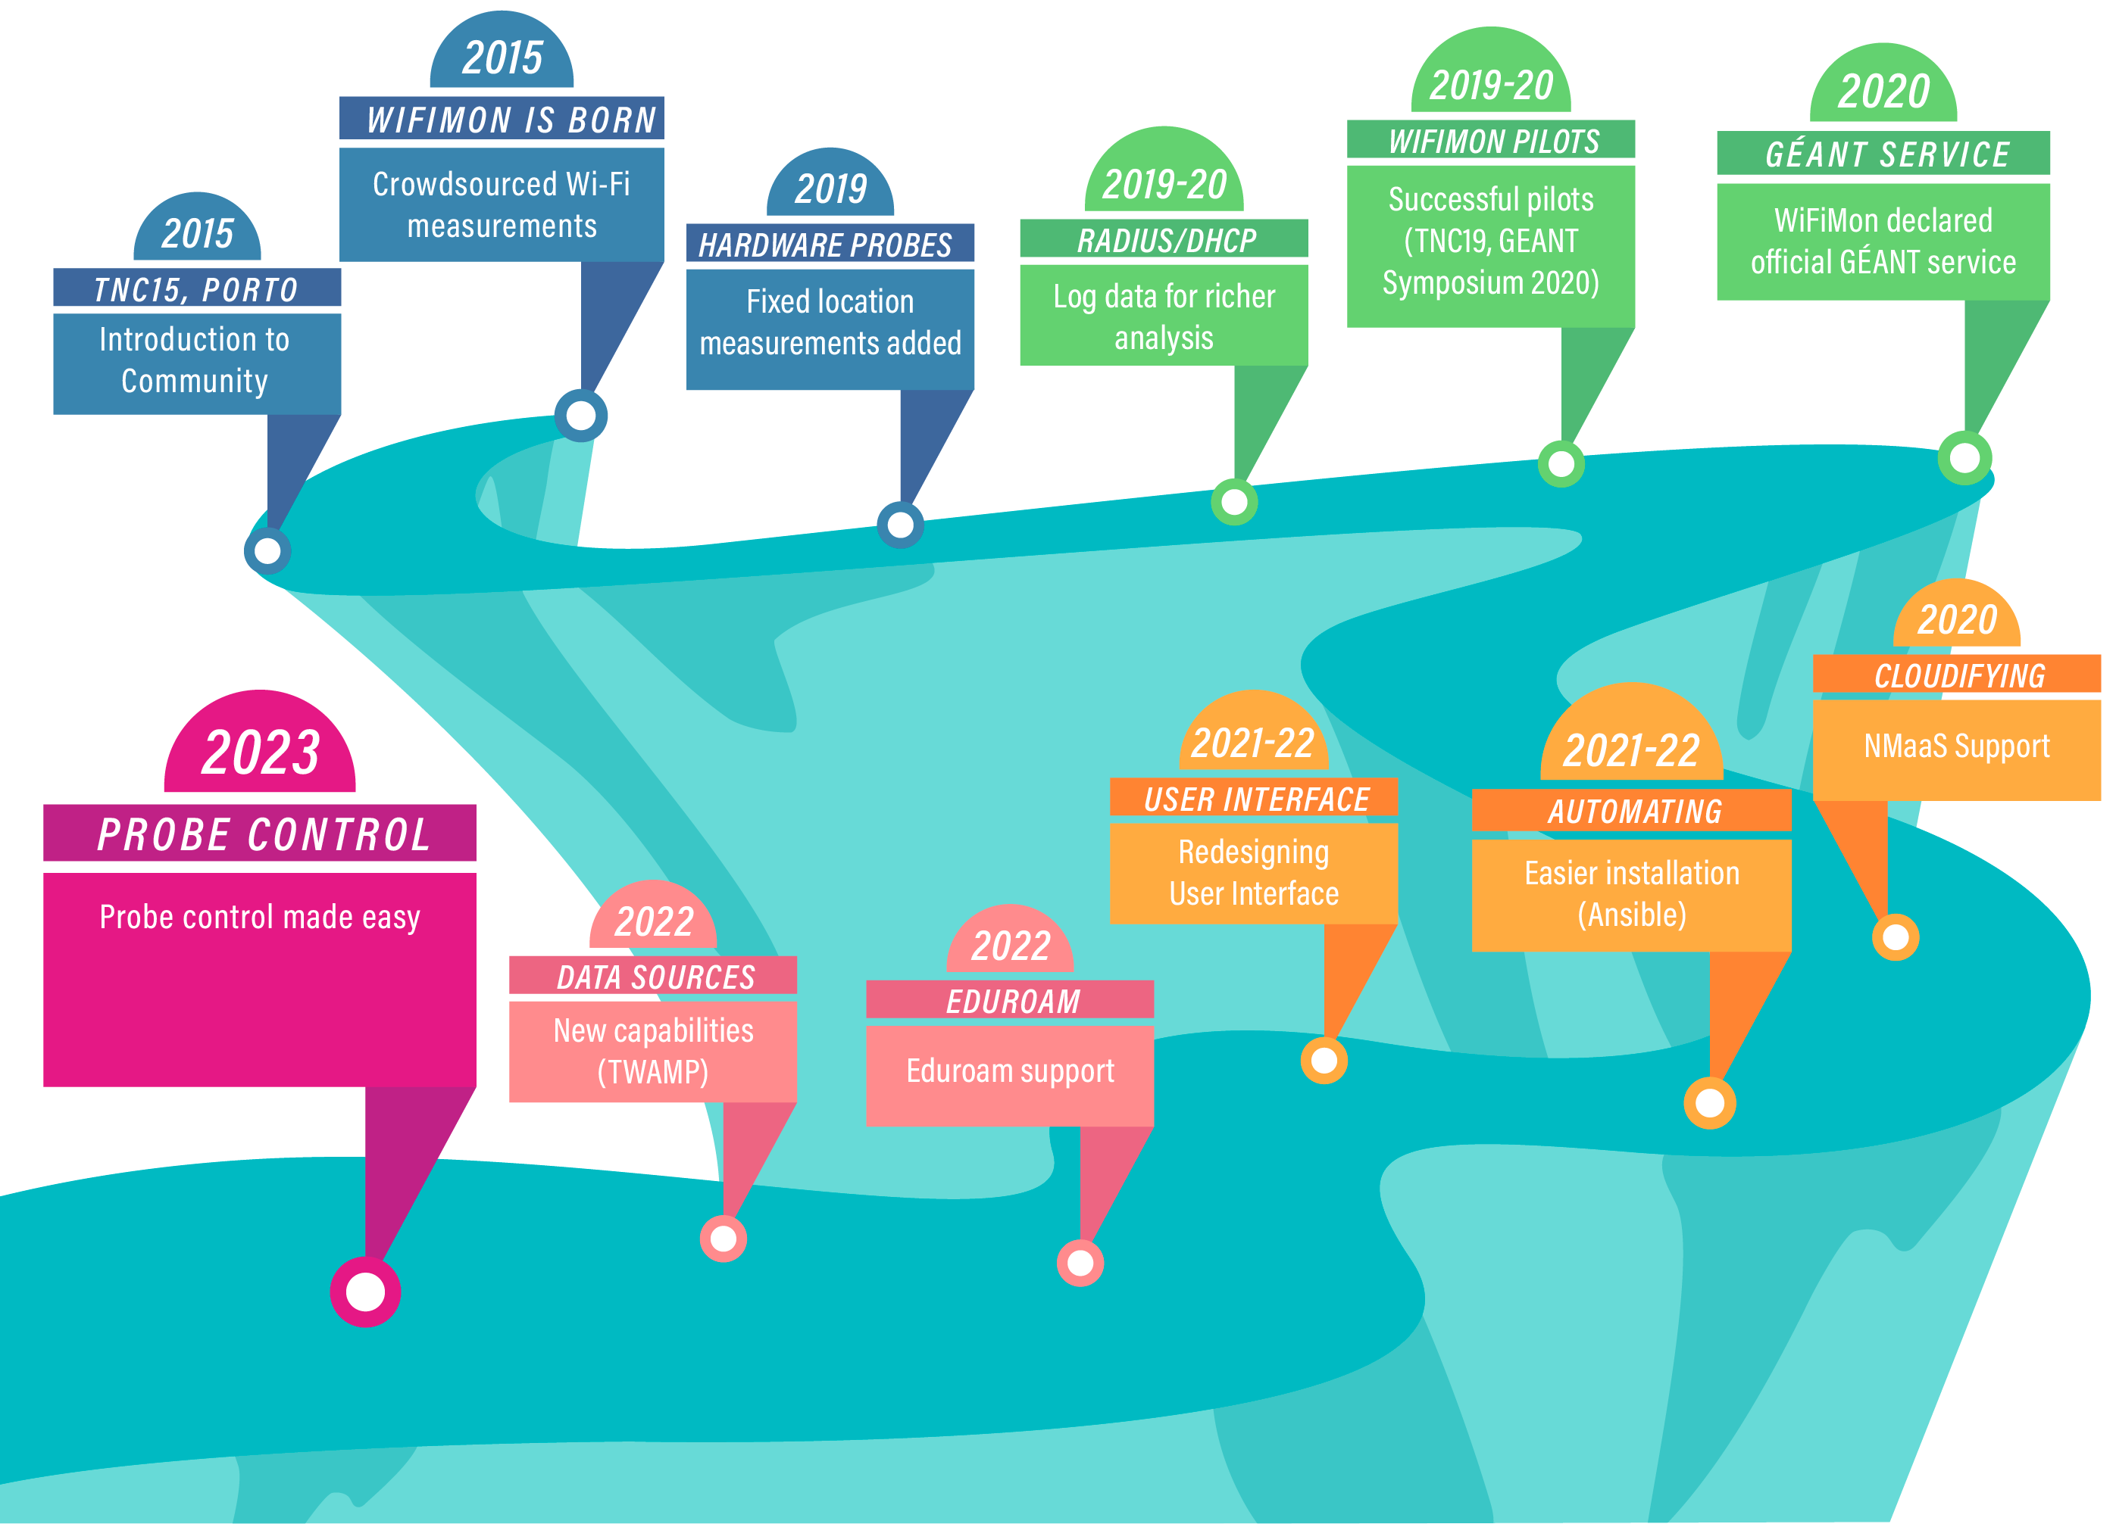
WiFiMon Evolution

Slide 18
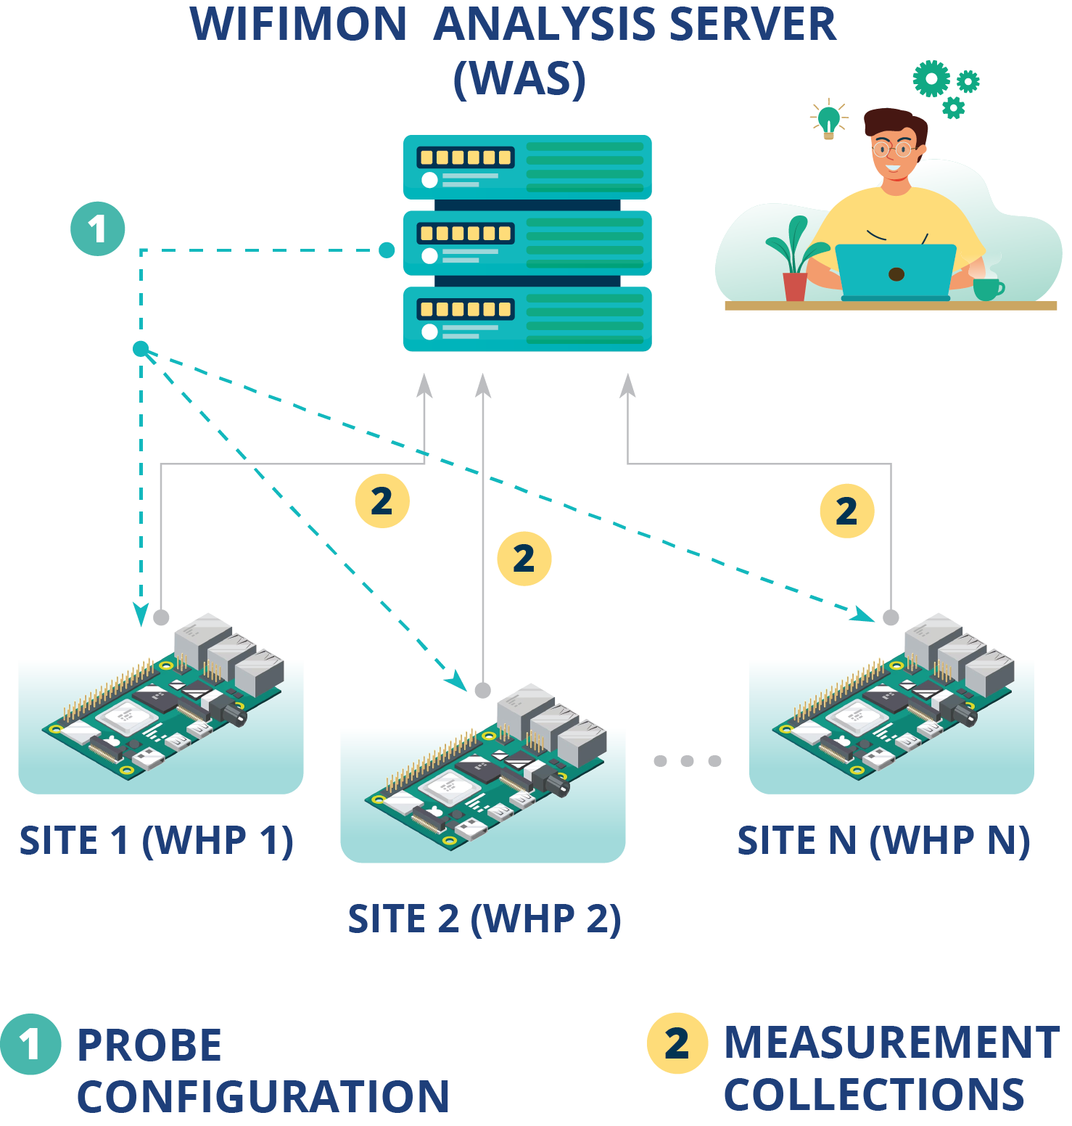
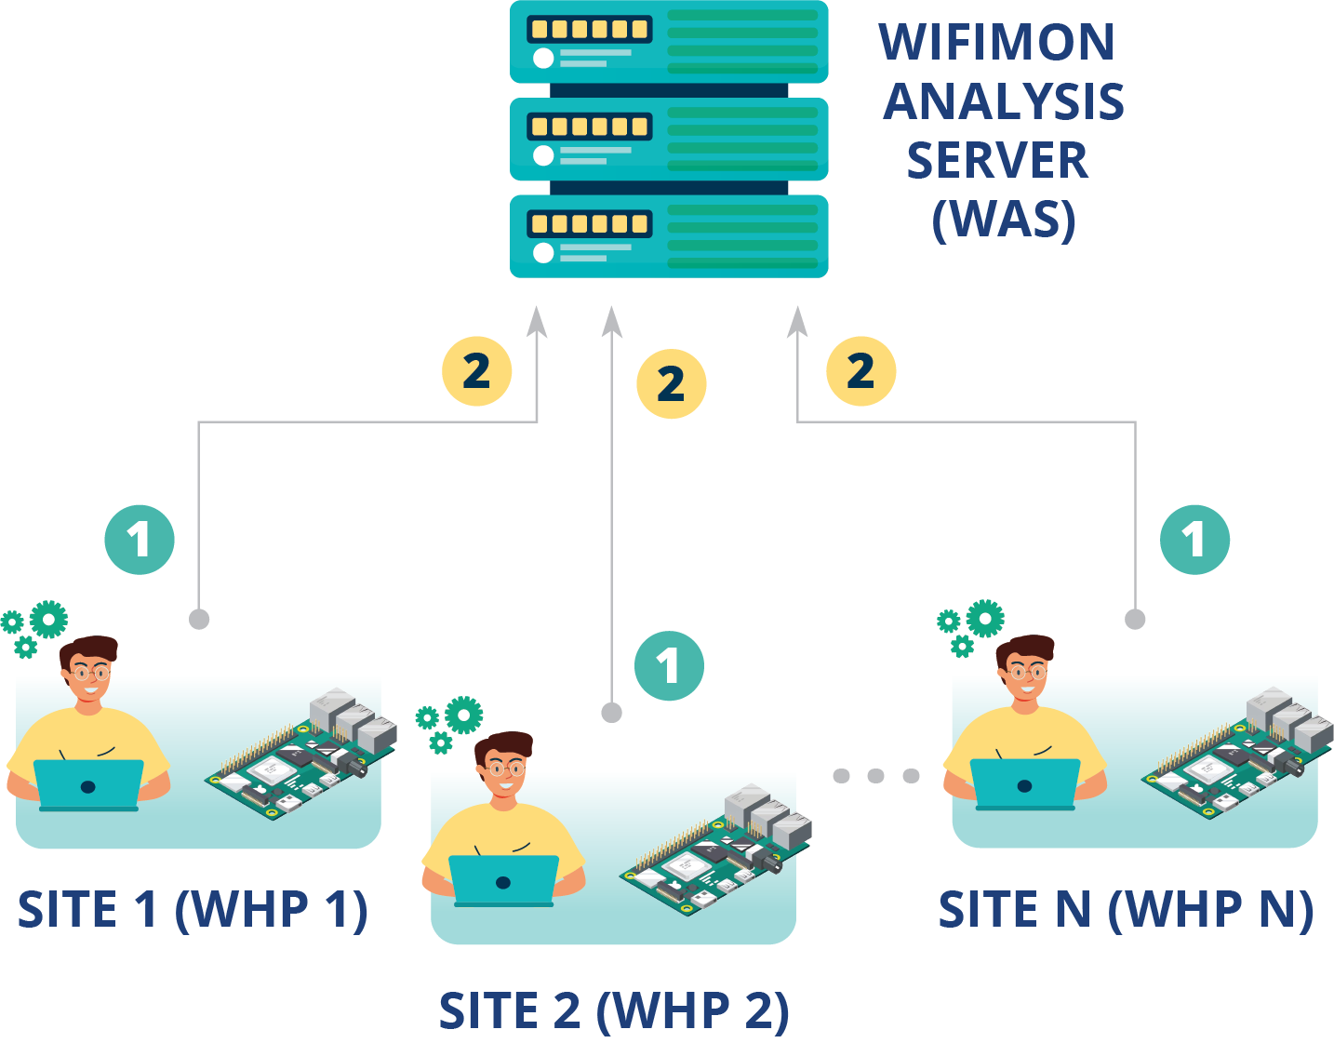
WHP Configuration & Control
Novel approach required!!!
Remote & user-friendly configuration of WHPs from a central point (WAS)
Flexibility to control WHPs behind NAT networks
Old approach
Administrator feedback demonstrated limitations:
In NAT networks
In public networks
Administrators edit config directly

Slide 19
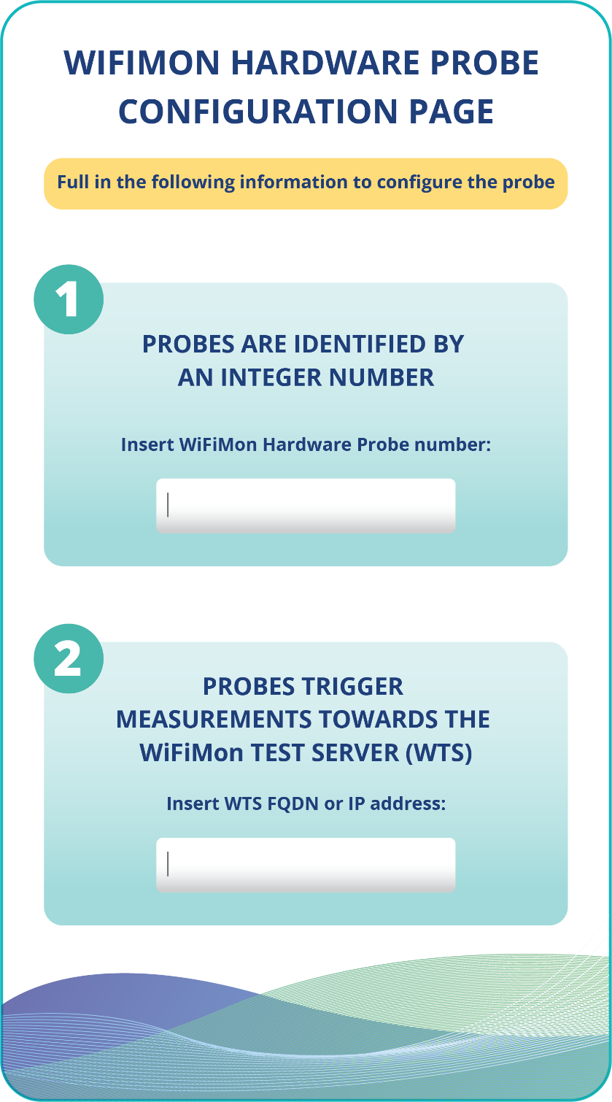
WHP Configuration Made easy
Administrators (re)configure WHPs from the WiFiMon UI
Provided data:
Device ID
FQDNs/IP addresses of WiFiMon components
Location information
Configuration files are generated based on Jinja2 templates

Slide 20
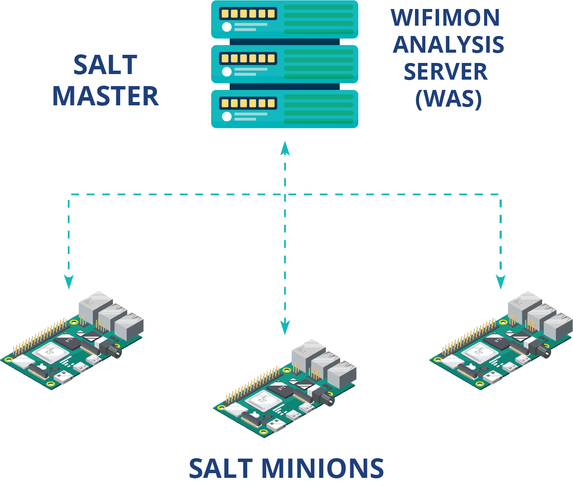
Remote WHP Configuration Made Possible
1
Salt establishes application layer communication:
- WHPs remotely configured from the WAS
Reconfiguration easier for WHPs behind NAT
Public IP addresses not required
→ IP space is conserved
Based on Salt
WAS→ Salt Master
WHPs→ Salt Minions
2
Salt includes a ZeroMQ message broker:
Parallel configuration regardless of the WHP number
3
Configuration files generated from templates transferred from the WAS to WHPs

Slide 21
Thank You

