Slide 1


Slide 2
GÉANT (GN4-3) WP6 T3 in brief
    WP6 – Network technologies and services development
    Task 1 – Network technology evolution
    Task 2 – Network services evolution and development
    Task 3 – Monitoring and Management
    perfSONAR
    PMP – Performance Measurement Platform
    NMaaS – Network Management as a Service
    WiFiMon
    CNaaS – Campus Network management as a Service
    Streaming telemetry
    High speed monitoring (100 Gbps and beyond)
    P4-based unsampled flow monitoring on high speed links

Slide 3
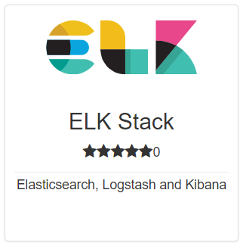
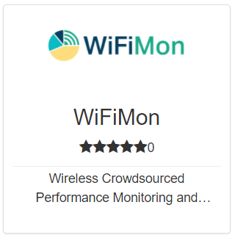
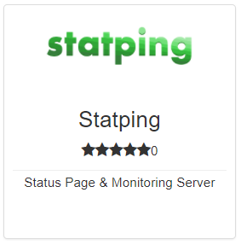
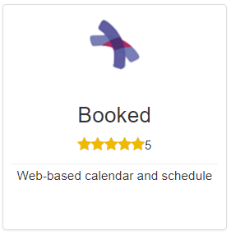
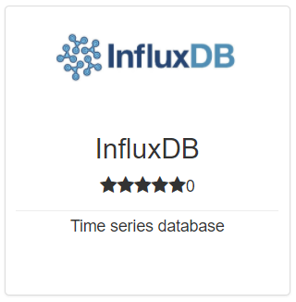
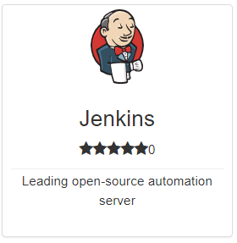
NMaaS in a nutshell
What?
“Market place” offering Network Management … in the cloud
Production service developed and maintained by the GÉANT Project
For whom?
NREN End Institutions, GÉANT Project teams, and NRENs
Why?
To ease network management and monitoring software deployment, configuration and maintenance
To allow users to focus solely on managing their services

Slide 4
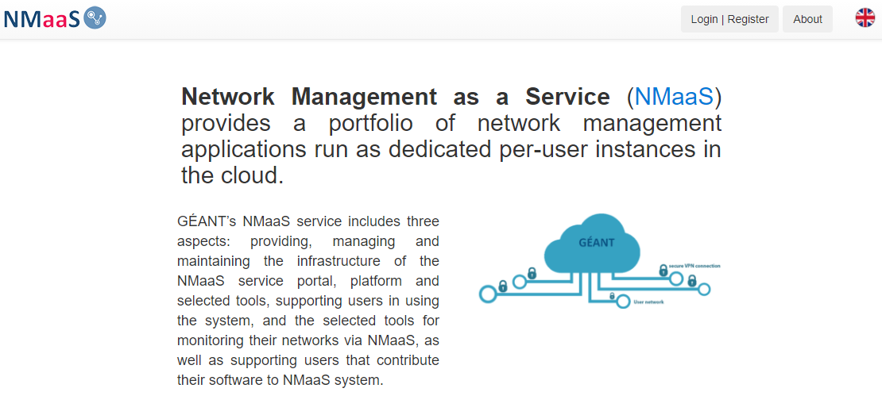
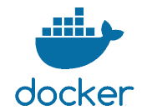
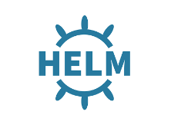

How NMaaS works
NREN
Institution
GÉANT
NMaaS service provider
Secure VPN
Connection
Ins. A
NREN
NREN B
NREN C
NMaaS Platform
Institution Network
Shared cloud platform managed by the GÉANT Project
Each user gets an isolated tenant environment connected over a secure VPN to his network
Tool deployment and access via a web portal

Slide 5
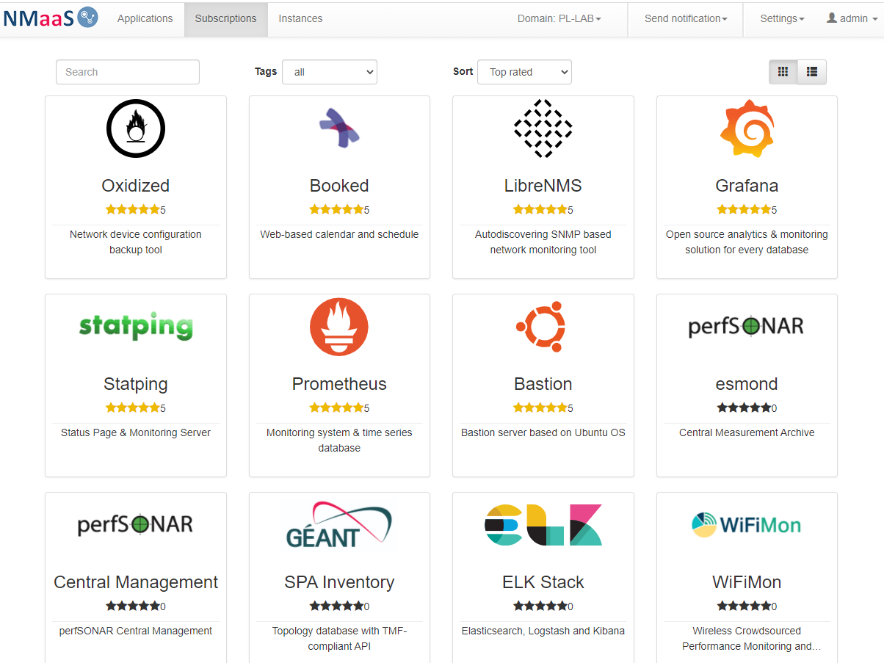
NMaaS Portal

Slide 6


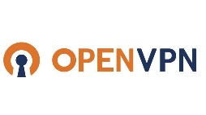

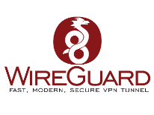
NMaaS Multi-Tenancy Support
Institution A2
NMaaS
service provider
Institution A1
Institution A3
Domain A
Domain B
NREN B
Domain C
Domain D
Institution C
NREN D
Notes:
Introduced NMaaS domains – tenant environments with isolation enforced on multiple levels
software (in NMaaS Portal)
user and role management
application subscription, deployment, configuration and access
Kubernetes namespace (a virtual sub-cluster)
network
routing and firewall rules
dedicated VPNs (user access, monitoring data exchange)
outgoing traffic control on Kubernetes namespace level

Slide 7
NMaaS Multi-Tenancy Support
Introduced NMaaS domains – tenant environments with isolation enforced on multiple levels
software (in NMaaS Portal)
  user and role management
  application subscription, deployment, configuration and access
Kubernetes namespace (a virtual sub-cluster)
network
  routing and firewall rules
  dedicated VPNs (user access, monitoring data exchange)
  outgoing traffic control on Kubernetes namespace level

Slide 8
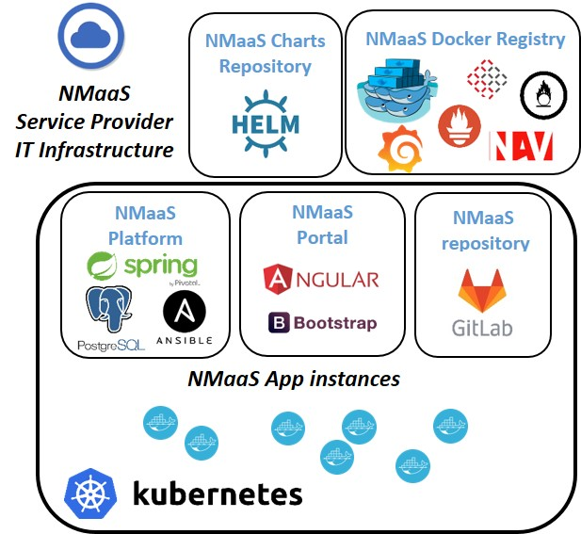
NMaaS System
Software components
NMaaS Platform
  Domain and user management
  Tool deployment process orchestration
NMaaS Portal
  Web-based user front-end
Tools (packaged applications)
Docker images
Helm charts
Infrastructure
Kubernetes
VPN
Networking

Slide 9















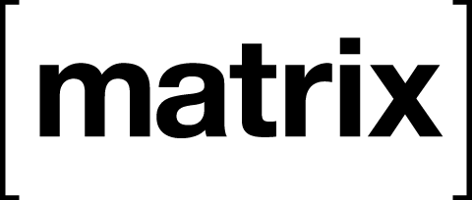


NMaaS Tools
23 applications available in the marketplace
Oxidized
Bastion
perfSONAR
4 components
LibreNMS
Statping
NAV
SPA Inventory
WiFiMon
Prometheus
Debian
repository
InfluxDB
Grafana
Jenkins
Booked
ELK Stack
Icinga
Routinator
Synapse
Victoria Metrics
CodiMD

Slide 10
Adding new Tools
…or new versions
At the moment done by the NMaaS team
Possible based on user request
Requirements
  Docker image(s)
  Helm chart
  Metadata and information about the application
Notes:
https://wiki.geant.org/pages/viewpage.action?spaceKey=gn43wp6&title=How+to+Submit+an+Application+to+the+NMaaS+Catalog

Slide 11
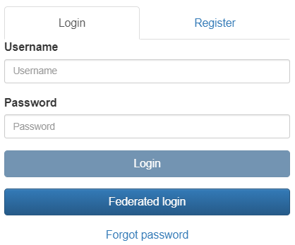
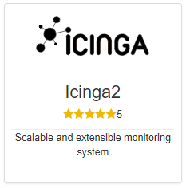
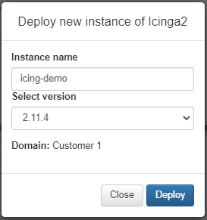
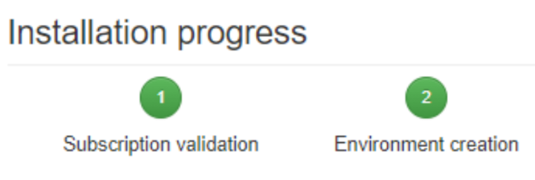
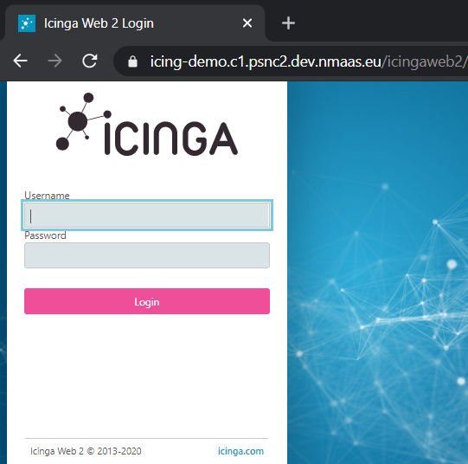
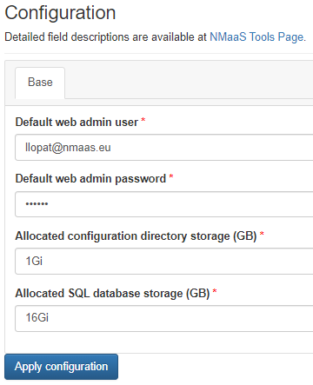
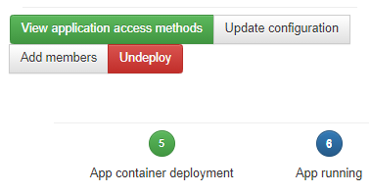
NMaaS Tool Deployment Process

Slide 12
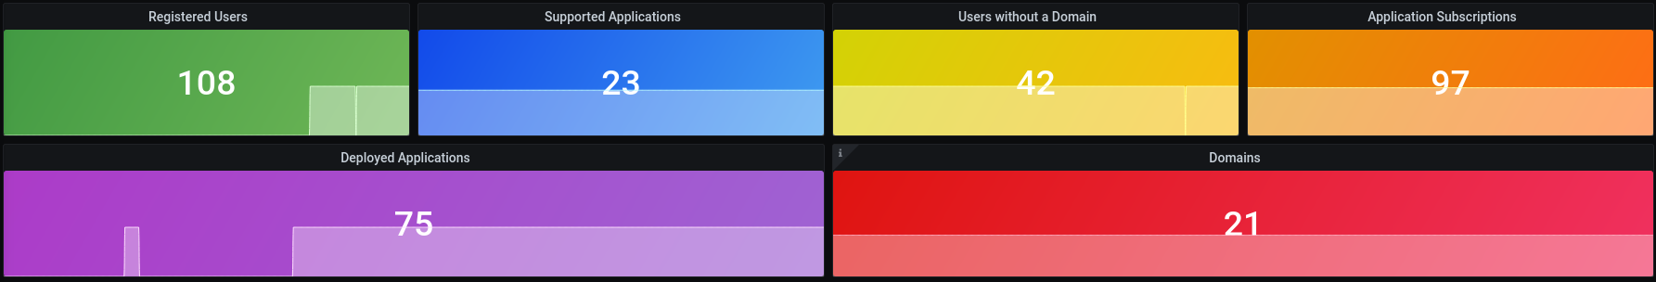
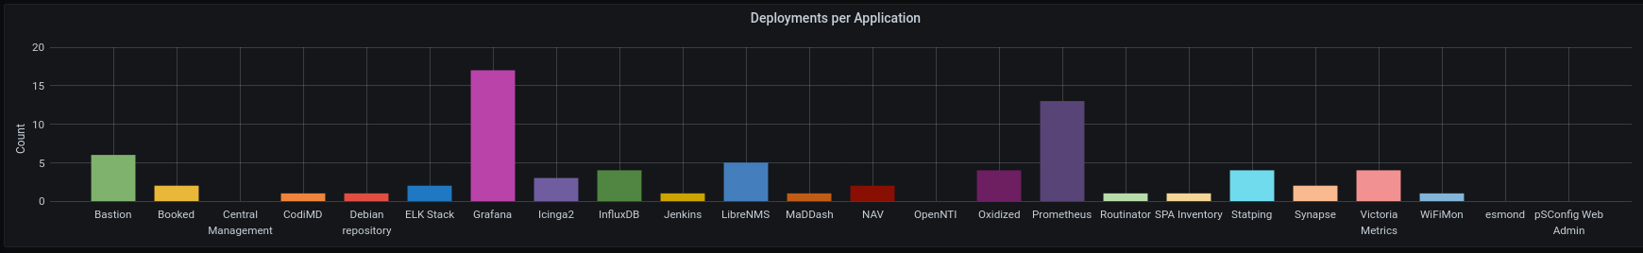
NMaaS Service Usage Statistics
https://nmaas-metr.pllab.nmaas.eu
https://a8e91173-eabd-4bac-a882-8856338eaaea.public.nmaas.eu

Slide 13
Who is using NMaaS?
NRENs + GÉANT
  CYNET
  HEANET
  PSNC
  ARNES
  SURFnet
End institutions
  Franja Malgaja Primary School / ARNES
  University of Murcia / RedIRIS
  Friedrich Alexander Universität / DFN
GÉANT Project teams
  Performance Measurement Platform (PMP)
  RARE project
  perfSONAR development team
Tool developers
  perfSONAR
  WiFiMon
  SPA Inventory

Slide 14
NMaaS for CNaaS
Fills the infrastructure gaps observed by CNaaS institutions
Assists CNaaS operators and managers
CNaaS institutions – Campuses or Schools – don't want to manage
The infrastructure needed to manage networks
  NMaaS provides the infrastructure
The tools needed to manage networks
  NMaaS provides and maintains the tools
CNaaS operators and managers don't want to have a separate monitoring infrastructure for each network they manage
NMaaS enables multi-tenant usage
A domain per network
Multiple domains per user / CNaaS operator

Slide 15

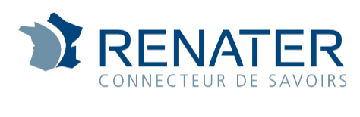
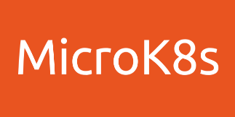
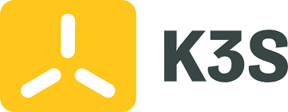
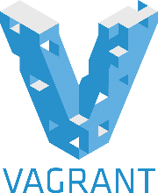
How can you use NMaaS service?
To try NMaaS out or test offered applications
use NMaaS sandbox instance: https://nmaas.geant.org
(no configuration overhead, demo applications already deployed)
To set up your own NMS on the central GÉANT NMaaS
NMaaS production instance: https://nmaas.eu
(secure, fully supported)
To run your own instance of NMaaS
visit NMaaS Installation Guide: https://wiki.geant.org/display/NMAAS/NMaaS+Installation+Guide
Notes:
those icons are meant to show that we are working on a procedure / scripts for easy installation of local Kubernetes cluster and NMaaS on top (on a local PC) using those technologies, please refer to https://wiki.geant.org/display/gn43wp6/Installing+a+Local+Kubernetes+Cluster+with+MicroK8s (still work in progress); so basically this will be another way a user can use / test the NMaaS service

Slide 16
NMaaS next steps
    Add IPv6 support (doable after Kubernetes 1.21)
    Build the community - define the process of having application maintainers from outside of the NMaaS team with some automated processes of publishing new versions of applications on the Portal
    Further technical improvement:
      this possibility to deploy local K8s cluster + NMaaS with few clicks to ease the testing process (mention above)
      enabling federation between multiple instances of NMaaS mostly to share the application portfolio
Notes:
Kubernetes 1.21 IPv4/IPv6 dual-stack support. IPv6 support for the underlying components used by NMaaS was lacking. This changed in the spring of 2021 when Kubernetes, the container orchestrator used by NMaaS, promoted dual-stack networking to a beta support level.
To adopt IPv6 dual-stack networking in NMaaS, infrastructure changes need to be made which would allow us to more efficiently use the IPv4 space as well. The goal is to utilize IPv6 connectivity for customers and applications that fully support this newer protocol, while resorting to a dual-stack architecture for publicly accessible services or services deployed by customers who have not adopted IPv6 yet.
With this new architecture not only would customer access to the applications be simpler, but it would also allow us to improve the existing user segmentation and security rules configuration that are already in place. In cases where the deployed applications support encryption, client-access VPN will not be required anymore, instead relying on publicly routable IPv6 addresses. Furthermore, it will also be possible to allocate dedicated private IPv4 subnets and public IPv6 subnets to each customer, allowing us to utilize another level of traffic segmentation on the firewall level, instead of relying on the built-in mechanisms within the Kubernetes container orchestration software.
The goal is to migrate the existing production environment to this new architecture, preserving existing application and customer data.

