Slide 1



Time and Frequency service monitoring and management
Krzysztof Turza
Poznan Supercomputing and Networking Center
(PSNC - Poland)
17 February 2023

Slide 2

Agenda
  User needs
  Ways of implementing T/F signal distribution
  T/F service monitoring and management
  International T/F connections in Europe

Slide 3


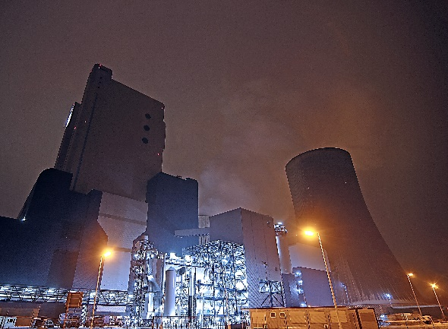
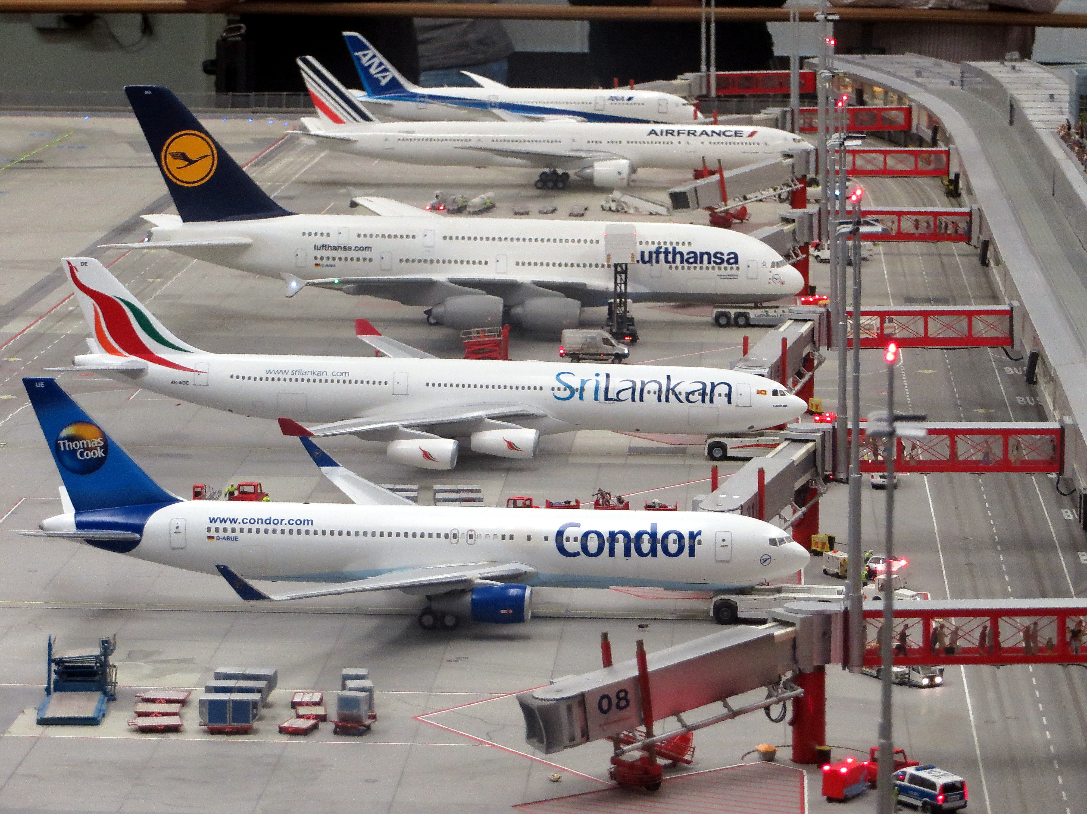
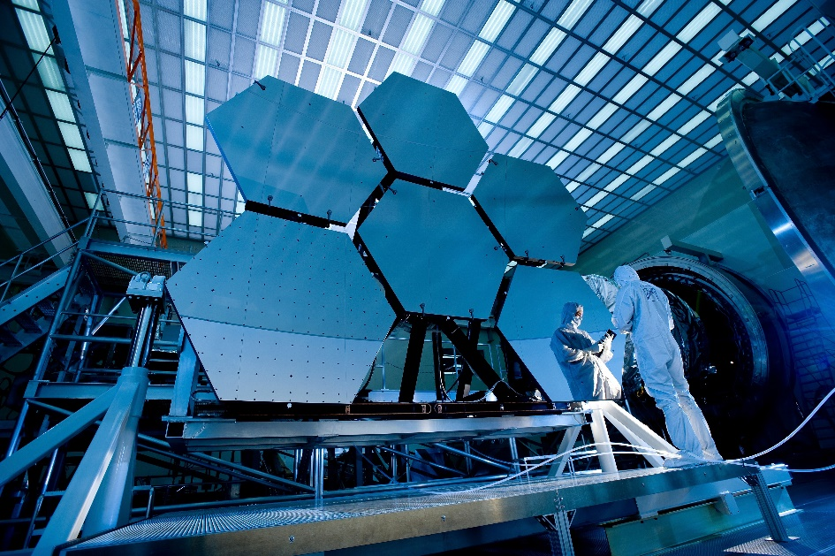
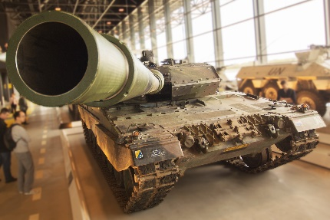
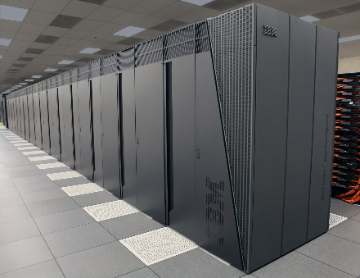
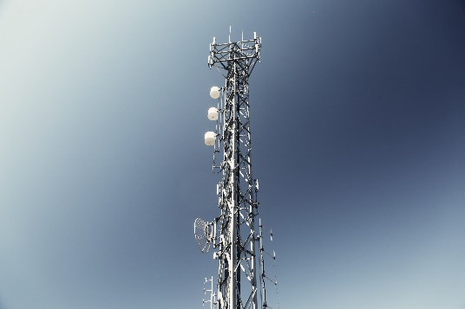
Group of users
Navigation
Finance
Transport
Power Grids
Defence
Security
Science
Telecommunication (ICT)
Notes:
It may surprise some of you how many areas of our lives require precise Time and Frequency signals.
So these signals are crucial not only in science but also transportation....

Slide 4
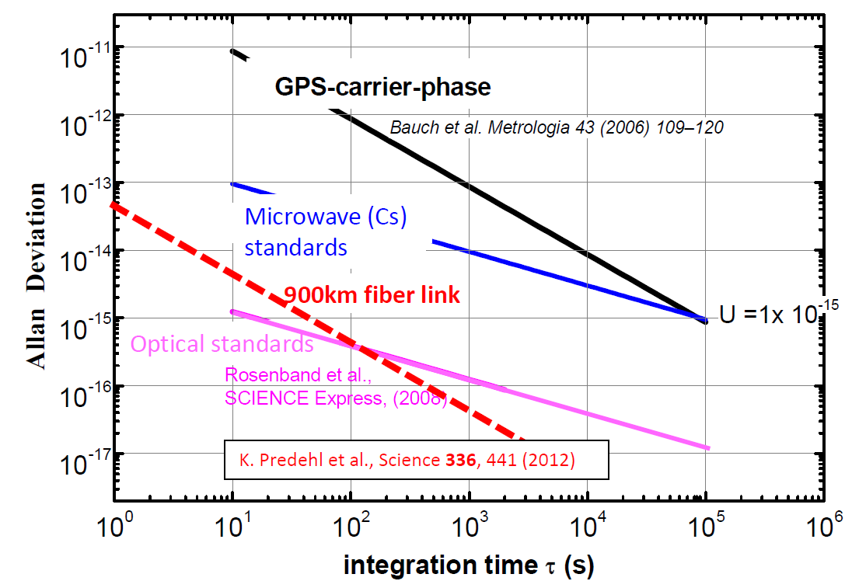
Satellite transmission vs fibre transmission
New Optical Standards
needs fibre links
for frequency transmission
Notes:
If we compare the capabilities of the most advanced satellite systems with those of fiber-optic networks, we see that fiber-optic networks represent a revolution in the transfer of ultra-precise time and frequency signals distribution.
On the right we see a favorite metrologists' graph - Allan's deviation. The y-axis shows the relative stability of the frequency. Here the smaller the value is the better. While on the x-axis is the averaging (observation) time. Here, too, we would like to achieve the smallest possible value on the y-axis in the shortest possible time.

Slide 5



T&F -> simple acronym – not easy decisions (1)
What kind of signal will be transmitted?
Radio Frequency (10 MHz)
& Time (1 PPS)
1PPS
1PPS
T & RF
Distribution
System
10 MHz
10 MHz
Optical Carrier
(Frequency ~194 THz)
Maser
or Cs Clock
End Users
OC
Distribution
System
Frequency comb
Frequency comb
Laser @1.5μm
Optical Clocks
End Users
Notes:
Unfortunately, systems for transfer ultraprecisie metrology signals have not reached standardization. Behind the simple acronym T&F there are many technical solutions how to do it.
First of all, we should answer ourselves what types of signals we would like to transmit.
Is it Radio frequency and time signals or it is Optical Frequecy (Optical Carrier).
In the first case we will transmit electical 1PPS and 10MHz signals generated by Maser or Cs clocks wich next will be encoded in the optical signal …
In the second case…

Slide 6
T&F -> simple acronym – not easy decisions (2)
How to implement?
Dark Fibers
the best option but also the most expensive
Dark Channels
does not require renting additional fibers, but requires difficult integration with transmission system (DWDM)
If Dark Channel which band? C or L?
Notes:
The next question we need to answer is: how we implement our T/F distribution network?
If we can use spare fibers for this or do we not have such fibers and we need to combine data transfer and metrology signals in sigle transmission system. Which band we have to use C or L band?

Slide 7
T&F -> simple acronym – not easy decisions (3)
Bidirectional time and frequency transfer in unidirectional DWDM
Notes:
If we decide to transmit in a common DWDM system we should remember that in order to achieve the proper level of accuracy of the transmitted signals we MUST transmit metrology signals in a bidirectional manner! This is quite different from DWDM systems where we usually transmit signals unidirectionally.
Therefore, the T/F signal must be demultiplexed in every node and amplified with a dedicated optical amplifier (bidirectional).

Slide 8
T&F service distribution techniques
Technology | Advantages | Disadvantages
Optical Carrier | • Best ultrastable frequency service performances • Has been operated in different setups (dark channel and dark fibre) | • Limited number (but more demanding) of end-users because frequency combs are required to use the distributed signal • Most of equipment is designed to work @ 194.4THz (C-Band) • Requires highly trained personnel.
ELSTAB Active cancellation with electronic delays | • Distributions Time and Frequency services • Wavelength is fixed but can be chosen all over C-Band to fit any ITU channel | • Even greater performances might be required for the most demanding end-users (optical clock comparisons)
White Rabbit PTP | • Easy to use • A wide range of potential end-users • Time and Frequency service • Affordable prices | • Performances only slightly better than GPS
Notes:
In terms of technology, there are three leading ones in Europe:

Slide 9
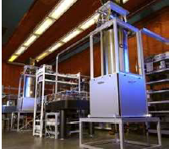
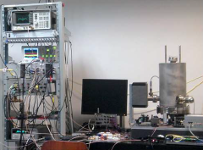
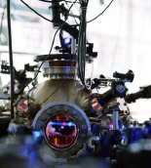
T/F service monitoring and management
Metrology
signal
sources
NOC
End
users
The metrology signal
transfer system
The telecommunication data transmission system

Slide 10
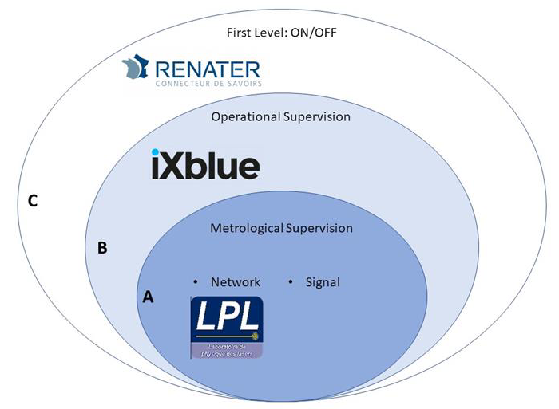
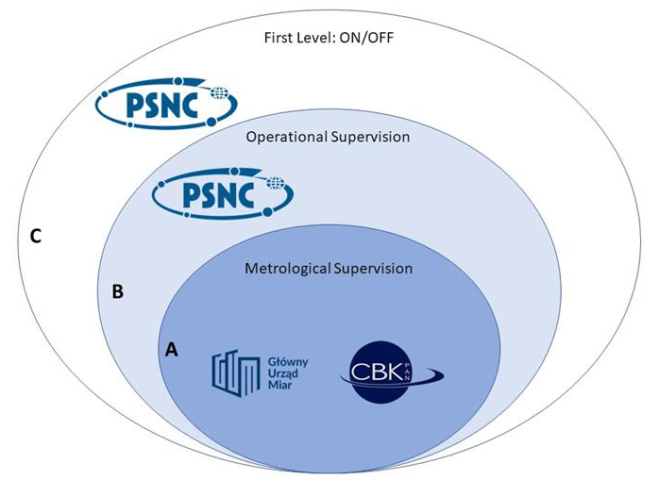
Levels of responsibility for metrological networks - examples
FRANCE
POLAND

Slide 11
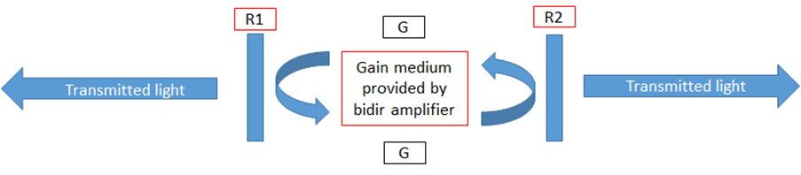
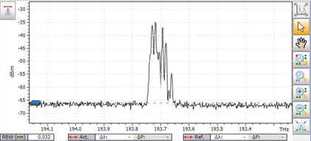
What might surprise network administrators (1)
Reflections and Rayleigh scattering in two-way systems can be a serious problem
Amplifier lasing (oscillating) issue
2G > R1+R2
Light generated by oscillating amplifiers is extremely chaotic both in terms of optical spectrum, and also in time domain.

Slide 12
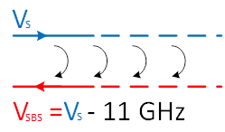
What might surprise network administrators (2)
Stimulated Brillouin Scattering (SBS)
Stimulated Brillouin Scattering is very narrowband (10 MHz) process
and so generally not observed in modulated data signals.
In particular, it is a limitation on the maximum optical power of OC signals,
however ...

Slide 13
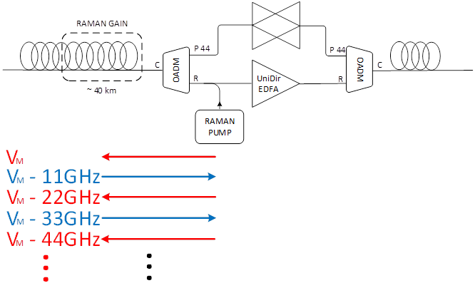
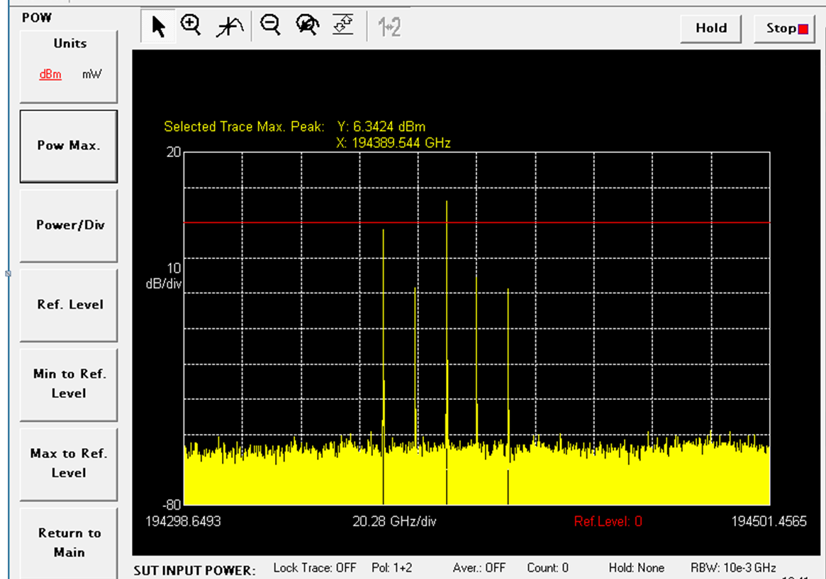
What might surprise network administrators (3)
… high optical signal copropagated with Raman pump can cause so-called „optical comb” (due to SBS, Rayleigh)

Slide 14

What might surprise network administrators (4)
Other issues:
Changing the level of Raman gain also changes the gain of metrology signals.
The need to calibrate the time transfer (total line delay) - without this the time signal is useless. The calibration procedure is usually well described but requires in different devices but usually requires a time interval counter which is not "standard equipment of networkers"
In summary:
There is a need for close cooperation between "metrologists" and "networkers"
in the management of T/F transfer services

Slide 15
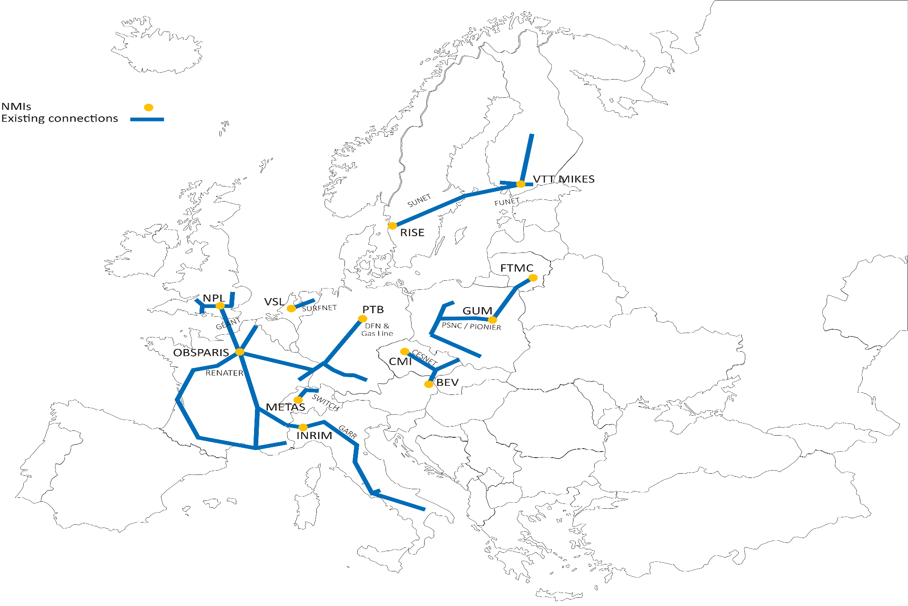
T&F connections in Europe

Slide 16
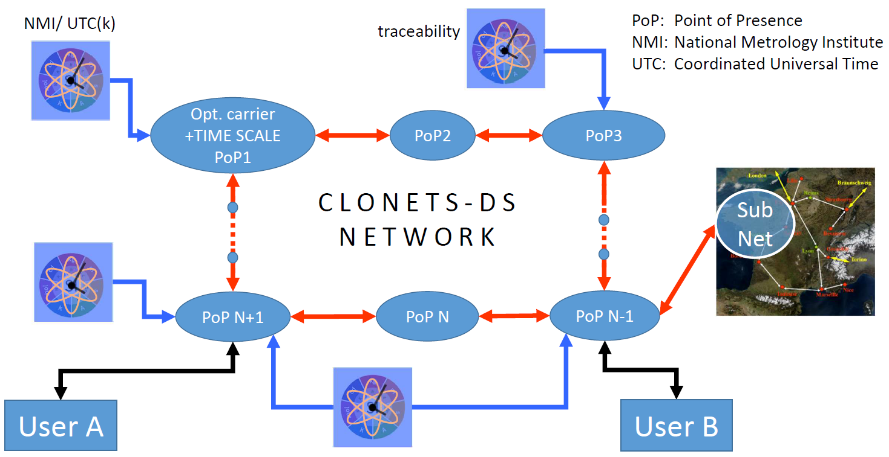

The CLONETS-DS vision of a network

Slide 17
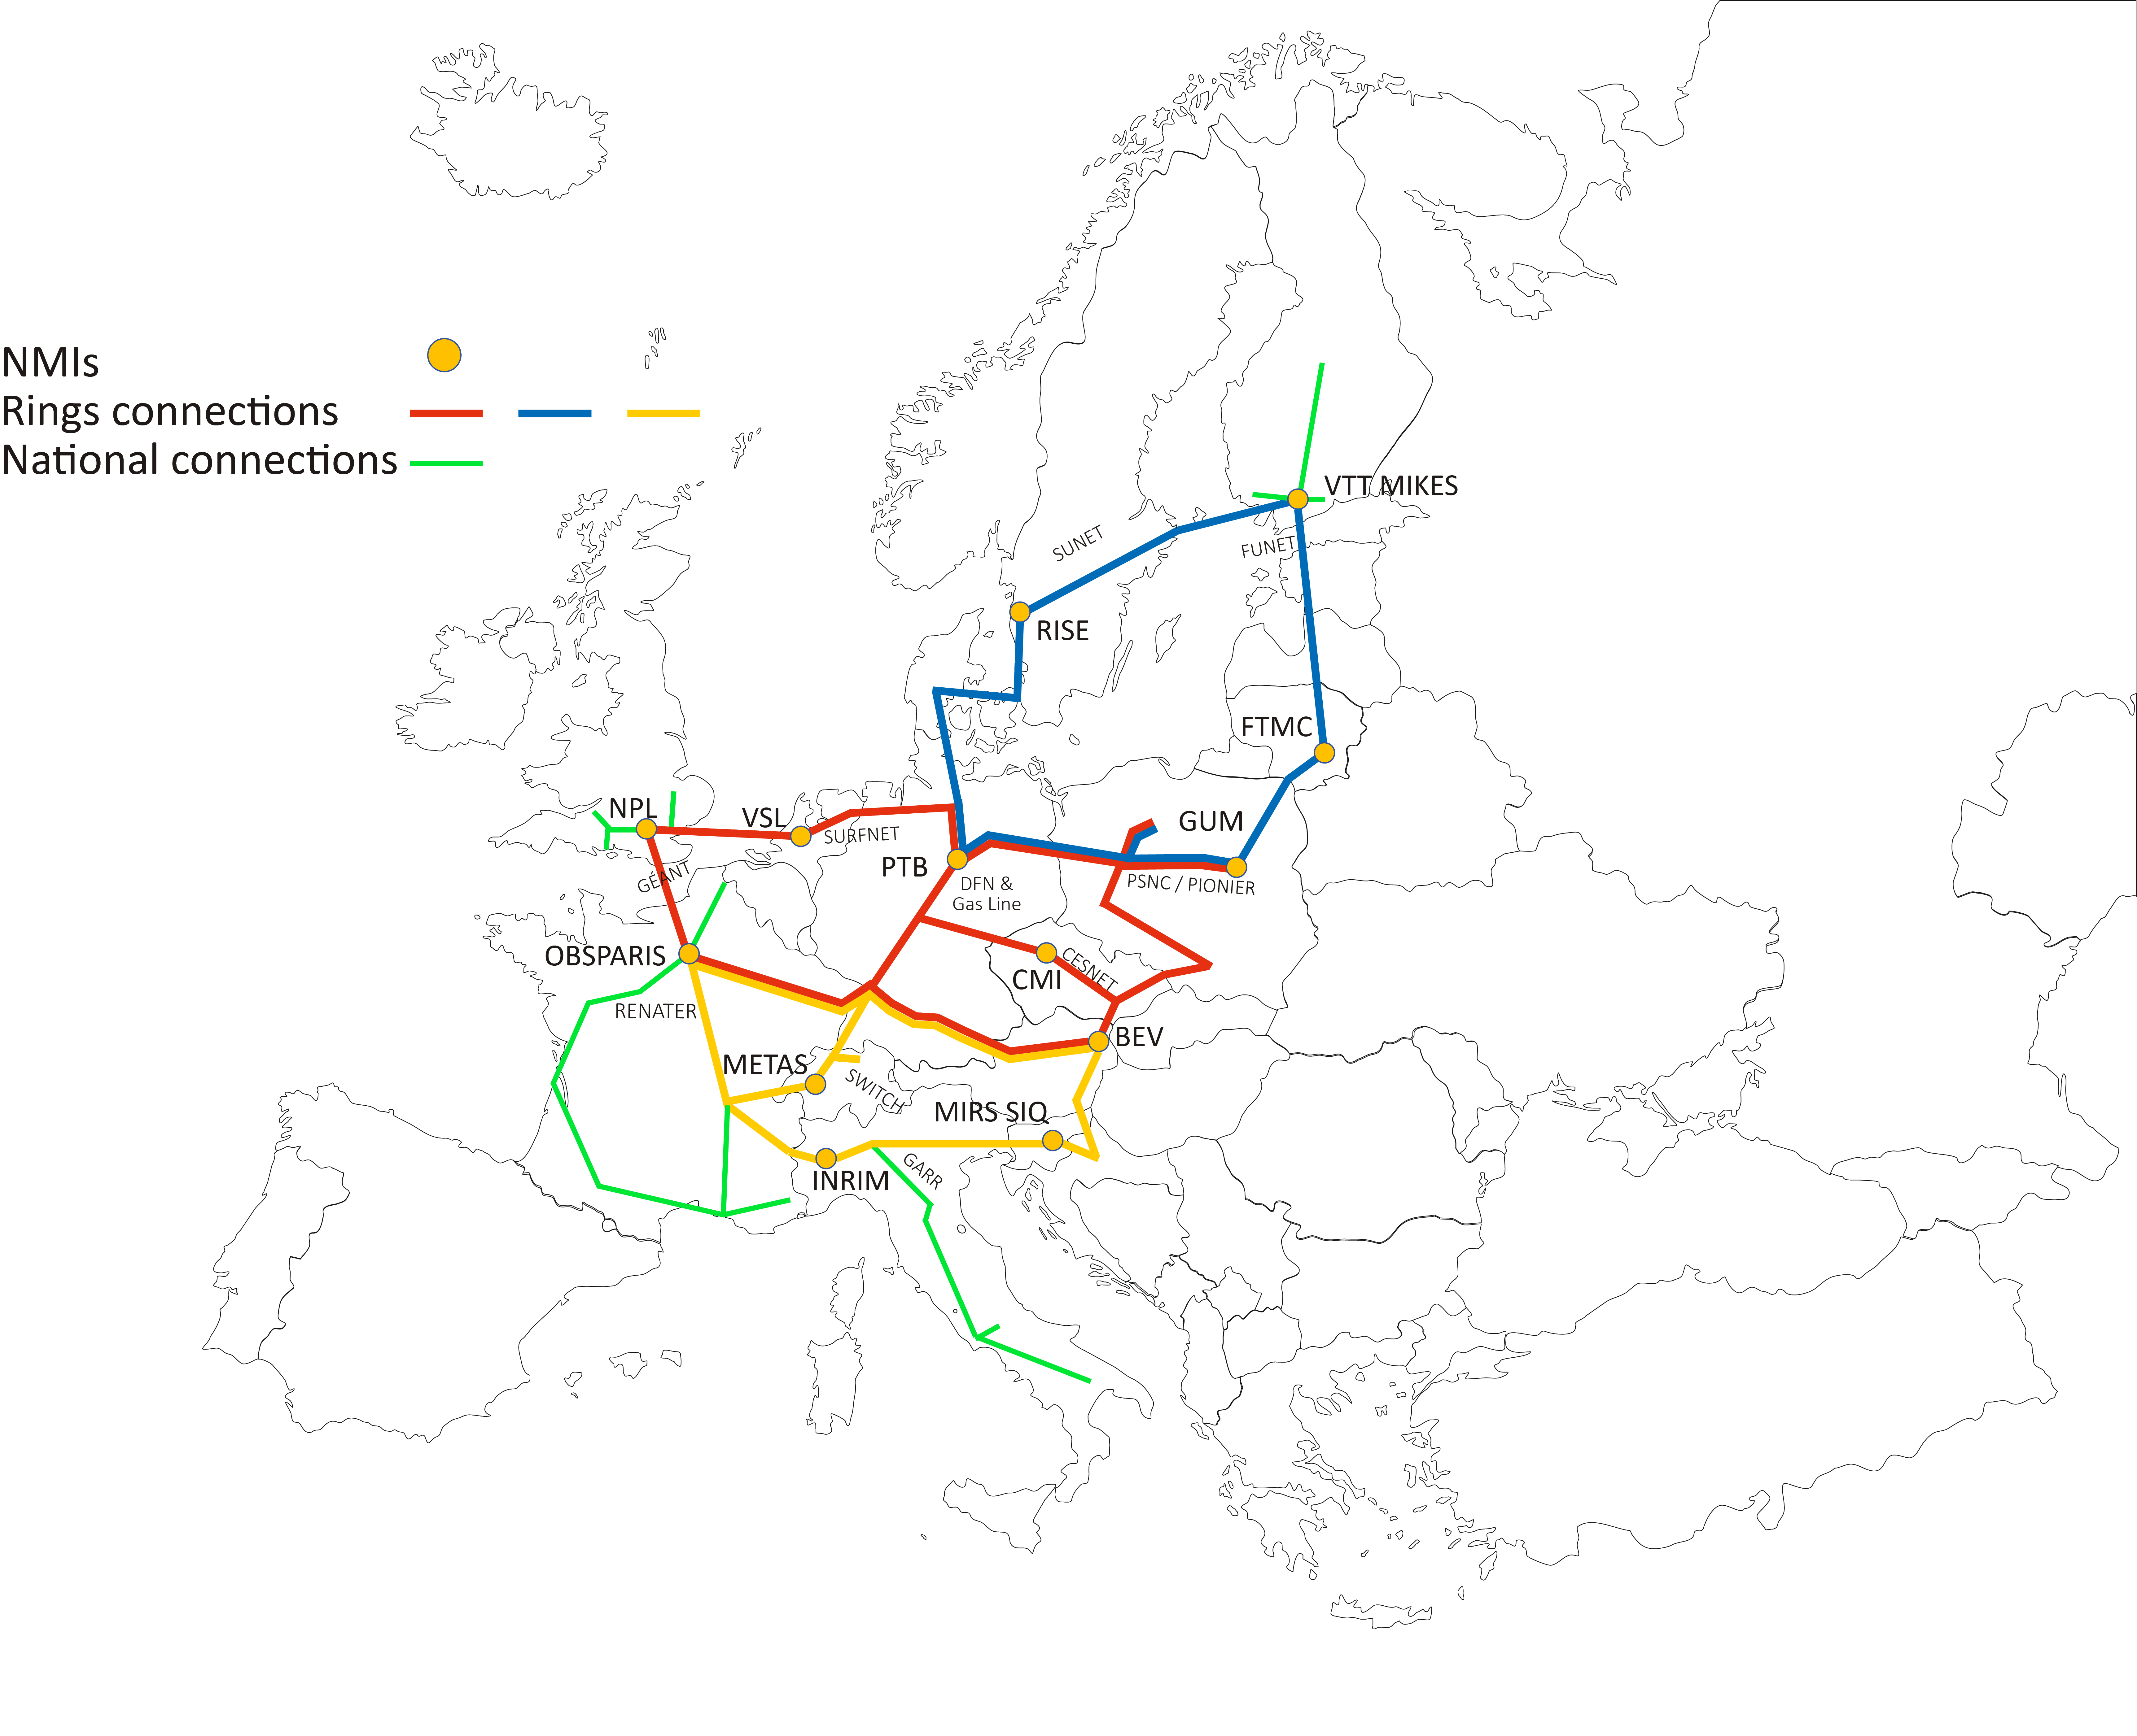
CLONETS-DS Results – RINGs topology
Benefits:
allows the incorporation of national implementations
allows the implementation of different techniques
no constraint regarding dark channel or dark fibre
no predetermined provider (NREN, GEANT, company...)
open, expandable, adaptable structure
easy implementation of novel concepts

Slide 18
Thank you
kturza@man.poznan.pl
The scientific work is published for the realization of the international project co-financed by Polish Ministry of Science and Higher Education in the years 2019 - 2022 from financial resources of the programme entitled "PMW"; Agreement No. 5023/H2020/2019/2
The CLONETS-DSproject receives funding from the European Union's Horizon 2020 research and innovation programme under Grant Agreement No. 951886 (CLONETS-DS).

