Slide 1
Communications in
AfricaConnect3
Year 2 – an update
Silvia Fiore, GÉANT, and
Yasmeen Al-Kouz, ASREN
SIG-Marcomms, 29/06/2021

Slide 2
Project Communications Activities Overview

Slide 3




What have we been up to?
Social
media campaigns
AfricaConnect
10th anniversary

Slide 4
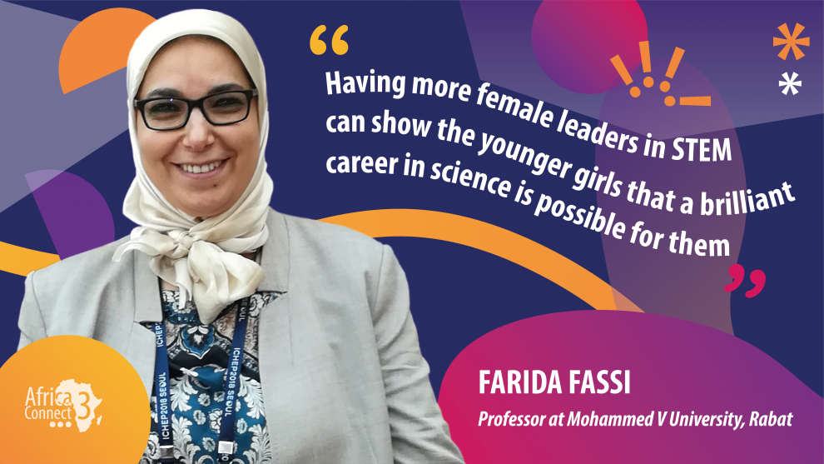
Women in STEM interviews
7 interviews
Twitter:
  >22k impressions
  Average 2.8% engagement rate
  >100 retweets and >100 likes
Website: >800 readers since February

Slide 5

AfricaConnect turned 10 on May 11

Slide 6
AfricaConnect turned 10 on May 11
1
4
AfricaConnect origin story
Testimonials from representatives of the European Commission
1
3
Interview with Cathrin Stöver and Tusu Tusubira
Quotes from CEOs of UbuntuNet Alliance, WACREN and ASREN (very soon)

Slide 7
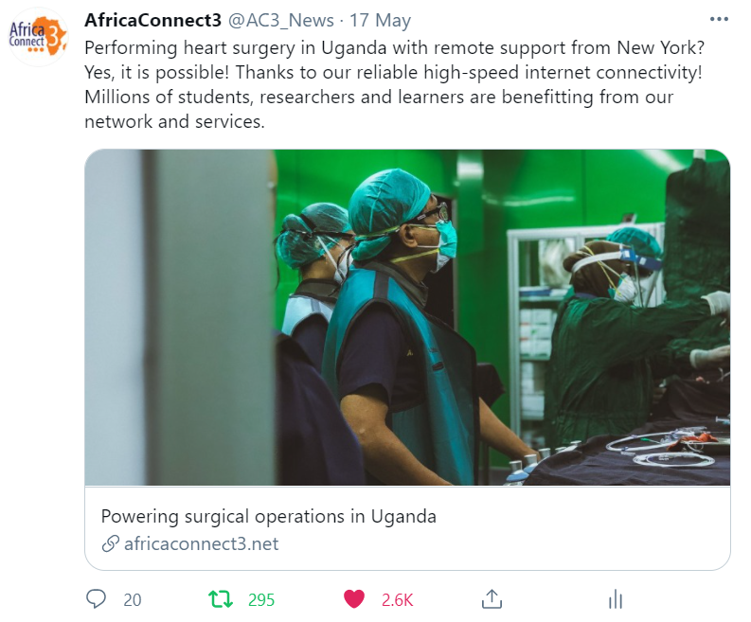
Social Media Campaigns

Slide 8
Social Media Campaigns
Cost
Results
TWITTER Engagement | 357.10€ (0.06€ per engagement) | 2.6k likes, 295 retweets and 20 replies | 3% eng rate
TWITTER Reach | 357.10€ (1.4€ per impression) | 255k reach: 195 likes and 33 retweets | 255k reach
TWITTER Followers | 215.55€ (0.93€ per follower) | 233 followers | 78k reach
FACEBOOK Website Card | 70€ (0.01€ per like) | 6,971 clicks on the website | 250k reach
FACEBOOK Page Card | 70€ (0.03€ per like) | 2,086 new followers | 40k reach

Slide 9
Social Media Campaigns
IMPACT
on the website
>1.7k new visitors
>1.4k visits to the webpage
Higher reading duration

Slide 10
The Impact on NRENs

Slide 11
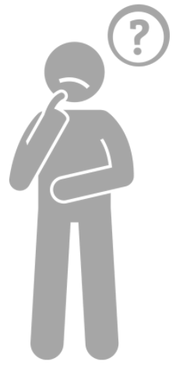
Why are we …
Highlighting women in STEM across NRENs?
Celebrating AfricaConnect 10th anniversary?
Running Social​ Media Campaigns?
The multiplier effect of our activities
On NRENs & their communities.
.

Slide 12
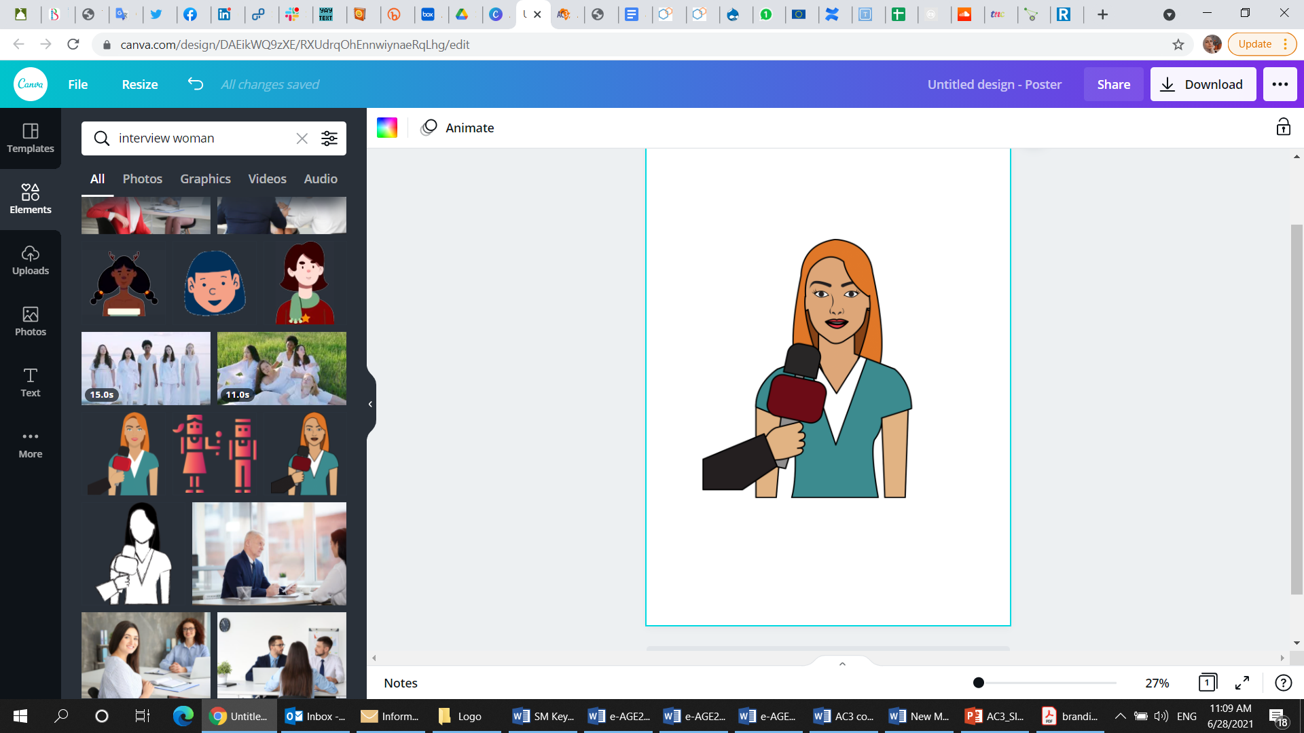
Women in STEM interviews
Give them visibility and a platform to speak
Spread awareness about female accomplishments in R&E
eduroam for
RENU
Chance to talk about ongoing/recent developments in their networks
NRADRE for EthERNET

Slide 13
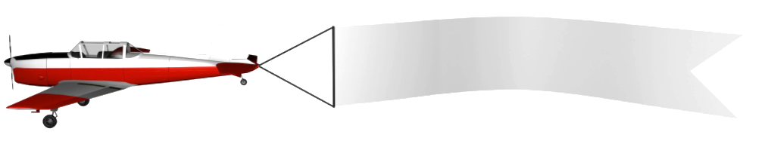
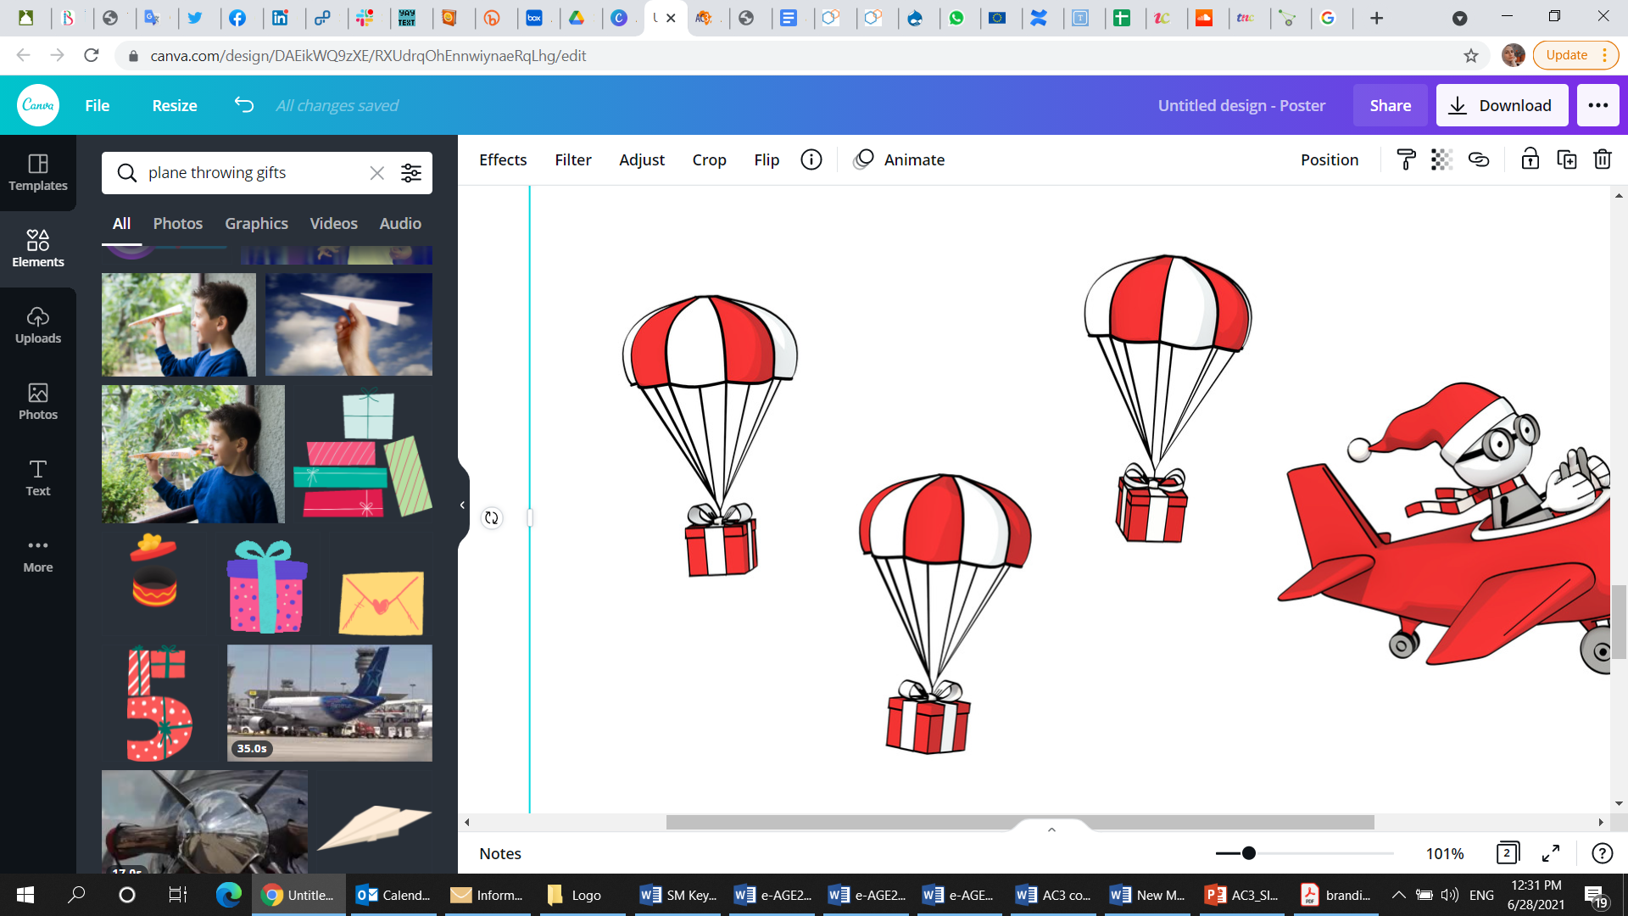
AfricaConnect 10th anniversary
AfricaConnect is the NRENs!
Emphasis on the added value of NRENs & RRENs
Ensure visibility
across Africa
Support advocacy & donor engagement activities

Slide 14
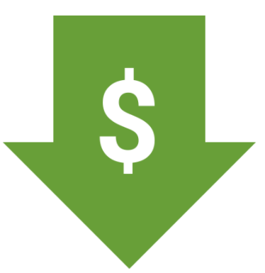
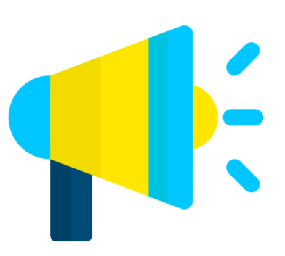
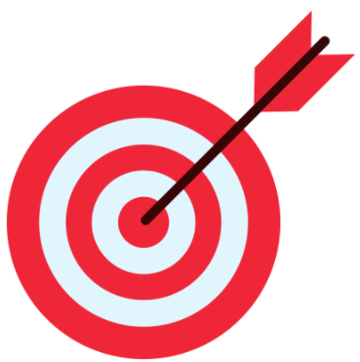
Social​ Media Campaigns
LOW COST
HIGH REACH
TARGETING OPTIONS

Slide 15
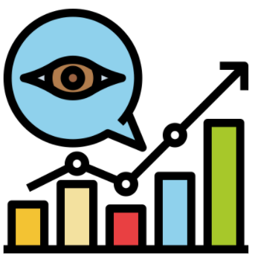
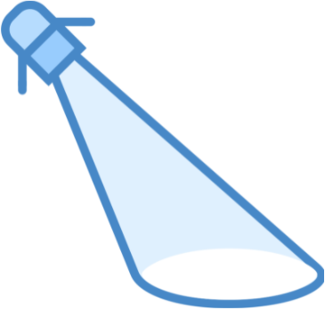
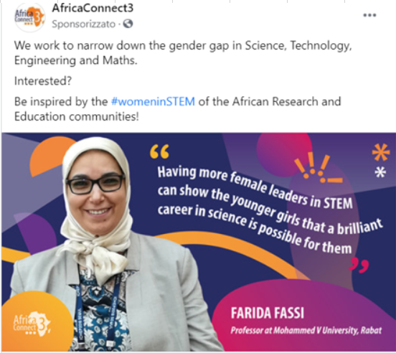
Social​ Media Campaigns
Target
new
members
Target
young
women
Boost visibility for NRENs activities quickly & more cost effectively
Maximize exposure to relevant stakeholders

Slide 16


Thank you
Any questions?
@AC3_News
AfricaConnect3
africaconnect3.net

Slide 17


