Slide 1
A 5 minute view of BELLA Comms
Rosanna Norman. Communications Officer, GÉANT
SIG-Marcomms – Online Meeting – 29 June 2021

Slide 2
Objectives
Develop project branding.
Design and implement a BELLA web presence.
Design and publish BELLA dissemination materials.
Raise awareness of BELLA progress.
Identify use cases which will benefit from BELLA connectivity.
Promote BELLA at relevant international events.
All partners encouraged to contribute.
BELLA communications working group
BELLA Steering Committee
Guided by the Communications Strategy and Plan

Slide 3
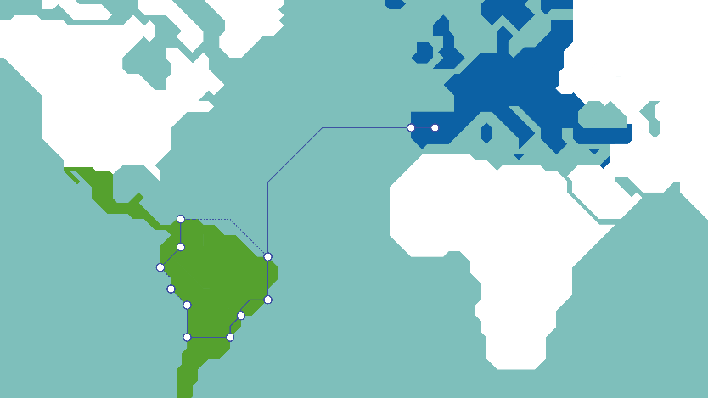
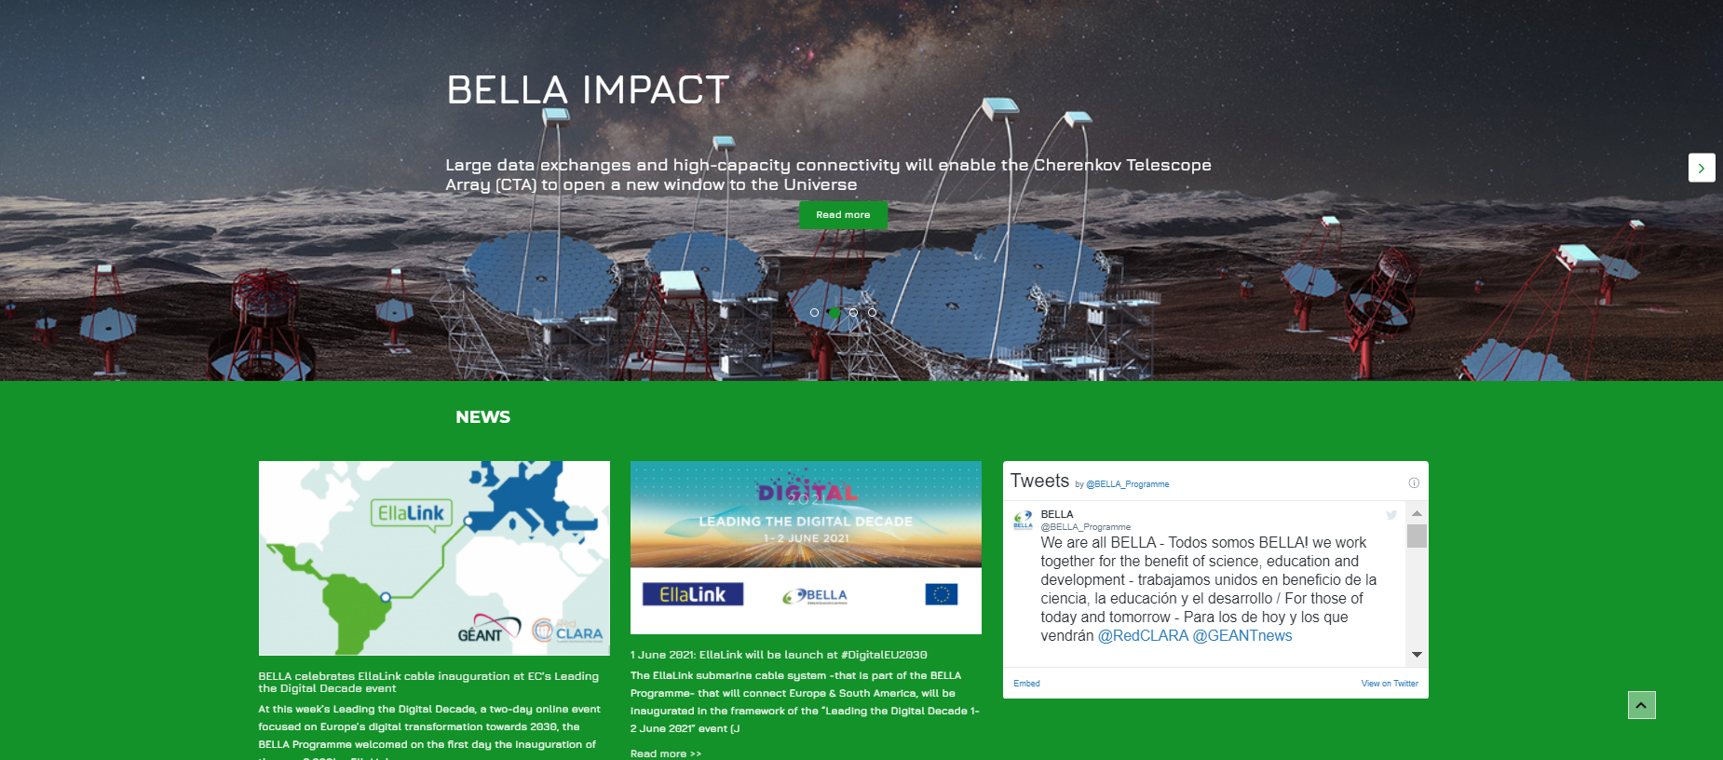
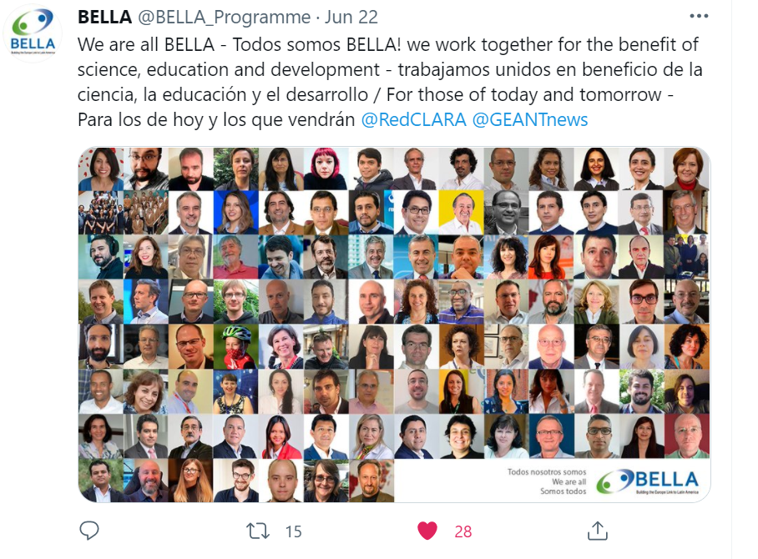
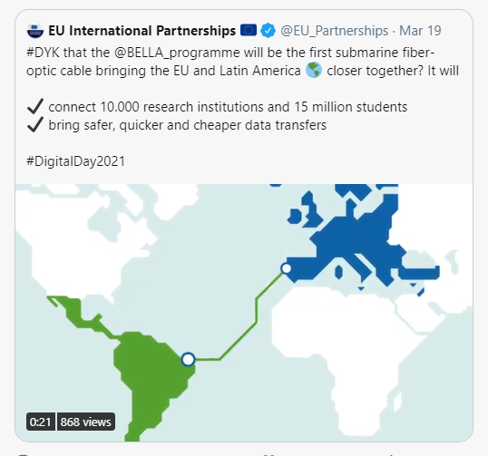
Main Communications Tools
Website and Twitter
Maps and graphics
Use cases – Copernicus, Cherenkov Telescope Array
Video animation
Events – TNC19, TNC21, TICAL 2020, TICAL 2021
Joint comms with EllaLink (Social media, interviews, blogs)

Slide 4
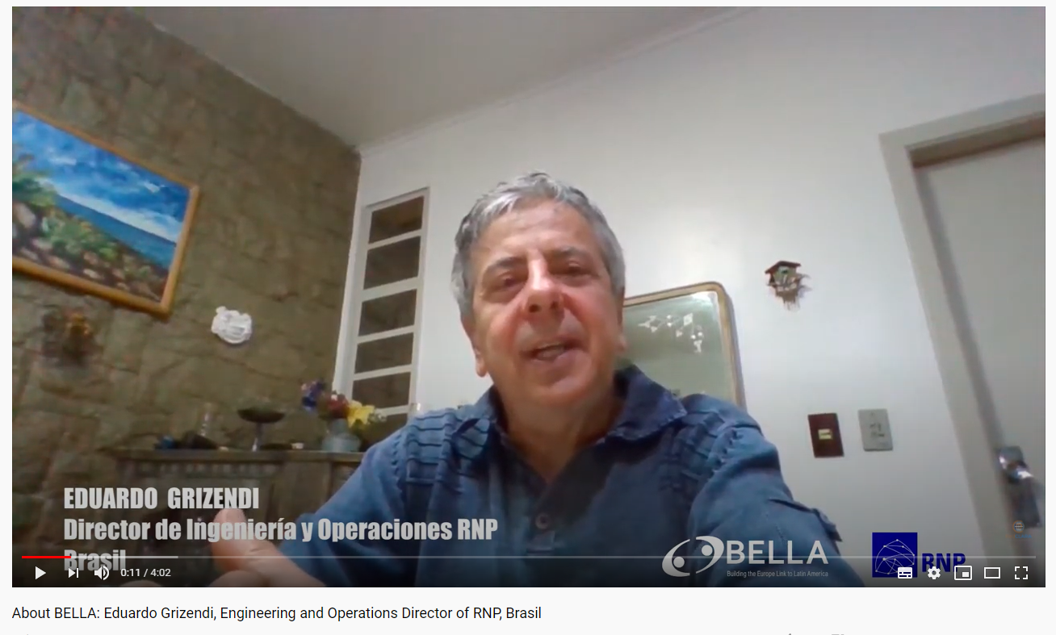
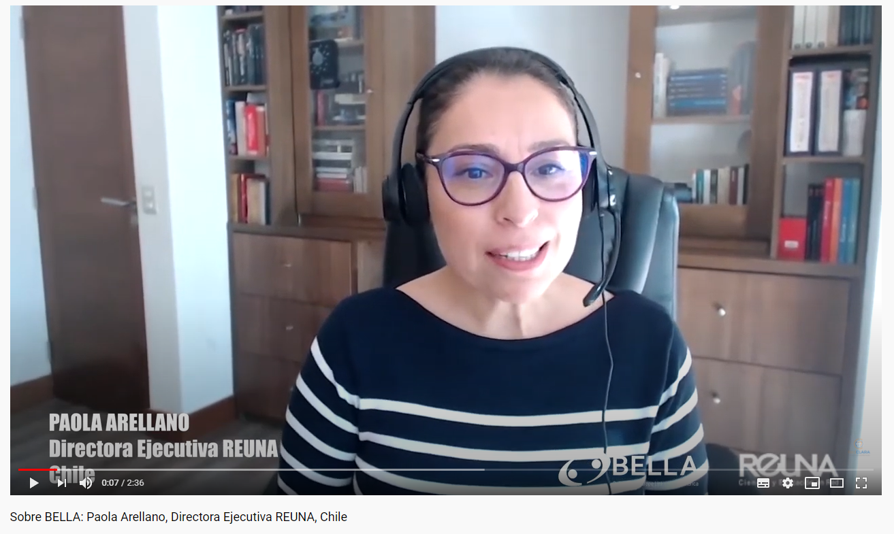
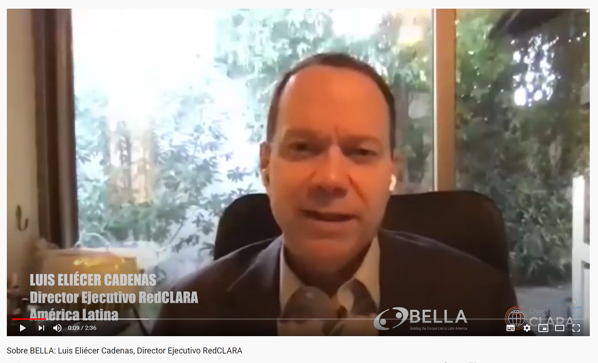
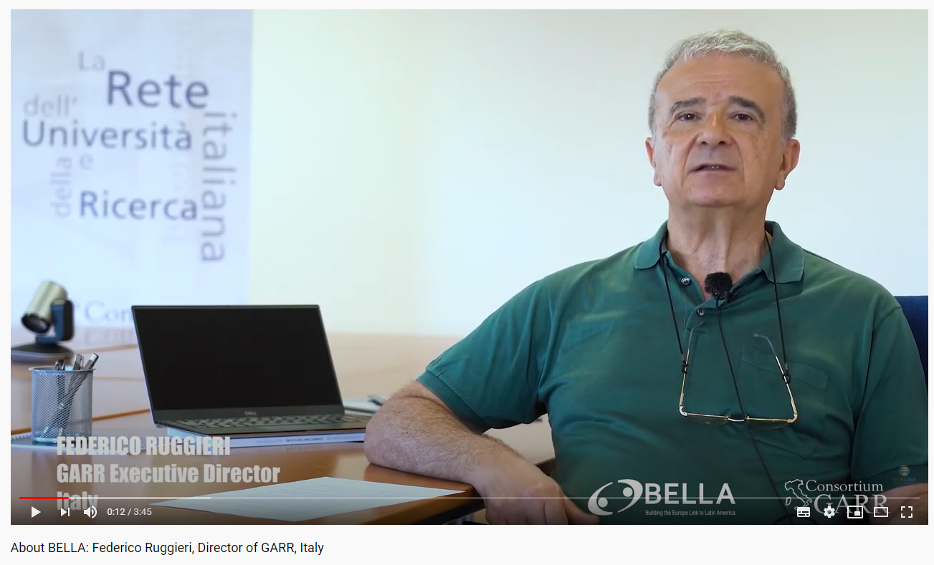
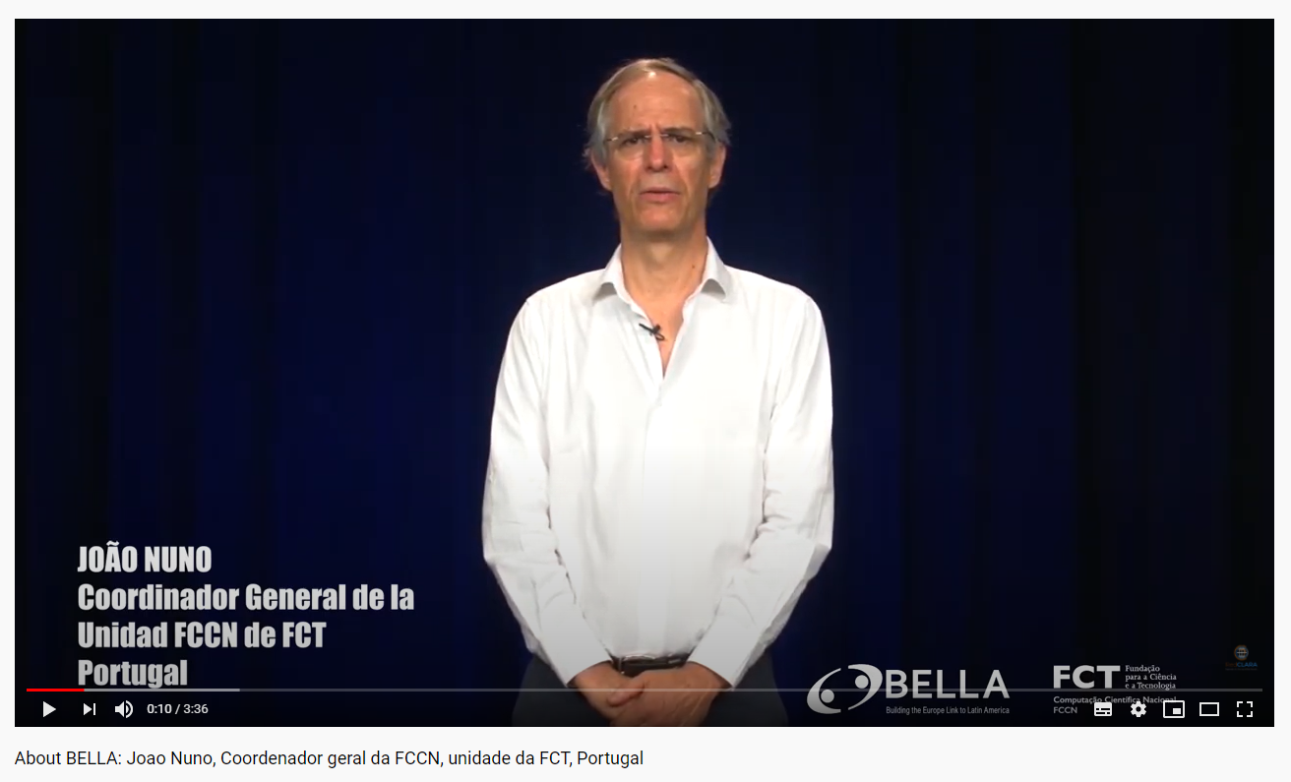
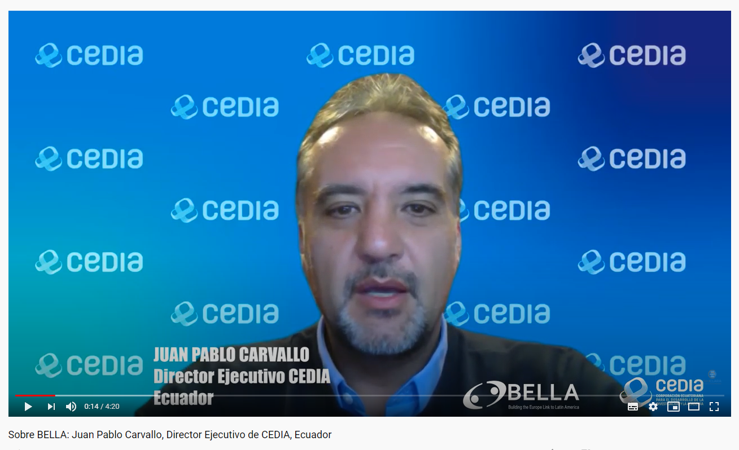
TICAL2020 – NREN Videos now on YouTube

Slide 5
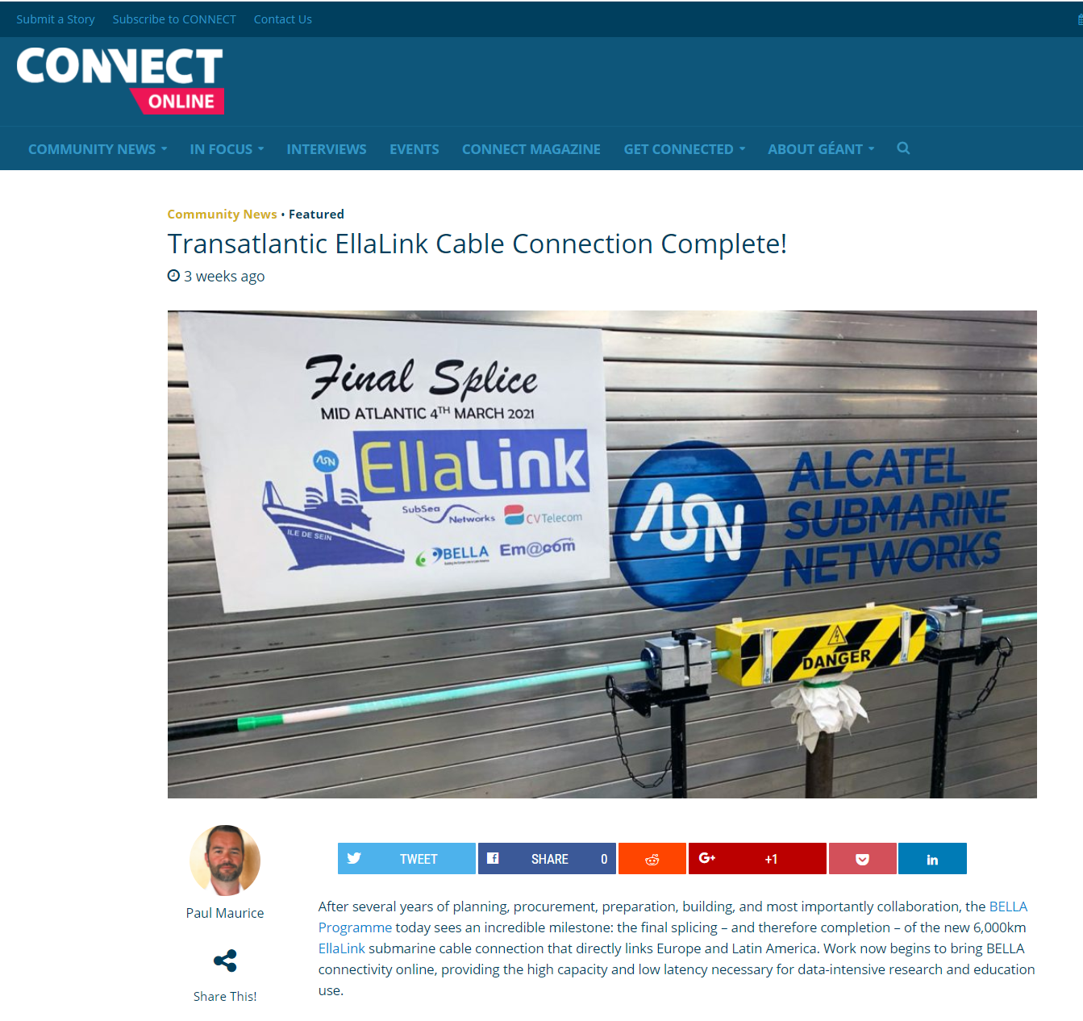
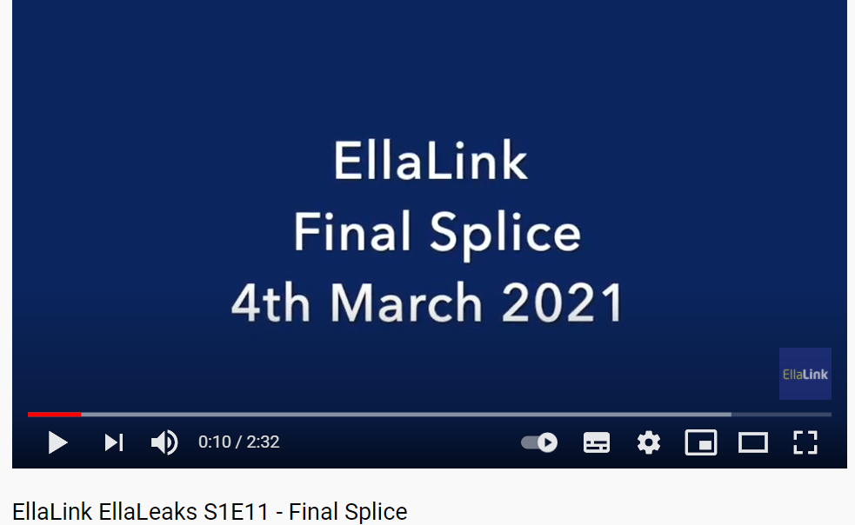
Milestone: EllaLink submarine cable splice
Joint comms with EllaLink on submarine cable final splice

Slide 6

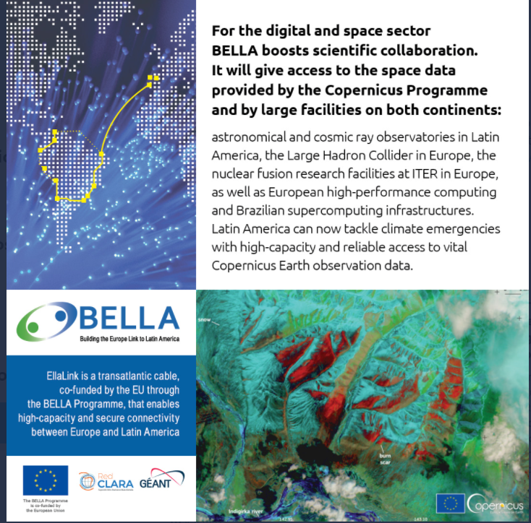
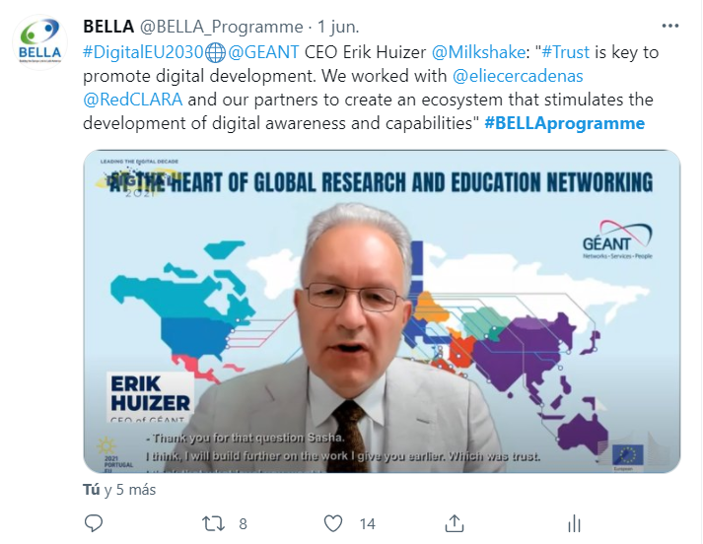
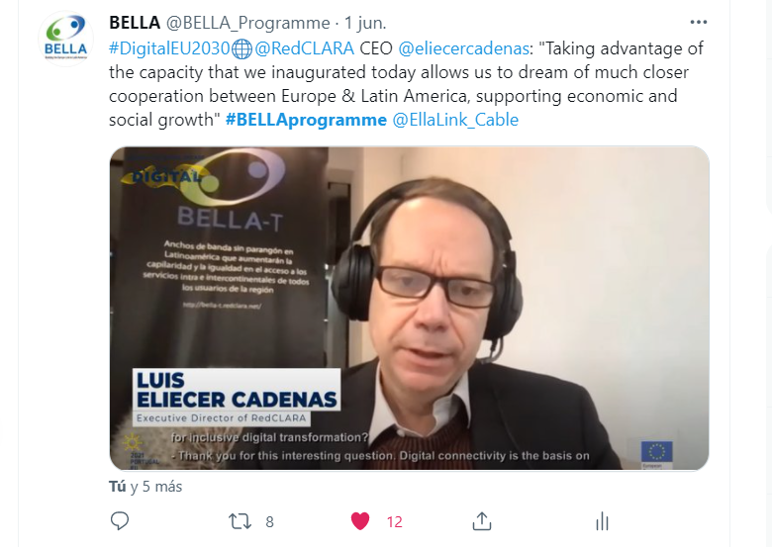
Latest
Meetings and collaboration with EU-LAC events and comms planning
  Twitter activity – EU INTPA handle (85k followers)
Leading the Digital Decade as part of Portuguese presidency, EllaLink official launch 1 June 2021
  Live participation of Erik Huizer (GÉANT CEO)
  and Luis Eliecer Cadenas RedCLARA CEO

Slide 7
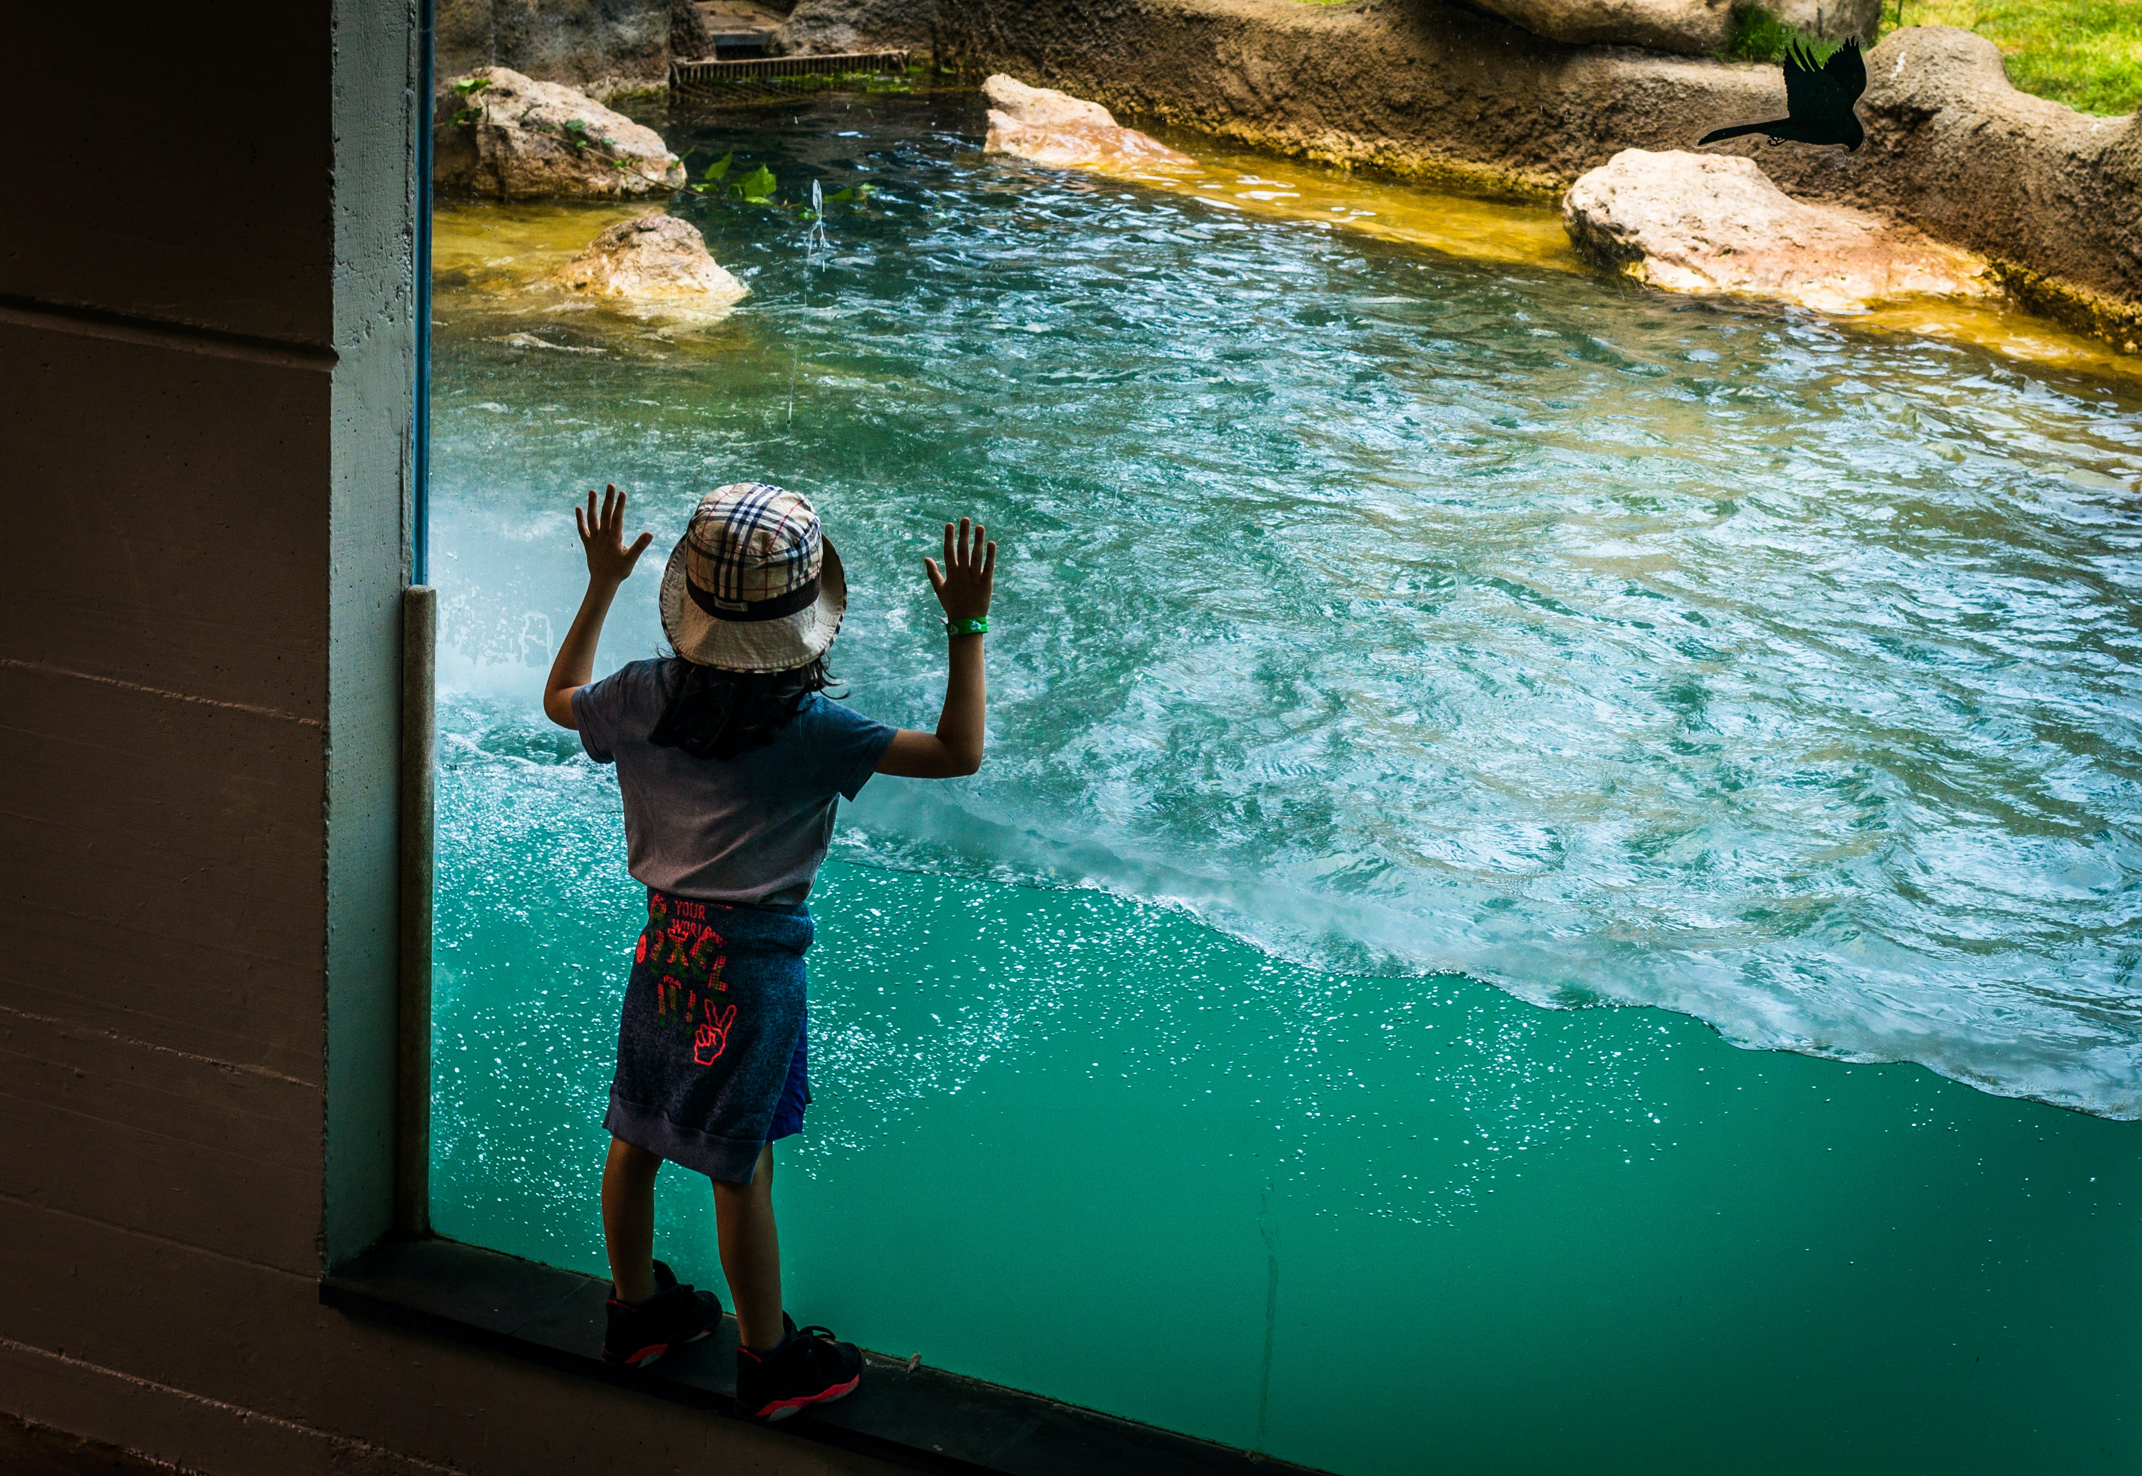
Next
BELLA launch TICAL 2021
  Presentations and more video testimonials from all partners
BELLA goes LIVE in August (date tbc) and we can’t wait!

Slide 8
BELLA contacts
Web
https://bella-programme.redclara.net/index.php/en/
Twitter
https://twitter.com/BELLA_Programme
BELLA Comms
Paul Maurice, GÉANT - Maria Jose Lopez Pourailly, RedCLARA - Rosanna Norman, GÉANT
Emails
bella_coms@redclara.net
bella_steering_committee@listas.redclara.net

