Slide 1
Belnet crisis
Last but not least
29/06/2021

Slide 2
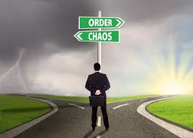
2016
2021

