Slide 1

Communications and Engagement – a REANNZ perspective
Hannah Edwards
Communications and Marketing Manager

Slide 2

The role of Engagement and Communications at REANNZ
Engagement - to listen and understand our members needs so that we can enable research outcomes both nationally and internationally.
Communications and marketing – to support the strategic objectives of REANNZ through clear, transparent and values-based communications and marketing activities.

Slide 3

REANNZ provides a specialist fibre network (our National Research and Education Network [NREN]), that is used to access, move and share research data, both nationally and internationally;
As a member of the international community made up of over 120 NRENs, REANNZ provides connections to global research partners that work with New Zealand scientists;
Our remit is to help support New Zealand’s researchers to use the network - to make their research lives easier by joining them with each other, and the rest of the world.

Slide 4






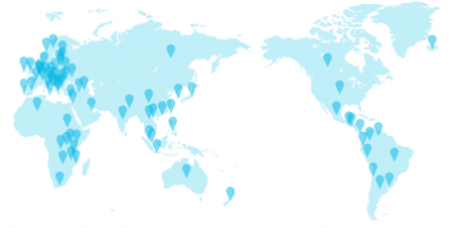

Communications and Engagement timeline -
2020
2021
Engagement Roadshow/Connect sessions for members
COVID-19 Comms and declutter
2021/22
Digital Comms Approach
Strategic Comms for REANNZ and Engagement with the wider community
eResearch NZ Conference
Notes:
So what have the last 18 months or so looked like for REANNZ’s communications and Engagement activities?
2020 communications and engagement activities were dominated by the COVID-19 pandemic, adapting to the changing alert levels here in New Zealand and ensuring that we were keeping members and stakeholders updated on what we were doing to ensure smooth operations, and to support our members while they also adapted to the ‘new normal’.
I was new to the role and new to communications as a profession, so I definitely admit to a very steep learning curve during this time! A lot of the activities that I prioritised were more operational, improving the consistency and frequency of communications to our members, tidying up our channels (the website, social media channels) and branding to give me a good foundation to build on. Putting into place a more digital approach to our communications activities, as well as information gathering about our local community with help from the Engagement team to see what it was that our member’s wanted to see from us going forward. In second half of this year I want to embed this by implementing a content and social media strategy to produce some more videos and dynamic content (loved AARNET’s interviews with researchers, the more I am getting to know the community the more I am seeing that some are allusive and some love to talk about their work and the role of the network so that’s something!)
eResearch conference – stats and learnings from a hybrid event – previous presentations from the global NREN community during the Sig Marcomms group catch up helped a lot with the thinking around the conference. Organising committee is coming together again in the next few weeks for next year’s event so communications and engagement will work closely on that.
REANNZ Connect/Roadshow framework – feedback from the Members, what they would like to see from us. Survey around how they would like to receive updates/keep informed about our activities. Transparency, frequency and engagement so that we are meeting their needs. Been a strategic priority that is being received positively from both the members and stakeholders.
In between these activities have been the usual reporting and compliance communications/documents. Case studies demonstrating the value of the network and what it enables, consistent messaging and narrative of the Annual report reflected across channels. Messaging that REANNZ is an NREN and what that means for our members, stakeholders and the wider community. Owning that as a key part of our identity and being clear in the direction of supporting and enabling data intensive research.
Looking to the future? Moving in to a more strategic role, comms is a team of one so looking to crowdsource and support internal capability to produce communications materials and this is where the relationship between communications and engagement is important. Continue to build more purposeful engagement with the wider community and our members. Now that I have my feet under the table and have developed some good connections with the local community I am really keen to get more involved in the wider, global NREN community and have thoroughly enjoyed the opportunities I’ve had so far (like attending APAN, working alongside the collaborators of APOnet and presenting here today!)

Slide 5
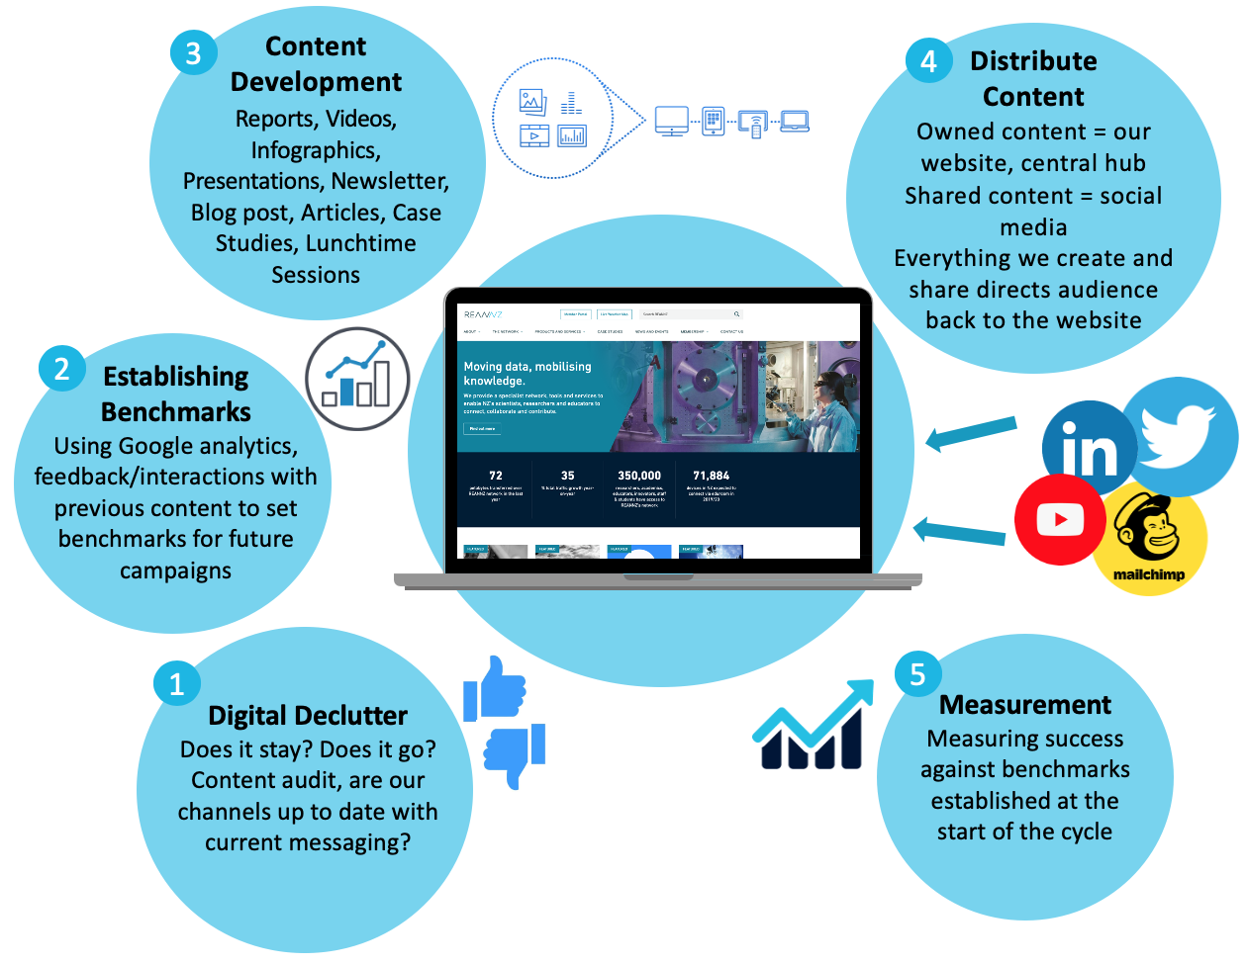

Slide 6
Communications and Engagement timeline -
2020
2021
Engagement Roadshow/Connect sessions for members
COVID-19 Comms and declutter
2021/22
Digital Comms Approach
Strategic Comms for REANNZ and Engagement with the wider community
eResearch NZ Conference
Notes:
So what have the last 18 months or so looked like for REANNZ’s communications and Engagement activities?
2020 communications and engagement activities were dominated by the COVID-19 pandemic, adapting to the changing alert levels here in New Zealand and ensuring that we were keeping members and stakeholders updated on what we were doing to ensure smooth operations, and to support our members while they also adapted to the ‘new normal’.
I was new to the role and new to communications as a profession, so I definitely admit to a very steep learning curve during this time! A lot of the activities that I prioritised were more operational, improving the consistency and frequency of communications to our members, tidying up our channels (the website, social media channels) and branding to give me a good foundation to build on. Putting into place a more digital approach to our communications activities, as well as information gathering about our local community with help from the Engagement team to see what it was that our member’s wanted to see from us going forward. In second half of this year I want to embed this by implementing a content and social media strategy to produce some more videos and dynamic content (loved AARNET’s interviews with researchers, the more I am getting to know the community the more I am seeing that some are allusive and some love to talk about their work and the role of the network so that’s something!)
eResearch conference – stats and learnings from a hybrid event – previous presentations from the global NREN community during the Sig Marcomms group catch up helped a lot with the thinking around the conference. Organising committee is coming together again in the next few weeks for next year’s event so communications and engagement will work closely on that.
REANNZ Connect/Roadshow framework – feedback from the Members, what they would like to see from us. Survey around how they would like to receive updates/keep informed about our activities. Transparency, frequency and engagement so that we are meeting their needs. Been a strategic priority that is being received positively from both the members and stakeholders.
In between these activities have been the usual reporting and compliance communications/documents. Case studies demonstrating the value of the network and what it enables, consistent messaging and narrative of the Annual report reflected across channels. Messaging that REANNZ is an NREN and what that means for our members, stakeholders and the wider community. Owning that as a key part of our identity and being clear in the direction of supporting and enabling data intensive research.
Looking to the future? Moving in to a more strategic role, comms is a team of one so looking to crowdsource and support internal capability to produce communications materials and this is where the relationship between communications and engagement is important. Continue to build more purposeful engagement with the wider community and our members. Now that I have my feet under the table and have developed some good connections with the local community I am really keen to get more involved in the wider, global NREN community and have thoroughly enjoyed the opportunities I’ve had so far (like attending APAN, working alongside the collaborators of APOnet and presenting here today!)

Slide 7
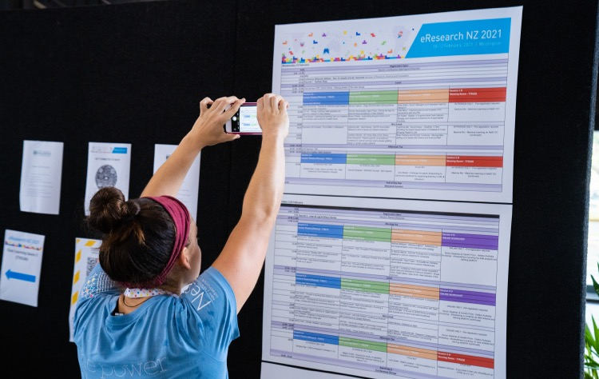
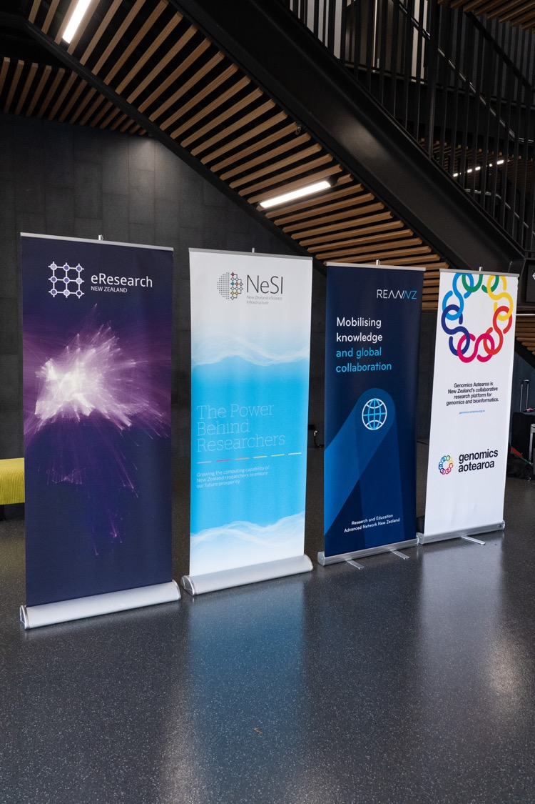
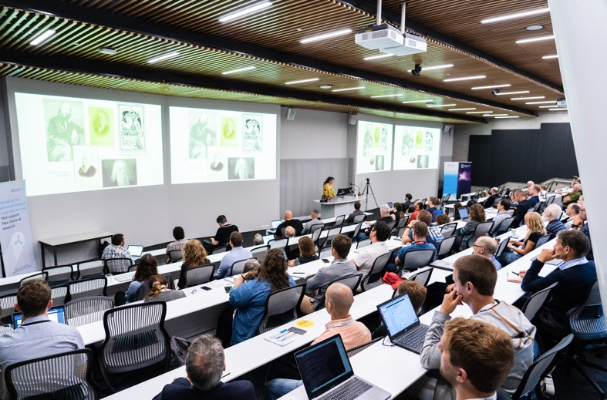
https://youtu.be/mIXwI4qjWBA

Slide 8
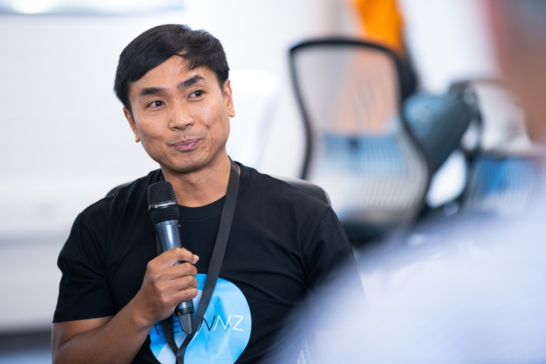
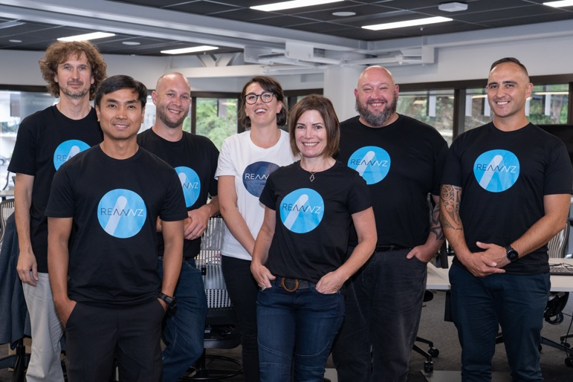
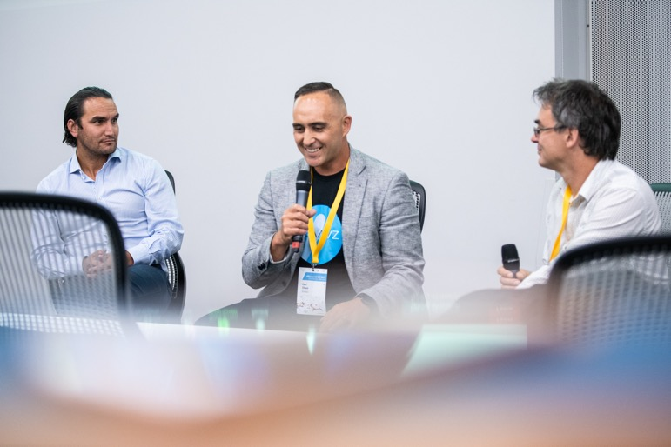
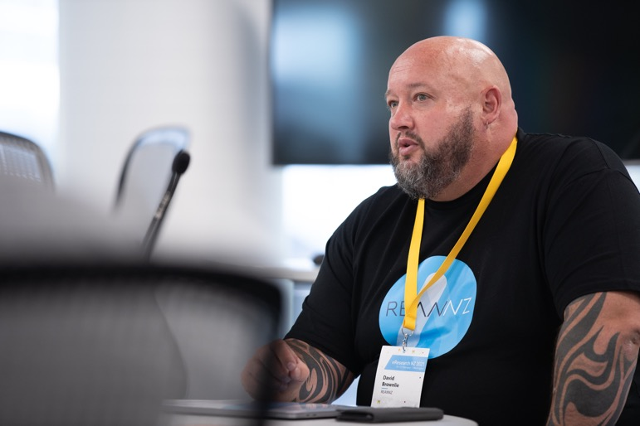

Slide 9
Communications and Engagement timeline -
2020
2021
Engagement Roadshow/Connect sessions for members
COVID-19 Comms and declutter
2021/22
Digital Comms Approach
Strategic Comms for REANNZ and Engagement with the wider community
eResearch NZ Conference
Notes:
So what have the last 18 months or so looked like for REANNZ’s communications and Engagement activities?
2020 communications and engagement activities were dominated by the COVID-19 pandemic, adapting to the changing alert levels here in New Zealand and ensuring that we were keeping members and stakeholders updated on what we were doing to ensure smooth operations, and to support our members while they also adapted to the ‘new normal’.
I was new to the role and new to communications as a profession, so I definitely admit to a very steep learning curve during this time! A lot of the activities that I prioritised were more operational, improving the consistency and frequency of communications to our members, tidying up our channels (the website, social media channels) and branding to give me a good foundation to build on. Putting into place a more digital approach to our communications activities, as well as information gathering about our local community with help from the Engagement team to see what it was that our member’s wanted to see from us going forward. In second half of this year I want to embed this by implementing a content and social media strategy to produce some more videos and dynamic content (loved AARNET’s interviews with researchers, the more I am getting to know the community the more I am seeing that some are allusive and some love to talk about their work and the role of the network so that’s something!)
eResearch conference – stats and learnings from a hybrid event – previous presentations from the global NREN community during the Sig Marcomms group catch up helped a lot with the thinking around the conference. Organising committee is coming together again in the next few weeks for next year’s event so communications and engagement will work closely on that.
REANNZ Connect/Roadshow framework – feedback from the Members, what they would like to see from us. Survey around how they would like to receive updates/keep informed about our activities. Transparency, frequency and engagement so that we are meeting their needs. Been a strategic priority that is being received positively from both the members and stakeholders.
In between these activities have been the usual reporting and compliance communications/documents. Case studies demonstrating the value of the network and what it enables, consistent messaging and narrative of the Annual report reflected across channels. Messaging that REANNZ is an NREN and what that means for our members, stakeholders and the wider community. Owning that as a key part of our identity and being clear in the direction of supporting and enabling data intensive research.
Looking to the future? Moving in to a more strategic role, comms is a team of one so looking to crowdsource and support internal capability to produce communications materials and this is where the relationship between communications and engagement is important. Continue to build more purposeful engagement with the wider community and our members. Now that I have my feet under the table and have developed some good connections with the local community I am really keen to get more involved in the wider, global NREN community and have thoroughly enjoyed the opportunities I’ve had so far (like attending APAN, working alongside the collaborators of APOnet and presenting here today!)

Slide 10

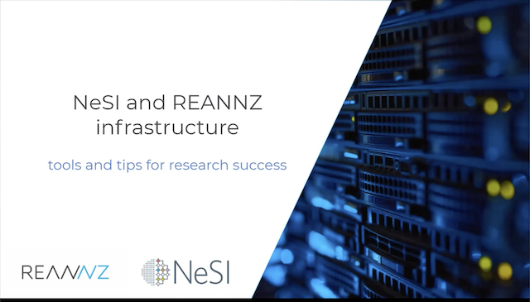

https://www.youtube.com/watch?v=aW5GuLq8_4k

Slide 11
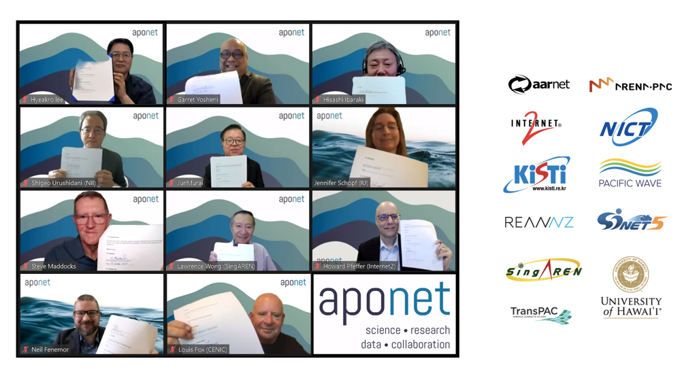
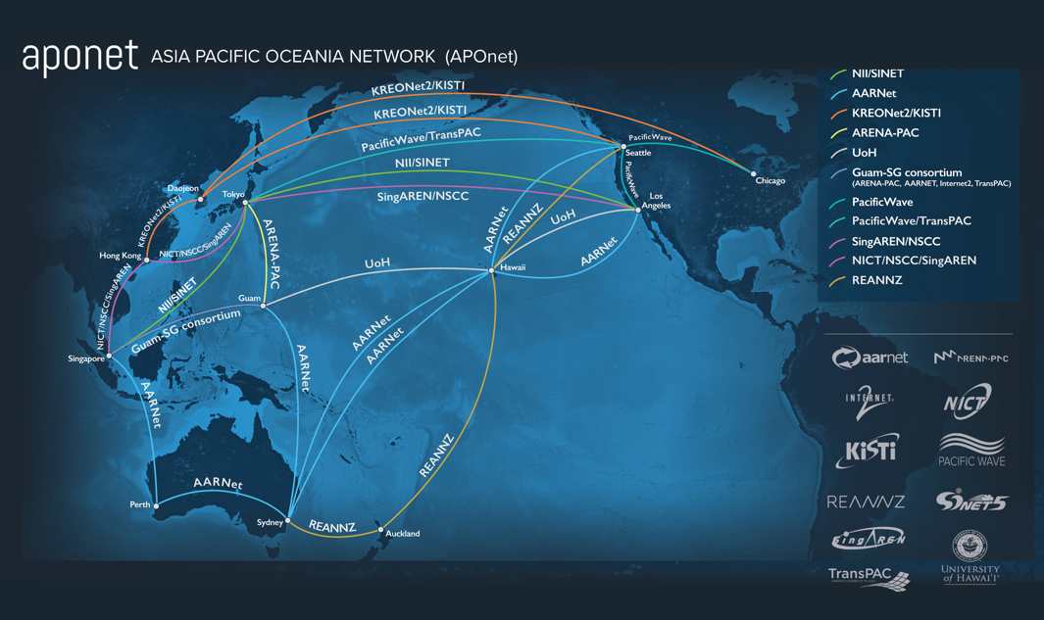

Slide 12







































Universities
Crown Research Institutes
Institutes of Technology, Polytechnics and Wānanga
Research and Education Sector

Slide 13




Thank you!
My email – hannah.edwards@reannz.co.nz
www.reannz.co.nz
@REANNZ
REANNZ Ltd.
Engagement team - engagement@reannz.co.nz
Communications – communications@reannz.co.nz

