Slide 1

Equality Diversity and Inclusion -
Comms perspective
Barbara Carroll 29/06/2021
Barbara.Carroll@heanet.ie

Slide 2

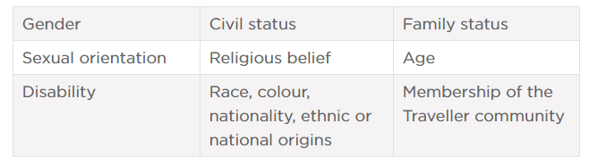
Why are we looking at this?
Notes:
- The Employment Equality Acts 1998 to 2011

Slide 3
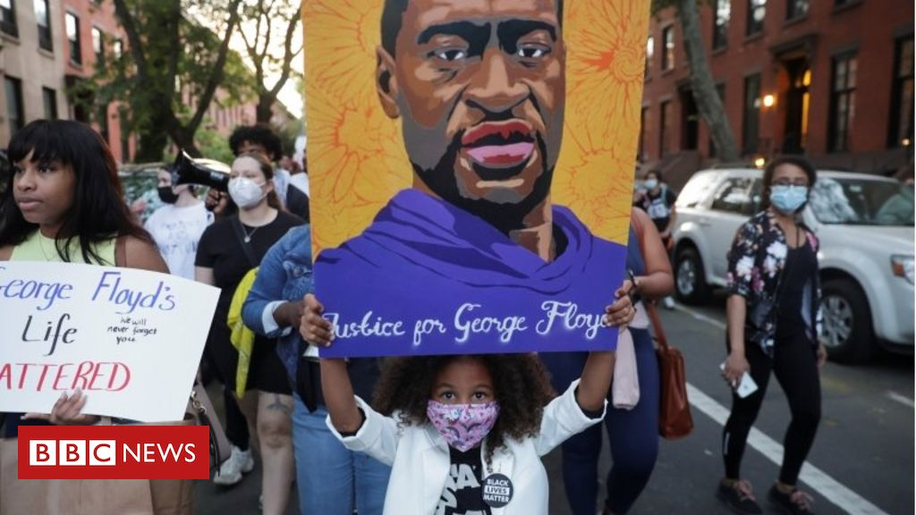


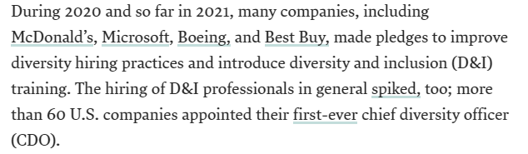
Global picture
Notes:
https://www.weforum.org/reports/gender-gap-2020-report-100-years-pay-equality/digest
https://hbr.org/2021/05/5-strategies-to-infuse-di-into-your-organization

Slide 4
What are we doing?

Slide 5


What are we doing?

Slide 6
Next steps
EDI steering group will take the lead
What impact we can have?
How can we celebrate our diversity?
Where do you draw the line?
How to ensure it’s ongoing, not one-off training
Develop a carefully crafted comms strategy
Your ideas / comments / suggestions?

Slide 7

What do you think?
Keep others informed

