Slide 1
GÉANT OER Pilot
9 October, 2014
Amsterdam

Slide 2
Value proposition
Systems and/or services where NRENs can collaboratively create added value for the benefit of global education and research

Slide 3
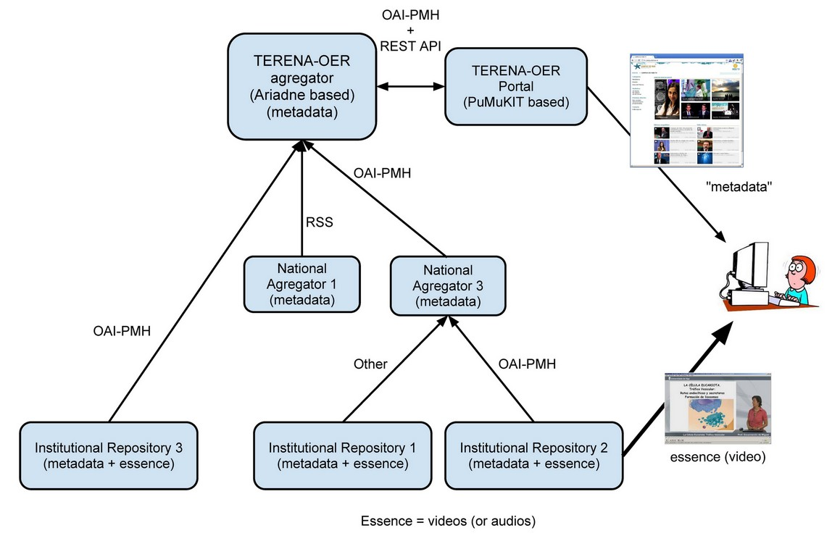
Concept

Slide 4
Added value
European level metadata aggregation point
Web front-end portal (DEMONSTRATOR)
  One stop shop for users
    Deep search
  Enrichment for providers
    Content linking, quality
  Paradata, collaborative/social features
  System integration (Search Widget, LMS)
    APIs

Slide 5
Focus
National level repositories and/or federations run by the NREN
National level repositories and/or federations run by other org.
Institutional repositories run by NREN connected institutes
Thematically organised repositories for research (EC funded projects)

Slide 6
Types
Multimedia (video)
  Lecture recordings
  Conference recordings
  Learning Objects (no still image)
Being ready for other types
MOOC is our customer
Moodle is an other customer

