Slide 1
The TERENA-OER Portal
9.10.2014
Eli Shmueli
IUCC- Israeli-Inter Universities Communication Center
MEITAL- Inter-University Center for e-Learning
eli@mail.iucc.ac.i

Slide 2
The project
European level metadata aggregation portal for Open Educational Resources
Harvesting metadata from the national to the pan-European level
Focus on audiovisual content (e.g. recorded lectures)
A forum for collaboration, innovation and knowledge sharing

Slide 3
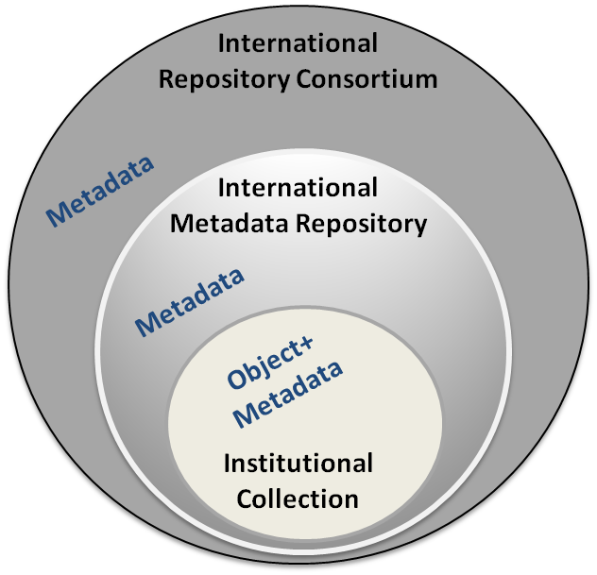
Material distribution and sharing levels

Slide 4
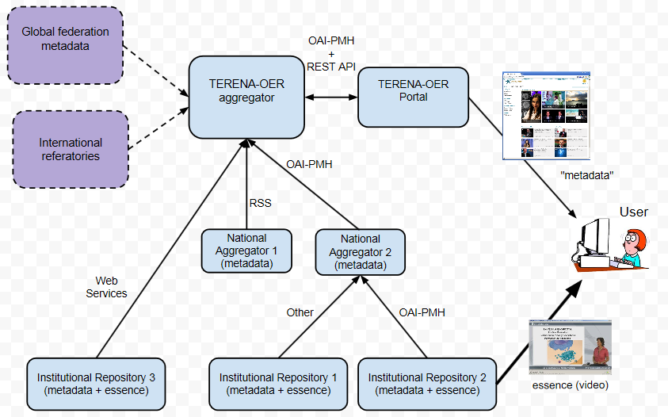
General infrastructure

Slide 5
Main components
General features
Metadata
Paradata
Federated search (connectivity)
Social media

Slide 6
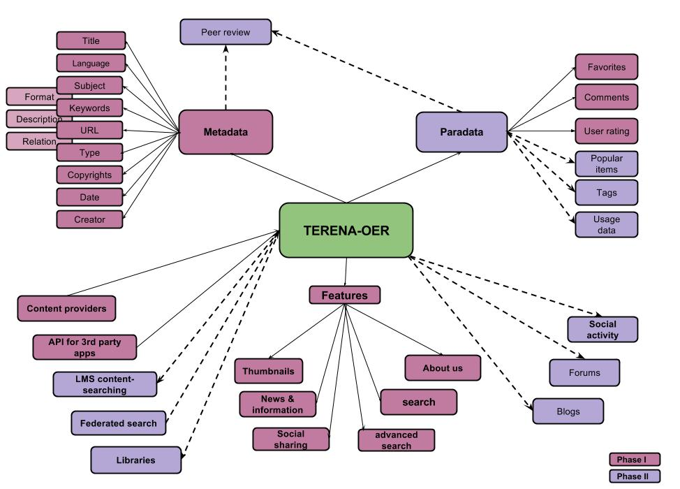
Components of the
TERENA-OER portal

Slide 7
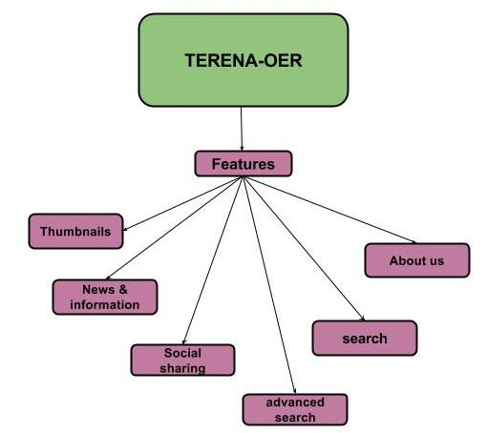
General features

Slide 8
General features (1)
Search
Advanced search
Categories
Thumbnails
Language
News and information
Social media sharing
About us
Help

Slide 9
General features (2)
Mobile applications
Membership
Responsive Web Design
Terms & policies
RSS
Alert
Web access for the disabled
Dashboard

Slide 10
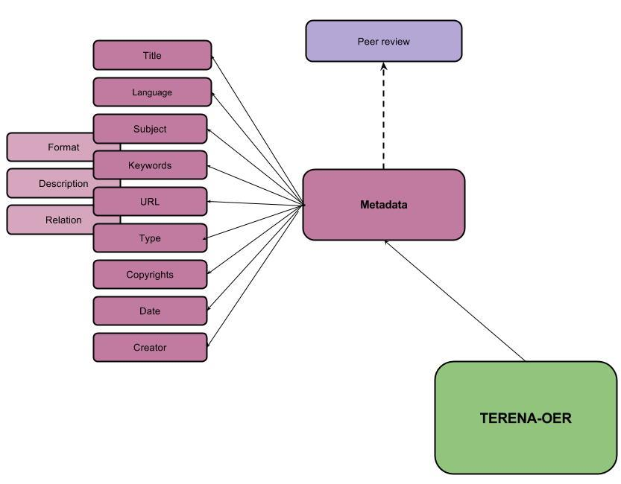
Metadata

Slide 11
Metadata - mandatory fields (1)
Title – Name given to the learning object
Language – The primary language or languages used within this learning object to communicate to the intended user
Subject – Educational topic/discipline
Keywords – A keyword or phrase describing the topic of this learning object
Format - Technical datatype(s) of (all the component of) the learning object
URL - Network location of the learning object
Description - A textual description of the content of this learning object (level)

Slide 12
Metadata – mandatory fields (2)
Learning Resource Type – Specific kind of learning object. The most dominant kind shall be first
Copyrights – Whether copyright or other restrictions apply to the use of this learning object
Date – The date of the contribution
Creator – Those entities (i.e. people or organizations) that have affected the state of this metadata instance during its life cycle (e.g., creation, validation)

Slide 13
Metadata – optional fields
Educational category
  Context – The principal environment within which the learning and use of this object is intended to take place
  Description - Comments on how this learning object is to be used
  Relation – Defines the relationship between this learning object and other learning objects, if any.

Slide 14
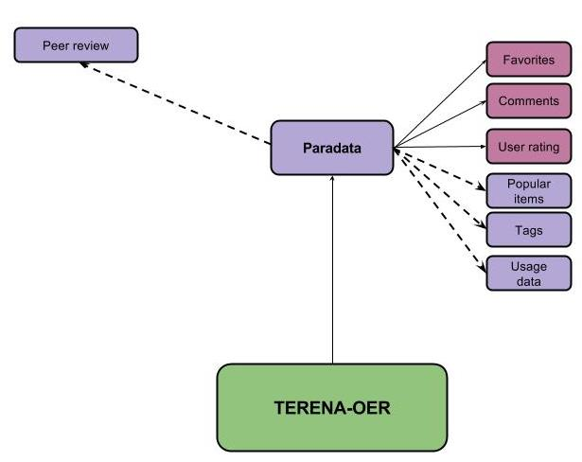
ParaData

Slide 15
ParaData
The usage of learning objects - TERENA-OER will collect data of users activity at the individual level and the overall referatory level.
Rating – Users will be able to assign a rating of 1-5 stars to an OER
Comments – Contributors will be able to add their comments regarding the OER they contributed using the comments mechanism
Dynamic tag cloud - Users will be able to freely tag resources. The tags will be aggregated and represented as a tag cloud.
Popular items - The homepage will present popular items.

Slide 16
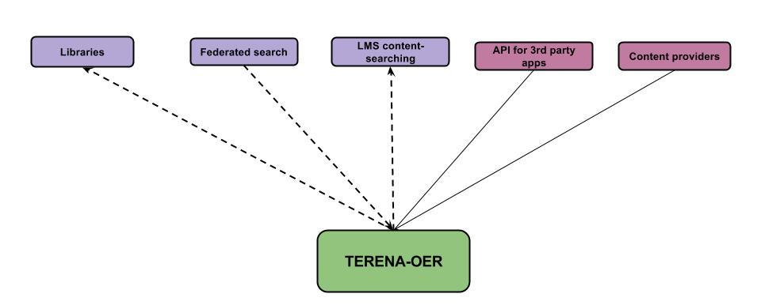
Connectivity

Slide 17
Connectivity
An import/export API
Integrating TERENA-OER services in LMS.
Federation of OER repositories (geographically distributed).
Enrich the variety of high-quality learning objects offered to faculty by academic libraries
Increase the chances of faculty implementing existing OER in class materials.
Expose TERENA-OER to a large number of users.
Encourage additional NRENs to contribute their metadata to the project.

Slide 18
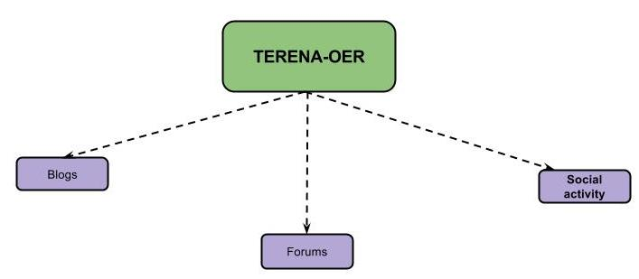
Social media

Slide 19
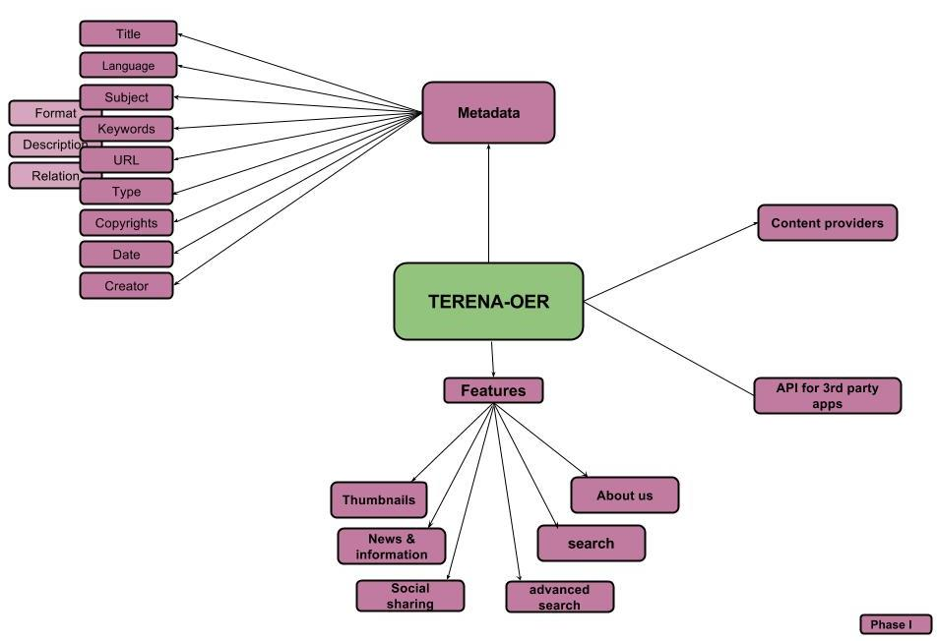
Phase I

Slide 20
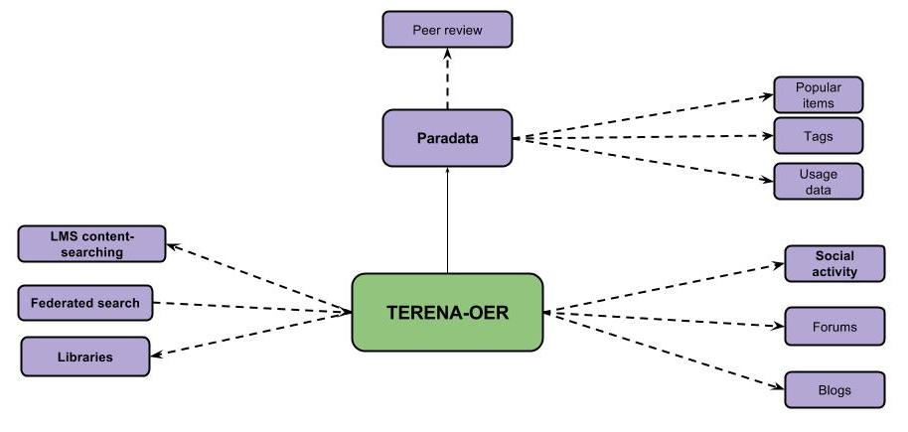
Phase II

Slide 21
About MEITAL
Inter-University Center for e-Learning (IUCEL)
Part of the Israeli IUCC - The Inter-University Computation Center
Assists Israeli institutions of higher education (universities and academic colleges) in advancing the use of e-learning technologies
Organizes an annual national e-learning conference
Research fund
Newsletter & social media
Workgroups (e.g. New technologies, Pedagogy)

