Slide 1

Building the TERENA Greenhouse
TERENA TTC
Amsterdam, Netherlands
19th September 2013
Nicole Harris
PDO
harris@terena.org
www.terena.org

Slide 2
Greenhouse?
A place to cultivate;
A place for support and growth;
A transparent structure.
<lastname@terena.org>

Slide 3
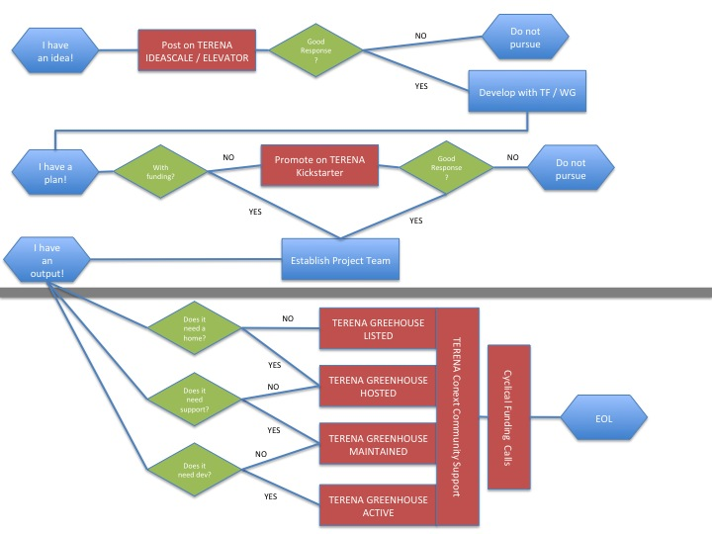
Lifecycle of an idea

Slide 4
Main findings to date
We ALREADY do most of this, in various forms.
(e.g.) REFEDS participants agreement and sponsor model.
(e.g.) TCS support processes for Djangora and Confusa.
It’s something we do that is not codified as a TERENA offer.

Slide 5
Initial proposal
  Define support models.
  Explore crowd-source funding / decision tools. (parked for now).
  Improve current hosting.
  Explore software maintenance options / review skills shortage.

Slide 6
Support Models
WHO can request support?
  Only TERENA members?
  Working with GEANT software people?
HOW do we assess requests?
  Steering Committee model, drawn from across the task forces?
WHAT is the offer?
  Do we want to offer all four types of support in the diagram?
  NOT a conservancy model with separate legal structure.
WHERE are the gaps?
  Participants / sponsors agreement.
  Effective way to promote / website.

Slide 7
Hosting arrangements - code
Have established a paid github organisation to allow for paid repository.
Moving current projects in to that space – going well.
Currently see no need for alternative (e.g. hosted TERENA jira).

Slide 8
Hosting arrangements - promotion
Need to be able to communicate the offer.
Need to be able to promote supported software.
Would be clumsy to try and just use activity pages on TERENA website.
Propose request for small amount of funding for a simple website design.

Slide 9
Software maintenance
Already well established contractual arrangements at TERENA for developers.
Skills shortage still causes problems (e.g. Confusa support). However, project skills often very specific.
Create more of a community of the current contractors / help identify generic skills.
More robust future model???

Slide 10
Proposal
Commission simple website design for greenhouse.
Create a participant / sponsor agreement for greenhouse.
Appoint a steering committee to make decisions around acceptance of software.
Work with small group of projects through the process (Filesender, REFEDS projects, TCS software, possibly Surfnet and GEANT projects).

