Slide 1

Licence Analysis with WhiteSource
Branko Marović, WP9T2, UoB/AMRES
© GÉANT Association on behalf of the GN4 Phase 3 project (GN4-3).
The research leading to these results has received funding from
the European Union’s Horizon 2020 research and innovation programme under Grant Agreement No. 856726 (GN4-3).

Slide 2
Agenda
OSS and WhiteSource services in the context of GÉANT IPR management (Branko Marović, UoB/AMRES)
Scanning a software product/project with WhiteSource (Tomasz Weiss, PSNC)
Reviewing and interpreting the results of a WhiteSource analysis (Milica Antić, UoB/AMRES)
Next steps in GÉANT IPR management (Magdalena Rzaca, GÉANT)
  Post your questions in the chat, which will be answered at the end of each part
  Comment now or after the webinar in the Miro canvas, so we could address your needs in the future

Slide 3
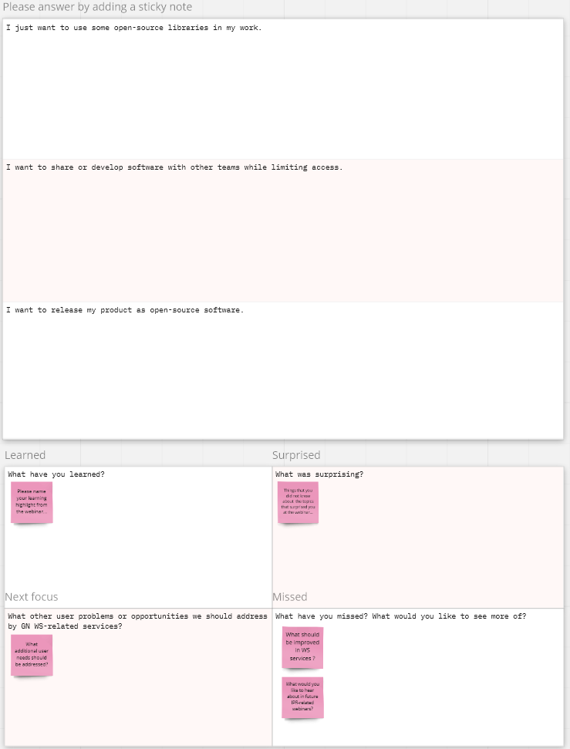
  Please
  1. Respond to 3 questions (now)
  2. Share your ideas and impressions on the Miro board (now or later) https://miro.com/app/board/uXjVONtFjbY=/

Slide 4
Open Source Software
Our work is increasingly dependent on Open Source Software (OSS)
OSS licences keep OSS software alive
License compliance is important for legal reasons and to ensure better collaboration
Licensing considerations are far significant when there is a distribution of software, as OSS licences come with specific conditions
Open Source Licensing and Compliance workshop recording and slides
https://e-academy.geant.org/moodle/course/view.php?id=214

Slide 5
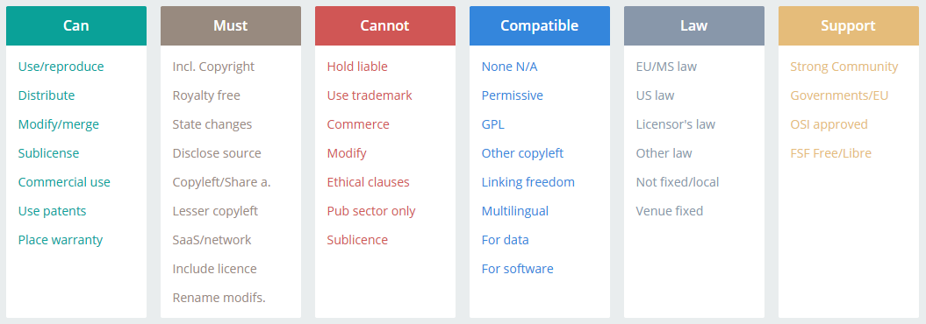
OSS conditions
Rights/permissions – what you can do
Requirements/obligations – related to behaviour and provisioning of compliance artifacts (copyright, disclaimer, licence text, notices, relevant source code, build and installation instructions…)
Restrictions/limitations – limits of use or what you must not do
Other characteristics – typical uses, classification, legal features, origin, community, endorsement…
Join-Up Licence Assistant: https://joinup.ec.europa.eu/collection/eupl/solution/joinup-licensing-assistant/jla-find-and-compare-software-licenses

Slide 6
Black Duck top list
https://www.synopsys.com/blogs/software-security/top-open-source-licenses/
Rank | License | Usage | Licensing Risk
1 | MIT | 32% | Low
2 | GPL 2.0 | 18% | High
3 | Apache 2.0 | 14% | Low
4 | GPL 3.0 | 7% | High
5 | BSD 2 | 6% | Low
6 | ISC | 5% | Low
7 | Artistic (Perl) | 4% | Medium
8 | LGPL 2.1 | 4% | High
9 | LGPL 3.0 | 2% | High
10 | Eclipse (EPL) | 1% | Medium

Slide 7
GÉANT WhiteSource top list
Rank | Licence | Usage | Note
1 | MIT | 36%
2 | Apache 2.0 | 16% | Inclination towards permissive
3 | GPL 2.0 | 9%
4 | BSD 3 | 5% | Inclination towards permissive
5 | Requires Review | 4% | Not automatically detected
6 | BSD 2 | 3%
7 | LGPL 2.1 | 3%
8 | GPL 3.0 | 3%
9 | ISC | 3%
10 | LGPL 2.0 | 2%
11 | Artistic 1.0 | 1%
12 | LGPL 3.0 | 1%
13 | BSD | 1% | Ambiguity
14 | GPL | 1% | Ambiguity
15 | GPL 2.0 Classpath | 1%

Slide 8
Impact of copyleft
Permissive licences have simple requirements – to credit original work, describe changes, provide disclaimer…
Copyleft licences (“reciprocal”, “protective”, “restrictive”, derogatory: “viral”) require the rights to be preserved in derivative works
If you use any components (libraries) with copyleft, you are obliged to make derived source code available, which may include the entire product/project!
Permissive
Weak copyleft
Strong copyleft
MIT
ISC
BSD
MPL 2.0
LGPL 2.1
LGPL 3.0
Network protective
GPL 2.0
GPL 3.0
Apache 2.0
AGPL 3.0
Most permissive
Least permissive

Slide 9
Use case: you just want to use your own code and existing OSS
For internal use, you can use any OSS and not worry about licences – you have your code and are not giving it to anyone, which is OK with every OSS licence
You can keep your code private, but internal use is very limited and may easily evolve into something else…
What when you later decide to offer software to others? You may end up with components with incompatible licences, unable to choose one for your product/project!
  Start early
  Learn licences of components that you are using
  Determine your possible future licence
Components with permissive licences may be volatile – you may be left with an unmaintained version after it is forked with a more restrictive licence!
  Elasticsearch and MongoDB limitations for SaaS providers…
For a service, you are safe if using any OSS except under AGPL

Slide 10
Use case: you want to distribute a closed source software
You want to distribute only executables
You can use permissive (MIT, Apache…) licences, but also MPL and LGPL components
Code leaking starts with MPL and LGPL...
  Your changes in files under MPL must be made available
  With LGPL (in addition) you must dynamically link so the user could substitute the component!

Slide 11
Use case: you want to share your software with someone
With permissive licences of components, you do not have to make any source code available
With copyleft components, you must allow access to some or all source code
But when sharing, you must use the same or compatible licence for changed code or even the entire project
If you are using several strong copyleft components, you may not be able to pick up a licence that is compatible with all of them!
→ Licence compatibility becomes a major issue…
Some customers may prefer copyleft to be protected from forks with licence changes

Slide 12
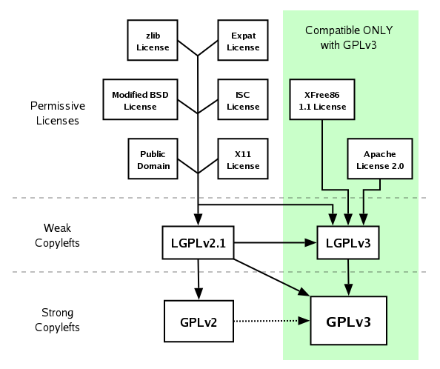
Licence compatibility (GPL family)
https://www.gnu.org/licenses/quick-guide-gplv3.html
Arrows are transitive and go from licences of the components toward the one of your project
Dotted line – “GPL 2 only” is not compatible with GPL 3”, but ”GPL 2 or later” is
AGPL
  (L)GPL 3.0(+) components can be used, thanks to an explicit GPL rule
  Code under AGPL cannot be used in (L)GPL projects unless dual-licensed
Dual and multi-licences help in avoiding licence compatibility issues, which makes the use of components more flexible

Slide 13
Typical steps in licence management
(ORCRO, Open Source Licensing and Compliance workshop)
Gather information (can be done with WhiteSource)
Document (can be done with WhiteSource)
Remediate
Create compliance artifacts (to ensure compliance)

Slide 14
Information gathering and documenting
Note the licence of your “product” (entire bundle of created components) or “project” (one program or standalone component), if set
Create an open-source inventory of used components
Detect vulnerable open-source components (to remove or replace)
Identify outdated open-source libraries (to replace?)
Identify licences of used components (in-licenses)
Clarify ambiguities or doubts
  A tool may not be able to properly identify a license – in WhiteSource, some are suspect or ambiguous
  Information about applied license may be false, unclear or contradictory
  Some licences may be recognized under several names
  Some (permissive) licences (BSD, Artistic …) have unnumbered variants or are sometimes edited by authors
  Applicability of “or later” may be unclear or even edited in the licence text
Document gathered information – WhiteSource does the above this through reports, UI and data exports
Document your decisions (some may be refined during remediation)

Slide 15
Remediation
Choose a product/project licence (out-licence) compatible with key dependencies
Initial improvements
  Remedy vulnerable open source components
  Update outdated open-source libraries (where possible)
  Ask component authors to clarify their licence or to relicense
  Pay for the required proprietarily licensed software
  Choose among dual licences of components
Identify remaining incompatible licences
Decide what to do with components that use these licences
  Remove (component and corresponding functionality) if not necessary
  Replace with an existing equivalent
  Move to server-side (central service)
  Write your replacement
Enforce open source license compliance (e.g., provide all required compliance artifacts)
Accept some risks

Slide 16
Checking of licence compatibility with WhiteSource
WhiteSource approach is still primarily based on (commercially oriented) Copyright Risk Score. It also quantifies the related
  Copyleft (no, partial, full)
  Linking (non-viral, dynamic, viral)
There is also Patent & Royalty Risk Score and related
  Royalty Free (yes, conditional, no)
It is gradually moving toward OSS license compatibility checks
Manual analysis is always an option – some decision making and remediation are needed anyway

Slide 17
GN WP9 T2 WhiteSource scan service
WhiteSource setup assistance
Mandatory first step - set up a product in WhiteSource tool
Inventory of product parts, other libraries and components of a software project
Insight into the status of libraries (if they are outdated or vulnerable)
Licences of used components
Initial data for licence selection and licence compliance analysis
WhiteSource scan analysis
Rescan - update of components and licences after changes in the project
Aligning WhiteSource licence settings with intended or actual licensing policy
Help in interpretation of obtained results
More than one scan is usually necessary until all parameters and libraries are adjusted

Slide 18
Scanning a software product/project with WhiteSource
Service flow and interaction between the participating teams
Scanning a software project with WhiteSource in practice (video)
Updating a scan to a new version of the project and automation of that process with CI tools
Integration of the project in Software Catalogue with WhiteSource (video)

Slide 19

Licence Analysis with WhiteSource
Next steps in GÉANT IPR management
Magdalena Rzaca, GDPR & IPR Legal Advisor, GÉANT
March 2022

Slide 20

IPR Policy update - overview
Updating the IPR Policy text:
- Further update will be provided in mid March 2022
Focus on licence compliance:
- Use of tools to ensure that we have adequate due diligence in place to ensure the cooperation
Providing IPR training:
-17.02.22 there was training focused on licensing in OSS
- Further trainings are being prepared

Slide 21
Where from here?
Your comments and needs on the Miro board, https://miro.com/app/board/uXjVONtFjbY=/
Request a WhiteSource scan, https://wiki.geant.org/display/gn43wp9/Client+guide+for+the+WhiteSource+Setup+Assistance
Resources
Open Source Licensing and Compliance workshop recording and slides,
https://e-academy.geant.org/moodle/course/view.php?id=214
WP9T2 wiki on licensing and materials from this webinar, https://wiki.geant.org/display/gn43wp9/General+information+about+OSS+licences
WP9T2 Best Practice B.6: Verify licences of the used libraries, https://wiki.geant.org/display/GSD/BP-B.6%3A+Verify+licenses+of+the+used+libraries
Thank you!!!
© GÉANT Association on behalf of the GN4 Phase 3 project (GN4-3).
The research leading to these results has received funding from
the European Union’s Horizon 2020 research and innovation programme under Grant Agreement No. 856726 (GN4-3).

