Slide 1
User Community Driven Development in Trust and Identity Services
Ann Harding, SWITCH

Slide 2
Trust and Identity Landscape
GÉANT
Research Community Engagement
Pilots
Conclusions
AARC - Authentication and Authorisation for Research and Collaboration
About AARC
Goals
Workplan
Panel
Bringing it all together – campus, eResearch and Federation

Slide 3

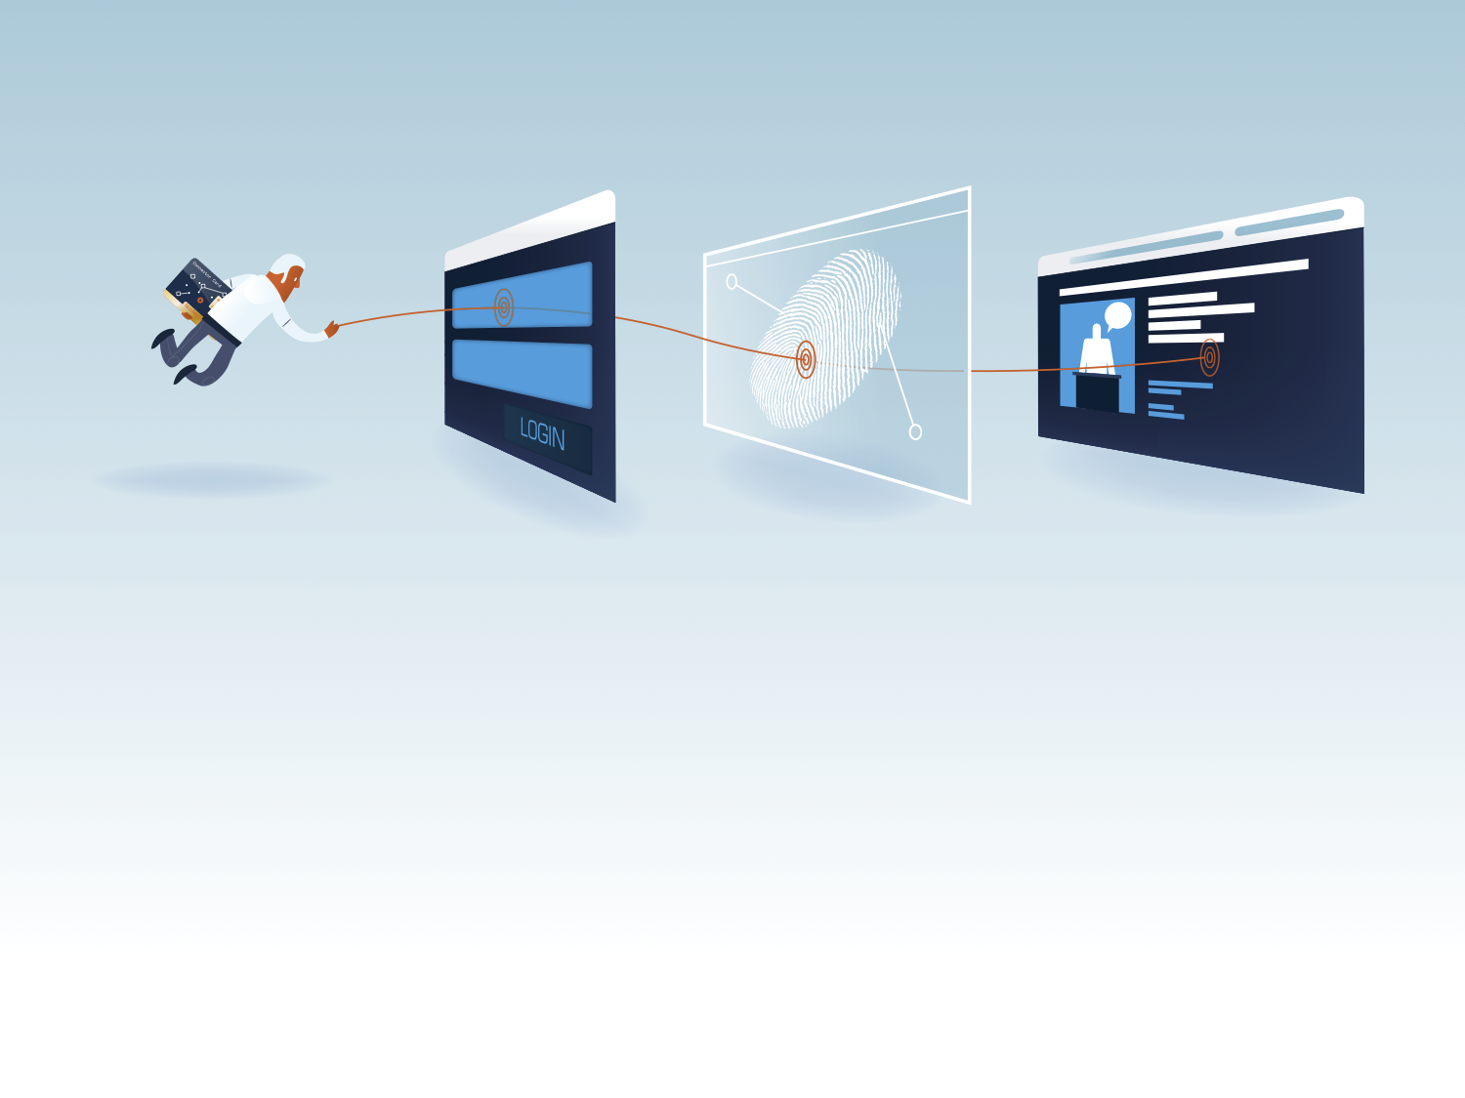
Trust and Identity Landscape
connect • communicate • collaborate
Where we are and how we got there.
Notes:
(Landscape section c 5 mins)

Slide 4
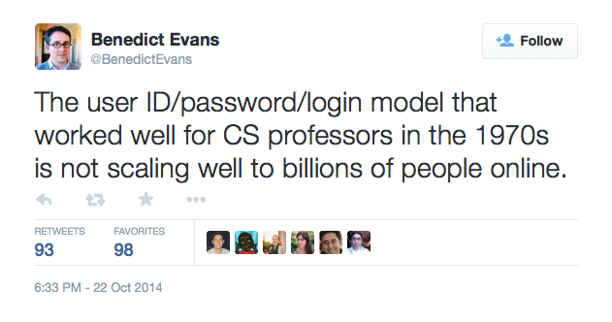
Identity Federation Use Case in a nutshell

Slide 5
Research and Education realised this early…
Tue, 29 Oct 2002 I2-NEWS: Over 20 Universities and Companies Successfully Test Privacy-Preserving Federated Web Authorization System
"After two months of using Shibboleth to manage web course material at
North Carolina State University, we saw an 80- to 85-percent drop in our
help desk calls," said John Hopkins, physics instructor at Pennsylvania
State University. "That's an incredible return, freeing up instructors
and staff for other responsibilities.”

Slide 6

























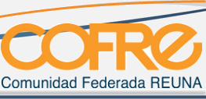







Coverage grew

Slide 7
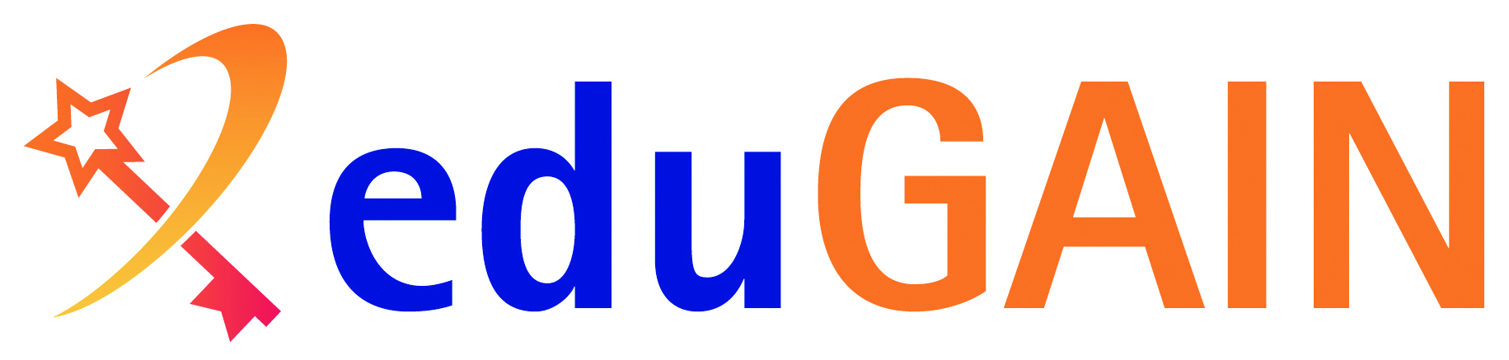
And evolved the global trust and identity landscape
The eduGAIN service interconnects identity federations around the world, simplifying access to content, services and resources for the global research and education community

Slide 8
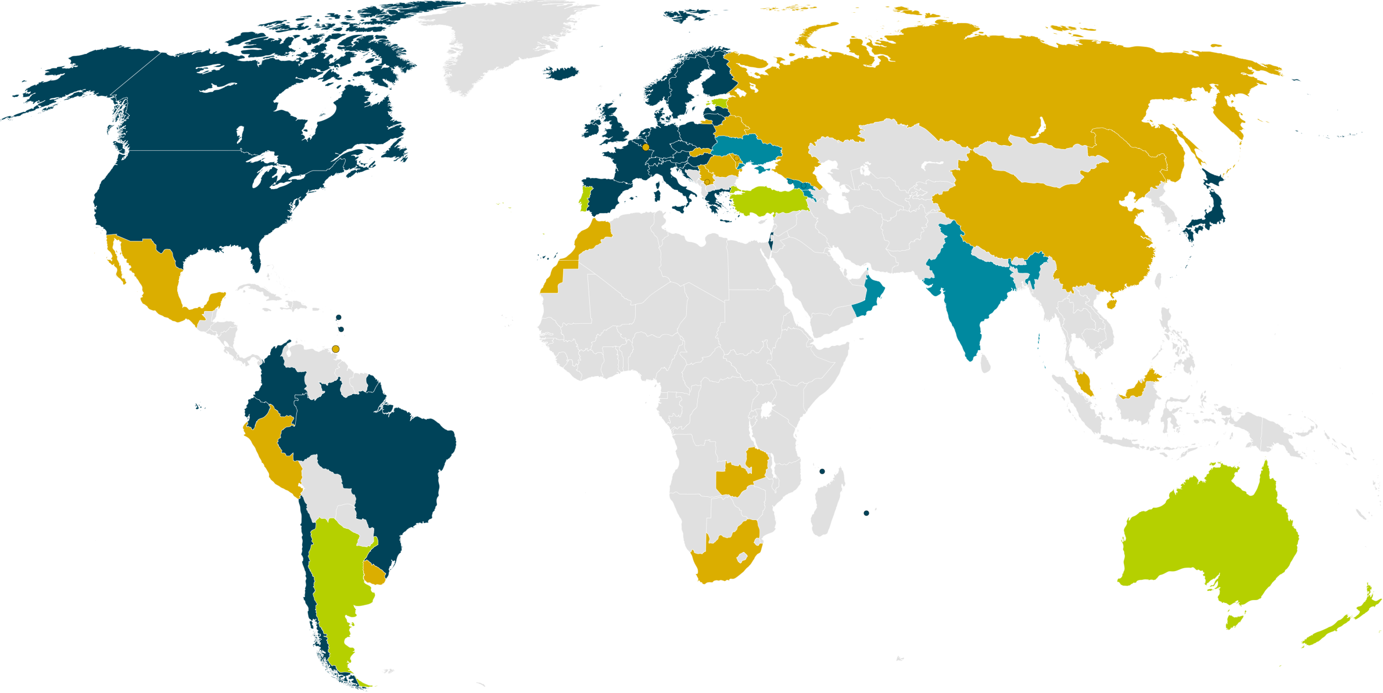
eduGAIN and Federation coverage
30 eduGAIN Members
6 Joining eduGAIN
5 Candidate Federations
14 Other Federations
25 February 2015

Slide 9

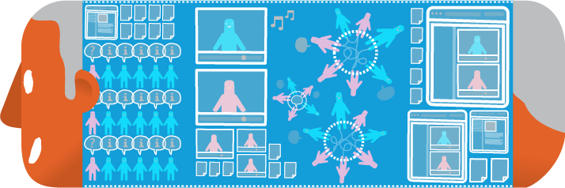
Commonly supported use cases
Journal Access
e-Learning

Slide 10



e-Research Driven Evolution
e-infrastructure
Technology
The Future
Crowd Intelligence
Digital Research
Big Data Acquisition
Crowd Sourcing
Crowd Funding, open Innovation
Collaborative Design
Society
HPC
Big Compute
Big Data
Science 2.0
More Machines
(Moore’s Law)
e-Science
Network Services
Conventional
Computing
Social
Networks
Trust and Identity Services
More People
Source: Professor David De Roure,
Professor of e-Research at University of Oxford
(Scholars, citizens)
Notes:
Meanwhile, in science….

Slide 11

Shared Challenges – FIM4R and TERENA AAA Study
Attribute aggregation
User
friendliness
Credential translation
Scalable, flexible attribute release
Levels of Assurance
Homeless
users
Bridging Communities
Non-web-browser

Slide 12

GÉANT Enabling Users
connect • communicate • collaborate
Working with eResearch to drive Federated Identity Innovation

Slide 13
About GÉANT
Why can GÉANT address these challenges?
The community
41 Partners
38 individual NRENs + NORDUnet + coordinating partners
The company
(DANTE+TERENA) GÉANT Association
Coordinating partner for the project & Consortium
Key functions in project coordination, backbone network ops, community coordination, user engagement
The project
GN3plus – 2 year project cycle, ends 30 April, GN4 to follow
Network, Trust and Identity, Collaboration tools and Cloud research, development, operations and engagement activities
Manpower delivered primarily by NRENs but also GÉANT Association
c250 participants
Owned by the community

Slide 14
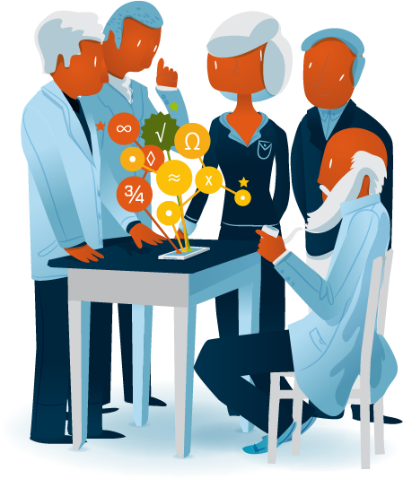
GÉANT Enabling Users Approach
Act as an expert partner for large, pan-European projects with AAI requirements & collaborate with international user communities to increase use of eduGAIN
Coordinate a set of two or three projects between GÉANT and user communities, addressing their federated-identity concerns
REFEDs/GÉANT calls for interested pilots
11 use cases received, 5 collaborations made

Slide 15

Pilots - CERN
CERN, the European Organization for Nuclear Research. Over 10,000 physicists from more than 60 countries collaborate to process LHC data.
Use case:
Add the CERN IdP and a selection of service to eduGAIN e.g. Indico
GÉANT partner - SWITCH
Service Development:
SIRTFI - A Security Incident Response Trust Framework for Federated Identity
Notes:
note SIRTFI now spun off to independent existence

Slide 16

Pilots - DARIAH
Use Case:
Enabling federated access to all DARIAH services
Enhancing attribute release by supporting the adoption of the GÉANT Data Protection Code of Conduct for Service Providers in EU/EEA.
GÉANT Partner - DFN
Digital Research Infrastructure for the Arts and Humanities. over 2000 users registered with the user management of DARIAH. Users highly distributed with little privileged access to IT.
Service Development:
White Paper – Options for Joining eduGAIN
Enhanced Code of Conduct Deployment
Open Letter to CIOs
  https://wiki.edugain.org/CoCoEndorsement

Slide 17

Pilots - Elixir
Use Case:
Make the EGA portal service provider available via eduGAIN
Make the REMS service provider available via eduGAIN
Minimise the number of homeless users
Identify ELIXIR’s requirements for Assurance vs. current federation capabilities
GÉANT Partner – CSC (Finland)
European infrastructure for biological information, supporting life science research and its translation to medicine, agriculture, bio industries and society. Many of the datasets in life sciences cannot be freely distributed due to ethical, legal, societal or intellectual property reasons.
Service Development:
https://wiki.edugain.org/isFederatedCheck/
Notes:
EGA has around (estimated at around 4000 users)

Slide 18

Pilots - ESA
Use Case:
Deployment of a test environment reproducing the Landsat data dissemination server as Service Provider in eduGAIN
Deployment of a test environment reproducing the ESA EO Identity Provider in the Italian test federation.
GÉANT Partner - GARR
The European Space Agency is Europe’s gateway to space. One of ESA’s branches is Earth Observation (EO). EO data is distributed via the use of ESA EO
web application services to a worldwide user community that includes around 20,000 scientists.
Service Development
Improved documentation for a commercial outsourced provider to manage the pilot.

Slide 19


Pilots - Umbrella
Use Case:
Bridging of eduGAIN-Umbrella
  Linking user’s university identity to an Umbrella identity
Non-browser access to facility servers.
GÉANT Partner - SWITCH
Umbrella is the pan-European authentication and authorisation platform for the photon and neutron research community. A total of
more than 30,000 users visit these facilities annually, with 40%-60% of these visiting multiple facilities
Service Development
Moonshot pilot for non web SSO
Account translation mechanism in Umbrella

Slide 20
Conclusions
Listen carefully to the user requirements
  Ask the users to describe what they want to achieve, not what they want to get from you
The research communities need to be properly resourced to run their parts
  Need to understand their identity management workflows before a solution
Progress can be slow
  But collaboration is welcomed
Chicken & egg scenario for deployment
  Aggregate demand and keep solutions manageable
Sometimes the best solution for the research group is too specific for the general service
  How far can we disrupt the cost/benefit equation for everyone?

Slide 21
Further Reading
Report on pilots
  http://www.geant.net/Resources/Deliverables/Documents/D9-4_DS5-5-1_Towards-Horizon-2020_The-Enabling-Users-Experience%20(3).pdf
Market Analysis, Federation as a Service
  http://www.geant.net/Resources/White_Papers/Documents/MS83_MS5-4-1_Federation-as-a-Service-Pilot-Service-Definition-and-Market-Analysis%20(2).pdf
White paper for eResearch on how to join eduGAIN
  https://wiki.edugain.org/index.php?action=remote&title=-&mod=SecureFileStore&rf=getFile&f=/a/a1/Options-for-Joining-eduGAIN.pdf

Slide 22
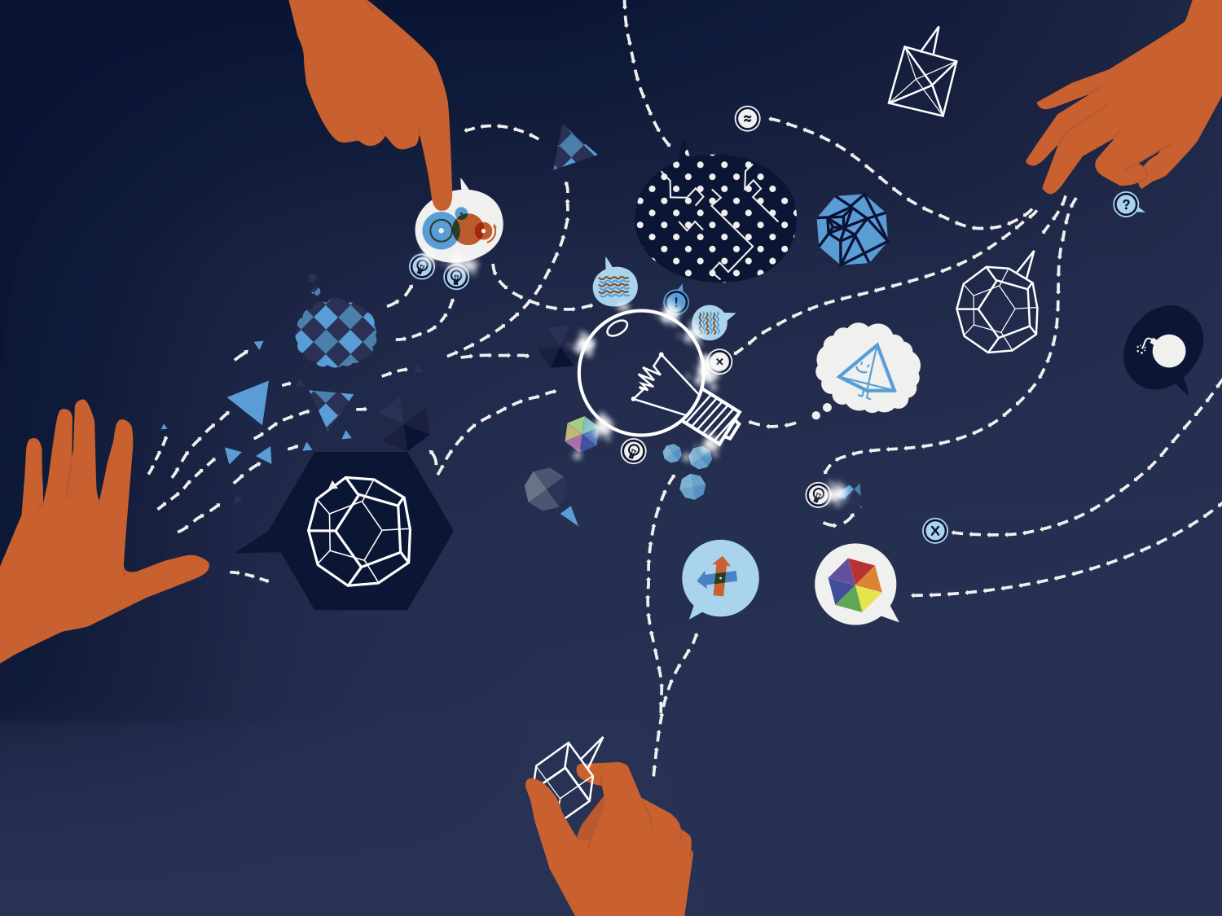
Panel
- Linking Campus and Research in Trust and Identity
connect • communicate • collaborate
Panelists:
Licia Florio, GÉANT Association
Ann Harding, SWITCH
Klara Jelinkova, CIO, Rice University
Scott Koranda, LIGO
Moderator:
Gyöngyi Horváth, GÉANT Association

Slide 23


Campus and Research
A deliberately extreme example
The Research Community/SP view
  Our resources are ‘special’ are we need to know they are protected properly.
  We need to know that you have taken care to make sure the right people are registered and can give us all the tools and data we need.
  This should be the responsibility of the infrastructure providers, not projects.
The Campus/IdP view
  Reasonable level of trust through federation – you know us.
  This change is EXPENSIVE and you are asking us to bear the cost.
  Different SPs want different things all the time.
  There are no clear use cases as to WHY you need this.
What can federations and eduGAIN do to balance the equation?

