Slide 1

Trust & Identity
Valter Nordh, NORDUnet
Federation as a Service Task Leader
Trust & Identity Committee Member
EC meets GÉANT
19 June 2014
Brussels

Slide 2

The Strategic Value of Trust & Identity
Collaborative applications of research & education networks require trust & identity
Our trust & identity systems enable greater collaboration, driving use of the network
The network becomes more cost-efficient to operate, and more business-critical to its users

Slide 3



NREN Trust & Identity
Thinking Differently
For most providers of identity, the user is the product and their customers are advertisers.
This inherently erodes security, privacy and other characteristics that are important to NREN users
The NRENs provide these characteristics through the federation of identity within the NREN community (“federated ID”): the products are trust and identity, and our users are the customers

Slide 4


GÉANT & NREN Leadership
Federated ID is an excellent match with the federative composition of the European R&E environment
Research and education communities need to express more elaborate trust relationships, spanning complex international communities, than commercial offerings can support
European NRENs today are world-leaders in developing & operating Federated ID systems
  eduroam: global system for wireless mobility
  eduGAIN: global system for Web SSO
Outside R&E there is a trend towards “social ID”, driven by low cost and high convenience that does not protect the user nor support complex needs

Slide 5

Managing Trust & Identity Strategy
Managed and coordinated by the NREN Trust & Identity Committee
Establish and manage a European NREN Strategy for Trust & Identity
Implement this strategy through the coordination of the NRENs’ various initiatives;
Nationally, GÉANT, REFEDs and other means.
Identify and, where appropriate, address any unmet requirements or capability gaps

Slide 6

Areas of Strategic Focus
Harmonise our national propositions to improve our European and global propositions, and drive adoption of these at a national level
Improve the effectiveness and excellence of our European operational capability to deliver these propositions
Build bridges with other sectors, both operationally and through other collaborations

Slide 7
GÉANT:
Delivering Trust & Identity
Ann Harding, SWITCH
Application Services Activity Leader
EC meets GÉANT
19 June 2014
Brussels

Slide 8
Trust & Identity Services in GÉANT
Core Production Services
Pilots Enhancing Core Services
eduPKI
Federation as a Service
Organisation and Structure
Key themes
Application Services
eduroam
Moonshot
eduGAIN
Enabling Users
Notes:
AAI – emphasise bigger, more ambitious programme than ever

Slide 9


About eduPKI
Task 1
Help users obtain the right certificates
for the right purpose
Competence centre for PKI issues
Define strategy for providing the GÉANT Cloud Service
Task 2
Solving problems commercial operators won't solve
Task 3
c.130 certificates issued, eduroam as main user
Notes:
eduPKI is….

Slide 10
About eduroam
Secure, consistent roaming access service
Home organisation does authentication, roaming organisation does authorisation
Task 2
GÉANT operates European eduroam infrastructure
“Open your laptop and be online”
Task 3
GÉANT delivers service development to enhance usability, support takeup
Notes:
Eduroam is…

Slide 11


eduroam Service Delivery
Almost 70 countries worldwide, 44 in Europe
Over 9300 eduroam service locations in Europe
KPI | Target | Achieved
Successful national authentications per month | 56 000 000 | 89 545 802
Successful international authentications per month | 8 000 000 | 17 576 920
ETLRS Uptime | 99% | >99%

Slide 12
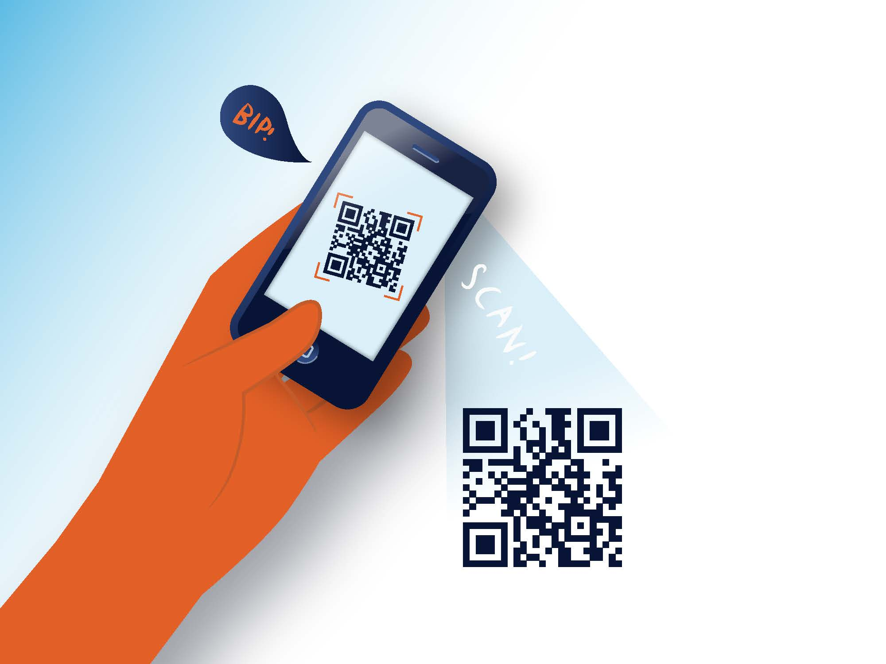
eduroam Service Innovations
Making eduroam even easier to use
CAT (configuration assistant tool) launched on 25 March 2013
577 IdP registered
(432 fully configured)
2900 admin downloads and c500,000 end-user downloads of profiles
Apple iOS and MS Windows 7 together make up over 50% of all downloads
Notes:
Reference integration with federated identity to find my user installer
Highlight proper support contacts
Roaming means MOBILE

Slide 13
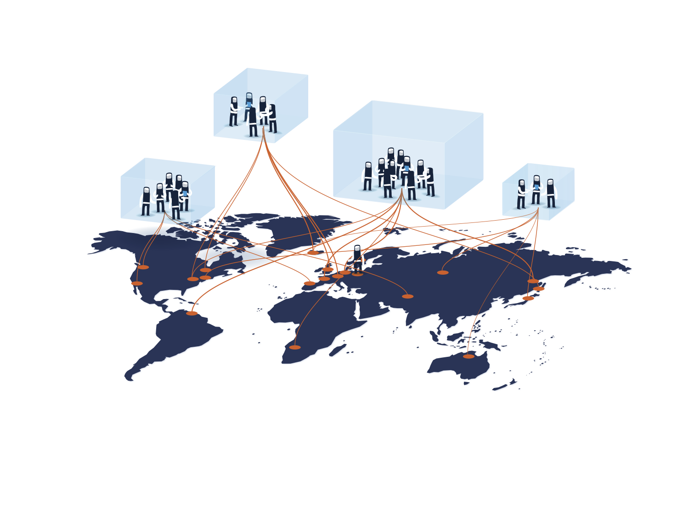
About eduGAIN
Federated identity and trust worldwide
Global Interfederation Service
Connects users and services securely across borders
Policy Framework for administrative and operational participation
Technical platform for the trustworthy exchange of Security Assertion Markup Language (SAML) metadata
Notes:
eduGAIN is….

Slide 14
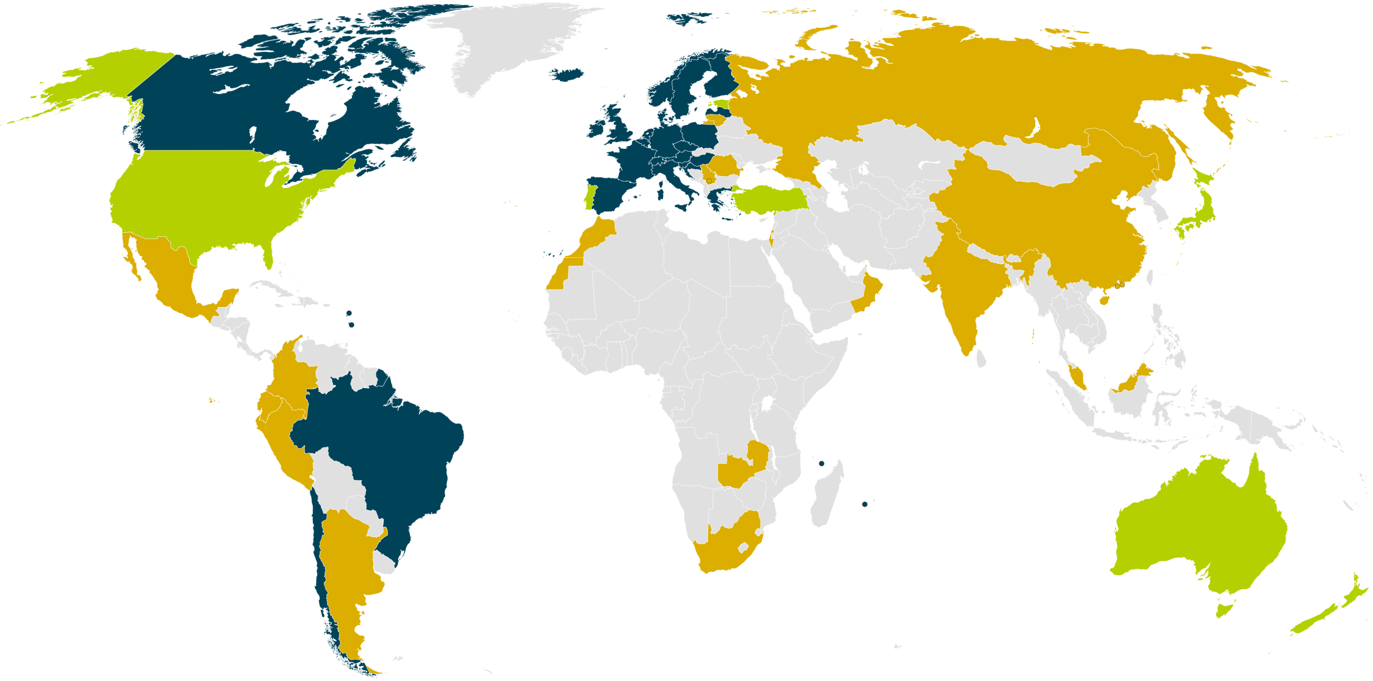
eduGAIN Service Delivery
24 eduGAIN Members
7 Joining eduGAIN
0 Candidate Federations
17 Other Federations
Status: 18 May 2014

Slide 15
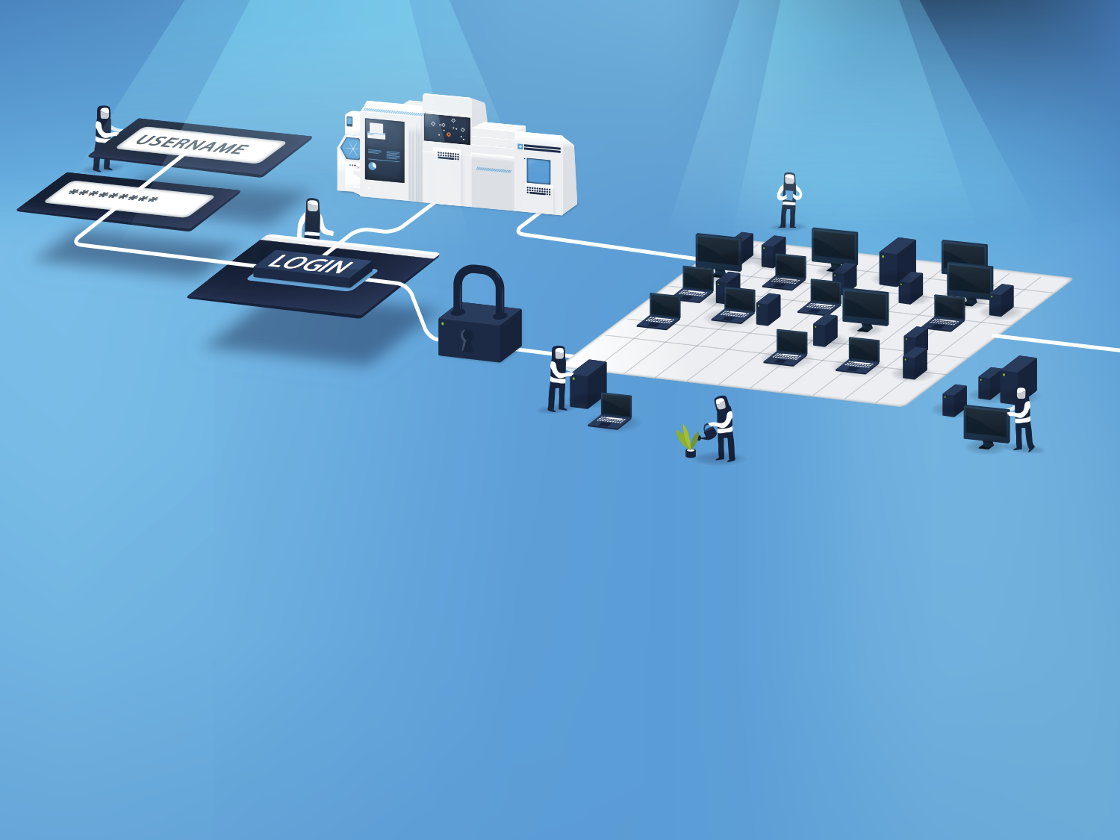
Service Innovation –
Federation as a Service - Bringing federation to all
Market Analysis of NRENs who do not have a Federation
Develop needed policy and technical infrastructure for offering
Federation as a Service
Notes:
Federation as a Service is….

Slide 16

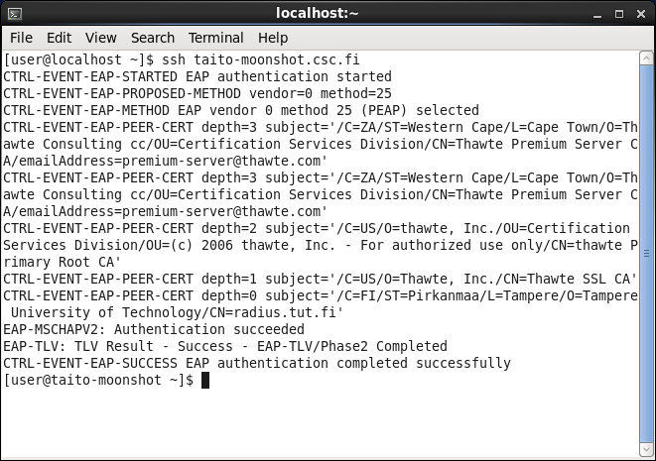
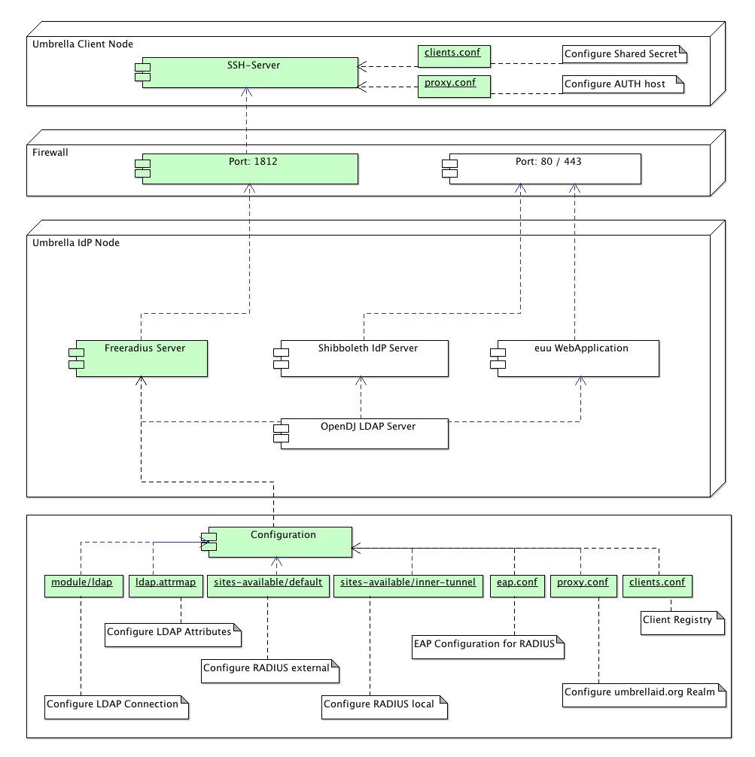
Service Innovation - Moonshot Pilot
New features for federated identity beyond web
Deployment Architecture at Swiss Light Source (PSI)
Deployment complete at UK Diamond Light
CSC/Nordunet:
SSH at Finland’s 2nd largest supercomputer
iRODs demo
IdPs at Tampere & Helsinki
A single unifying technology to manage user identities and control access to a wide range of web and non-web services
CESNET:
Successful SAMBA tests

Slide 17

Service Innovation - Enabling Users
Helping communities benefit from federated identity
Collaborate with international user communities to increase usage of AAI infrastructure
Act as an expert partner for large, pan-European projects with AAI requirements
Help increase the number of services using eduGAIN
Pipeline for service development
Notes:
Enabling users is…

Slide 18

Enabling Users
Addressing the challenges for researchers and other users
Attribute Aggregation
Non-Browser Access
Scalable and Flexible Attribute Release
Credential Translation
Levels of Assurance
Homeless
Users
User-friendliness
Notes:
The context & driving strategy of enabling users – work with the research community on issues they identify

Slide 19




Collaborative Development
Enabling users’ community pilots
Requirements for
Levels of Assurance
Mapping to Federation Policies
ELIXIR Services in HAKA Production Federation
Bridging Umbrella- Persistent Identities
Non-web-browser Based Access
Architectures for
using eduGAIN
Consult on DASISH AAI strategy
Support safe attribute release via GÉANT CoCo
Notes:
Ref. importance of listening to user community rather than leaping immediately to NIST style conclusions

Slide 20

Roadmap
Launch Federation as a Service Pilot
Additional User Community Support
Data Protection & Code of Conduct
Ongoing Global
Engagement
Technical Service Improvements
Moonshot Pilot
Enhanced STORK2.0 Engagement

Slide 21

Thank you
Any questions?

