Slide 1

Case Studies in Federated Identity Management for Research Communities
Ann Harding, SWITCH/GN3plus
Peter Gietz, DAASI International GmbH/DARIAH
Tommi Nyrönen, CSC - IT Center for Science/ELIXIR
Mirjam van Daalen, Paul Scherrer Institute/Umbrella
TNC 2014
20 May 2014
Dublin

Slide 2







Federated Identity Management for Research
The Wizard Gap
30+ Research Infrastructures in Europe

Slide 3


Shared Challenges – FIM4R and TERENA AAA Study
Attribute aggregation
User
friendliness
Credential translation
Scalable, flexible attribute release
Levels of Assurance
Homeless
users
Bridging Communities
Non-web-browser
Notes:
Also Authorisation under community control, open standards, well defined, harmonised attributes

Slide 4




Collaborative pilots between user communities and GÉANT
  “A connected network of people, information, tools, and methodologies for investigating, exploring and supporting work across the broad spectrum of the digital humanities.”
  “Basic life science information constitutes a testament of human and natural evolution and advancement. As such, this wealth of knowledge should be freely available for all to access, study and process”
“Umbrella is the Federated Identity Solution of the Photon and Neutron Community, enabling user initiated trans-facility access.”
Notes:
Goal – use these pilots to address issues from FIM4R for the benefit both of the individual communities and the wider community. Both geant and the communities invest significant time and effort.

Slide 5
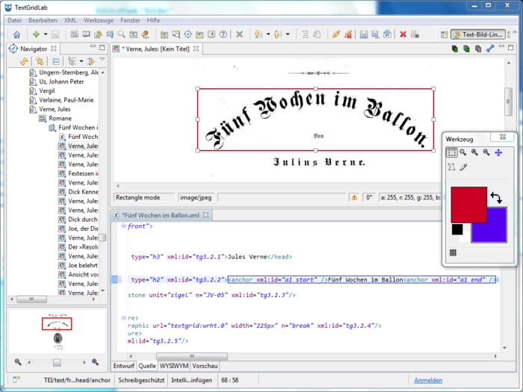
DARIAH Goals
Support digital humanities researchers
Find and use a wide range of research data
Work across domains and disciplines
Experiment and innovate in collaboration with other scholars
  Make DARIAH services available via eduGAIN
  Encourage attribute release based on GÉANT Code of Conduct
  Group and attribute management integration with DARIAH-DE
Textgrid Lab tools for scholarly digital editions

Slide 6

DARIAH Progress
Distributing group and attribute management
5 DARIAH services in DFN AAI:
Portals, search, wiki, collections, research tools
Architecture based on standards interoperable with eduGAIN
Support GÉANT Code of Conduct

Slide 7

DARIAH Experience
eduGAIN is the best approach to pan European AAI for DARIAH
  Some time needed to fulfil all requirements
DARIAH would like to see more entities available in eduGAIN
  And reasonable attributes available
DARIAH has been able to meet many requirements
  Distributed user and privilege administration
  Policies that allow for integration into DFN-AAI and eduGAIN
Combination of eduGAIN and community specific
  DARIAH homeless-IdP and attribute authority

Slide 8
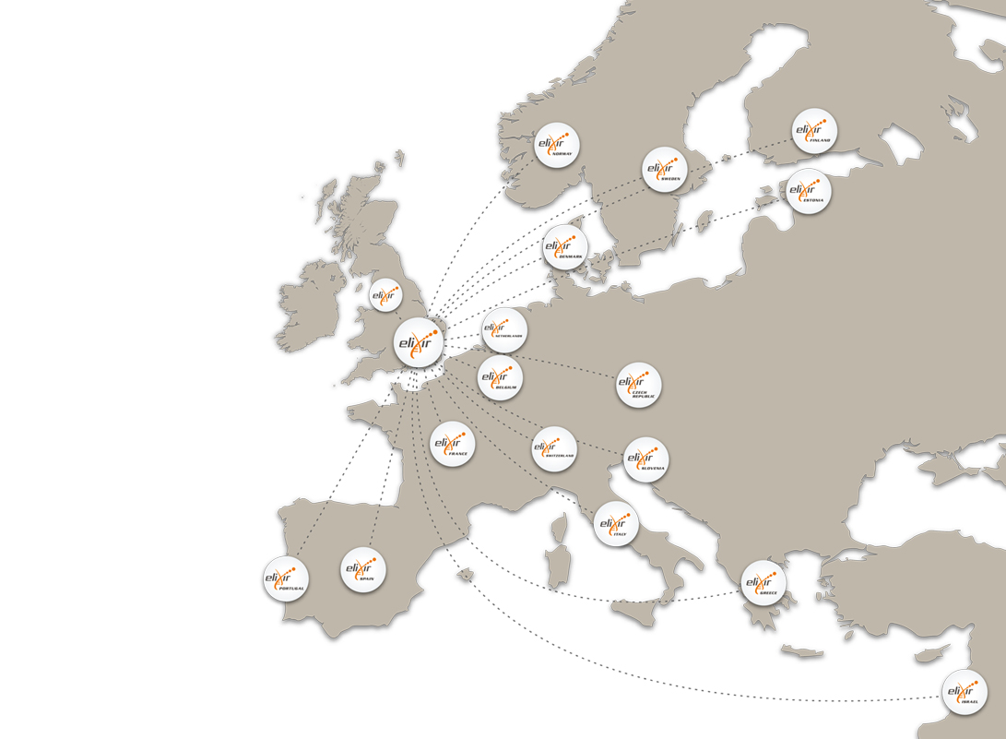
ELIXIR Goals
Research requiring AAI – Matching the treatment to the cancer
One in 10 women in the EU-27 will develop breast cancer before the age of 80.
If they can identify patterns of genes that are active in different tumours, we can diagnose and treat cancers earlier
Pilot Goals: Requirements for Levels of Assurance
Make EGA and REMS available on a pan-European basis via eduGAIN
Part of a wider portfolio of ELIXIR AAI work
ELIXIR distributed infrastructure

Slide 9
ELIXIR Progress
Level of Assurance capabilities for European Identity Federations/IdPs vs. EGA’s security needs
Use of GÉANT Data Protection
Code of Conduct
EGA SP registered to Haka
(the Finnish Identity Federation).
EGA SP exported to eduGAIN

Slide 10
ELIXIR Experience
Next phase of AAI in ELIXIR – blueprint for discussion
  External IdPs via eduGAIN
  ELIXIR specific services for authorisation (REMS), non web, homeless users and community management
Federated identity cross sector collaboration:
REMS to be used by FI-CLARIN & FI-CESSDA
A pan-European approach to LoA would be appreciated/necessary in the future
Minimise ELIXIR-specific customisation

Slide 11
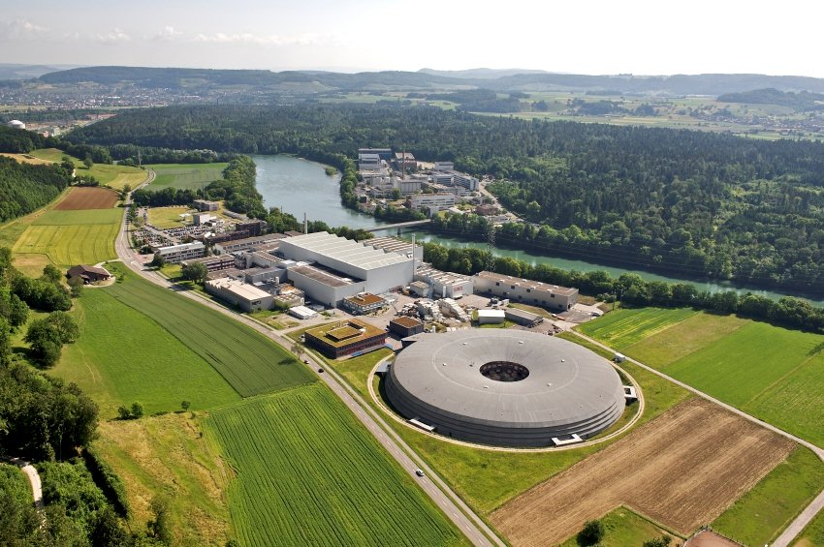
Umbrella Goals
Umbrella platform - a collaborative effort by leading European Photon and Neutron facilities as part of several EU projects
Unique and persistent user identification for interdisciplinary user community from biology, physics to earth sciences
Optimisation of the process from experimental data acquisition to data publication
Bridging Home Institution Accounts with Umbrella persistent identities
Enable Home Org identities to be used in Umbrella
Enable Umbrella identities to access resources available via eduGAIN
Non-web-browser based access
Swiss Light Source at Paul Scherrer Institute in Villigen Switzerland,
Six such facilities use Umbrella and serve over 30’000 users - 40% of these researchers use multiple facilities.

Slide 12
Umbrella Progress
Next step – considerations for interfederation testing of Moonshot
Moonshot pilot infrastructure for SSH
Umbrella-eduGAIN Bridging prototype
Considerations for usability in a production Umbrella context

Slide 13
Umbrella Experience
More opportunities for NREN/Research Infrastructure Collaboration
  Security analysis discussion at FIM4R
Piloting with a wider community has benefits
  JANET/Diamond Light in UK Moonshot Pilot
Confidentiality aspects critical for Umbrella - high competition, especially structural biology
  Authorisation is delegated to the systems participating in Umbrella

Slide 14

GÉANT Goals
Better Understanding = Better Services
Collaborate with the wider GÉANT project and with international user communities to increase usage of AAI infrastructure.
Act as an expert partner for large pan-European projects with AAI requirements.
White paper “Options for Joining eduGAIN”
Improved public documentation & knowledgebase
Custom support for finding the best option
Help you reach the right federation contacts
In development – test IdP, plans for other services beyond basic eduGAIN

Slide 15

GÉANT Experience - What still needs work?
Attributes - Release, consistency, community specific and harmonisation
Levels of Assurance
A long term issue to be broken down
Understanding security and incident response
Progress can be slow as we learn to work together
More experience, work faster
Non web
Early pilot not novice user
Many other research communities developing their AAI requirements and workplans

Slide 16
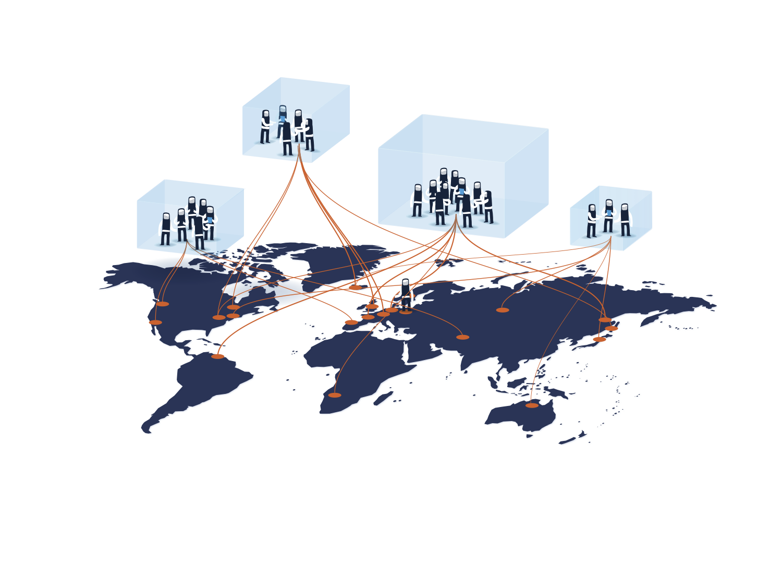
GÉANT Experience - where do we see progress?
Sharing knowledge of federation capabilities
  Survey of Levels of Assurance
Federations looking to do more
  Support of GÉANT Code of Conduct
  Emerging ‘opt-out’ pilots for eduGAIN
  REFEDs Federation Operator Best Practice
Research communities services appearing in national federations and eduGAIN
Knowledge gained with these pilots helps support other communities & plan service
  Ask us for help:
  edugain-integration@geant.net

Slide 17

Thank you
Please join the BoF after today’s sessions!

